Slide 1
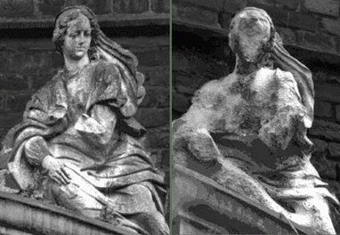
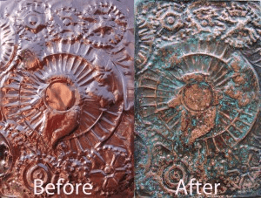
Do Now: Explain the process that caused these changes.
How are rocks broken down?

Slide 2
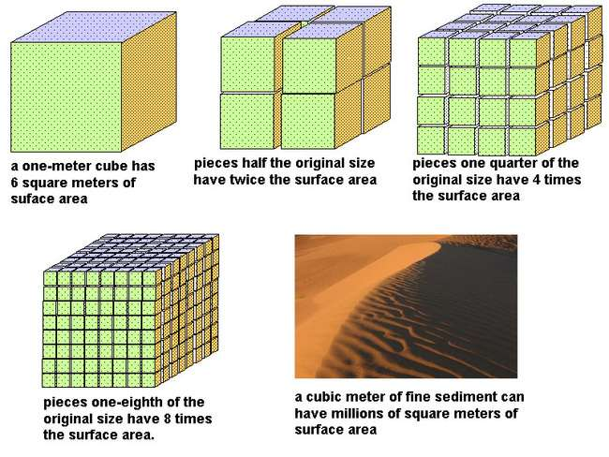
Surface Area

Slide 3
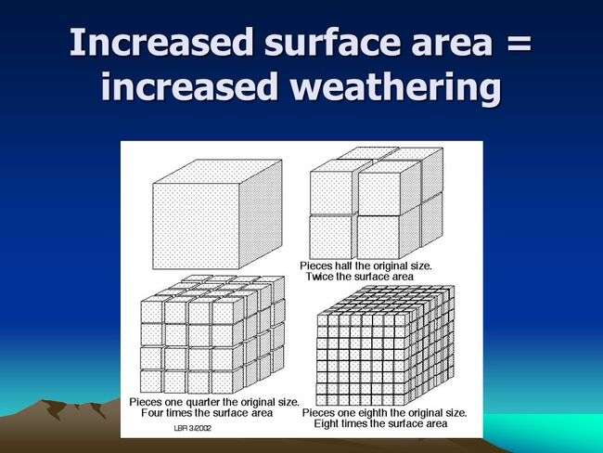

Slide 4

Weathering
Breaking down rocks. This
produces soil.
2 Types
Physical: Only size and shape changes.
Chemical: composition changes

Slide 5
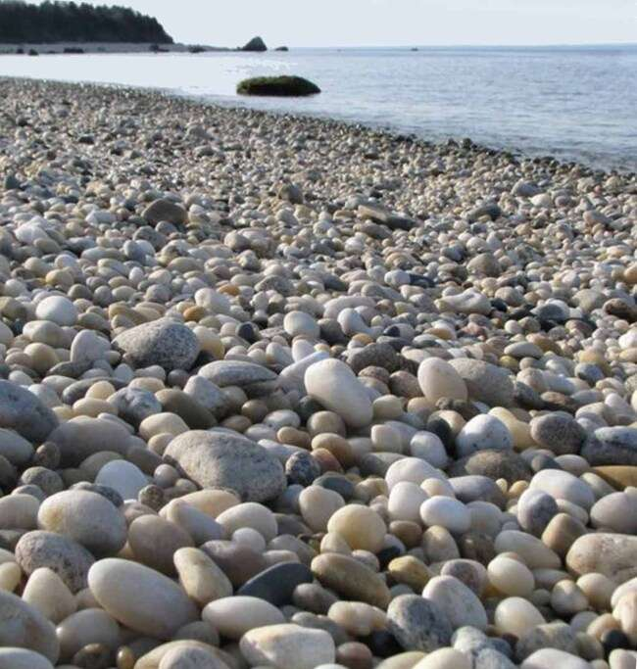
Physical Weathering
Water
rocks become round, smooth and small.
Abrasion = rocks rub together and break.

Slide 6
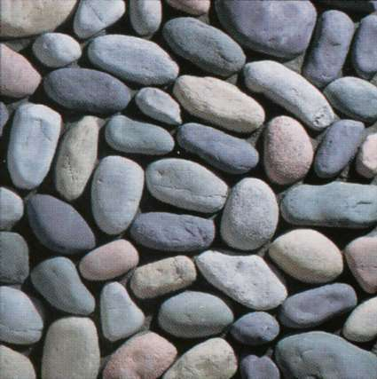

Slide 7
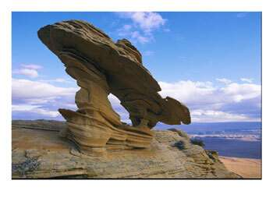

Slide 8
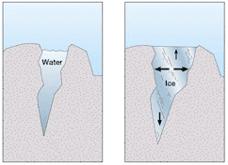
Physical Weathering
Ice
freezing and thawing (frost cycle).

Slide 9
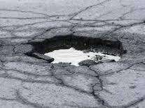
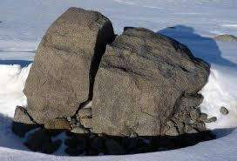
Freeze / Thaw Cycle

Slide 10
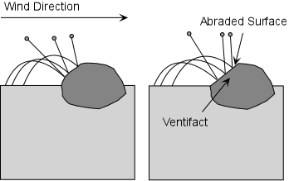
Physical Weathering
3. Wind
rocks pitted by blown particles.
Ventifact = angular, pitted rock with 1 or more flat sides.

Slide 11
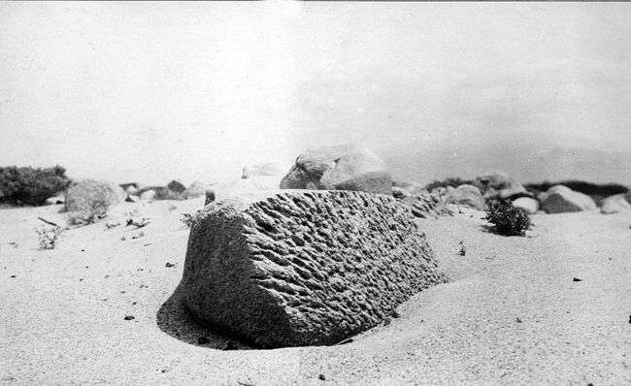

Slide 12
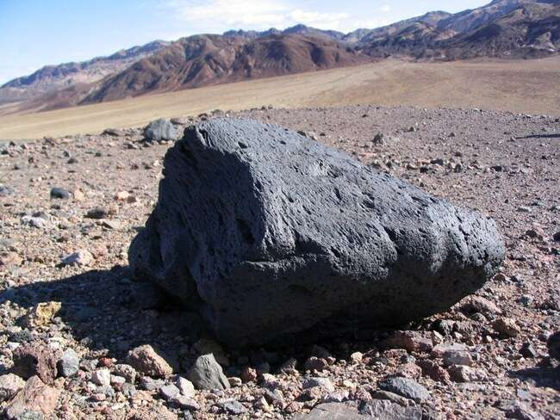

Slide 13
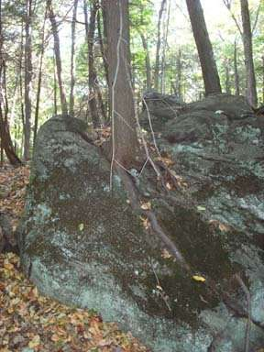
Physical
Weathering
Biology
Plants
Animals
Humans

Slide 14
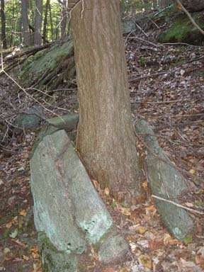

Slide 15
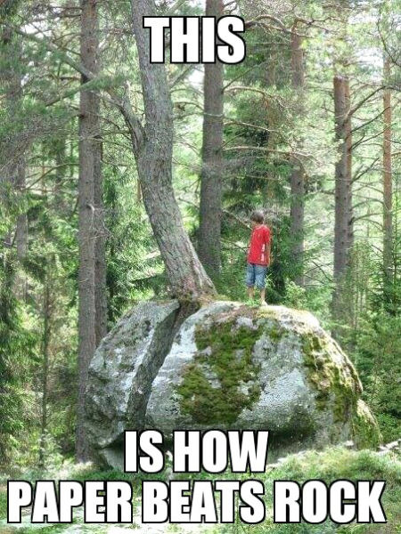

Slide 16
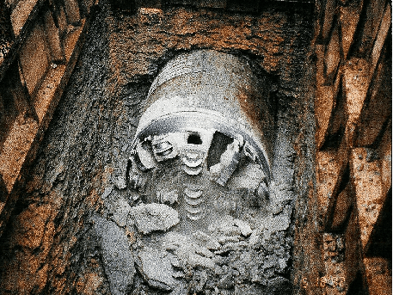

Slide 17
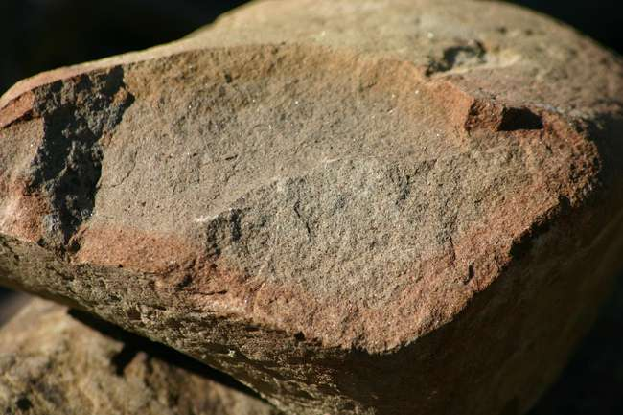
Chemical Weathering
Increases in hot and wet weather.
1. Oxidation - rust

Slide 18
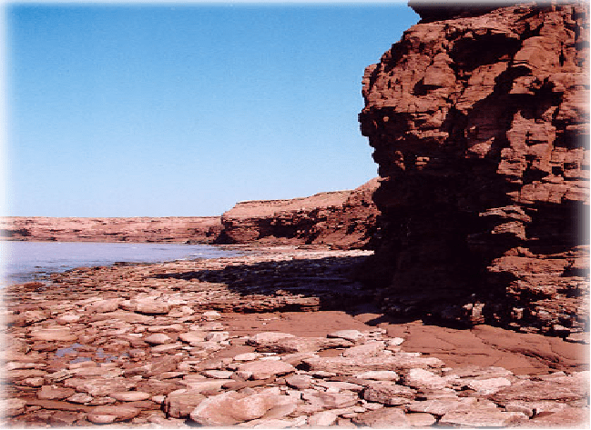

Slide 19
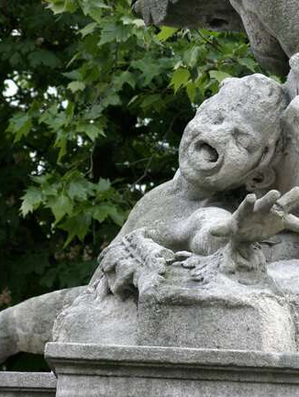
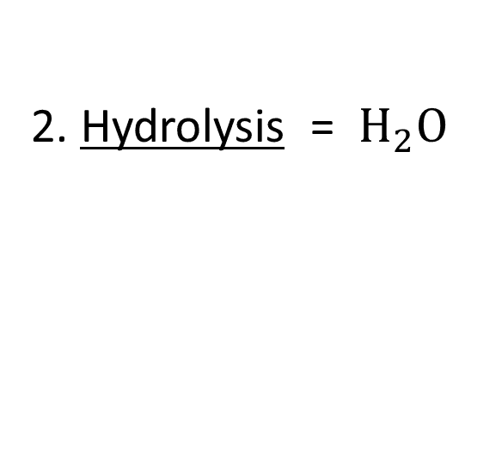
Chemical Weathering
2. Hydrolysis = $H_{2}O$

Slide 20
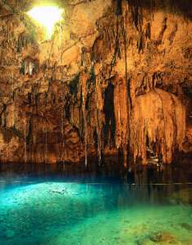
Chemical Weathering
Carbonation = CO₂

Slide 21
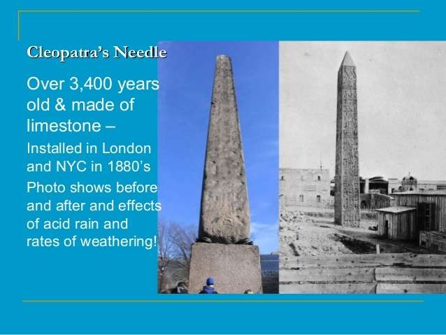

Slide 22
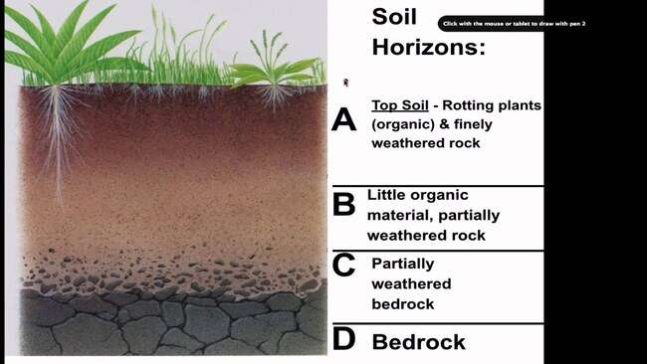
Soil
- From weathering and biological activity of rocks
- Soil forms layers of different characteristics called horizons.
- Climate and parent bedrock most important for type of soil.
Notes:
22

Slide 24
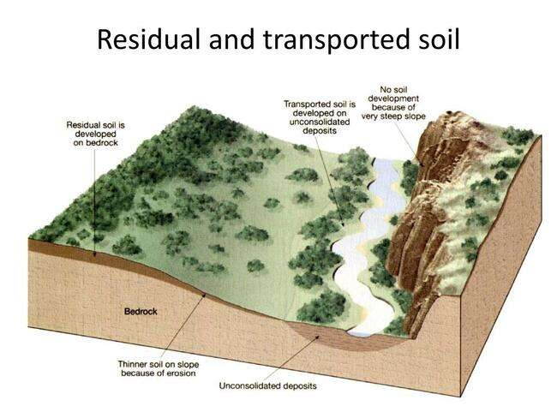
Soil
Residual soil = formed from parent rock.
Transported soil = moved from another location.
Most soil on Earth's surface is transported.

