Slide 1
Aim:
What are the different types of storms?
Do Now:
Today’s temperature is 50 degrees. Tomorrow’s temperature will be in the 60’s.
What’s happening?
Why no rain tonight or tomorrow?

Slide 2
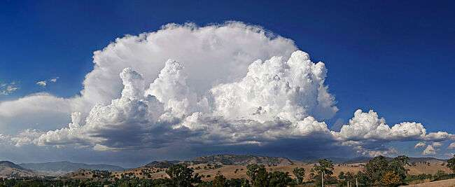
Clouds
Precipitation = water falling from sky.
Cloud = liquid water droplets.
Fog = cloud on the ground.
Condensation Nuclei – particles in the air

Slide 3
Storms
severe disturbance in the atmosphere.
High winds
Heavy precipitation
Low pressure

Slide 4
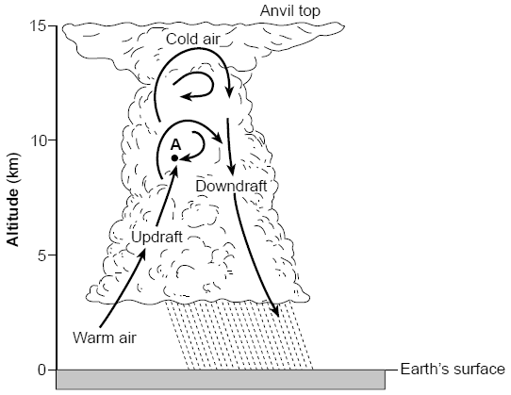
Thunderstorms
storm with lightning.
warm, moist air rising.
rising air creates friction and electrical charge (lightning).

Slide 5
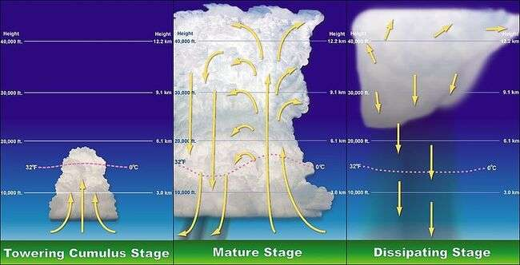

Slide 7
Cyclones
Cyclones – spiraling winds around a center
Hurricane
Engine: Warm water
- wind at least 74 mph.
- starts near Africa
- storm surge (water pushed in front by storm that causes flooding)
called “Typhoon” in the Northern Pacific, and
called “Cyclone” in the Southern Pacific

Slide 8
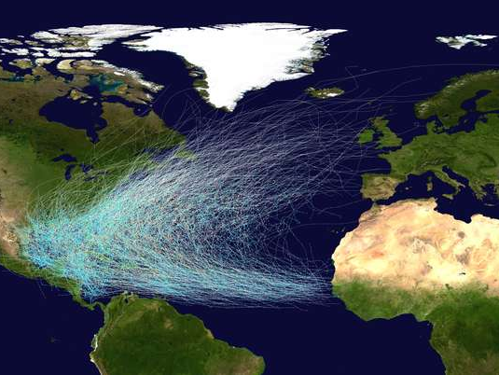
Hurricane Paths (1851-2012)

Slide 9
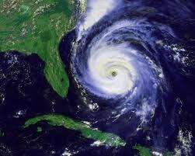

Slide 10
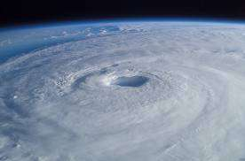

Slide 11
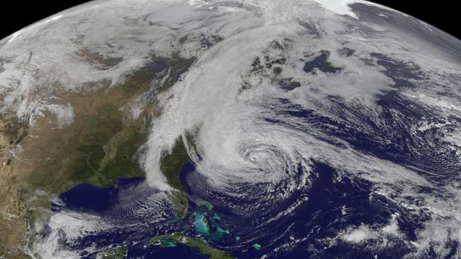
Sandy

Slide 12
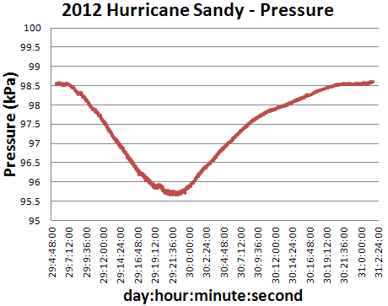

Slide 13
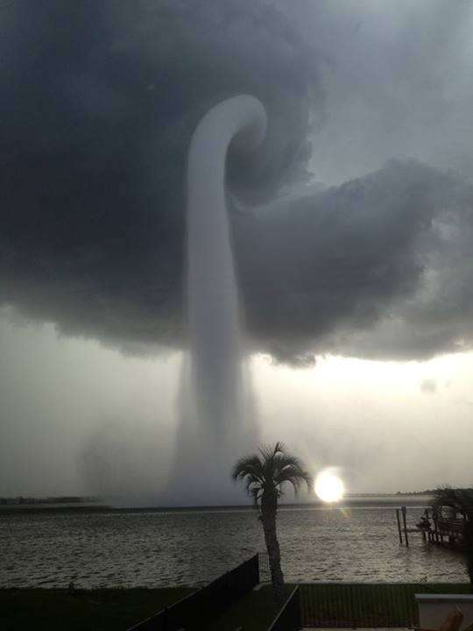
Tornado
- strongest thunderstorm
- compact storm with strong wind (up to 350 mph).

Slide 14
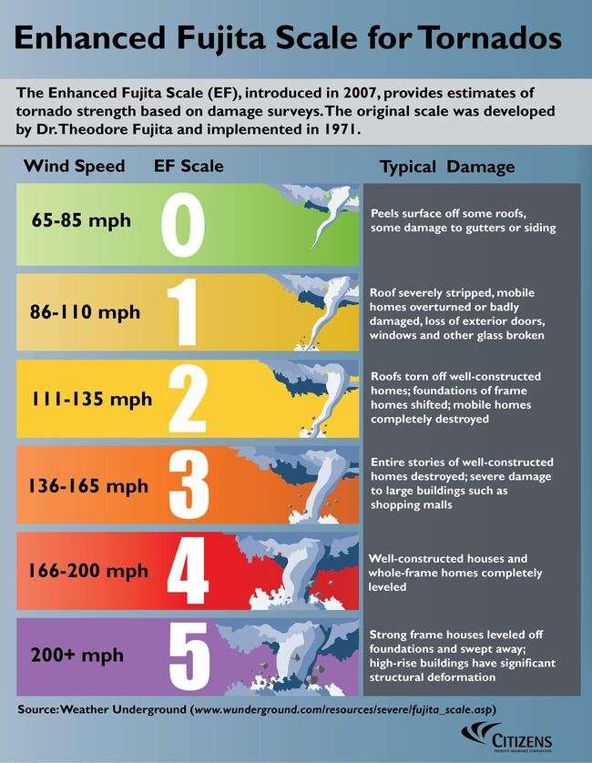

Slide 15
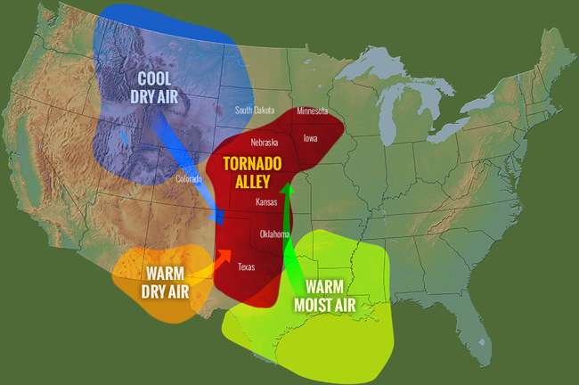

Slide 16
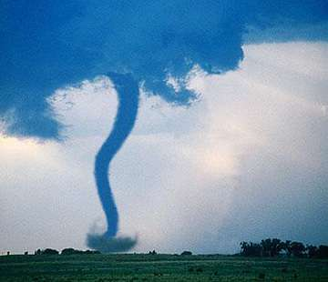

Slide 17
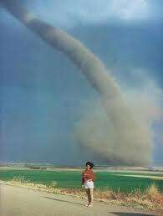

Slide 18

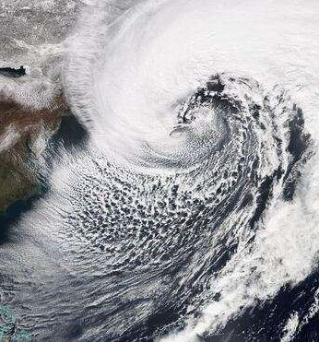
Nor’easter
comma-shaped storm effecting the northeast.
Winds come from the Northeast

Slide 19
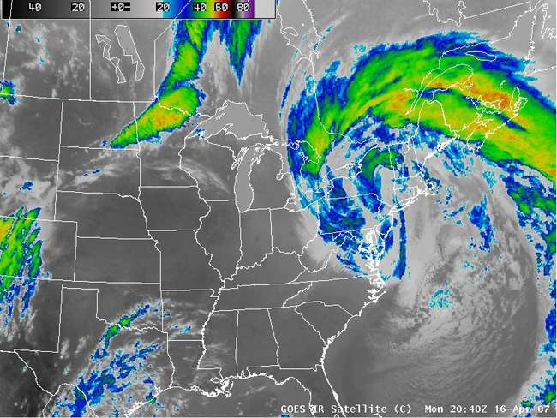

Slide 20
