Slide 1
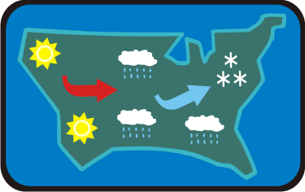
Aim: How are weather stations used to display weather conditions?
Do Now: Using your knowledge of air masses and the nature be which different air temperatures behave, explain why it is snowing in the North East of the USA?

Slide 2
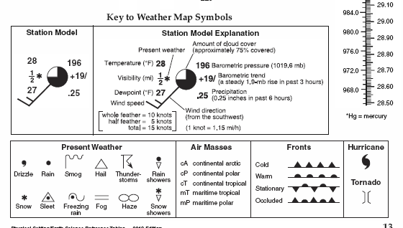
Temperature (degrees F)
Top Left of Station Model

Slide 3
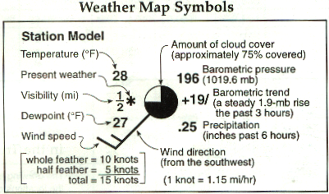
Present Weather

Slide 4
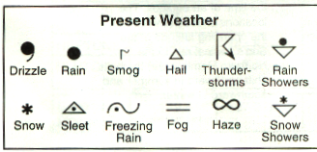
Types of Present Weather

Slide 5
Visibility (In Miles)

Slide 6
Dewpoint Temperature in ˚F
Bottom Left of Station Model

Slide 7
Wind Speed & Direction

Slide 8





Wind Symbols: Speed
Calm
Less than 5kts
5 kts
10 kts
50 kts

Slide 9
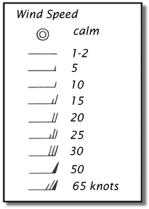
Remember your wind speed feathers…
Does anyone see what is wrong with these images?
The flags and feathers are on the wrong side of the staff.

Slide 10
Cloud Cover in %
Inside the center of the station model

Slide 11
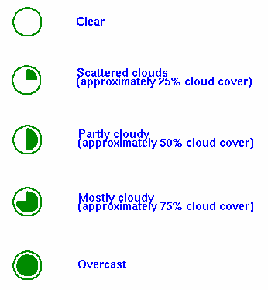
Amounts of Cloud Cover

Slide 12
Barometric (Atmospheric) Pressure
Upper right corner of station model

Slide 13
Remember how to convert pressure code
If your number is under 500, add a 10 and a decimal point after the first number.
If your number is OVER 500 add a 9 and a decimal point after the first number.
196…………………………..1019.6mb
423…………………………..1042.3mb
895…………………………..989.5mb

Slide 14
Barometric Trend over the past 3 hours

Slide 15
Barometric Trend (continued)
+ :pressure rising
/ :pressure rising steadily
- :pressure falling
\ :pressure falling steadily

Slide 16
Precipitation in inches over the past 6 hours
Bottom right of station model

Slide 17

Class Work: Plotting Station Model Information

Slide 18
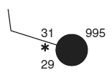
Summary: How do we write a weather station?
Exit Ticket:
Fill in the correct information for each weather variable listed for this station model.
Air temperature: 31 °F
Dewpoint: 29 °F
Wind speed: 10 knots
Cloud cover: 100 %

