Slide 1
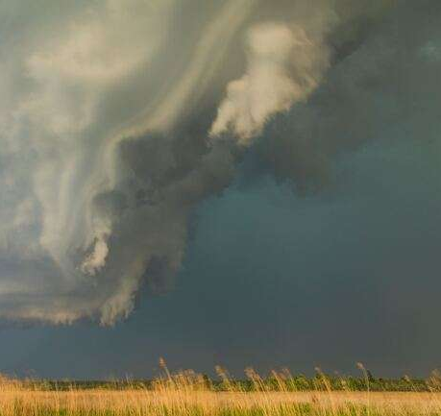
Weather
Weather = present condition of atmosphere.
Factors:
Temperature
Air pressure
Wind
Humidity (water)

Slide 2
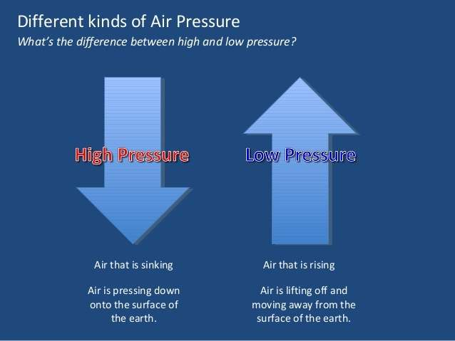
Air Pressure
The Sun warms Earth unequally… this causes temp differences.
Temp is related to pressure
Cold, dry air sinks =
High Pressure
Warm, wet air rises =
Low Pressure

Slide 3
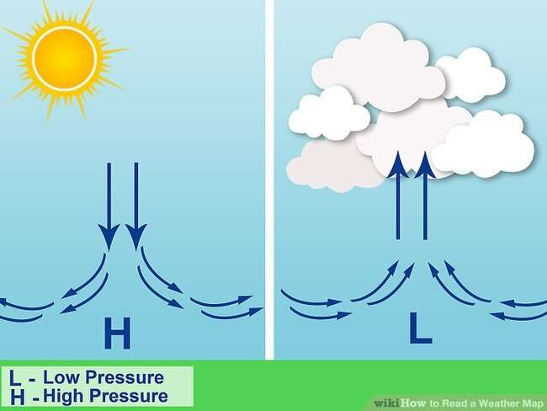

Slide 4
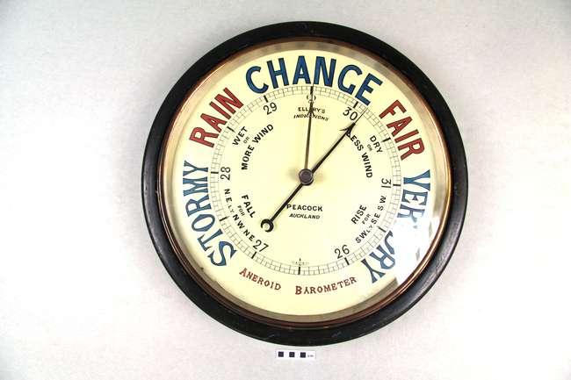

Slide 5
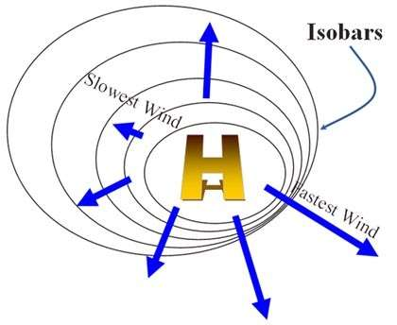
Wind
Wind = Air moving from high to low pressure
Anemometer measures wind speed.
Weather Vane tells wind direction.

Slide 6
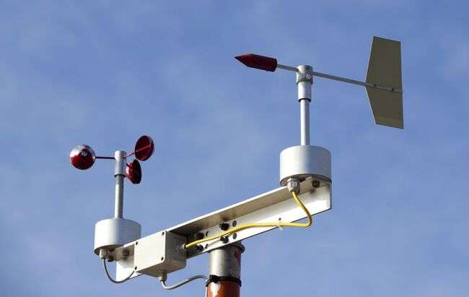
Anemometer and Weather Vane

Slide 7
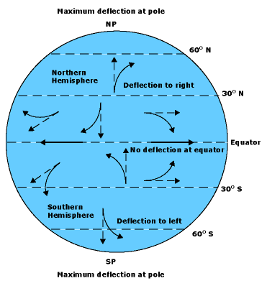
Coriolis Effect
Winds deflect to the right in the Northern Hemisphere.
Caused by Earth’s rotation

Slide 8
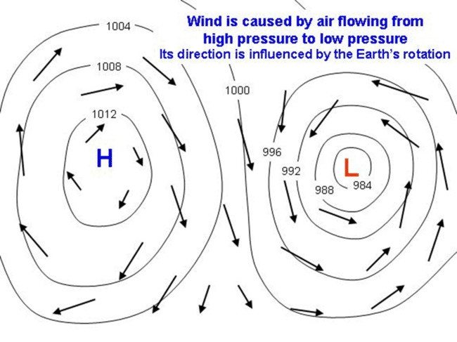
Pressure Systems
High pressure flows out and clockwise.
Low pressure flows in and counterclockwise.

Slide 9
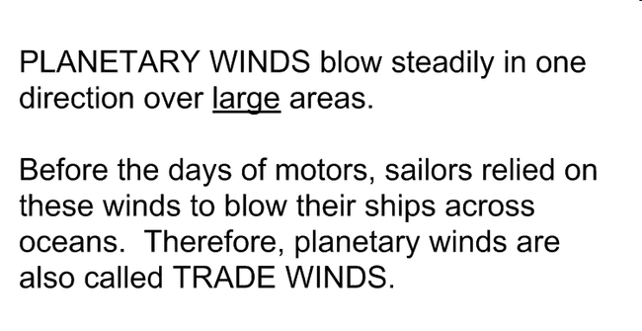


Slide 10
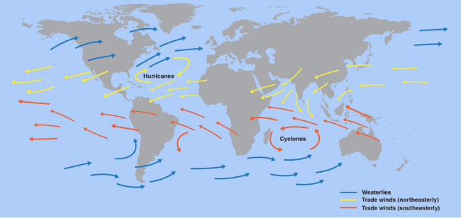
Planetary Winds

Slide 11
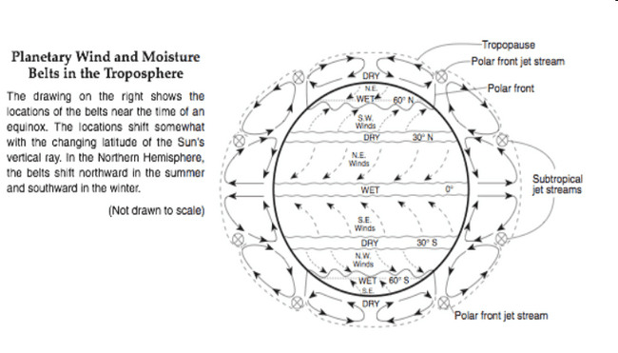
Planetary Winds

Slide 12
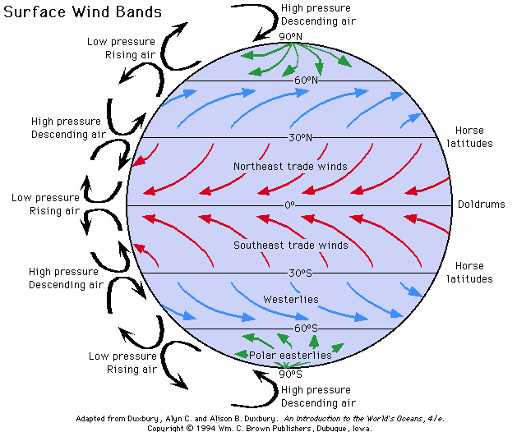

Slide 13
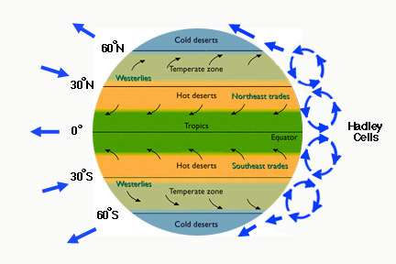
Wind - Convection

Slide 14
Station Model Code
When converting millibars to station model code, use only the last three digits.
ex. 1013.0 mb = 130
When converting station model code to mb:
a. if code is 500 or higher, put a 9 in front.
b. otherwise put a 10 in front.
c. always put decimal before last number.
ex. 024 = 1002.4 697 = 969.7

