Slide 1
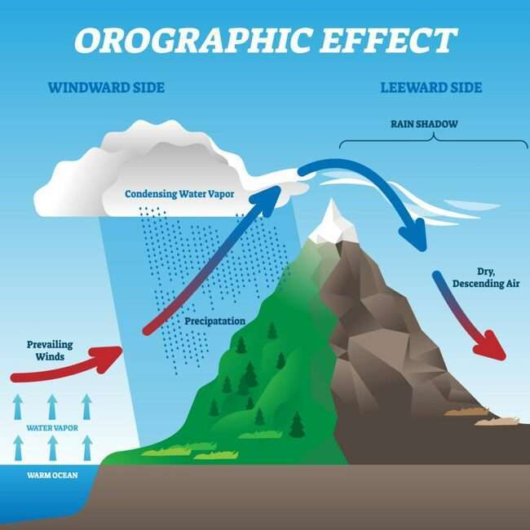
Orographic (Mountain) Effect
1. Warm moist air gets pushed up by the mountain.
2. Air expands and cools, then condenses and rains/snows (forests and vegetation).
3. At top of mountain, cold dry air sinks, compresses and warms (deserts)

Slide 2
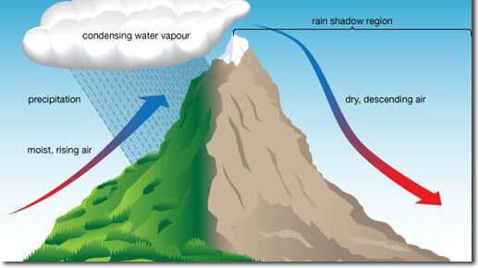
Orographicc (Mountain) Effect

Slide 3
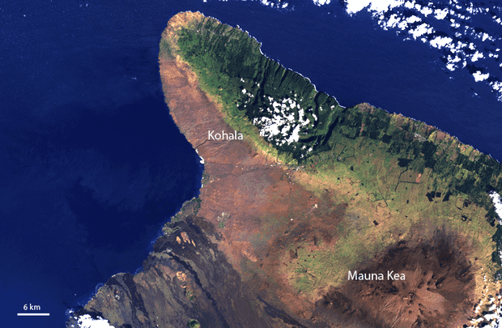
Rain Shadow

Slide 4
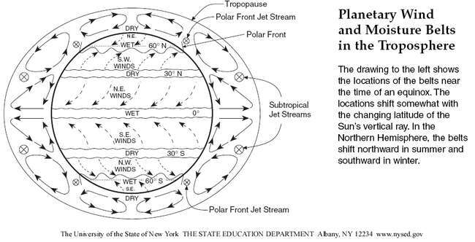
Forests and Deserts
- Moist air rises at the Equator, and 60⁰ N and S. The air cools, condenses and rains.
(Forests in these locations)
- Dry air sinks at the Poles, and 30⁰ N and S.
(Deserts in these locations)

Slide 5
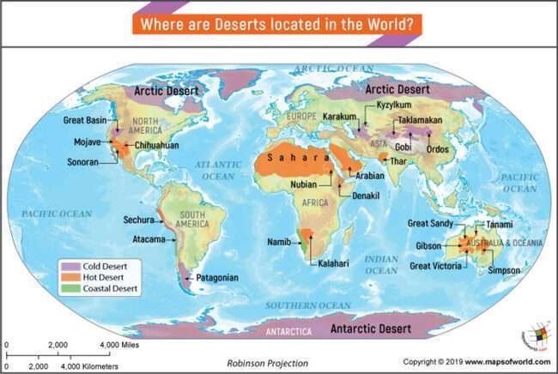

Slide 6
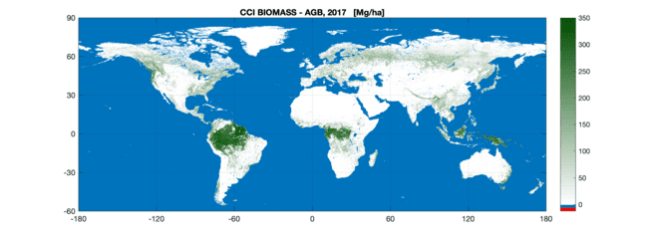

Slide 7
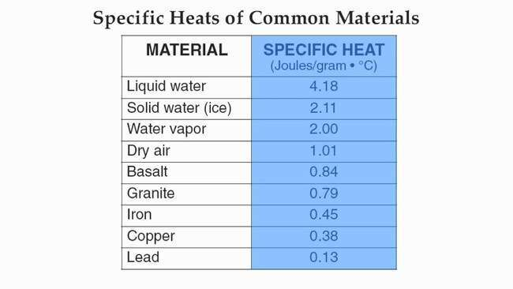
Land Breeze – Sea Breeze
Specific Heat = amount of energy needed to raise temperature one degree.
High SH = temp. changes slowly (Water)
Low SH = temp. changes quickly (Land)
Water’s high SH moderates coastal temperatures.

Slide 8
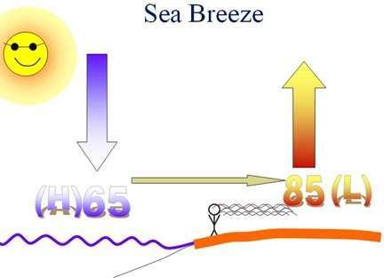

Slide 9
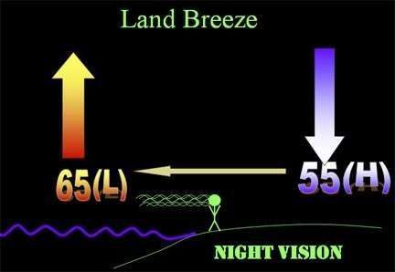

Slide 10
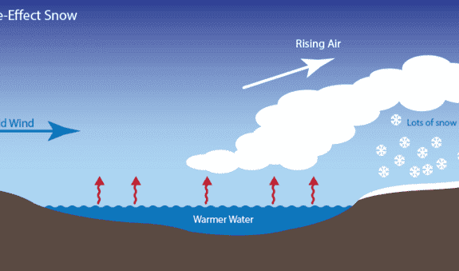
Lake Effect Snow

Slide 11
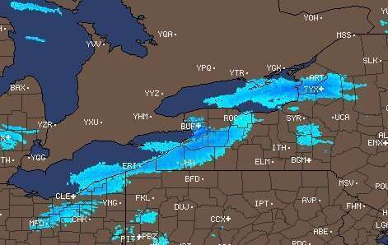
Lake Effect Snow (Great Lakes)

Slide 12
