Slide 1
Do Now
Do Now: (Quick Write)
In one sentence, explain how it rains using the terms:
Evaporation
Condensation
Precipitation

Slide 2
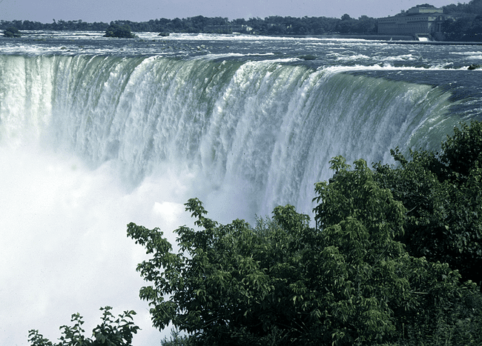
Humidity and the Water Cycle

Slide 3
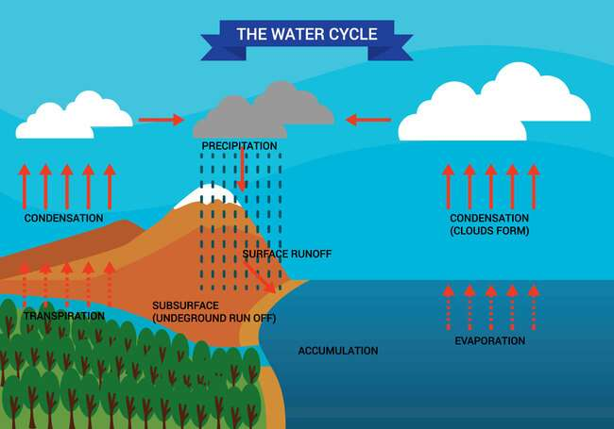
Water Cycle
Humidity
moisture (water) in atmosphere.
Water enters the atmosphere by:
Evaporation
liquid to gas
Transpiration
plants release water
Water exits the atmosphere by:
Condensation
gas to liquid

Slide 4
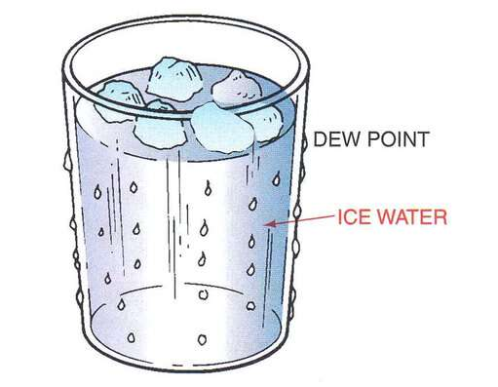
Dewpoint
Dew Point Temp. (condensation)
Temp. when gas condenses to liquid (100% humidity)
always lower than air temp.

Slide 5

Why Does it Rain?
1. The Earth is heated unequally by the sun, causing warm and cold areas.
2. Warm areas are less dense, so air rises.
3. Rising air cools until it reaches “dew point”, the temp when water vapor (gas) condenses to form rain droplets (liquid)

Slide 6
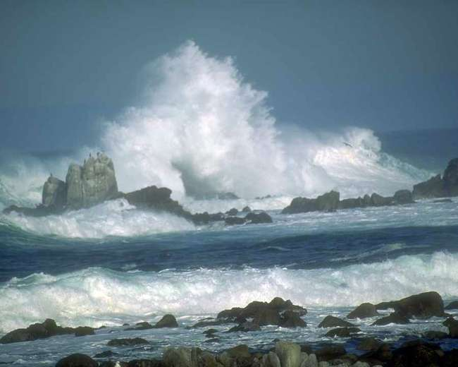
How and Where does water primarily enter the atmosphere?
Evaporation from oceans and Transpiration from vegetation

Slide 7
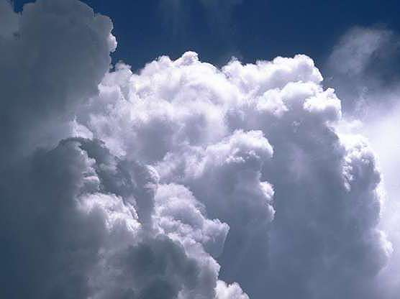
The moisture rises, cools, and condenses forming ______.

Slide 8
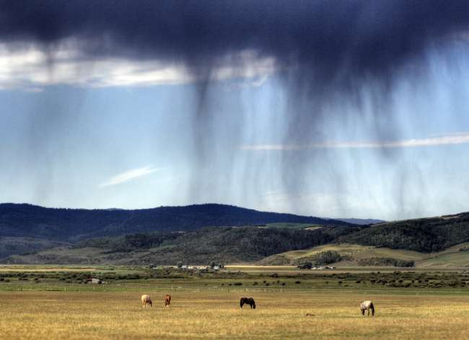
Precipitation falls from the clouds providing water for the Earth’s land masses.

Slide 9
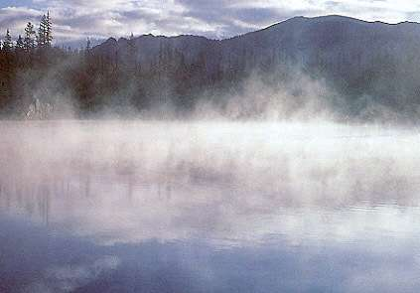
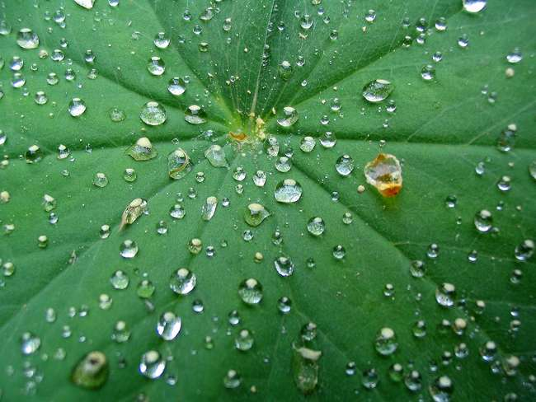
1
The rainwater can evaporate back to the atmosphere, or soak into the ground.
2
The rainwater can be intercepted and used by plants and animals.

Slide 10

What do we call evaporation from plants?
Transpiration

Slide 11
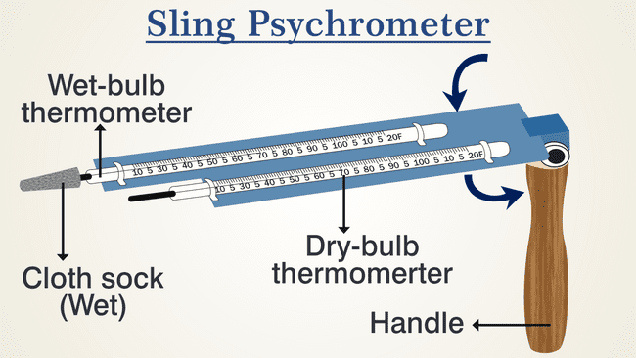
Psychrometer
Instrument that measures humidity.
Dry-bulb
room temp.
Wet-bulb
Measures evaporation

Slide 12
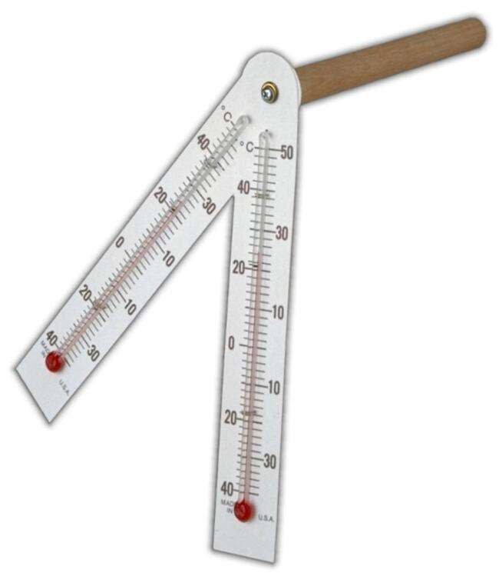
Psychrometer
Evaporation causes cooling…so wet-bulb temp decreases
Humid air
little evaporation (wet and dry-bulb temps similar)
Dry air
more evaporation (wet and dry bulb temps farther apart)

Slide 13
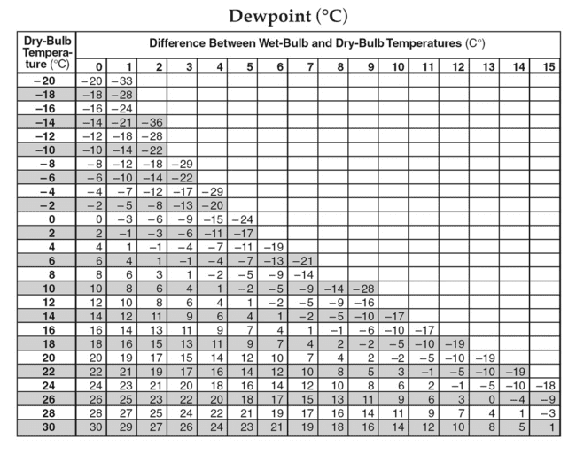
How to Calculate Dewpoint/Humidity
Dry Bulb:
Regular Temperature
Wet Bulb:
Evaporation Cooling
Dewpoint:
The temp at which water condenses.
Difference between wet and dry bulbs.

Slide 14
Procedure
Subtract Wet-bulb from Dry-bulb.
Example:
Dry-bulb = 12
Wet-bulb = 8c
12-8= 4
Find where your dry-bulb and difference cross.

Slide 15
Another Example
Dry-bulb = 18 Wet-bulb = 6.
18 - 6 = 12
-19 means the temperature would have to drop to -19 degrees for water to condense.

Slide 16
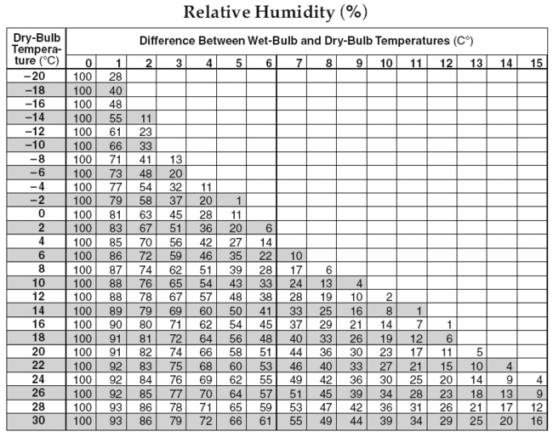
How to calculate Humidity
Same process as Dewpoint:
Wet-bulb is 15
Dry-bulb is 17
Whats the difference?
We find the average of 80-81

Slide 17
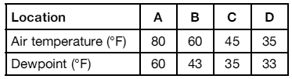
Summary and Exit Ticket
The table shows the air temperature and dewpoint at each of four locations, A, B, C, and D.
Based on these measurements, which location has the greatest chance of precipitation and why?

Slide 18




Aim: How do we calculate dewpoint and humidity?
Do Now
A
B
Which station model represents a location that has the greatest chance of precipitation and why?
C
D

