Slide 1
Fronts when two air masses collide.
Warm Front
Cold Front
Warm air climbs slowly over cold air.
Light rain. Moves slowly.
Cold air moves under warm air and quickly pushes it up.
Heavy rain. Moves quickly

Slide 2
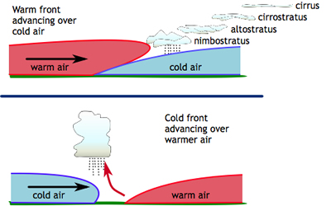
Fronts

Slide 3
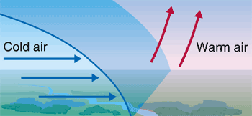
Cold Front

Slide 4
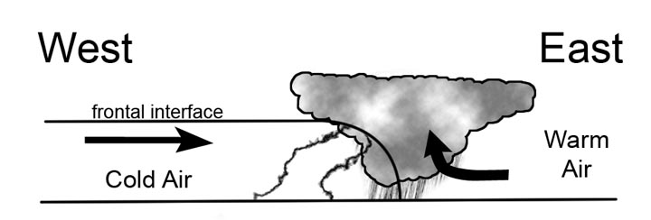
Cold Front

Slide 5
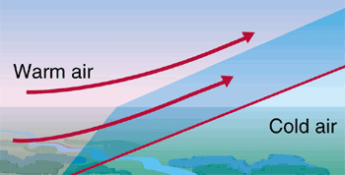
Warm Front

Slide 6
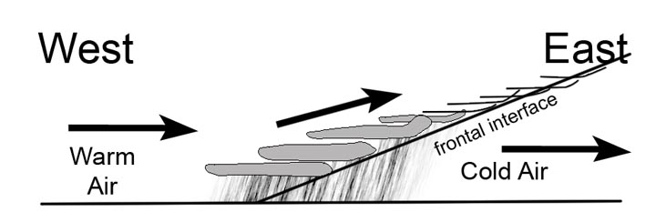
Warm Front

Slide 7
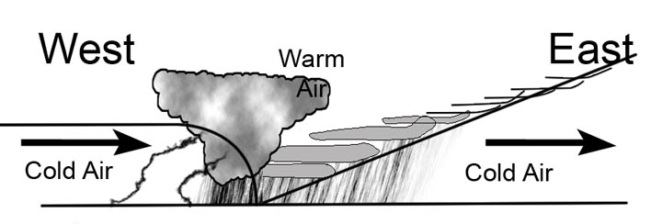
Occluded Front

Slide 8
Aim:
What are the different types of storms?
Do Now:
Today’s temperature is 50 degrees. Tomorrow’s temperature will be in the 60’s.
What’s happening?
Why no rain tonight or tomorrow?

Slide 9
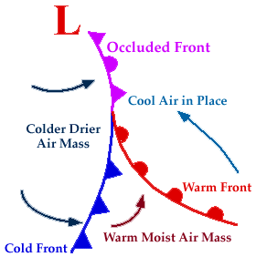
Front Symbols

Slide 10
Currently
Yesterday was 70⁰ (day), 45⁰ (night).
Today will be 65⁰ (day), 38⁰ (night). It will rain tonight.
Tomorrow will be 50⁰ (day), 34⁰ (night).
Explain what is happening?

