Slide 1
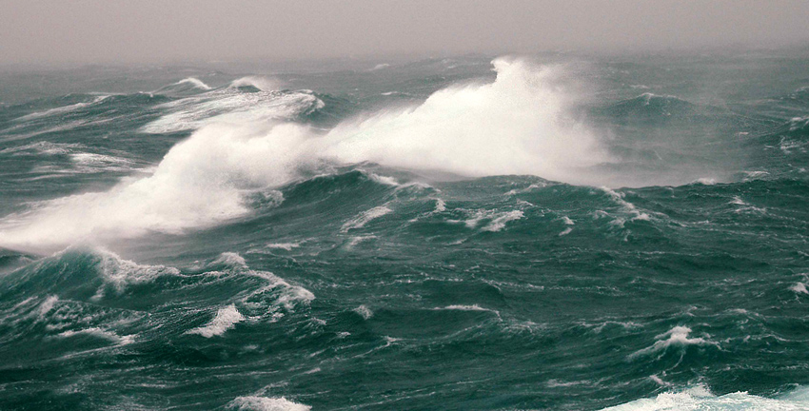
What are Waves?
Rhythmic rise and fall of water’s surface.
Caused by wind

Slide 2
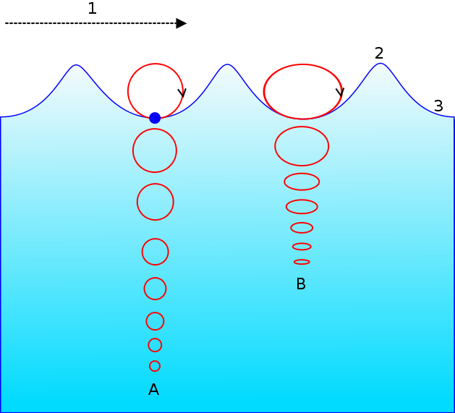
Do waves move water?

Slide 3
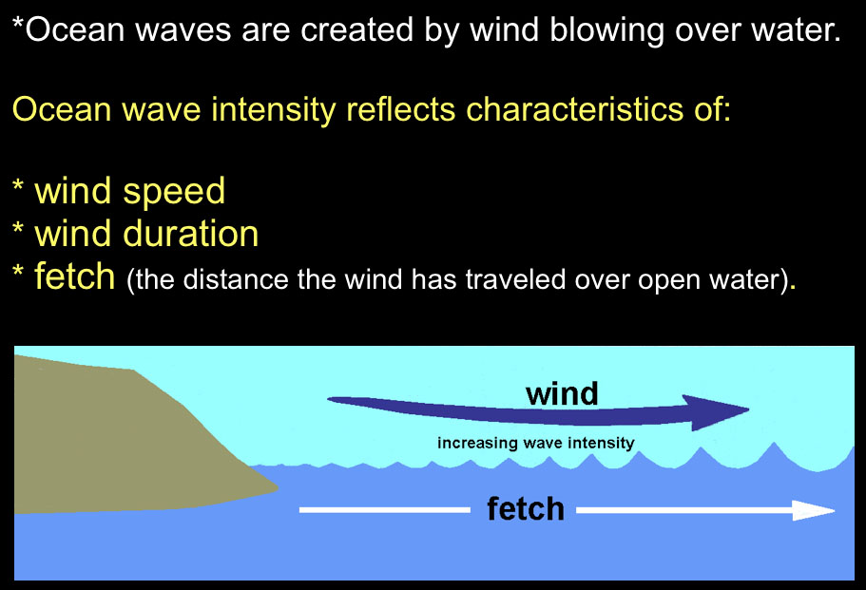

Slide 4
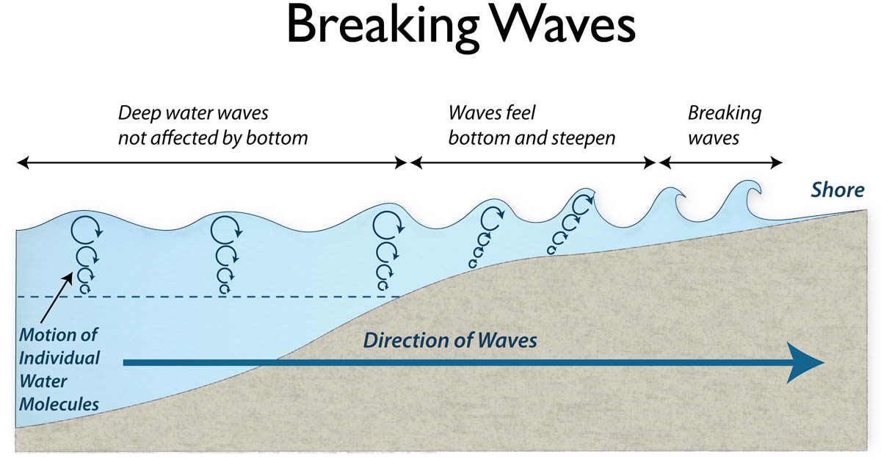

Slide 5
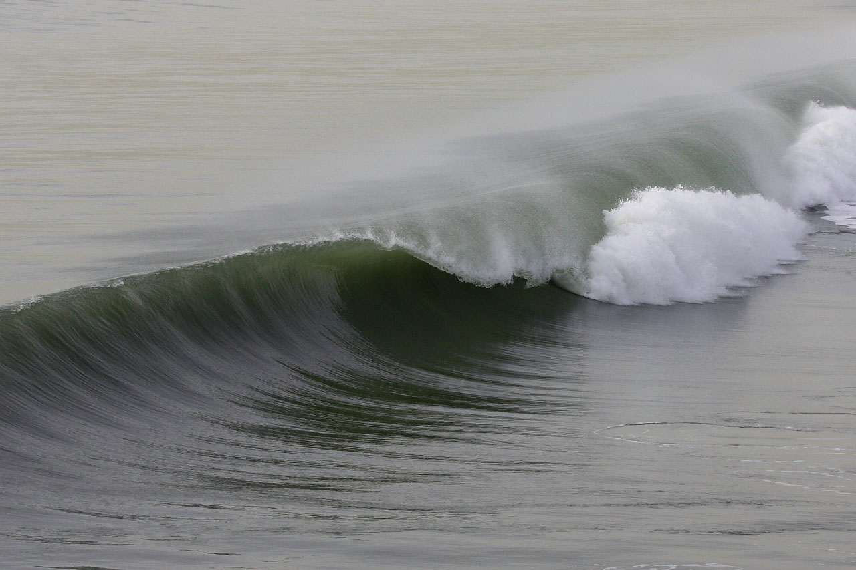

Slide 6
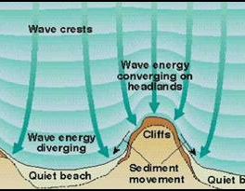
Wave Refraction
Waves bend (refract) when they enter shallow water.

Slide 7
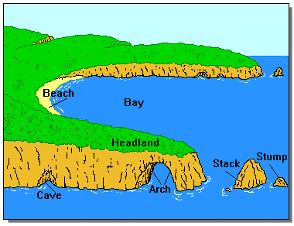
Shoreline

Slide 8
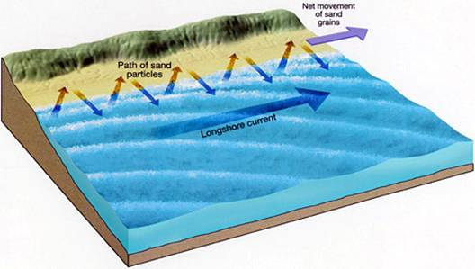
Longshore Current
Current that runs parallel to the shore.

Slide 9
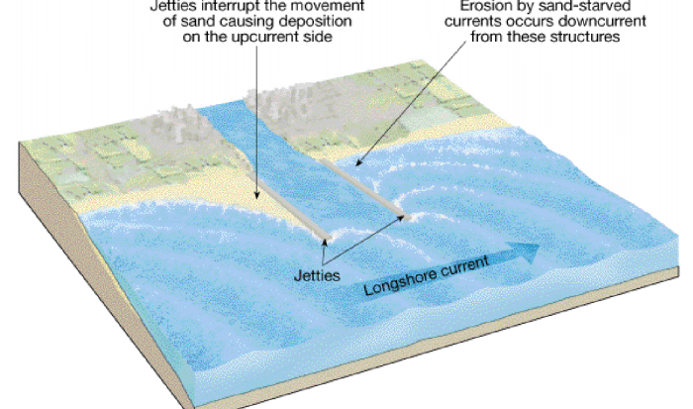
Jetties - Groins

Slide 10
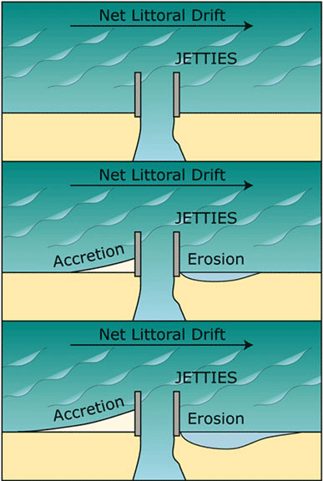

Slide 11
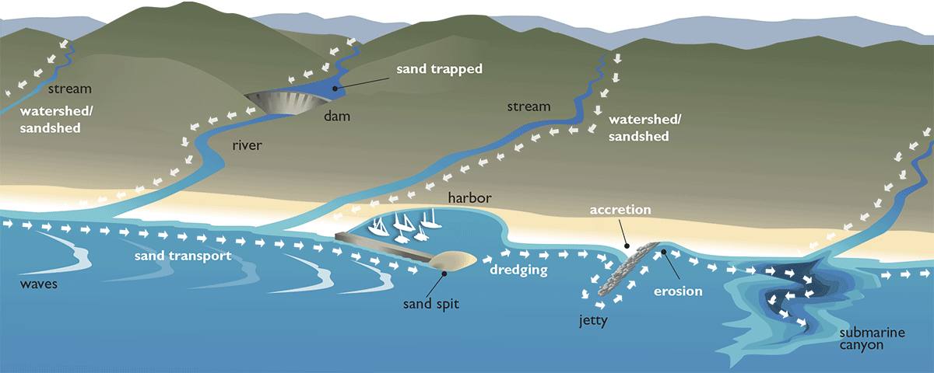

Slide 12
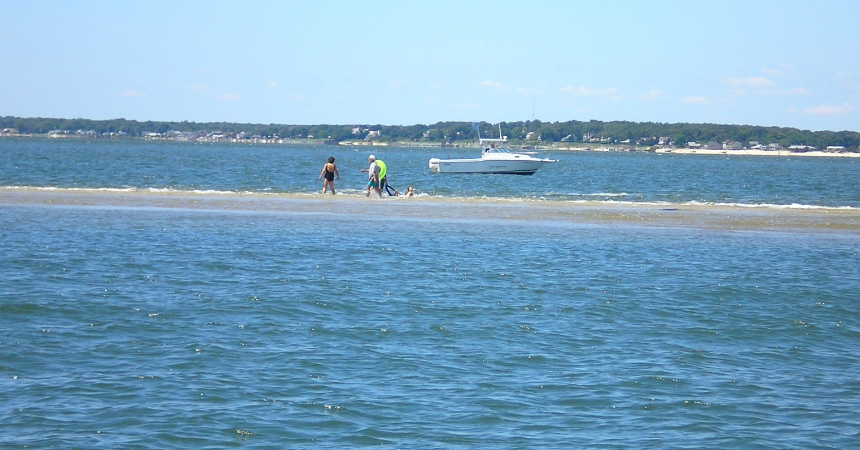
Sandbar
Pile of sand in open water; usually temporary

Slide 13
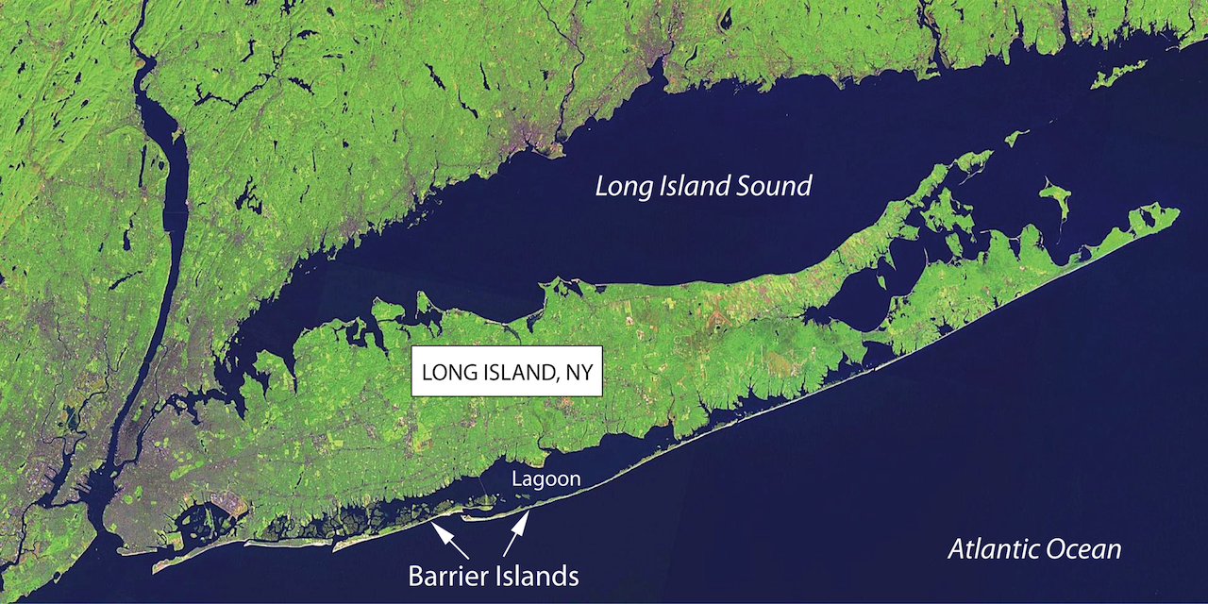
Barrier Island (from waves)

Slide 14
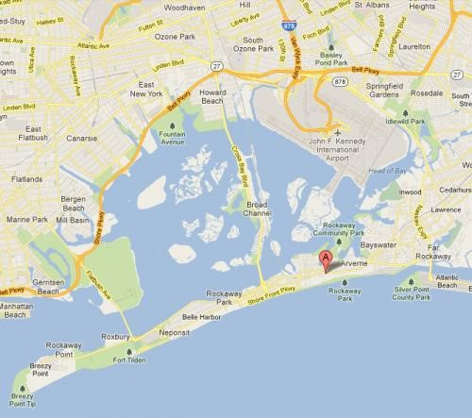
Spit sandbar connected to the land forms when longshore current enters bay.

Slide 15
