Slide 1
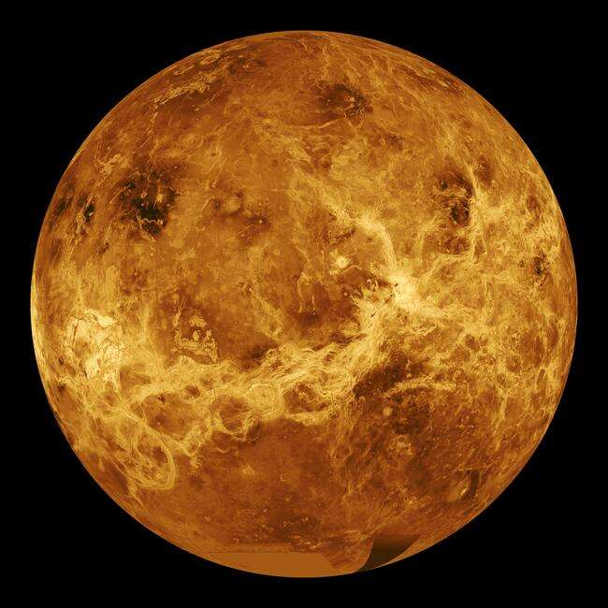

Slide 2
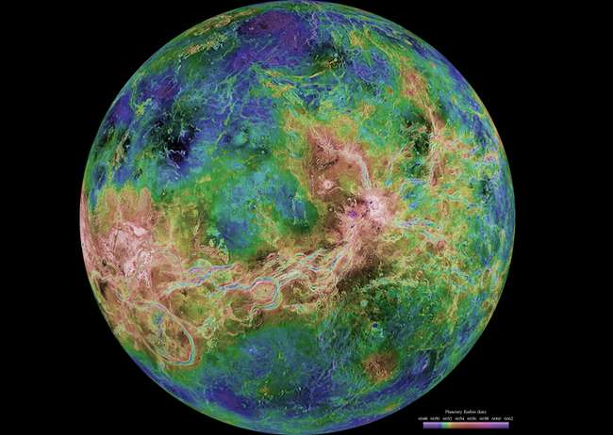

Slide 3
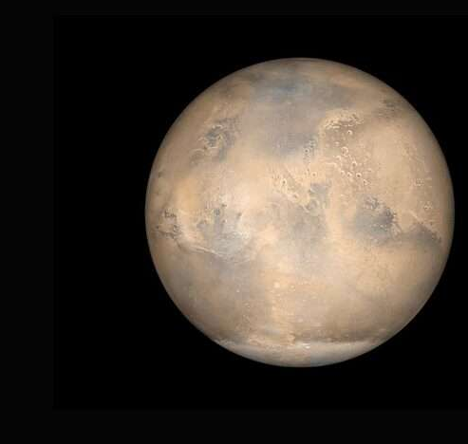
Venus as seen by the Parker Solar Probe (2021)

Slide 4
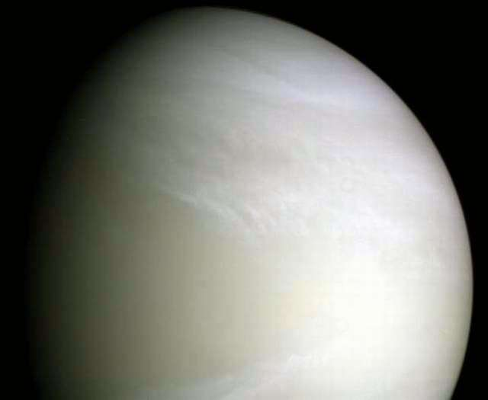

Slide 5
Basic Facts
Similar to Earth in size and density.
Hottest planet in solar system - 864⁰ F
(Mercury 800⁰ F)
Extreme surface pressure from thick atmosphere
-- 92x Earth (crushes surface rocks).

Slide 6
Rotation and Revolution
Rotates in opposite direction than other planets (E to W). Maybe due to early impact.
Rotation - 243 days
Revolution - 225 days
So, every day is a new year.

Slide 7
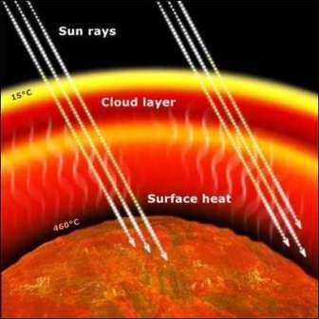
Greenhouse Effect
Outgassing = CO₂ released into atmosphere.
CO₂ = greenhouse gas…
lets solar radiation in, not
out.
Atmosphere very thick

Slide 8
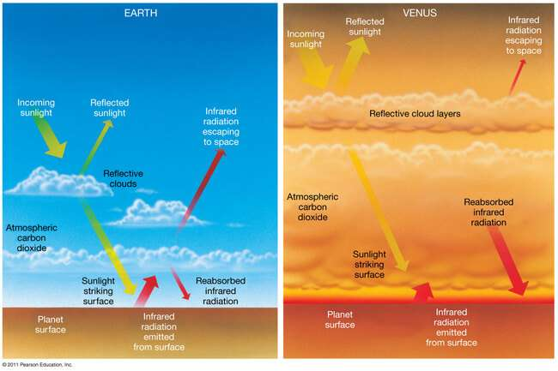

Slide 9
Runaway Greenhouse
Venus has no liquid water on surface but has some water vapor in atmosphere.
On Earth, oceans absorb CO₂, keeping greenhouse effect in check.
Will Earth be like Venus in the future?

Slide 10

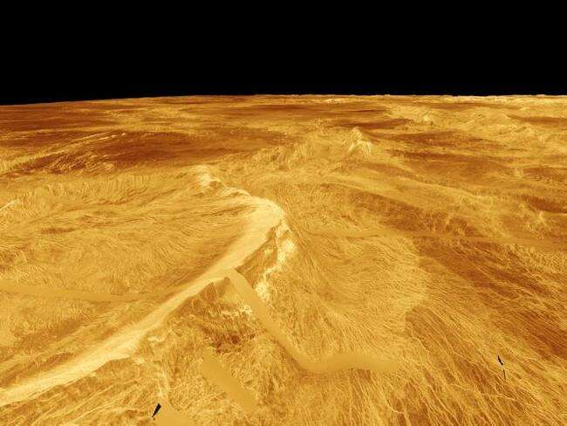
Volcanism
Few craters found on surface. Why?
Possibly because:
500 million years ago, surface repaved; or
Volcanic eruptions constantly cover old craters

Slide 11
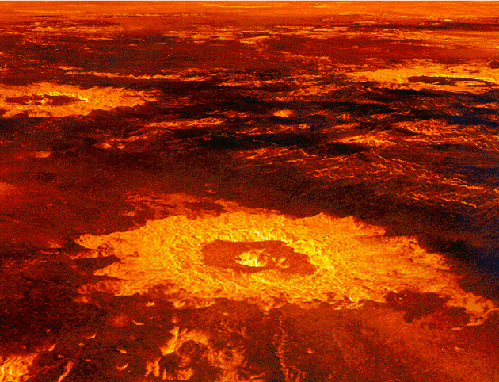

Slide 12
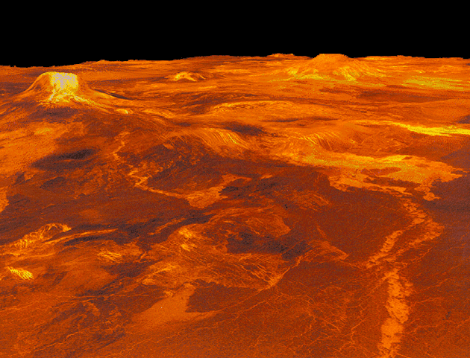

Slide 13
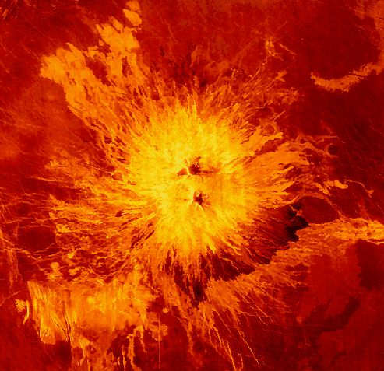
Volcano
Sapas Mons
300 miles across and 3 miles high.

Slide 14
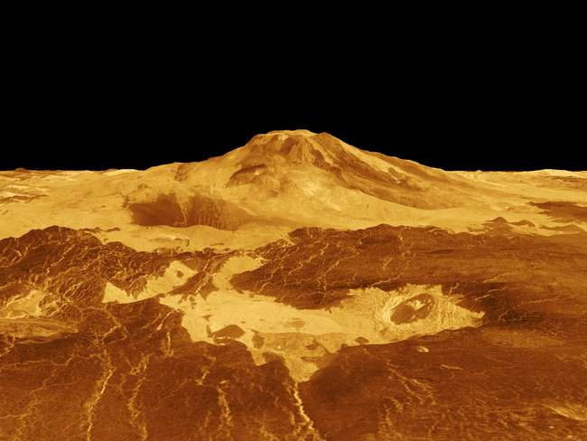

Slide 15
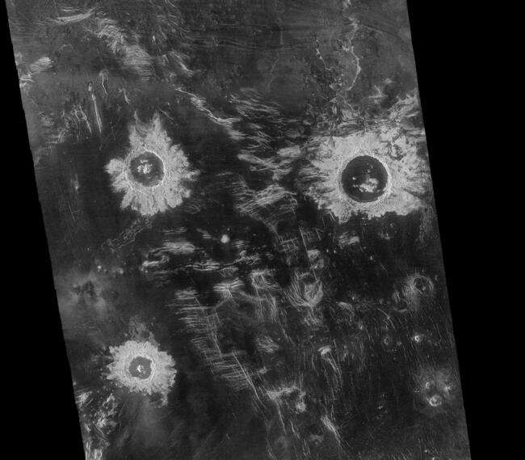

Slide 16

Atmosphere
Upper atmosphere is cool like Earth… maybe bacterial life?
Clouds - sulfuric acid rain, frequent lightning

Slide 17
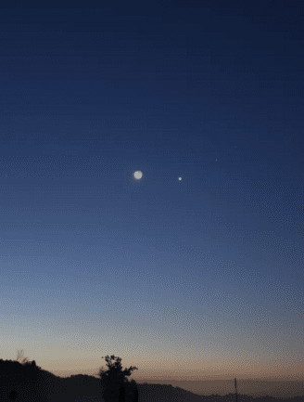
Observing Venus
Third brightest object in sky.
Viewed in early morning or early evening
(Morning Star, Evening Star).

Slide 18
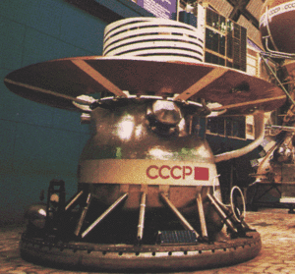
Venera 13 and 14 (1981)

Slide 19
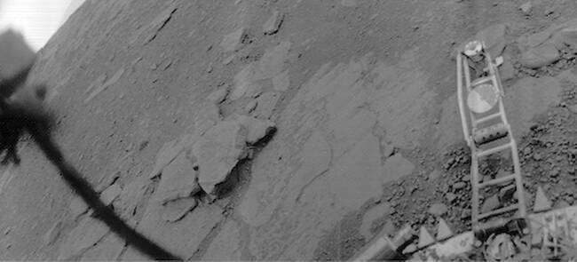

Slide 20
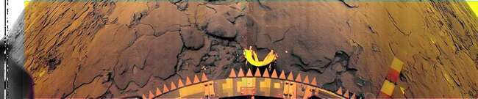

Slide 21
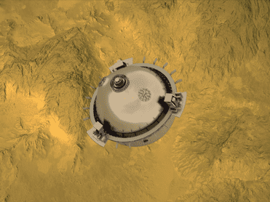
DaVinci to Launch in 2029

