Slide 1
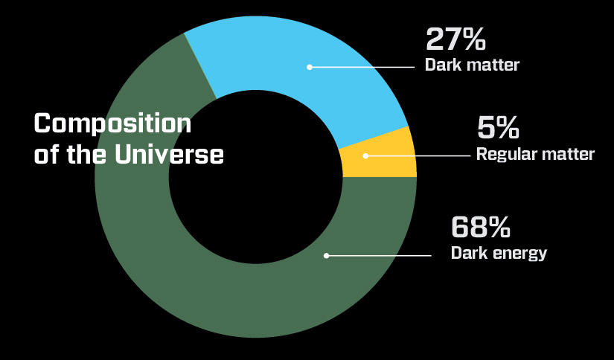
Composition
Until recently, we thought all matter was regular (baryonic) matter (atoms).
Now:
5% is baryonic matter
95% is non-baryonic matter

Slide 3
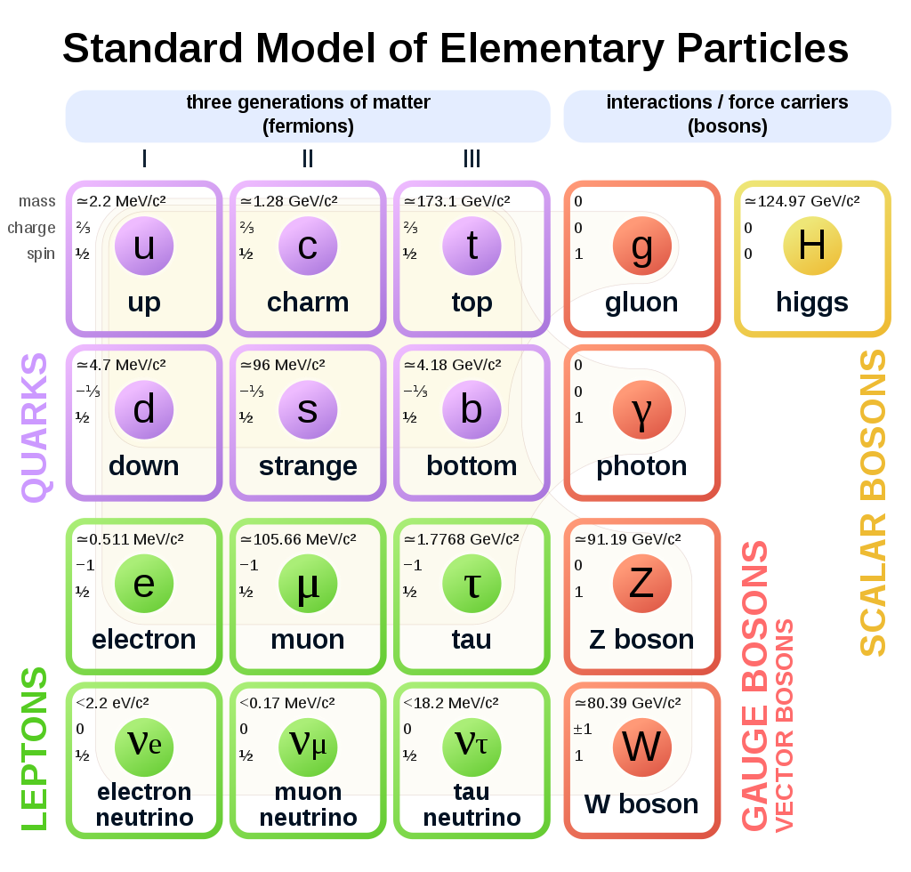
Regular Matter (Baryonic)

Slide 4

Non-Baryonic Matter
23% is Dark Matter - sub-atomic particles that interact weakly with ordinary matter.
72% is Dark Energy - It seems to be the energy of empty space…”vacuum energy”
??% are neutrinos - like electrons, but without a charge.

Slide 5
Cosmological Constant
Einstein was afraid his equations showed the universe should contract (too much gravity), so he put in a Cosmological Constant (anti-gravity) to balance the universe to keep it static (standing still). He was wrong about a static universe.
To Einstein the CC is the energy of empty space.
We now know the universe is expanding and accelerating (1998).
So the CC is now Dark Energy. This explains the observed acceleration of the universe… so Einstein was right after all.

Slide 6
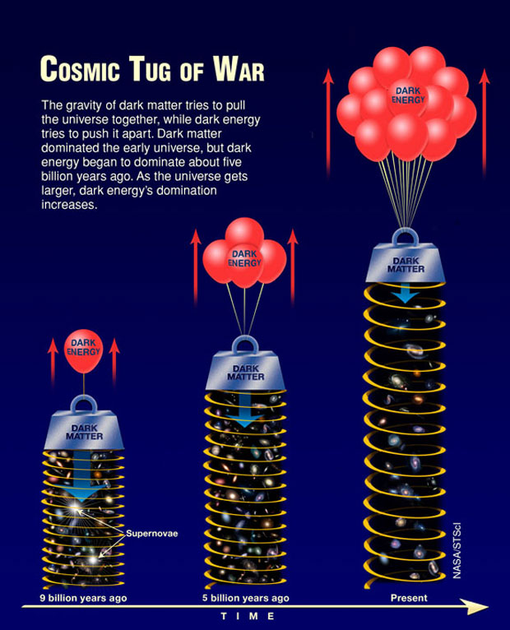
Dark Energy
Dark Energy pushes the universe apart… the opposite of gravity.
As the universe expands, there is more empty space, which pushes the universe further apart.
This explains the acceleration of the universe.

Slide 7
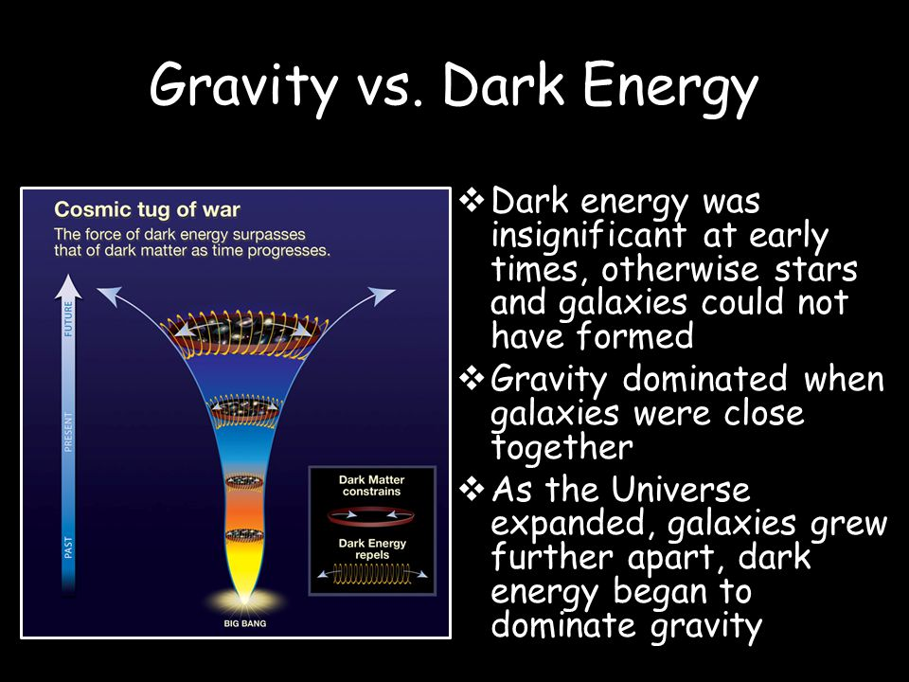

Slide 8
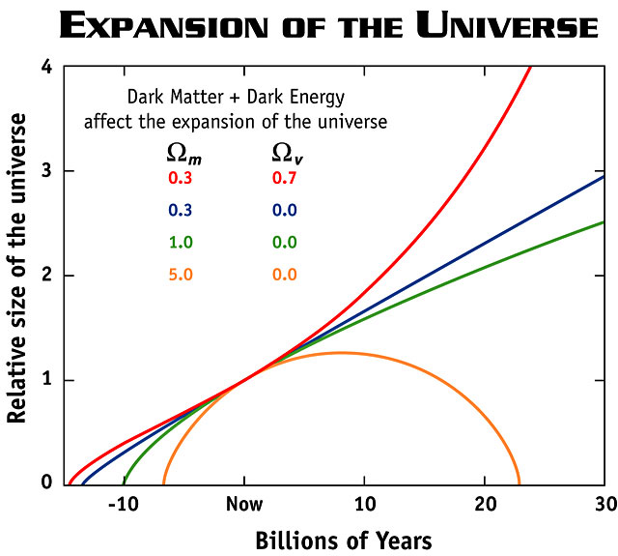
Notes:
Orange = closed
Green, Blue = open
Red = accelerating

Slide 9
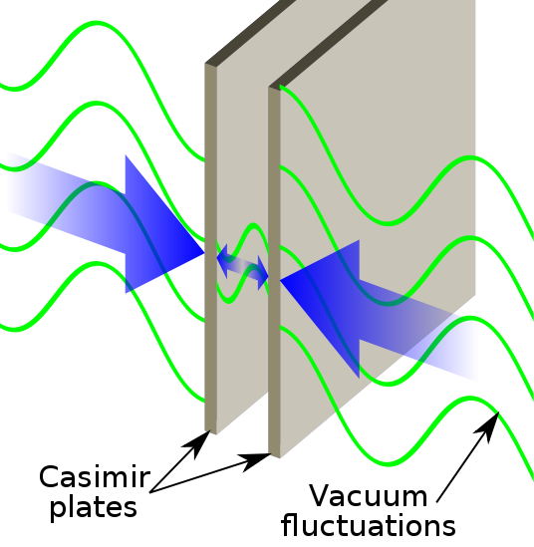
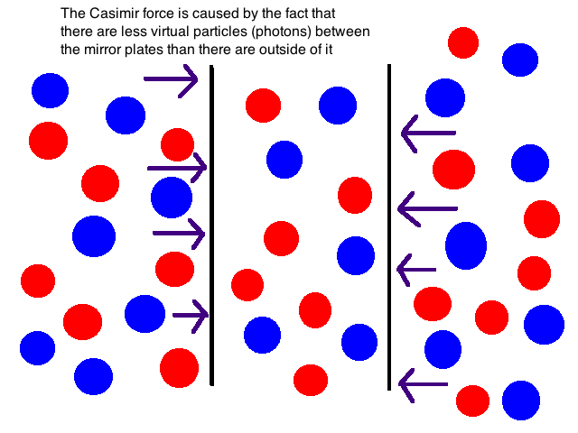
Casimir Effect

Slide 10
Dark Matter
Gravity alone cannot hold galaxies together.
Stars and dust make up only 10% of galaxy mass. What is the other 90%?

Slide 11
Dark Matter
Measure mass of galaxies and stars by how fast objects orbit them.
Galaxies have more mass than stars, gas and dust within them.
Also, gravitational lensing shows too much mass in galaxies.

Slide 12
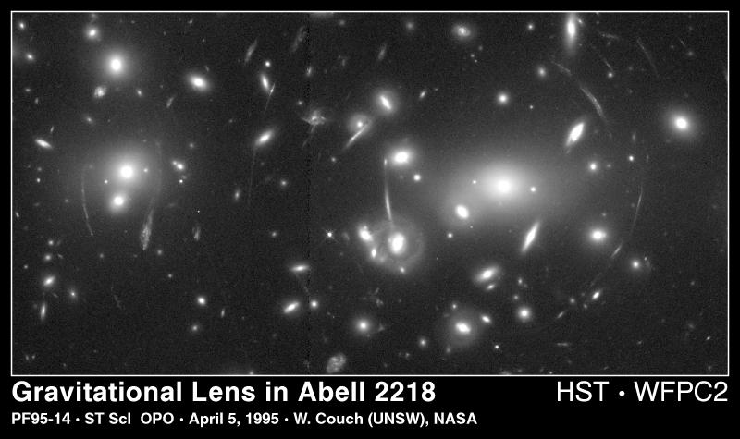

Slide 13
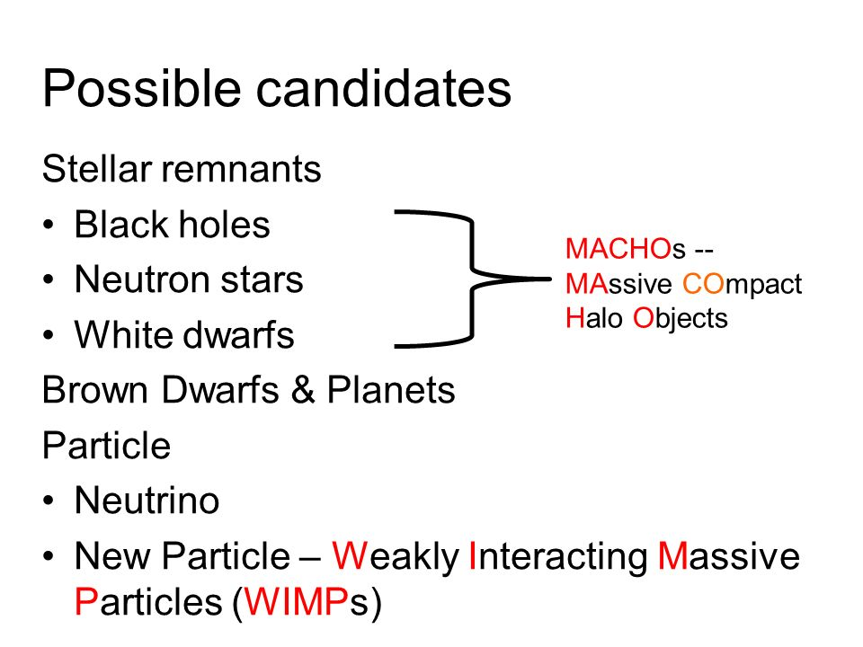
Dark Matter: Could Be…

Slide 14
Dark Matter
Gravitational pull, but does not emit or absorb light. Could be…
Brown Dwarfs: small stars too small to shine, but still have large gravity.
- called MACHOS (massive compact halo objects). If so, then missing mass is baryonic.

Slide 15
Dark Matter
Supermassive Black Holes: May power quasars. May be detected through lensing.
New Forms of Matter: Called WIMPS (Weakly Interacting Massive Particles)… non-baryonic matter.

