Slide 1

Age of the Universe
How do we know?
Look at the oldest stars.
Measure rate of expansion and extrapolate back to Big Bang.
Universe is 13.8 billion years old.

Slide 2
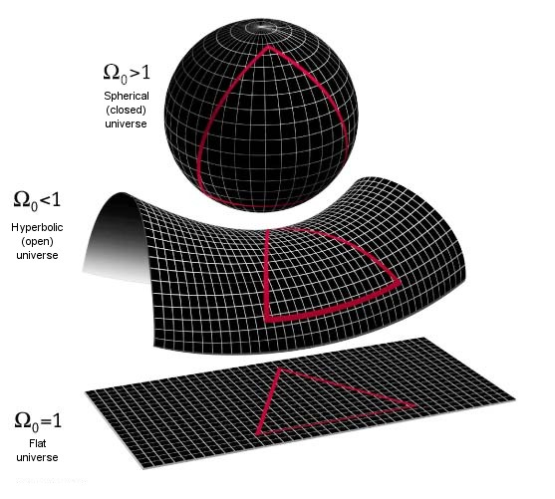
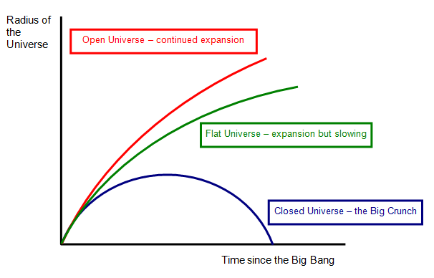
Shape of Universe

Slide 5
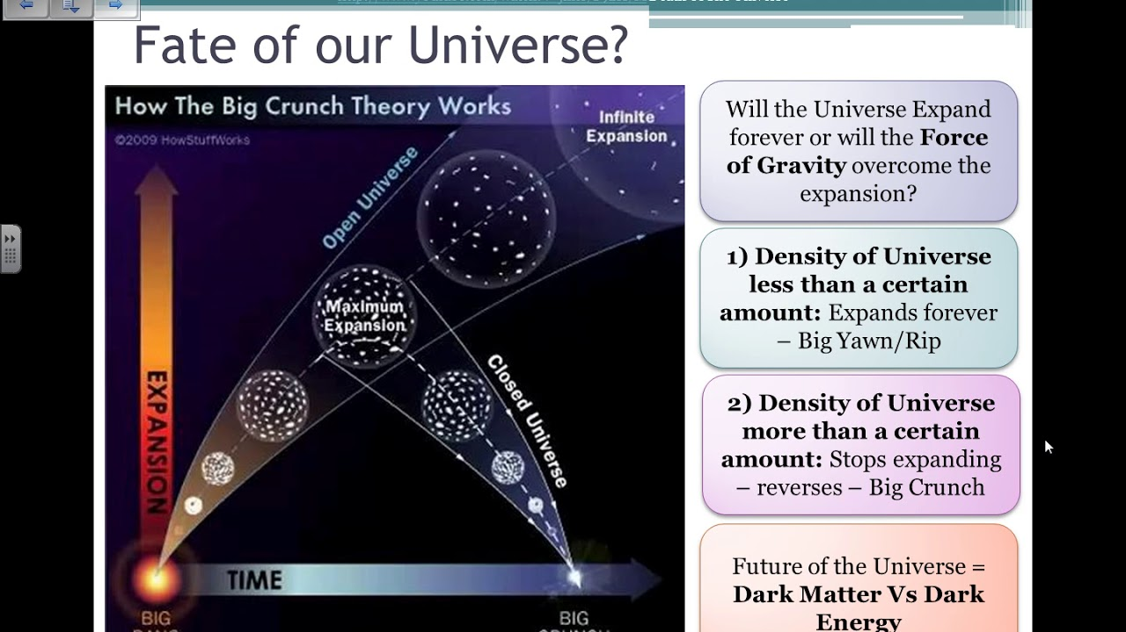

Slide 6
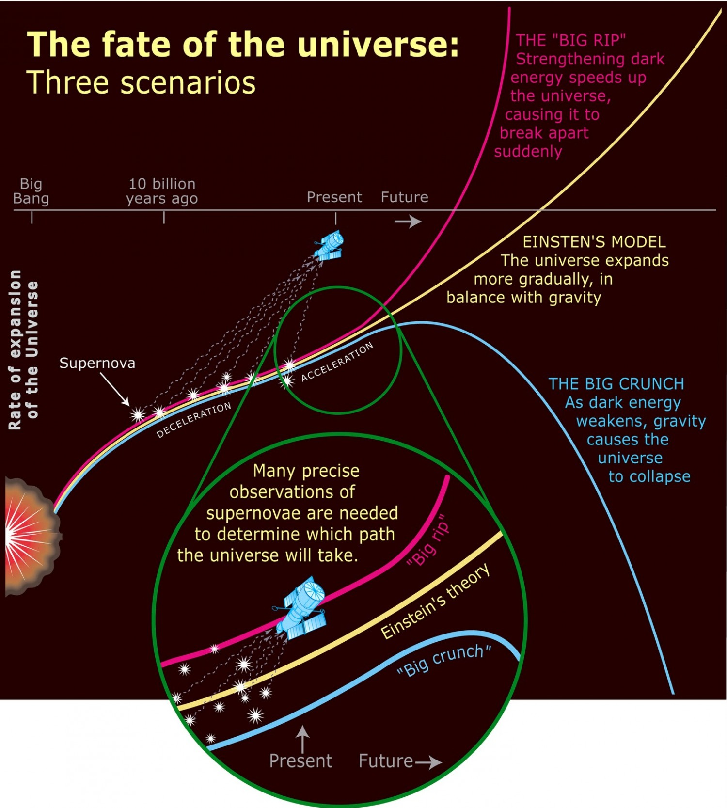

Slide 7
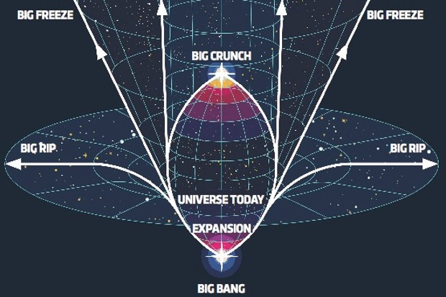

Slide 8
Big Freeze
Stars will continue to form for another 1-100 trillion years.
Eventually gas runs out…no more stars.
Only black holes left…then they disappear too.
Universe grows darker and colder.

Slide 9
Big Rip
Universe has “phantom” dark energy (stronger than regular dark energy)
Universe keeps expanding at a faster rate
Eventually, everything rips apart and disintegrates into fundamental particles and radiation

Slide 10
Big Crunch
Expansion begins to slow and gravity takes over.
Universe begins to contract and ends up in a singularity (then another big bang?)

Slide 11
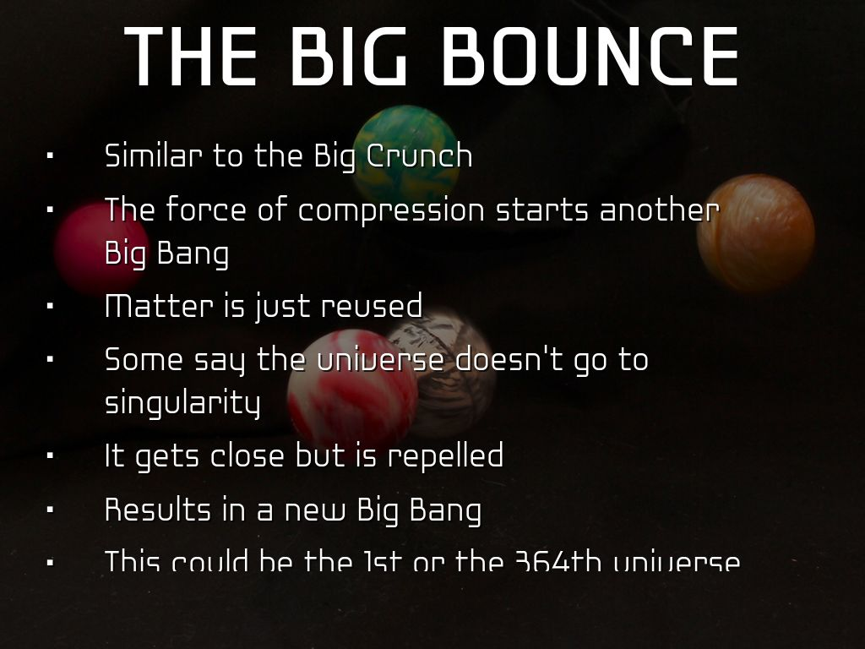

Slide 12
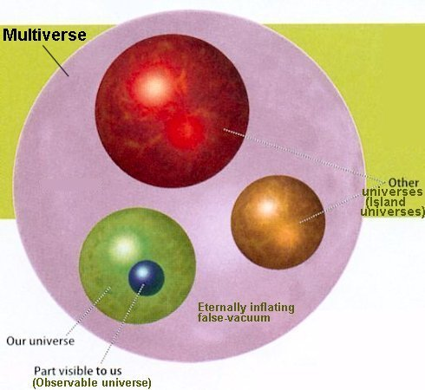
Eternal Inflation
no single Big Bang
inflation keeps repeating from uninflated areas of the universe.
our universe is not unique… there may be many at once (multiverses).

Slide 13
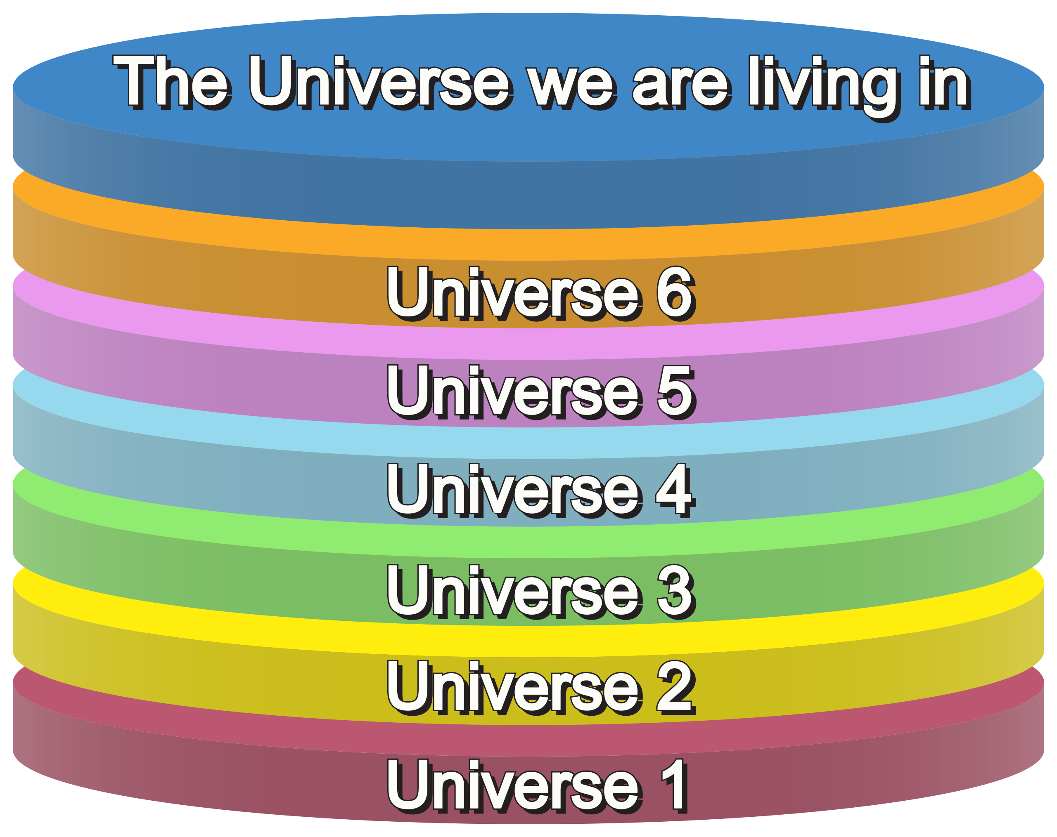

Slide 14
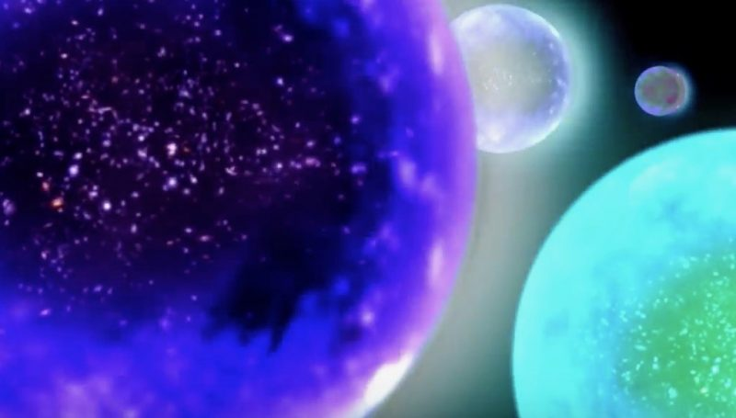
Multiverse?

Slide 15
