Slide 1
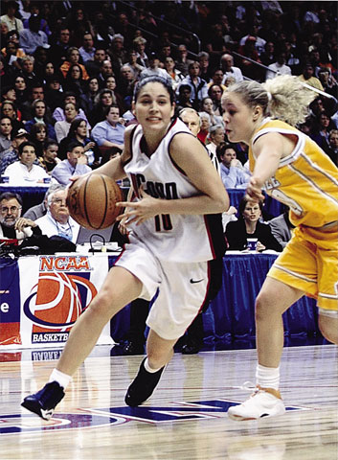
Individual Behavior in the Presence of Others
Social Facilitation:
Improved performance in the presence of others.
Triplett (1898) noticed cyclists’ race times were faster when they competed against others than when they just raced against the clock.
Michelle Agnis/ NYT Pictures
Notes:
OBJECTIVE 10| Describe conditions in which the presence of others is likely to result in social facilitation, social loafing, or deindividuation.

Slide 2
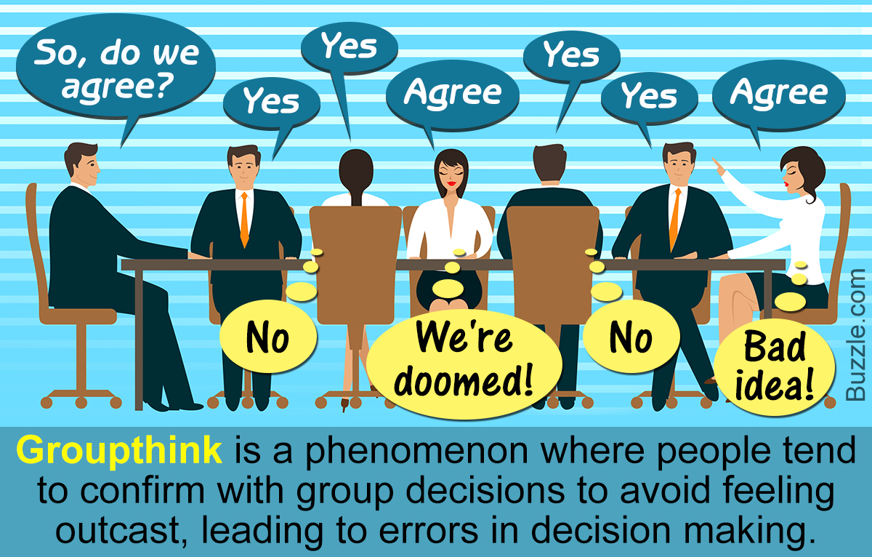

Slide 3
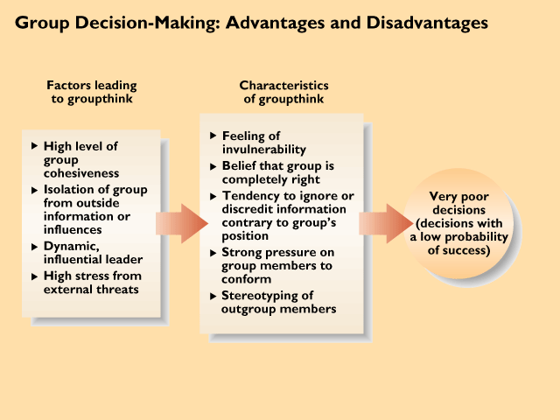
Groupthink
syndrome of bad decision-making
12.17
Notes:
13
12
4

Slide 4
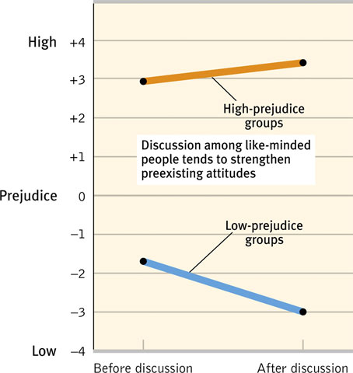
Group Polarization
If a group is like-minded, discussion strengthens its prevailing opinions and attitudes.
Social media tends to exaggerate polarization.
We’re okay with people who like (stamps, red planes, raccoons, etc.) finding each other. But what about nazis, pedophiles, terrorists, etc.?
Notes:
OBJECTIVE 11| Discuss how group interaction can facilitate group polarization and groupthink.

Slide 5
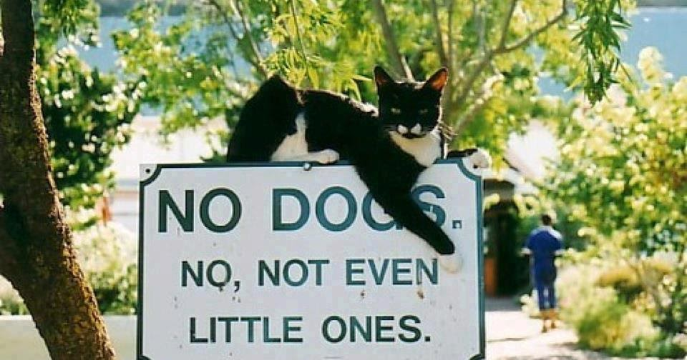
In-Group Bias
We tend to favor our group.
Ex: You side with the sports team that you like.

Slide 6
Out-Group (the Other) Bias
When we categorize people as being part of our own “in-group”, others are part of the "out-group“.
We view members of the out-group as different, causing us to have negative biases against them. (“they’re all like that”). We depersonalize out-group members in order to maintain out-group bias.
If we start to like the out-group, we have cognitive dissonance (which could change our behavior or solidify it with justifications).

Slide 7
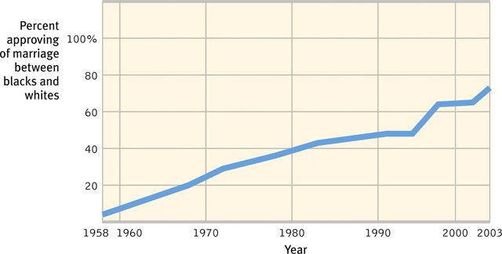
How Prejudiced are People?
Over the duration of time many prejudices against interracial marriage, gender, homosexuality, and minorities have decreased.
Notes:
OBJECTIVE 14| Contrast overt and subtle forms of prejudice, and give examples of each.

Slide 8
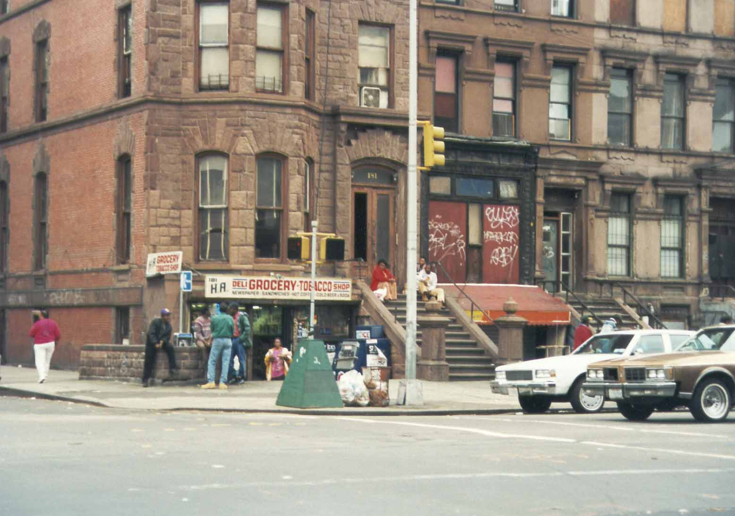
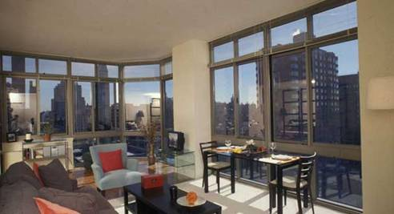
Social Inequality
Social inequality increases prejudice (“Just World”)

Slide 9
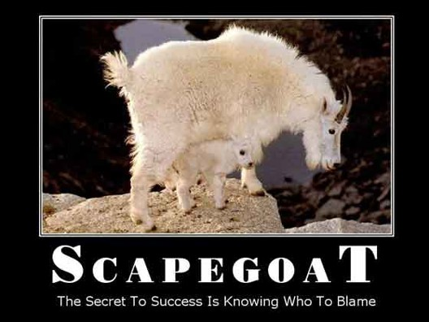

Slide 10
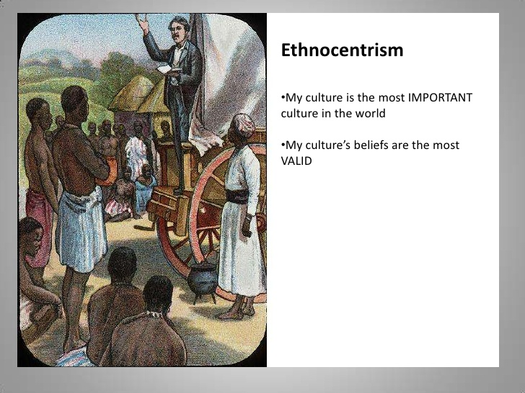

Slide 11
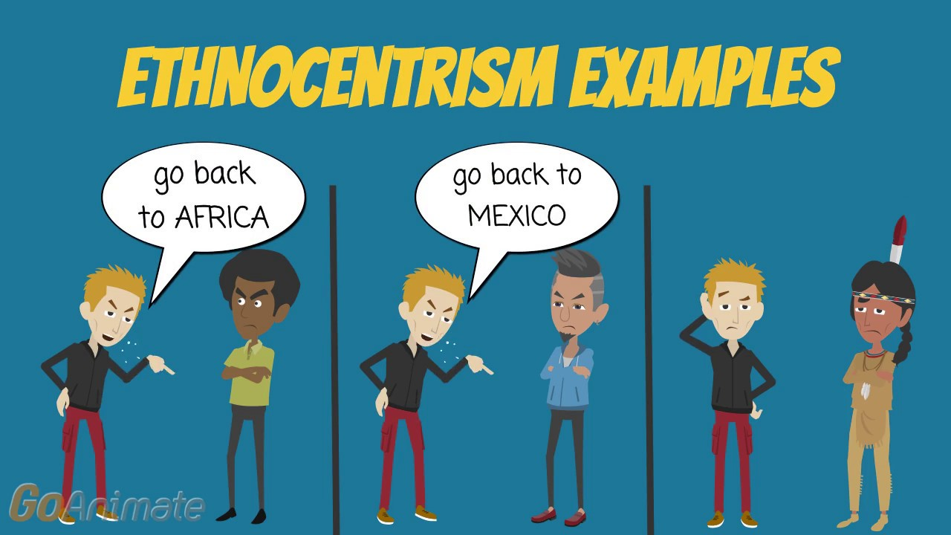

Slide 12
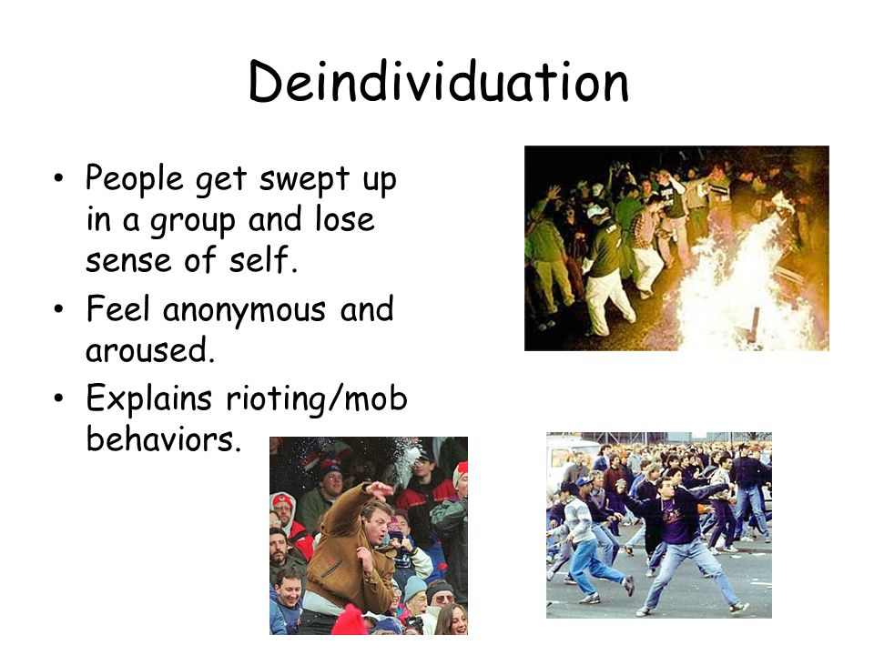

Slide 13
We Shall Overcome
Recategorize – expand a schema.
Not Protestant vs. Catholic, but instead both Christianity.
Or even better, how about we are all human beings!
Increase contact between groups.
  Equal status – perceive them as worthy (situational vs. dispositional)
  One-on-one contact
  Come together to cooperate (work together), not compete

Slide 14
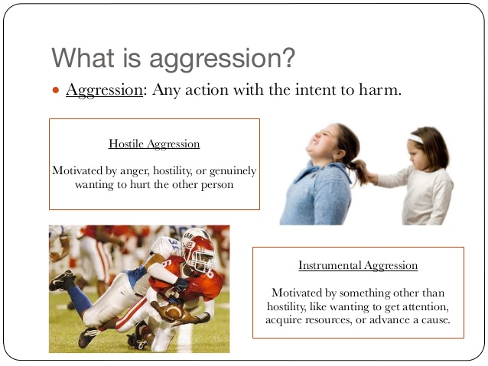

Slide 15
Robbers Cave Study
11-12 year-old children at summer camp in 1954. Broken into 2 groups. At first, each group separated. They named their group and created norms and hierarchies.
Then when told about the other group they spoke negatively about them. During a contest for a prize, each group became hostile. Burned each others flags and raided cabins.
How to resolve this?

Slide 16
Conflict Resolution
Robbers Cave Resolution
Having groups do fun activities together didn’t work (watched movies, ate together, etc.). Devolved into conflict.
Focused on subordinate goals (tasks that benefit both groups). They cut off the water-supply, so groups had to work together to fix it. This worked to reduce conflict and aggression.
Problems: 1. Researchers posed as camp counselors. 2. Same study previous year did not produce conflict. 3. Some children weren’t debriefed until decades later. 4. No control group.

Slide 17
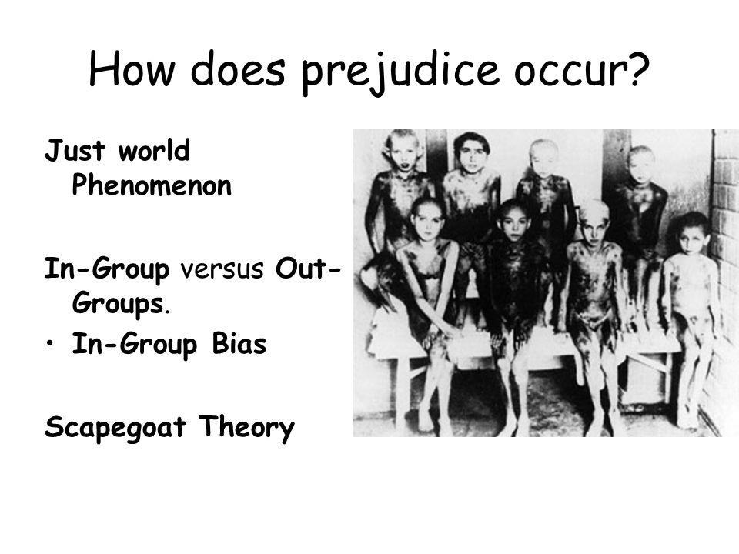
Prejudice
Simply called “prejudgment,” a prejudice is an unjustifiable (usually negative) attitude toward a group and its members.

Slide 18
Sources of Prejudice
Frustration-aggression theory
  People who are frustrated in their goals may turn their anger toward another, less powerful target. (Scapegoat)
Authoritarian personality
  Personality pattern characterized by rigid conventionality, exaggerated respect for authority, and hostility toward those who defy social norms
Racism
  Prejudice (ideas) and discrimination (behavior) directed at a particular racial group

Slide 19
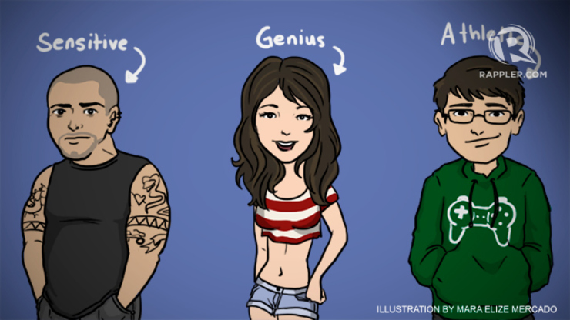
Cognitive Roots of Bias
Heuristics – shortcuts cause stereotypes (categorize)
Top-Down Processing – Fill in missing information
Schema – set of ideas (preconceptions)
Mental Set – a fixed way of thinking

Slide 20
Altruism
Doing something to help another at some cost to yourself.
Evolutionary – cooperation is important
It can be both selfish (feels good – “warm glow” effect) and selfless (may put life at risk).
Reciprocal altruism – more altruistic if a chance of interacting in the future.
May be neurological (some people are extreme altruists)
Culture and other facts contribute (empathy, ability, etc.)

Slide 21
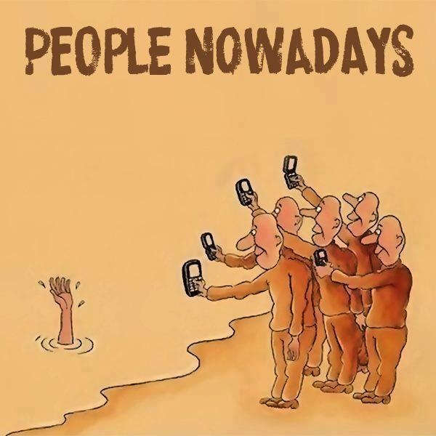
Bystander Effect
Tendency of any given bystander to be less likely to give aid if other bystanders are present.
Notes:
OBJECTIVE 26| Describe the steps in the decision-making process involved in bystander intervention.

Slide 22
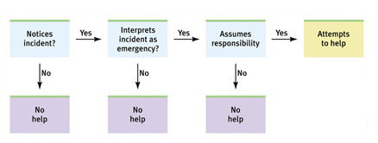
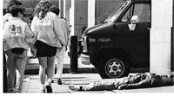
The decision-making process for bystander intervention.

Slide 23
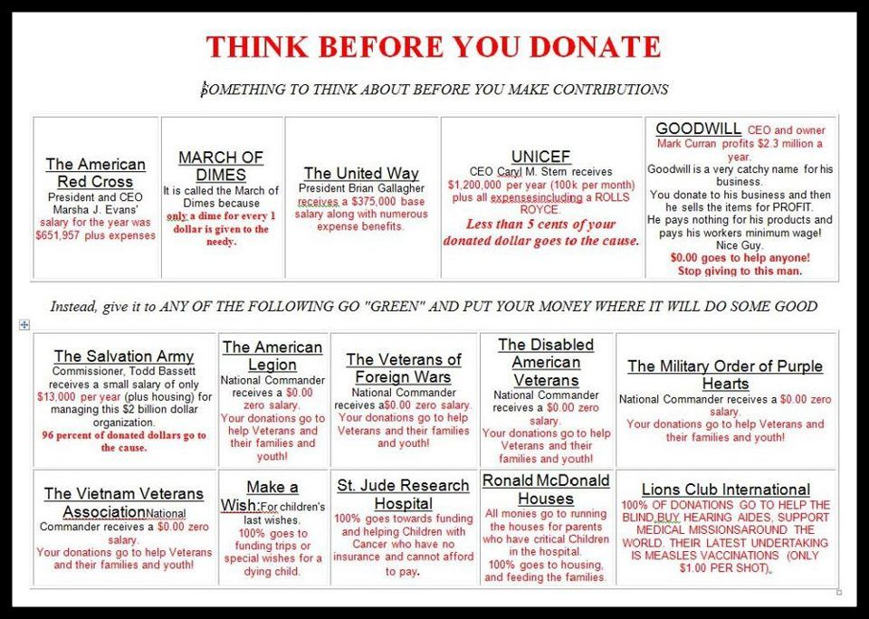
Effective Altruism
Popular idea currently
Using evidence and reason to best allocate resources.
“effective altruism is the form of altruism in which we bring our rational capacities to bear in order to do the most good that we can”. Peter Singer
Many charities are not efficient…waste money on administration, salaries, etc.
Generally, more effective to give to overseas problems

Slide 24
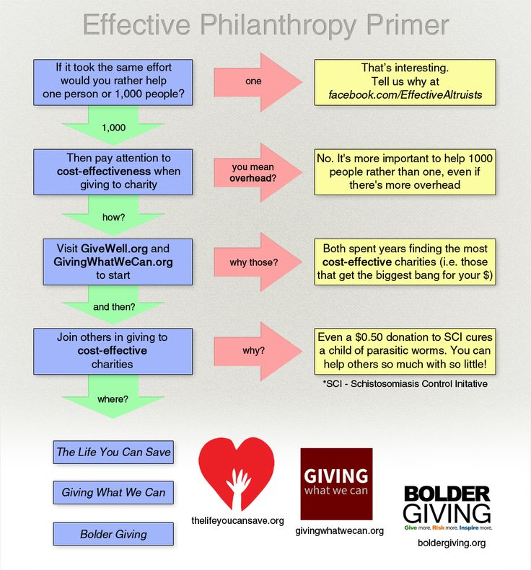
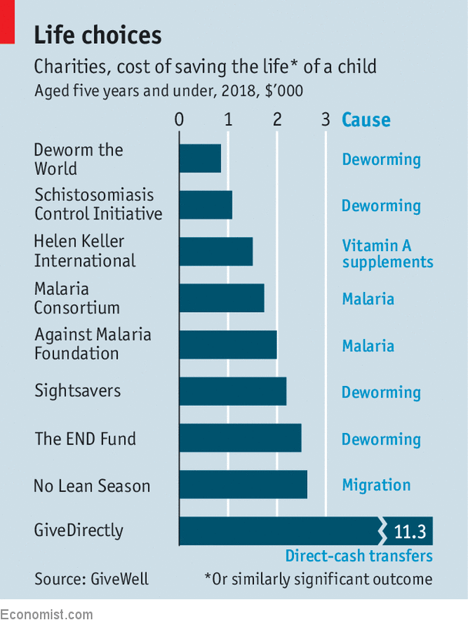
Effective Altruism

Slide 25
Attraction
Attraction is closely linked to
  Proximity
  Physical attractiveness
  Similarity
  Exchange
  Intimacy

Slide 26
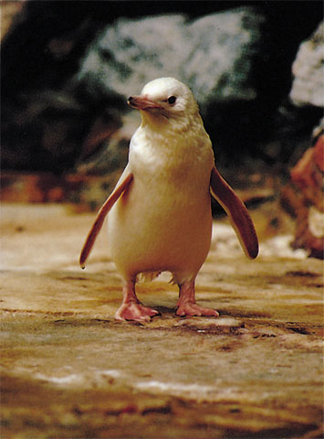
Proximity
Proximity: nearness is a powerful predictor of friendship. Repeated exposure to novel stimuli increases their attraction
Mere Exposure Effect = we like the familiar.
Ex. A rare white penguin born in a zoo was accepted after 3 weeks by other penguins just due to proximity.
Rex USA
Notes:
OBJECTIVE 23| Describe the influence of proximity, physical attractiveness, and similarity on interpersonal attractions.

Slide 27
Proximity leads to liking
Moreland & Beach, 1992
IV: Four female confederates attended large class 0, 5, 10, or 15 times
DV: How much liked slides of confederate at end of semester
Results: The more times confederate attended the class, the more she was liked.

Slide 28
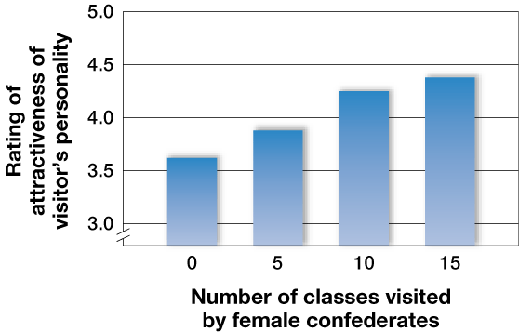
Proximity leads to liking

Slide 29
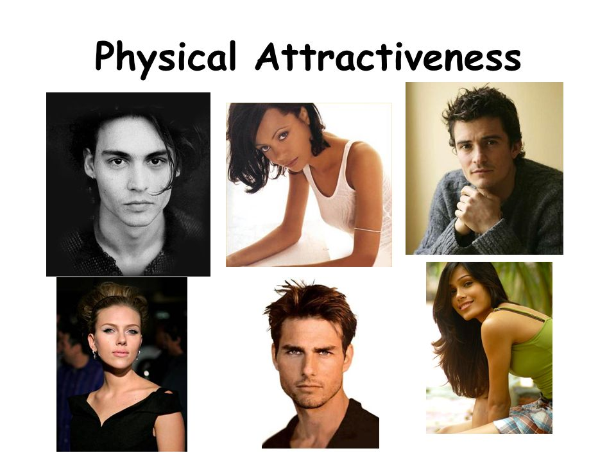
After proximity, physical appearance is next most important.
Hatfield et al. (1966)

Slide 30
Physical Attractiveness
Halo Effect: We tend to think attractive people have better qualities (nicer, smarter, etc.)
Bias to like children who are attractive
(Dion-1972)
IV: mild vs. severe misbehavior
IV: attractive or unattractive photo of child
DV: Rate typicality of behavior
Results: Severe misbehavior rated more typical when performed by an ___________child than an __________child.

Slide 31
Is Attractiveness Objective?
Arguments for Objective Standard
High consensus across countries, race/ethnicities
Particular features are associated with attractiveness
  F: large eyes, prominent cheekbones, small nose, wide smile
  M: broad jaw, large eyes, prominent cheekbones, wide smile
Babies look longer at faces rated as attractive by adults. (less likely to be affected by cultural standards)

Slide 32
Is Attractiveness Subjective?
Arguments for Subjective Standard
Cross-cultural differences in ways to look beautiful
Face painting, plastic surgery, scarring, piercings, etc.
Variations in preference for female body size

Slide 33
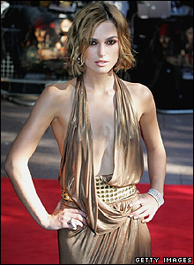
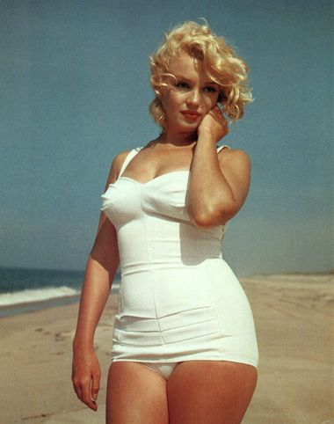
Subjective?
Standards of beauty within a culture
change over time
  Marilyn Monroe versus Keira Knightly

Slide 34
Similarity
Similarity: Similar views among individuals causes the bond of attraction to strengthen.
  Finding others who agree with us strengthens our convictions and boosts our self-esteem
  Opposites don’t attract – they don’t even meet
  Complementary Traits – you complete me

Slide 35
Exchange
The give and take of a relationship.
Social Exchange Theory
how we feel about a relationship with another person as depending on our perceptions of:
  The balance between what we put into the relationship and what we get out of it.
  The kind of relationship we deserve.
  Contrast Effect – seeing something ‘better’ makes us temporarily devalue what we’ve got

Slide 36
Intimacy
closeness and trust achieved through communication
Must be mutual
Can’t be too much too soon

