Slide 1
The String Theory
A Theory of Everything

Slide 2
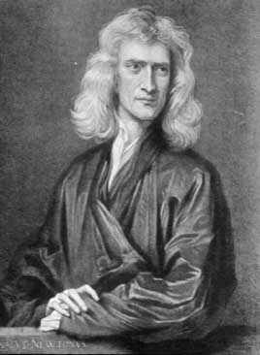
Background: Newton & Einstein
Newton could not explain how gravity worked, only knew of its existence.
Einstein’s work contradicted Newton’s idea of instantaneous gravity.
Einstein’s space/time theory described gravity as warps and curves in the fabrics of space and time [General Relativity].

Slide 3
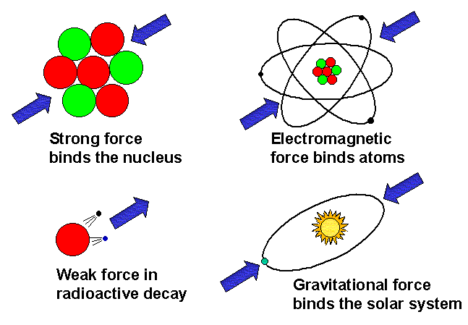

Slide 4
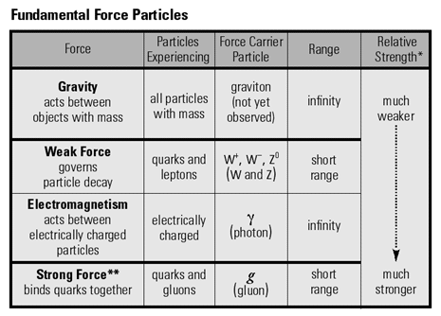

Slide 5
Background: Einstein’s Quest
Wanted to unify the stronger electro-magnetic force (Maxwell) and the weaker gravitational force.
Bohr’s study of subatomic particles and quantum mechanics (uncertainty, chance) made Einstein’s quest impossible.
Quantum Mechanics (study of atoms): You can only calculate the odds of an experiment. The universe doesn’t behave in a certain and predictable way.
“God does not play dice” –Albert Einstein

Slide 6
Conflicts Within Physics
Quantum Mechanics: Two new forces, strong and weak nuclear force coupled with electro-magnetic described phenomena of subatomic particles.
General Relativity (Gravitational force) was used to describe phenomena of large objects (planets, galaxies).
Results become chaotic and nonsensical when using General Relativity to describe quantum phenomena.
Black Holes: Are both extremely massive (gravity) and extremely small. Theories need to unify to explain their phenomena.

Slide 7
The Uncertainty Principle
The process of measurement involves interaction
  this interaction necessarily “touches” the subject
  by “touch,” we could mean by a photon of light
The more precisely we want to know where something is, the “harder” we have to measure it
  so we end up giving it a kick
So we must unavoidably alter the velocity of the particle under study
  thus changing its momentum

Slide 8
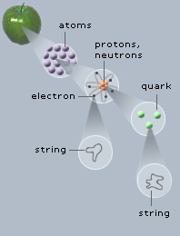
The String Theory: The Holy Grail?
A theory to unify quantum mechanics and general relativity (all known forces).
Every particle boils down to vibrating strings .
The difference in vibration makes up each atom and gives them their properties.
All forces (and phenomena) in existence described in one equation.

Slide 9
Problems of The String Theory
Theory included a particle (a Tachyon) that was faster than the speed of light.
Theory required multiple dimensions.
No observation or experiment could discount the theory.
The mass-less particle. Later proposed as the graviton. A particle that governs gravity at atomic level and ultimately decided how small the strings are.
If an atom were the size of the solar system, a string would be the size of a tree.

Slide 10
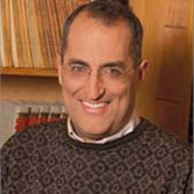
The String Theory Expands
Five correct versions of the theory condensed to one by Edward Witten at a USC string theory conference.
If we could master the rhythms of strings then we could explain all the matter, forces, and phenomena in nature from the biggest things (planets, galaxies) to the smallest quantum particles.-
Edward Witten (Einstein’s successor?)

Slide 11

The Possibilities are Infinite
11 dimensions were needed for the 5 string theories to combine into one. Multi-dimensions are at the heart of the string theory.
The degrees of freedom we (and what we can observe) have locked us in to three dimensions of space and one of time. While strings do not have the same limitations they can traverse all 11 dimensions.
The 11th dimension allows strings to stretch into membranes that can grow to enormous sizes (like the size of a universe).
Eleven dimensions, parallel universes, and a world made out of strings. It's not science fiction, it's string theory.

Slide 12
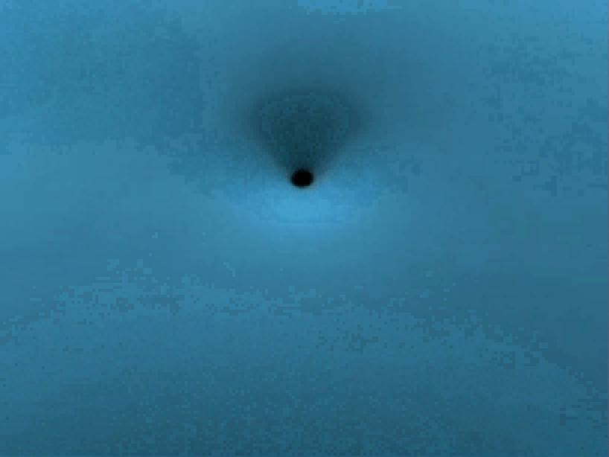
Science or Philosophy
We live in a three dimensional plate that traverses a 11 dimensional spatial universe.
It is conceivable that our universe is just one membrane that is a part of an infinite number of membranes. However, those membranes could reside in 5, 6, or 7 dimensions. Therefore, they could be right next to us but our three dimensional existence could never interact with them, but strings could.
Multi dimensions could explain why gravity is so weak in our universe. Gravity could be just as strong as the other forces, but gravity could be a force that works in 5 or 6 dimensions and is weak in our three dimensional space.

Slide 13
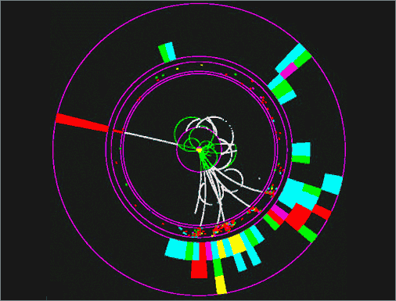
The Future of String Theory
Fermi Lab is already doing tests on their particle accelerators to find the presence of the graviton when conducting experiments.
CERN, a French particle physics laboratory, is 7 times stronger than Fermi. It will look for sparticles (super symmetry) and gravitons (or absence of).
The better the atom smashers the better chance we have of finding these particles and furthering the theory.
This is a simulation of the production and decay of supersymmetric particles in a proposed linear collider detector. The straight line is a lepton, the tracks are two overlapping jets of particles, and several invisible particles are inferred by conservation of energy and momentum.

Slide 14
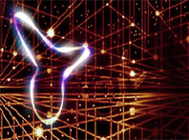
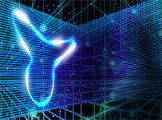
Implications for E.T.
The theory has pre-big bang explanations.
Two membranes in a four dimensional space collided and all the laws, constants, and make up from the two four dimensional membranes combined into our existence.
There is no reason why life (intelligent) has to be limited to four dimensions.

Slide 15
More Implications for E.T.
Would a proven theory make it harder or easier to search for E.T.
Would this expand our possibilities?
The theory accounts for hyperspace, traveling faster than light, multiple dimensions, strings traversing different universes.
Will the theory help in finding bacterial life forms since it can determine the behavior of basically everything at its core (i.e. where certain particles, bacteria, is limited to, how nature “picks” certain molecules)?
Will knowing the behavior of everything about our four dimensional universe help us flesh out where we should look in our universe?
Can the theory go far enough to determine how humans came to be and the possibilities of it happening elsewhere?

Slide 16
References and Information
http://superstringtheory.com/experm/exper3.html - Basics of String Theory
http://superstringtheory.com/basics/basic5.html - Basics of String Theory
http://www.sukidog.com/jpierre/strings/ - Basics of String Theory
Superstrings: A Theory of Everything?, ed. P.C.W. Davies and J. Brown, Cambridge University Press, 1988;
E. Witten, Reflections on the Fate of Spacetime, Physics Today, April 1996.
http://public.web.cern.ch/Public/Welcome.html - CERN Website
Hyperspace: A Scientific Odyssey Through Parallel Universe, Time Warps, And The Tenth Dimension by Michio Kaku
The Elegant Universe; Superstrings, Hidden Dimensions, And The Quest For The Ultimate Theory by Brian Greene

