Slide 1
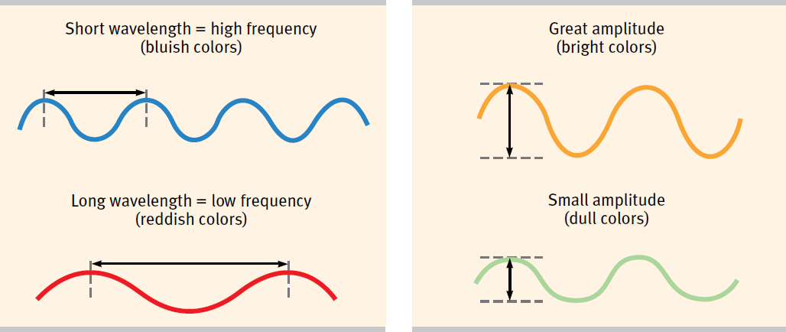
The Physical Property of Waves

Slide 2
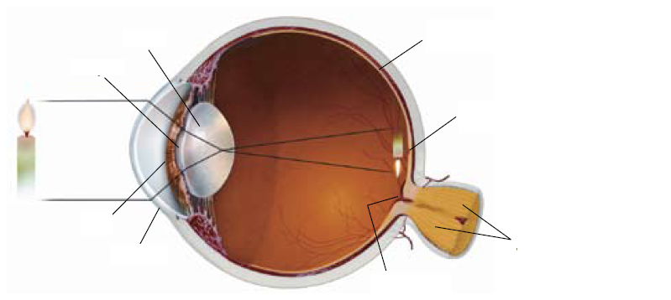
The Structure of the Eye

Slide 3

The Structure of the Eye
Cornea - outer covering of the eye.

Slide 4
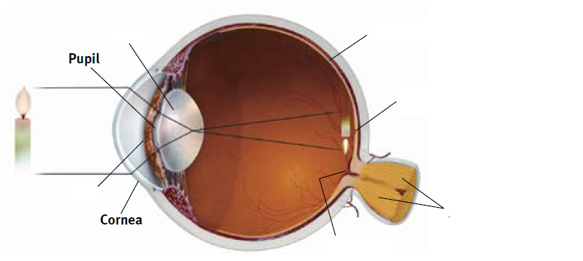
The Structure of the Eye
Pupil - the adjustable opening through which light enters.

Slide 5

The Structure of the Eye
Iris - the colored portion of the eye that controls the size of the pupil opening.

Slide 6

The Structure of the Eye
Lens - structure behind the pupil that focuses images on the retina.

Slide 7

The Structure of the Eye
Retina - the light-sensitive inner surface containing rods and cones.

Slide 8
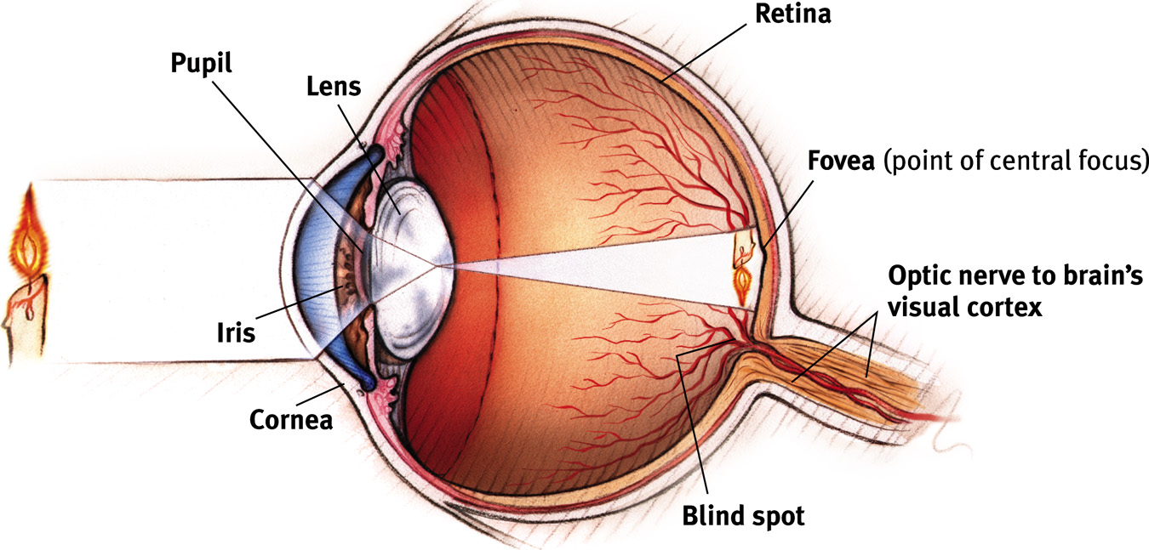
The Eye

Slide 9
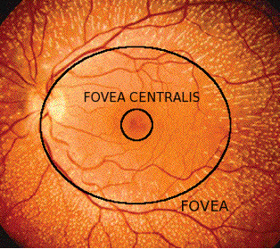
Fovea
Central Fovea (Fovea Centralis)
responsible for visual acuity and color sensitivity.

Slide 10
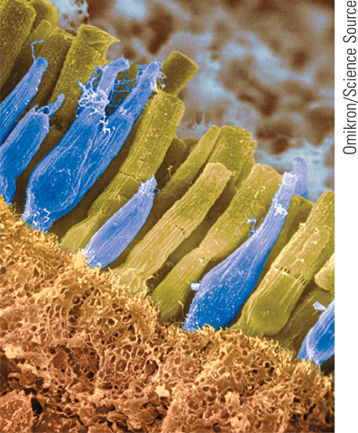
The Retina
Rods (black and White)
Cones (color)
Rods are more light
sensitive than cones.
Rods
Cones

Slide 11
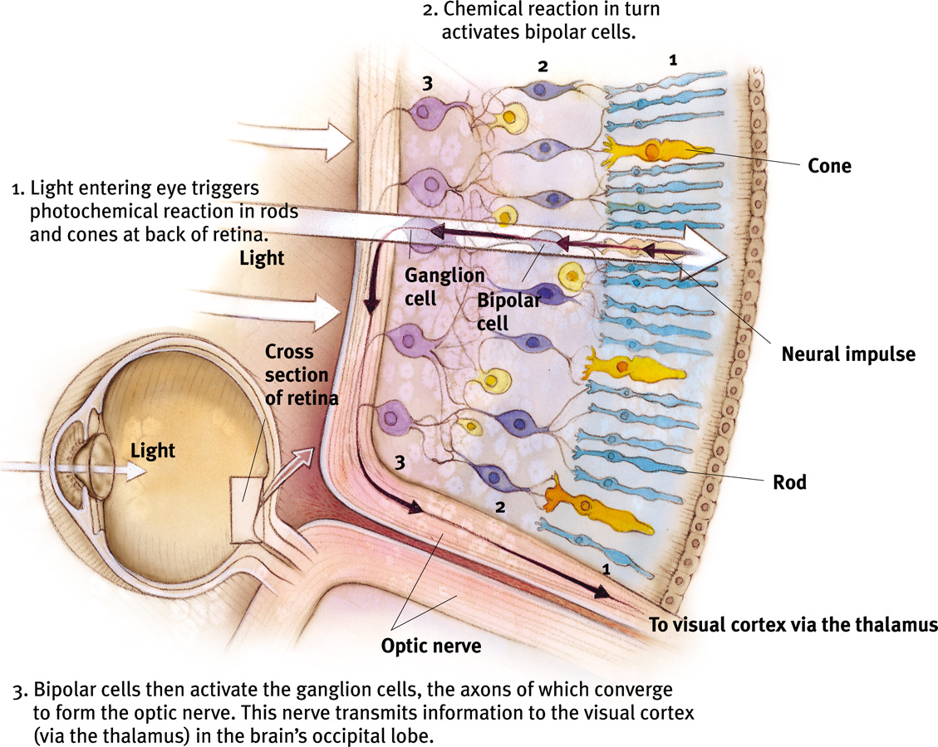
Transduction occurs in the Retina

Slide 12
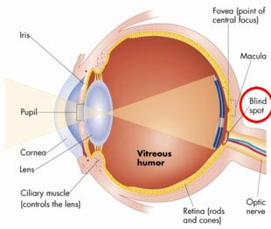
Find Your Blind Spot
Video

Slide 13
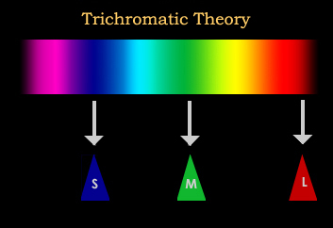
Trichromatic Color Theory
(Young-Helmholtz)
We see color due to the
RED
GREEN
BLUE
Cones in the retina

Slide 14
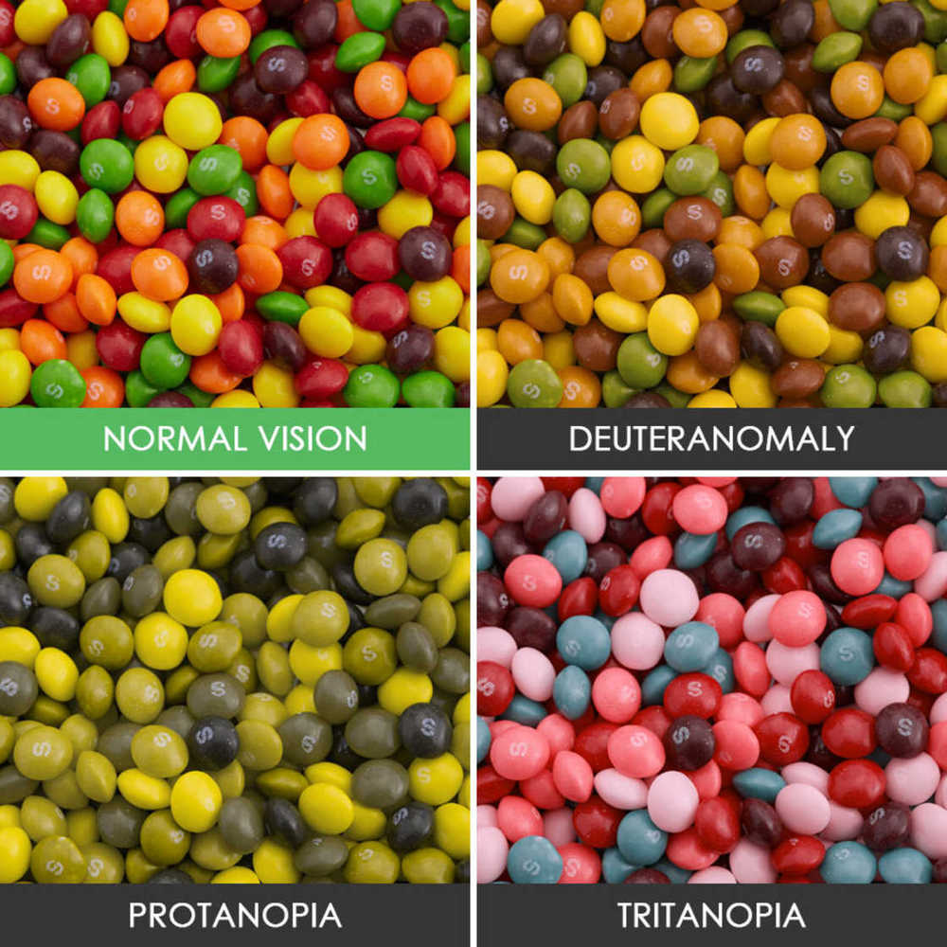
Color Blindness
Notes:
Deuteranomaly – green deficient
Tritanopia – blue deficient (very rare)
Protanopia – red deficient

Slide 15
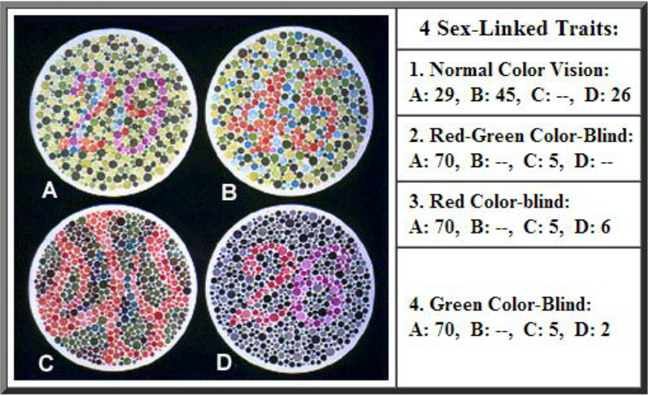
Color Blindness Tests

Slide 16
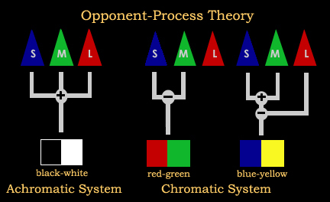
Opponent Process Theory
In the optic nerve, neurons work in pairs to process color.
Red vs. Green
Blue vs. Yellow
Black vs. White
This theory helps us explain the after-image effect

Slide 17
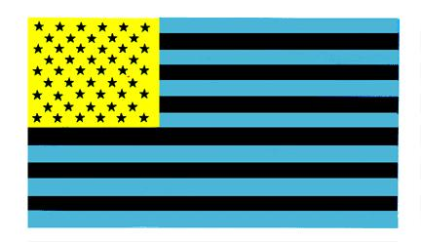
Opponent Process Theory

Slide 19

Neuroscience of Ghosts!

