Slide 1
Telescopes
Instrument to gather as much EMR as possible and concentrate it into a focused beam.
Optical telescopes gather visible light.
Other telescopes gather invisible parts of EMR spectrum.

Slide 2
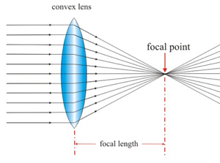
Optical Telescopes
Refracting Telescopes:
Use 2 lenses and tube. Light is refracted (bent) as it passes through lens.
The eyepiece lens magnifies the image.

Slide 3
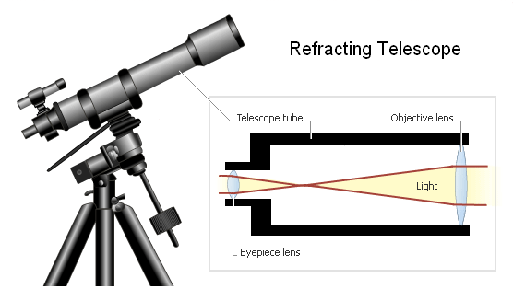

Slide 4
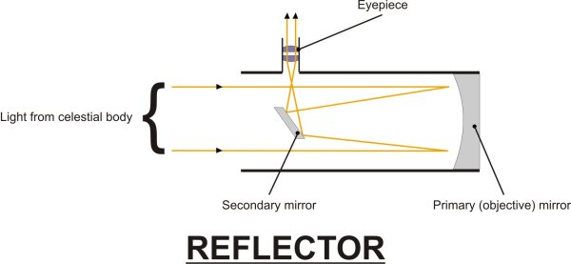
Optical Telescopes
Reflecting Telescopes:
Use 2 mirrors instead of lenses.
Light reflects off curved primary mirror to flat secondary mirror tilted toward eyepiece.

Slide 5
Advantages-Disadvantages
Refractor -
Advantages:
  Easy to handle, small and portable.
  Relatively inexpensive.
  Disadvantages:
  Lens can distort image since wavelengths focus at different points of lens (like prism).
  Two sides of lens to polish
  As the lens gets bigger, the glass sags and causes distortion.

Slide 6
Advantages-Disadvantages
Reflector -
Advantages:
  Light is reflected evenly; no distortion.
  Large mirrors are cheaper and lighter than large lenses.
  1 side of mirror to polish, not 2.
  Disadvantages:
  Large and hard to handle.

Slide 7
Large Telescopes
Resolution = ability to form distinct separate image.
Earth’s atmosphere blurs image before it reach the telescope -- caused by refraction.

Slide 8
Best Conditions
Dark
High
No weather -
top of a mountain…good
top of mountain range…no good

Slide 9
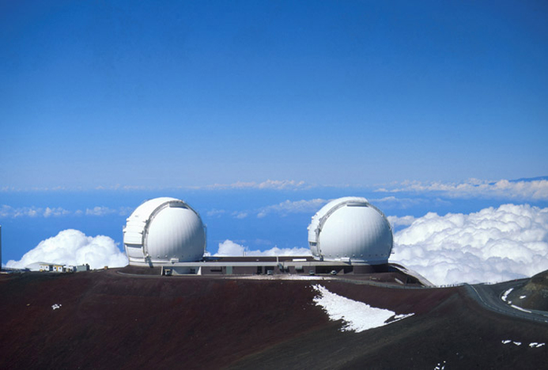
Keck Observatory
Two 10-meter mirrors composed of 36 hexagonal segments each.
Atop Mauna Kea volcano in Hawaii - ~14,000 feet.
No mountain ranges to effect atmosphere or city lights to spoil view.

Slide 10
Radio Astronomy
Telescope detects radio waves.
Need large surface to detect faint waves.
Can be used 24 hours a day.
Some objects only emit radio waves.

Slide 11
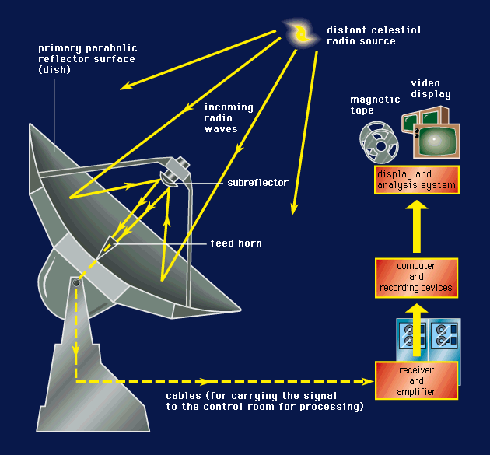

Slide 12
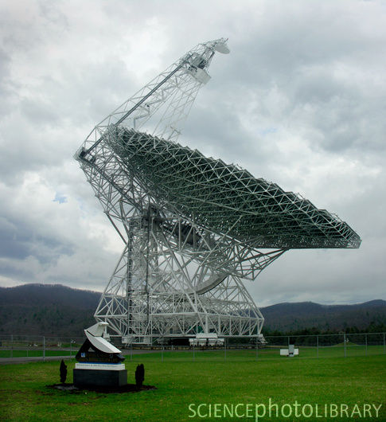

Slide 13
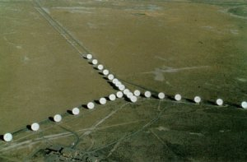
Interferometry
Using two or more telescopes together.
Only possible since computer speeds can handle data.

Slide 14
Other Types
Shorter wavelengths are difficult because this radiation is not easily reflected… it passes through everything.
Infrared wavelengths
Ultraviolet wavelengths
X-ray wavelengths - Chandra Telescope

Slide 15
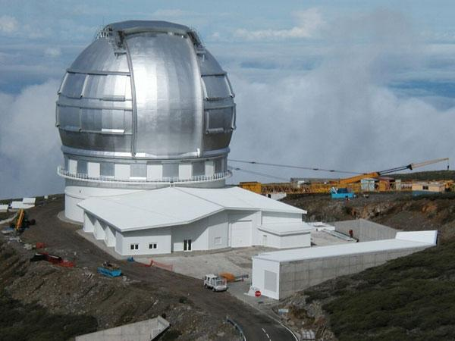
Largest Reflectors

Slide 16
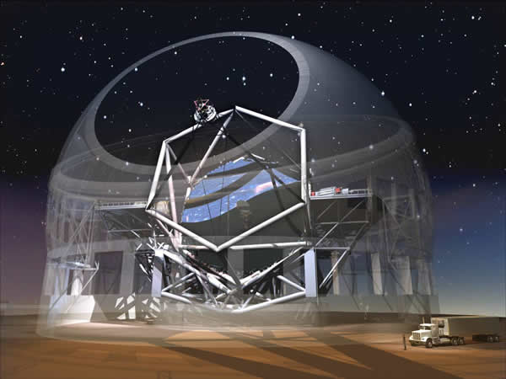
30 Meter in 2018

Slide 17
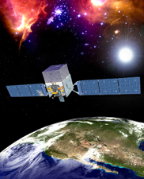
Fermi Gamma Ray Telescope

Slide 18
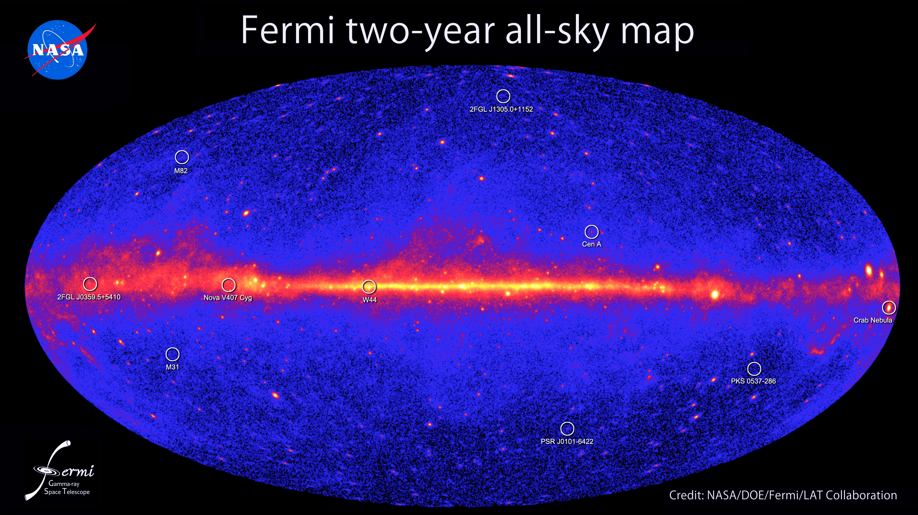
600 out of 1,873 sources are mysteries.

Slide 19
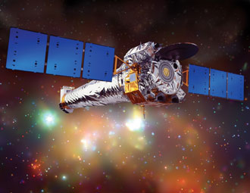
Chandra X-Ray Telescope

Slide 20
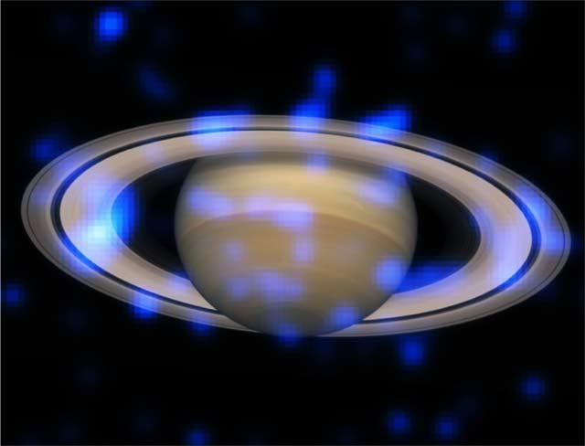
Saturn’s Rings’ X-Ray Sparkle

