Slide 1

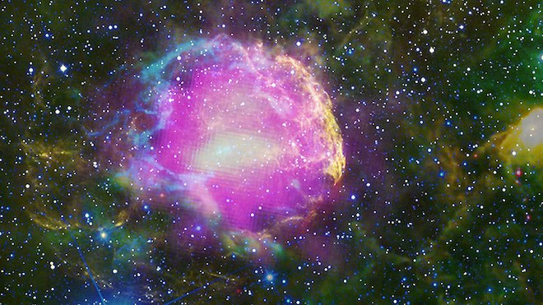
Supernovas
When gravity wins… core collapses and a star explodes.
Type I and Type II
Rare: occur every 50-100 years in a galaxy.

Slide 2
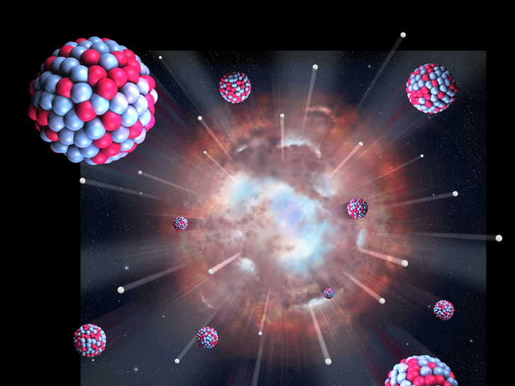
Supernovas
The only way most elements form.
Expanding shock wave can trigger the formation of new stars…like our Sun

Slide 3
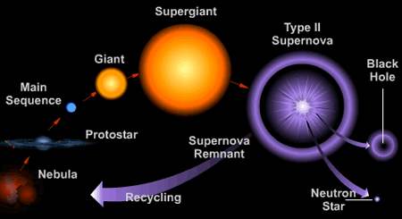
Life Cycle of Large Star

Slide 4
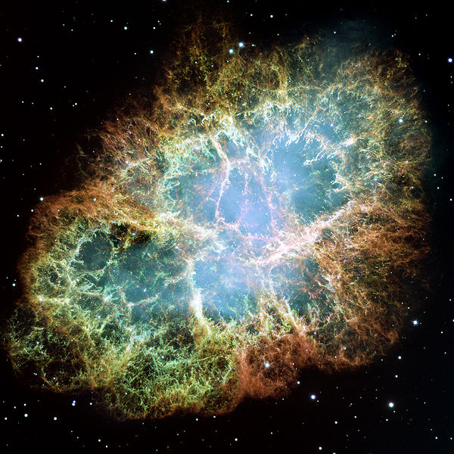
Crab Nebula

Slide 5
Observations
Earliest recorded SN by Chinese in 185 AD.
First widely observed SN in 1054 - created the Crab Nebula.
Last one observed in 1604 (by Kepler).

Slide 6
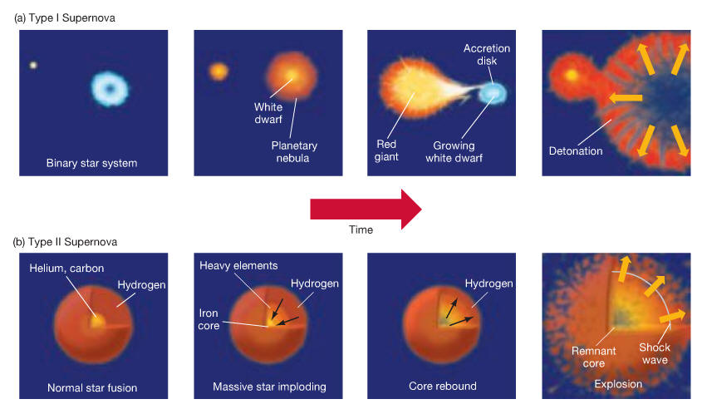
Supernova Types
Type I = no hydrogen
Type II = hydrogen

Slide 7
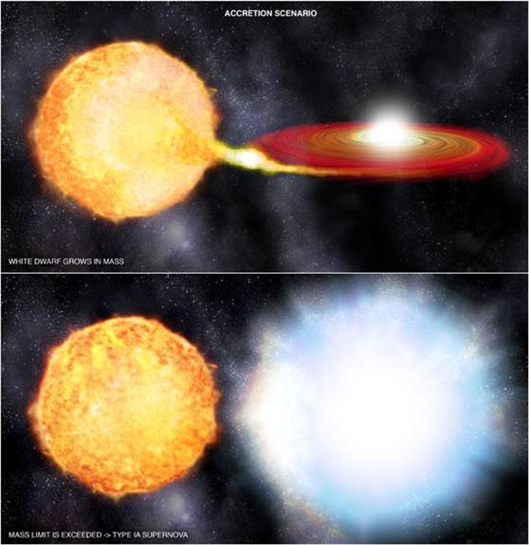
Type I
White dwarf steals matter from a companion star.
Once matter reaches 1.4 solar masses, star explodes within seconds…leaving nothing.

Slide 8
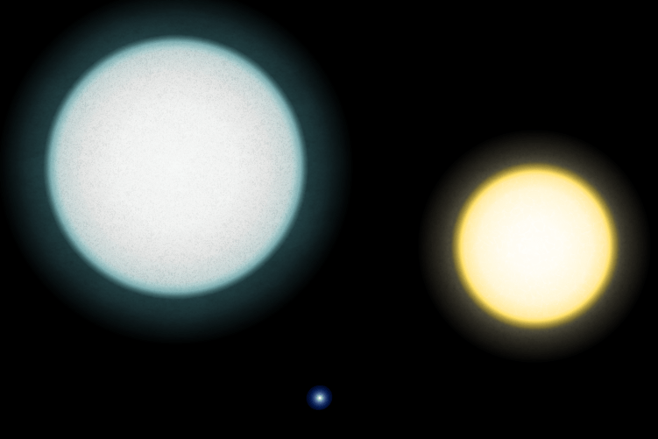
Type A_White Dwarf_Sun

Slide 9
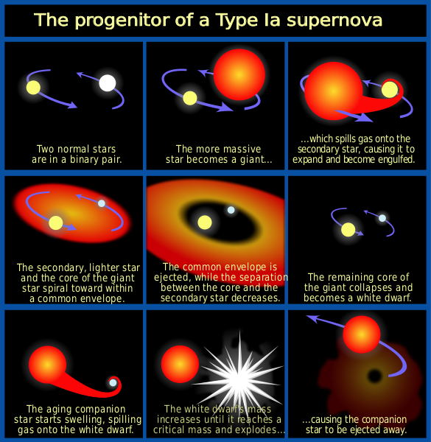

Slide 10
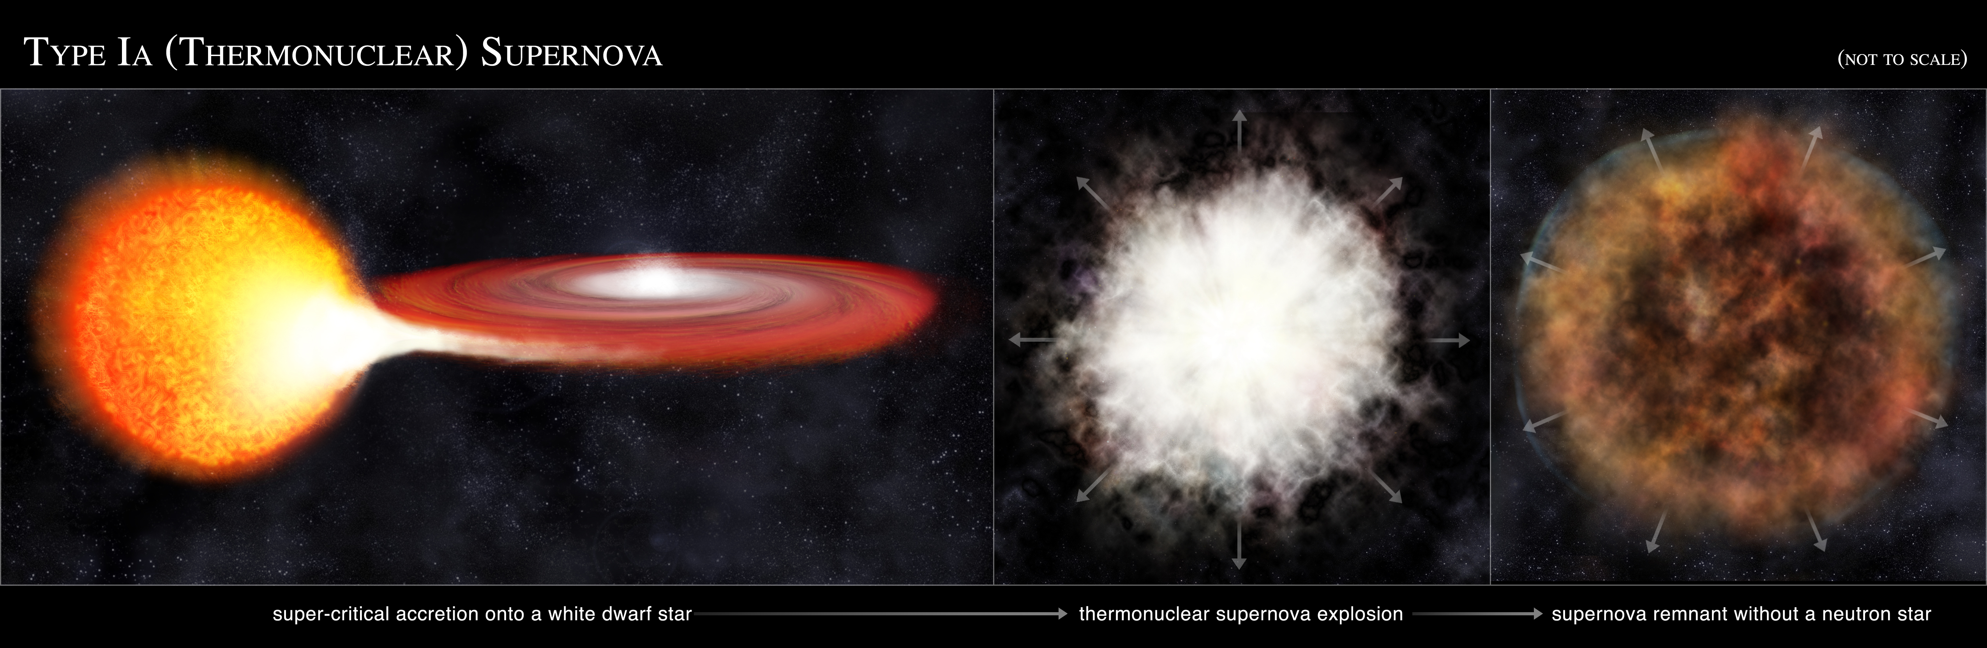

Slide 11
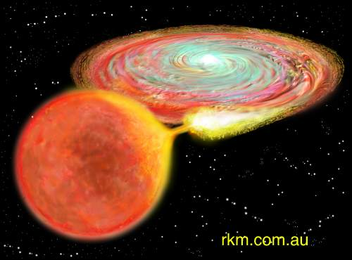

Slide 12
Type II
When a big star (8x mass of sun) explodes
Explosion produces more energy than our Sun will produce in its lifetime.

Slide 13
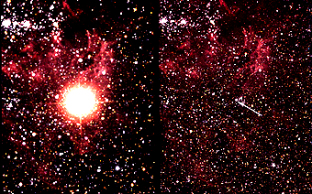
SN 1987A – before/after

Slide 14
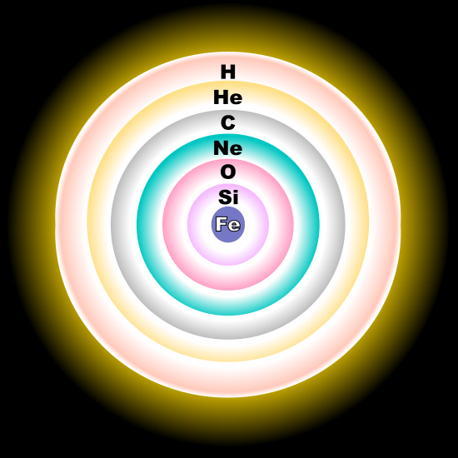
Type II
How it happens:
Elements fuse until only iron is left.
Iron will not fuse…
within seconds gravity collapses core, then it rebounds and explodes.

Slide 15
Type II
If less than 20x mass of sun, neutrinos stop complete collapse… creating neutron star.
If more than 20x mass of sun, neutrinos fail to stop collapse…. black hole is formed.

Slide 16
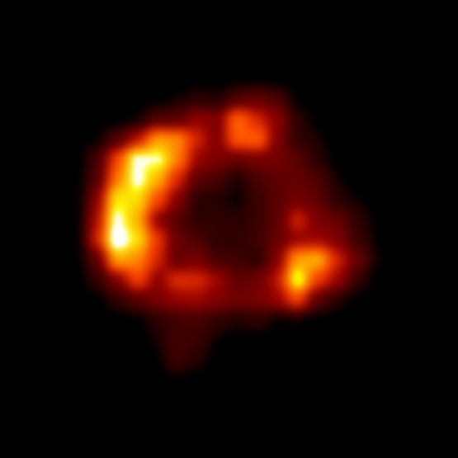
SN 1987A – early shock wave

Slide 17
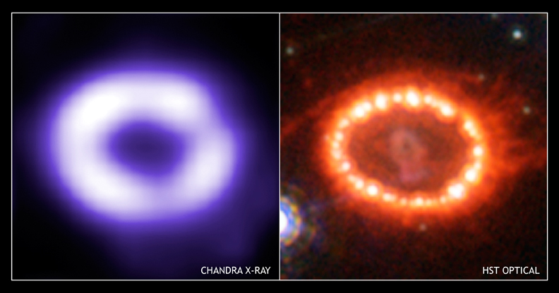
SN 1987A - shock wave (1999)

Slide 18
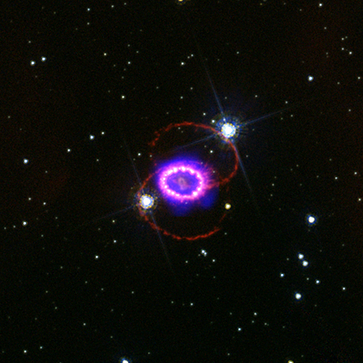
SN 1987A – Chandra (2005)

Slide 19
