Slide 2
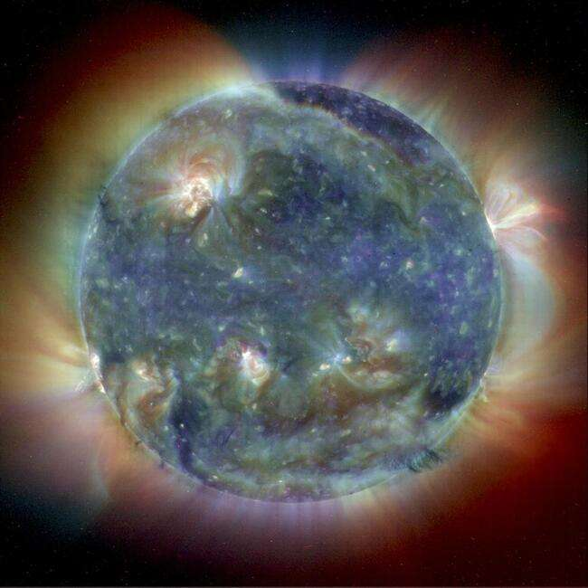

Slide 3
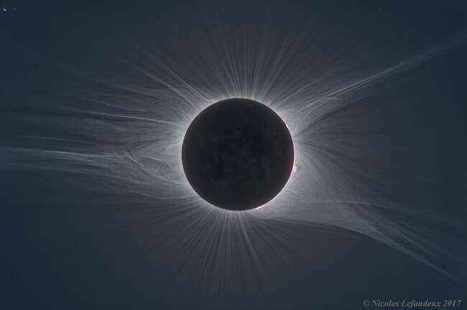

Slide 4
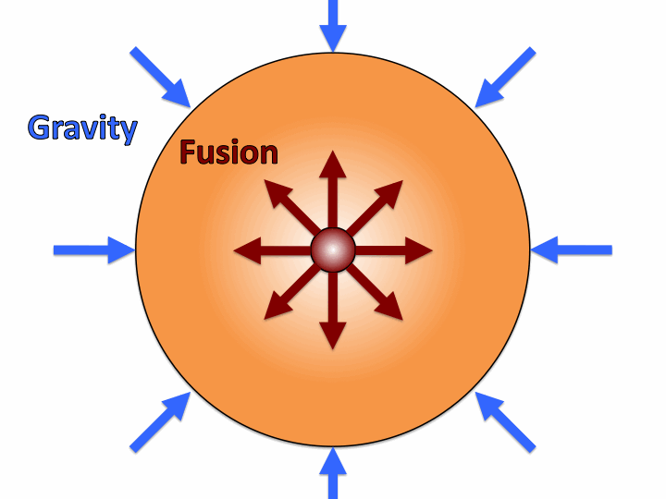
The Sun
The Sun is a star
Huge ball of plasma (electrically charged gas).
Hydrostatic Equilibrium
(Gravity vs. Fusion)
Gravity wants to crush the star
Nuclear Fusion wants to explode the star

Slide 5
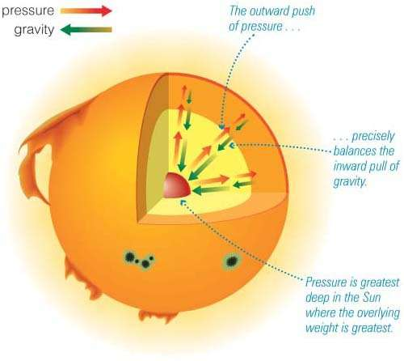
Hydrostatic Equilibrium

Slide 6
Facts
Rotation = 30 days (watch sunspots move.. none above 60 degrees latitude).
Revolution = 225 my to circle the Milky Way (cosmic year).
Surface Temp = 5,780 K
Core Temp = 15 million K

Slide 7

Plasma
Plasma - ionized gas (fourth state of matter)
most common phase of matter in universe.
reacts with magnetic fields
ionized = electrically charged

Slide 8
Facts
Density = average 1.41 g/cm³ (like Jupiter)
Volume = 1,000,000 Earths can fit inside.
Composition = 92% Hydrogen, 8% Helium

Slide 9
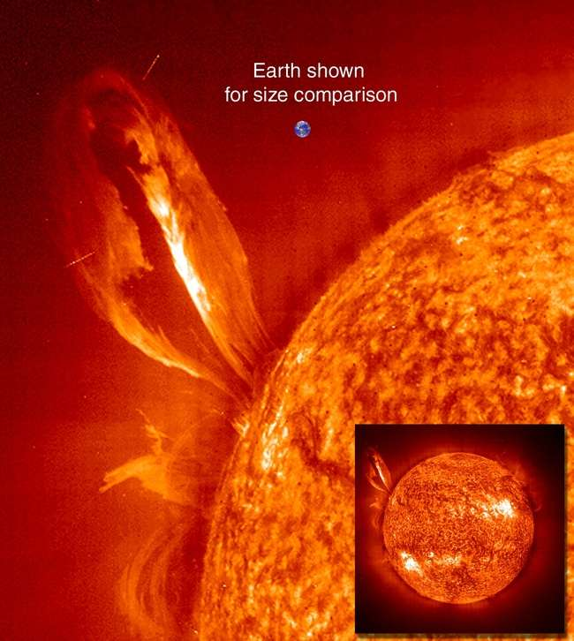

Slide 10
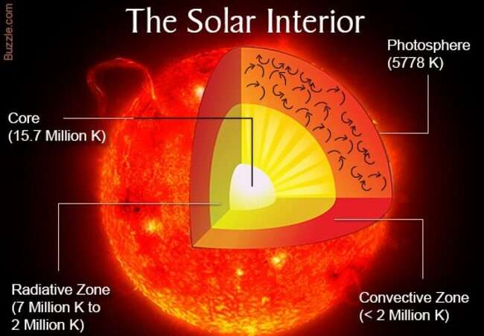
Interior
Core
15,000,000 K
nuclear fusion

Slide 11
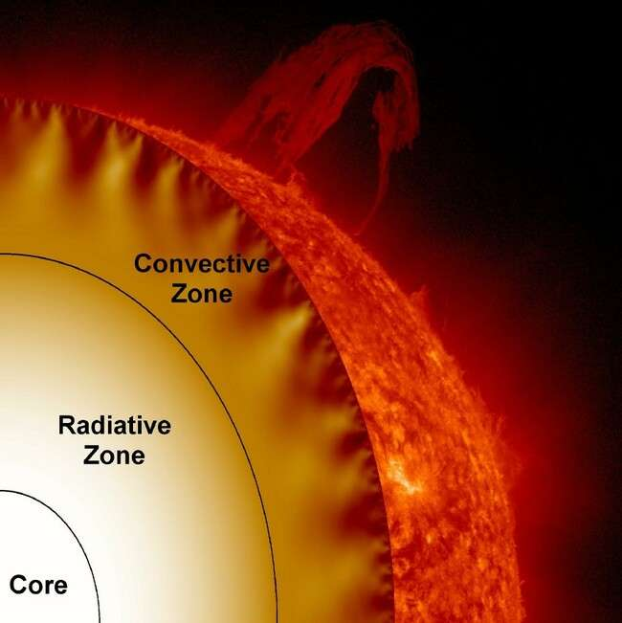
Interior
Radiation Zone - energy from core carried outward by radiation.
Convective Zone -
large bubbles of hot plasma convect to surface

Slide 12
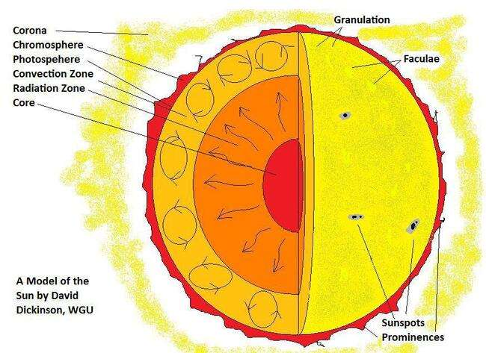

Slide 13
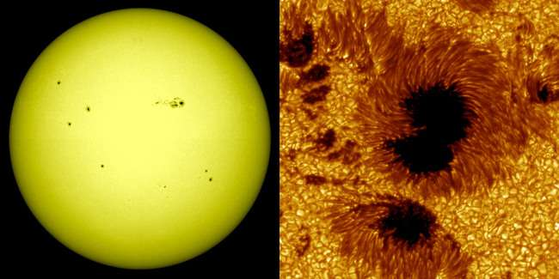
Surface
Photosphere
visible layer
Sunspots

Slide 14
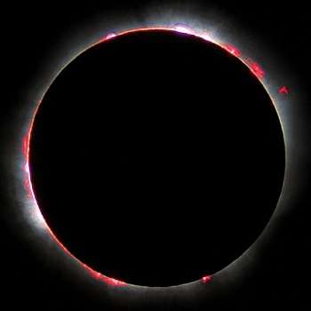
Atmosphere
Chromosphere
red layer above
photosphere

Slide 15
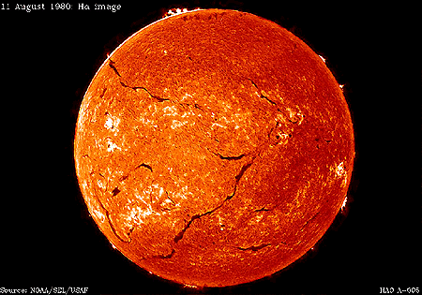

Slide 16
Atmosphere
6. Corona
-- uppermost layer
-- temperature increases (not sure why)
-- best seen during eclipses
Solar Wind - charged particles blown from the Sun.

Slide 18
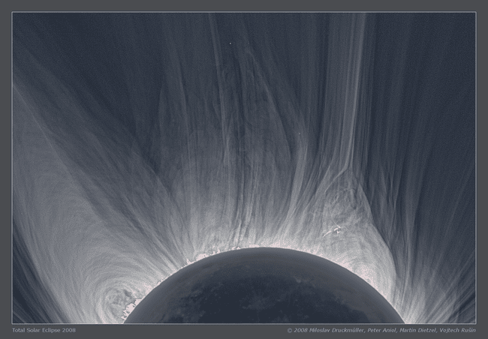

Slide 19
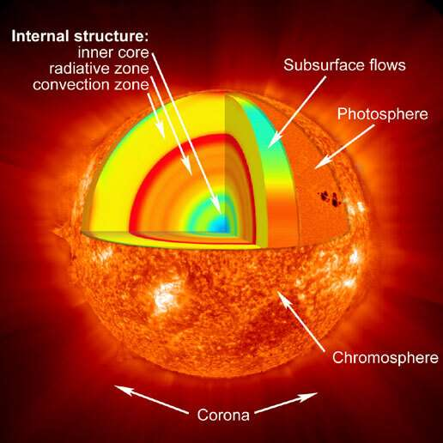

Slide 20

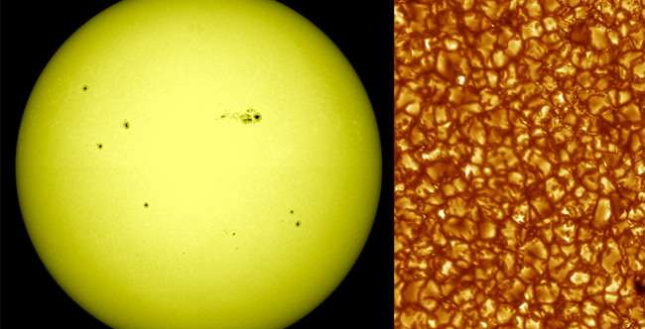
Granulation
Photosphere covered with regions of bright and dark gas known as granules.
Evidence of convection… bright gas rising, dark gas sinking.
Top of each convection cell is blue-shifted… which means gas is moving up.

Slide 21
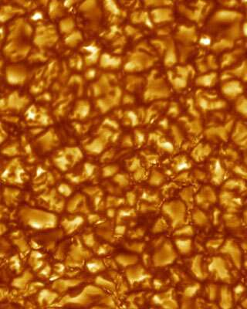

Slide 22
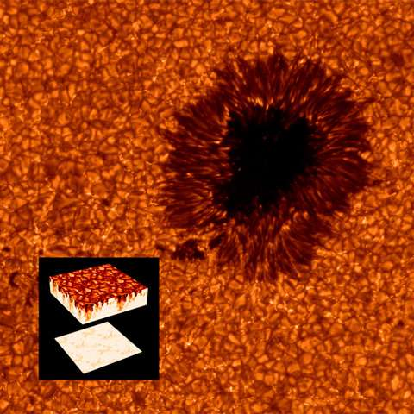

Slide 23
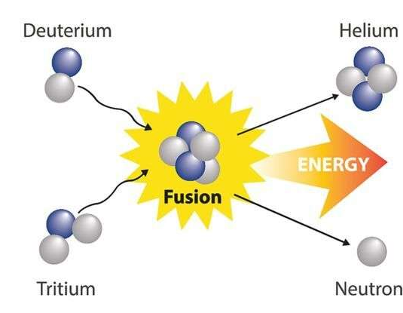
Nuclear Fusion
Combining lighter elements into heavier ones.
Mass of He is less than 4H = energy

Slide 24
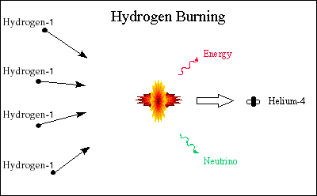

Slide 25
Sunspots
Dark spots on photosphere…relatively cool.
Sunspots occur in pairs.
Anywhere from hundreds to none at any time.

Slide 26
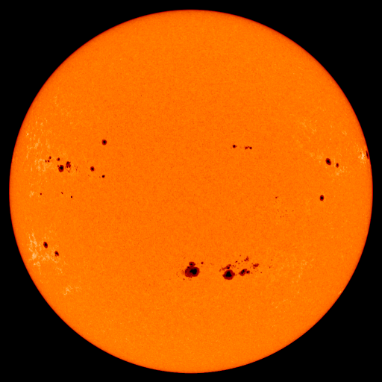

Slide 27
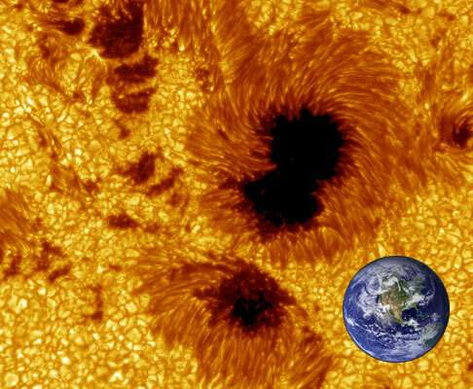

Slide 28
Sunspots
Magnetic field at sunspot is 1,000x greater than surrounding area.
Sunspots (and Sun) flip polarity every 11 years.

Slide 29
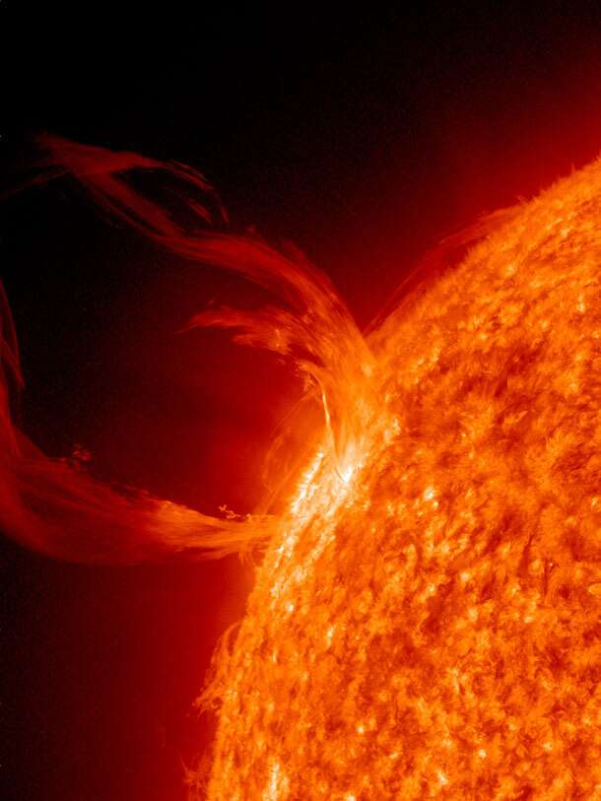
Solar Activity
Prominences Loops or sheets of glowing gas
Follow magnetic field lines

Slide 30
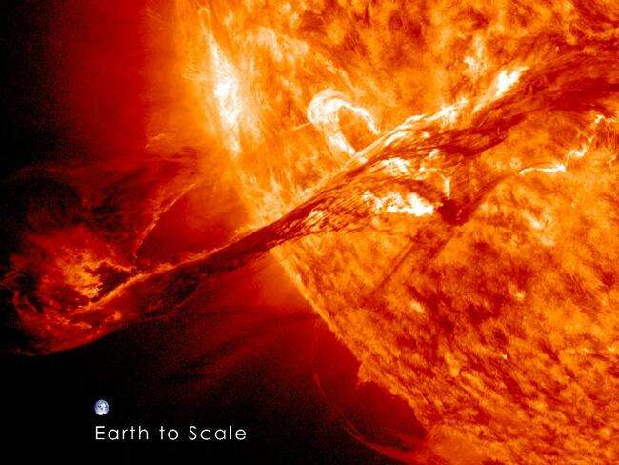

Slide 31
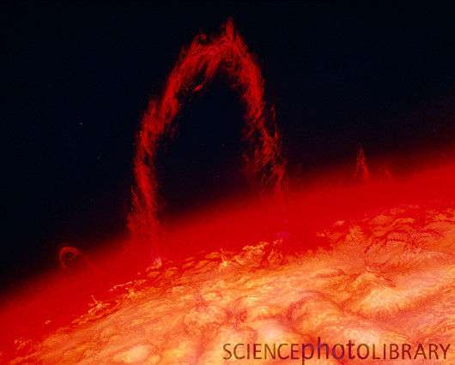

Slide 32
Solar Activity
Flares
more violent than prominence… blasts material into space.
temperatures up to 100 million K (6x hotter than core).
may effect astronauts, satellites, and communications.
Coronal Mass Ejection (CME) massive burst of solar wind released into space.

Slide 33
Solar Flares
X-class = major event that can trigger planet-wide radio blackouts and long-lasting auroras.
M-class = medium-sized; can cause brief radio blackouts that effect Earth’s polar regions.
C-class = minor storms with few noticeable effects on Earth.

Slide 35
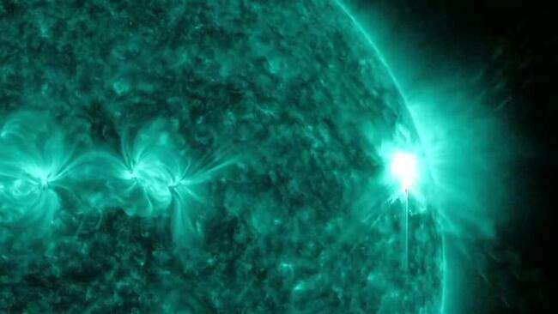

Slide 36
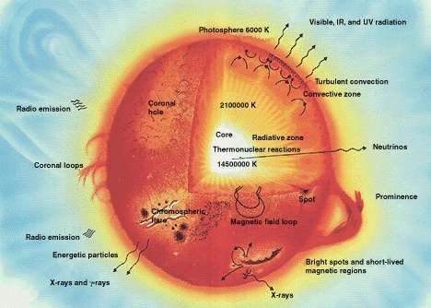

Slide 37
Spicules
Located on chromosphere
Jets of hot matter shoot out… look like thin spikes.

Slide 38
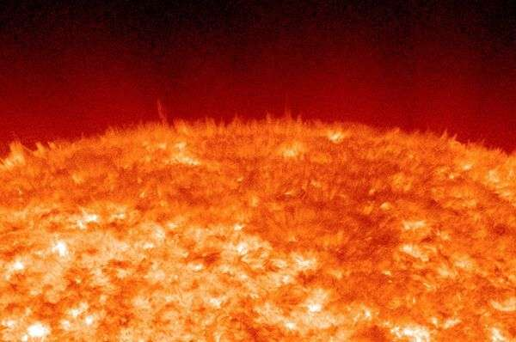

Slide 39
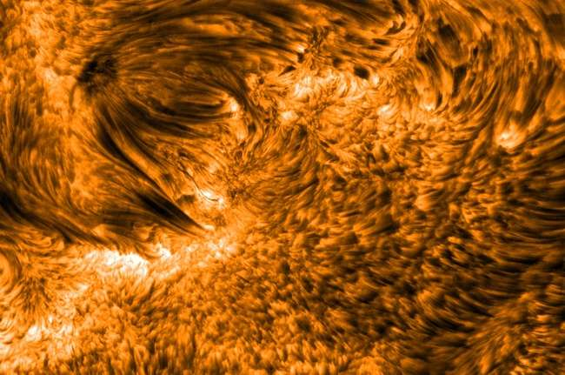

Slide 40
