Slide 1
What is Stress?
The process of appraising and responding to a real or imagined threat.
Stress is our reaction to something. It is not given to us.

Slide 2


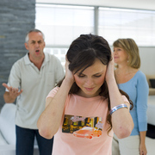

What are your SOURCES of stress?

Slide 3
Stressor
Events/circumstances that are potentially threatening.
Just because you experience a stressor doesn’t mean you will feel ‘stressed’

Slide 4
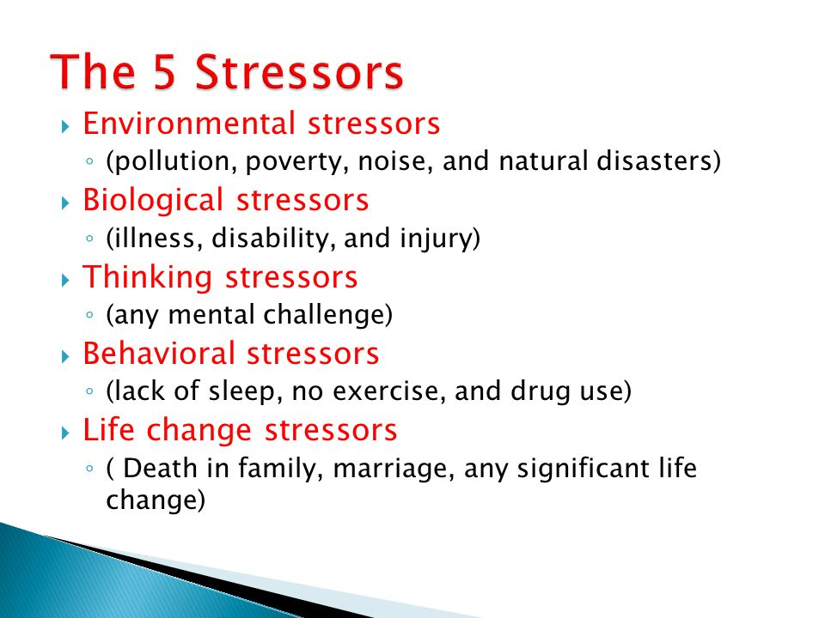

Slide 5
Types of Stressors
Conflict
Approach/approach conflict
When there is a conflict between two appealing possibilities
      Ex. Disney World or Hawaii (Regret)
Avoidance/avoidance conflict
When there is a choice between two undesirable possibilities
      Ex. Study or doing the dishes (Escape)
Approach/avoidance conflict
Simultaneously attracted to and repelled by the same goal
Ex. Medical procedure can fix problem, but may be risky

Slide 6
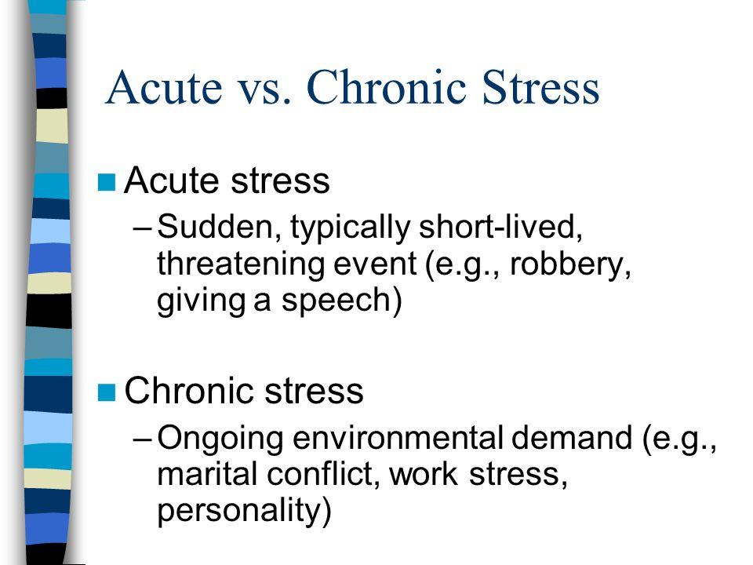

Slide 7
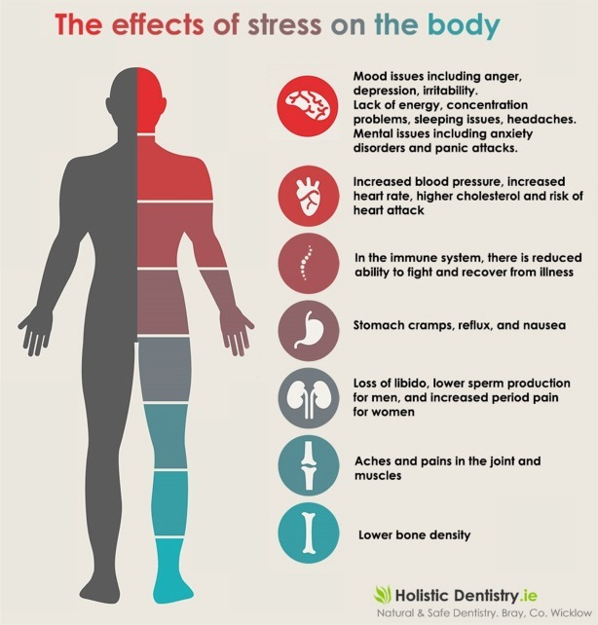

Slide 8
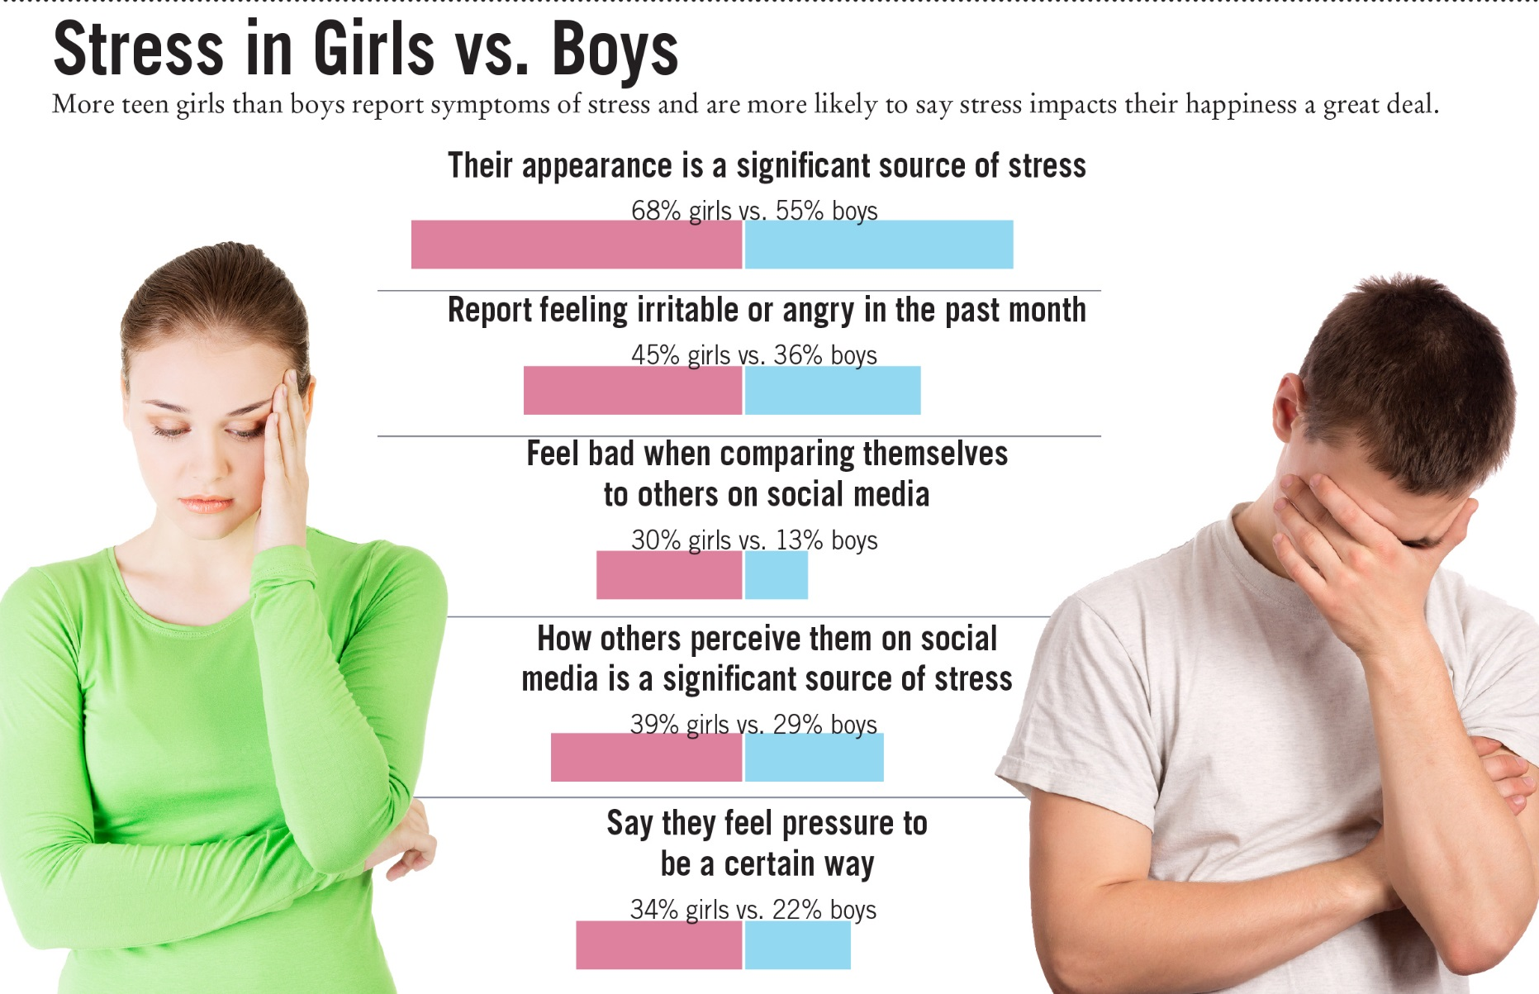
Gender Difference?

Slide 9
Teens and Stress
Many American teens report experiencing stress at unhealthy levels, appear uncertain in their stress management techniques, and experience symptoms of stress in numbers that mirror adults’ experiences.

Slide 10
SRRS – Social Readjustment Rating Scale
Life Event | Value
Death of Spouse | 100
Divorce | 73
Marital separation | 65
Jail term | 63
Death of close family member | 63
Personal injury or illness | 53
Marriage | 50
Fired at work | 47
Marital reconciliation | 45
Retirement | 45
Change in health of family member | 44
Pregnancy | 40
Sex difficulties | 39
Gain of new family member | 39
Business readjustment | 39
Change in financial state | 38
Death of close friend | 37
Change to a different line of work | 36
Change in number of arguments with spouse | 35
Home Mortgage over $100,000* | 31
Foreclosure or mortgage or loan | 30
Change in responsibilities at work | 29
Son or daughter leaving home | 29
Trouble with in-laws | 29
Outstanding personal achievement | 28
Spouse begins or stops work | 26
Begin or end school | 26
Change in living conditions | 25
Revision of personal habits | 24
Trouble with boss | 23
Change in work hours or conditions | 20
Change in residence | 20
Change in schools | 20
Change in recreation | 19
Change in church activities | 19
Change in social activities | 18
Mortgage or loan of less than $100,000* | 17
Change in sleeping habits | 16
Change in number of family get-togethers | 15
Change in eating habits | 15
Single person living alone | **
Other- describe | **
Total:

Slide 11
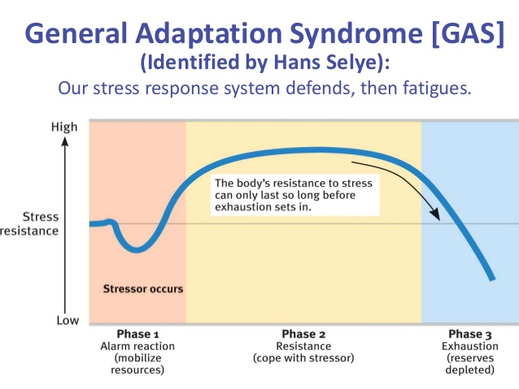
General Adaptation Syndrome
According to Selye, the stressed individual goes through three phases.

