Slide 1
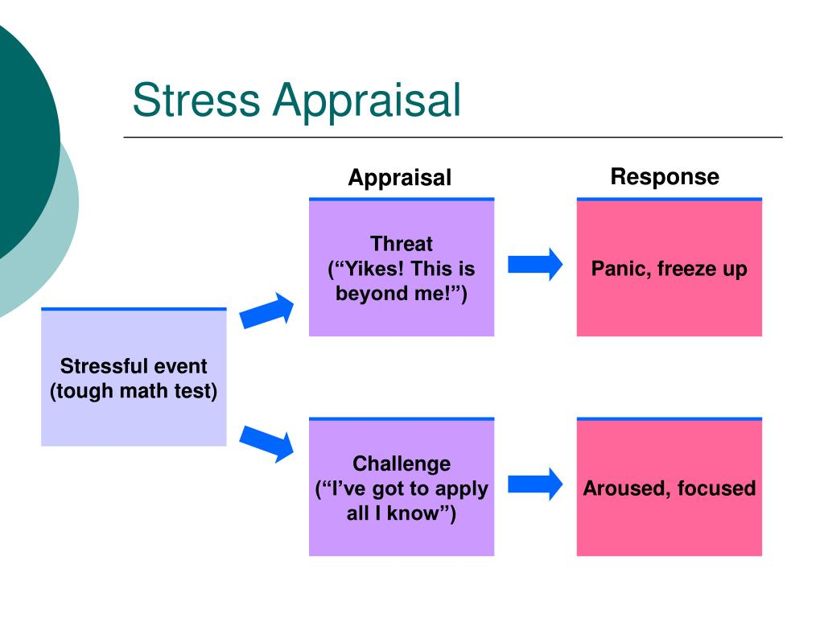
Appraisal Determines Stress Reaction
Differences in reaction to stress may be due to an individual’s appraisal.

Slide 2
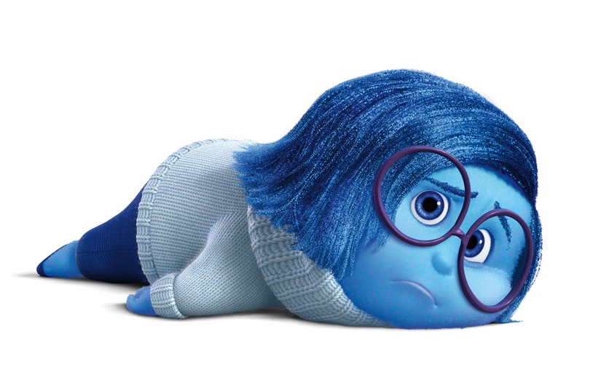
Harmful Appraisal
Irrational Negative Self-Talk
  Awfulize events
    I failed a test now I’m going to fail the course.
    I didn’t get into the college of my choice now my life will be a failure.
  Absolutize events
    I must be perfect vs. I can strive to do my best and learn from failures.
    Everything should go as planned vs. bad stuff just happens.

Slide 3
Type D Personality?
(Denollet et al) in the American Journal of Cardiology – 2006
Tendency to experience negative emotions
Tendency to inhibit these emotions
Tendency to isolate oneself

Slide 4
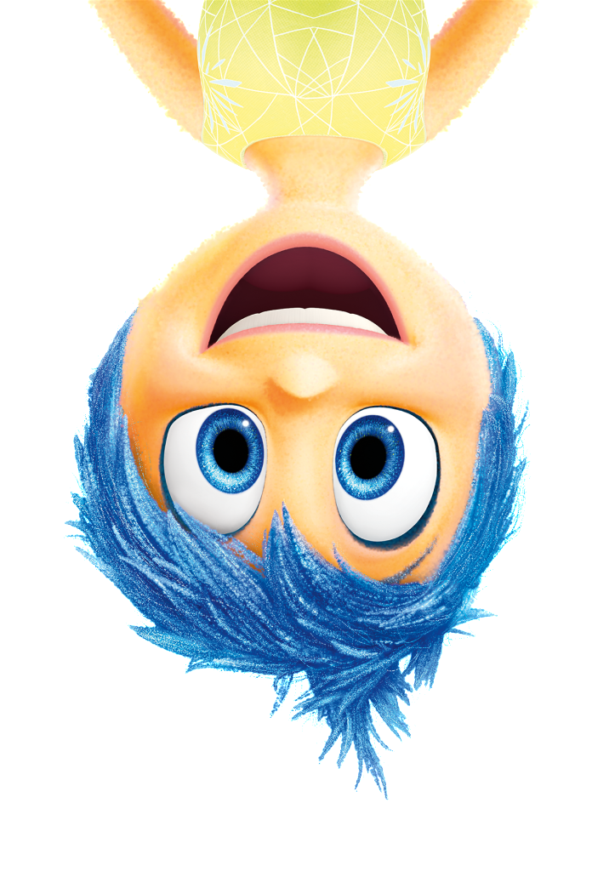
Stress Hardy
Optimistic Explanatory Style
  Well, that happened.
  I have some measure of control here
  This stressor is a challenge/new opportunity or maybe I can grow from this
  I have other people that can help me
Emotional Intelligence
  Self-Aware of emotional state
  Can moderate emotional state
  Can empathize with others

Slide 5
How do you make the switch?
Awareness - Stressor doesn’t cause the stress, my appraisal does.
Irrational negative self-talk is lightning quick so slow down the process to gain control.
Everything is exactly as it is. A caused B which led to C. The universe is not out to get you.
All humans make mistakes

Slide 6
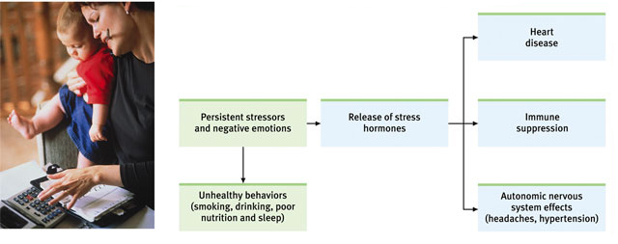
Health-Related Consequences
Stress can have a variety of health-related consequences.

Slide 7
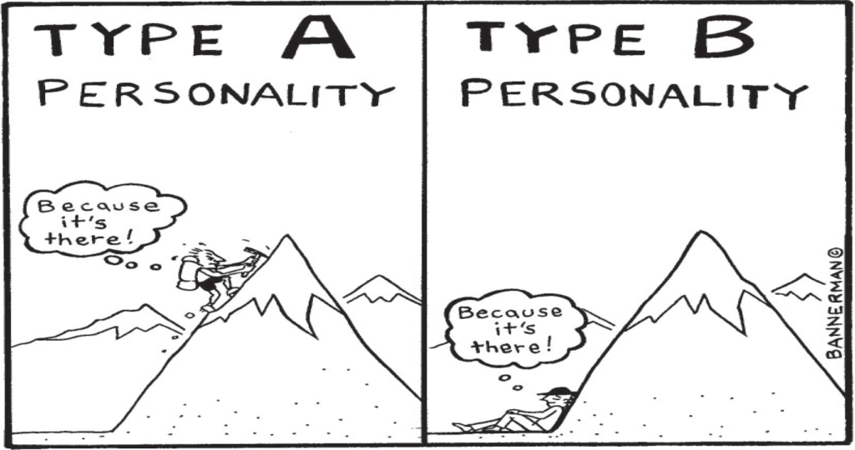
Stress and Heart Disease
Frequent or chronic stress can cause damage to the heart and blood vessels
Type A personality
  Competitive, impatient, verbally aggressive, and anger-prone
  Correlated with development of heart disease
Type B personality
  Relaxed and easygoing

Slide 8
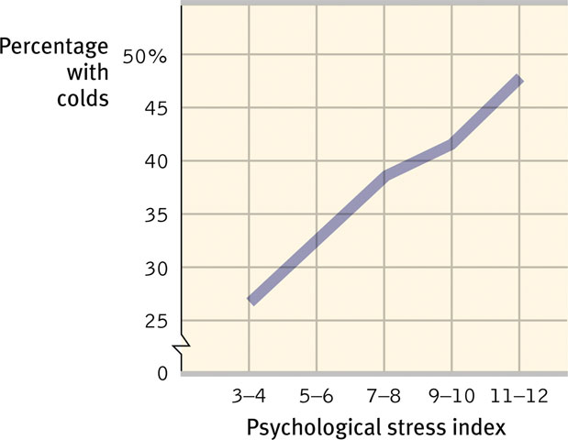
Stress and Colds
People with high stress scores were also the most vulnerable when exposed to a cold virus.

Slide 9
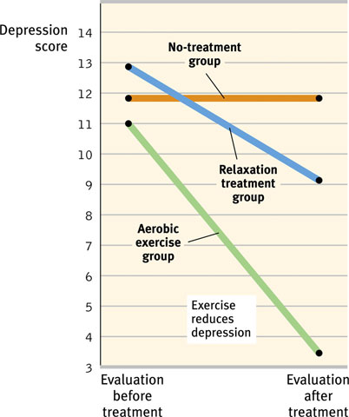
Aerobic Exercise
Many studies suggest that aerobic exercise can elevate mood and well-being.
Notes:
OBJECTIVE 16| Discuss the advantages of aerobic exercise as a technique for managing stress and fostering well-being.

Slide 10
Adopt a Healthy Lifestyle
Eat a well-balanced diet
Exercise
Avoid high risk behaviors
Moderation

