Slide 1
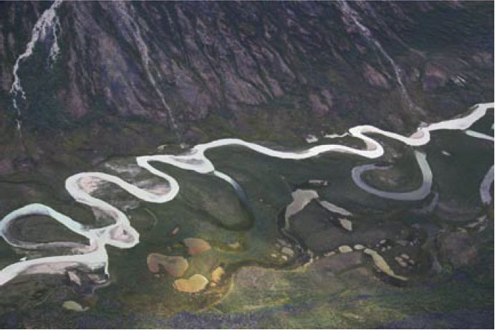
What are meandering streams?

Slide 2
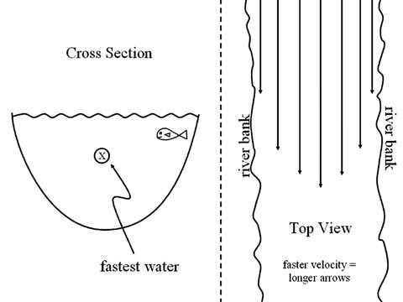
Straight Stream
Where does water travel fastest?
In the middle near the surface

Slide 3
Straight Stream
Why?
Friction

Slide 4
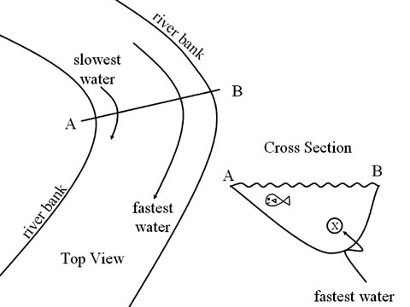
Meandering Stream
Where is water fastest?
outside corner
So, erosion occurs here
Where is water slower?
inside corner
So, deposition occurs

Slide 6
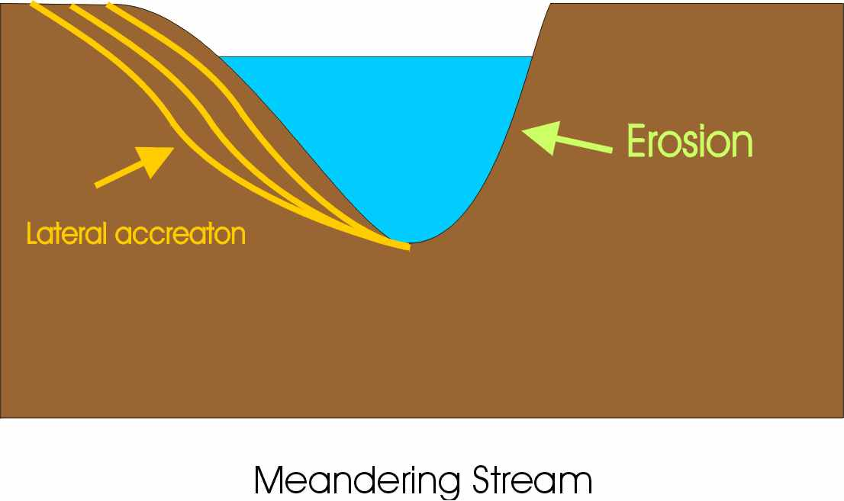

Slide 7
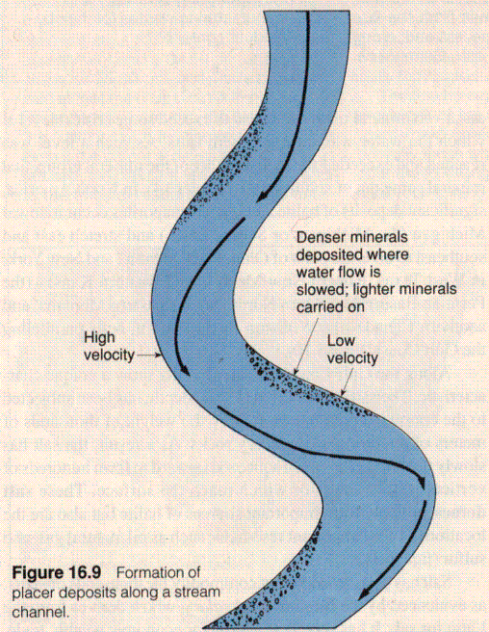

Slide 8
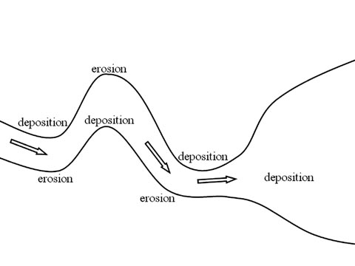
Meanders

Slide 9
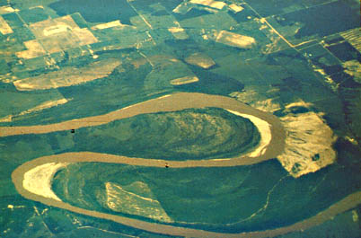

Slide 10
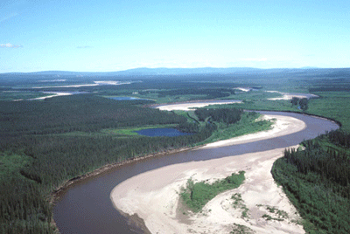
Cut Banks and Point Bars

Slide 11
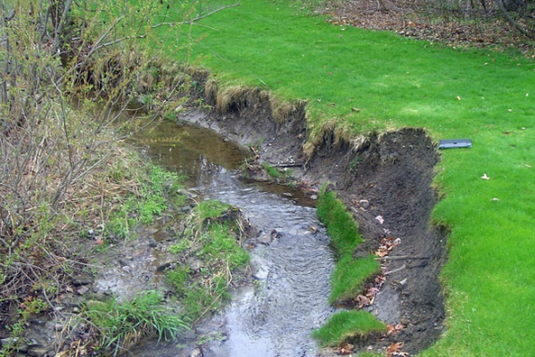

Slide 12
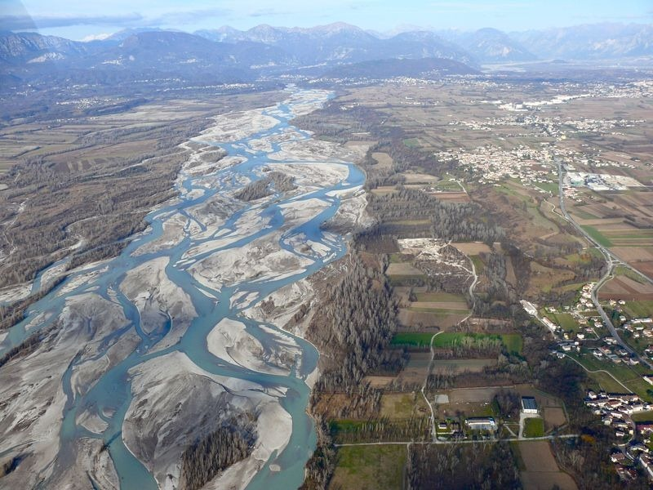
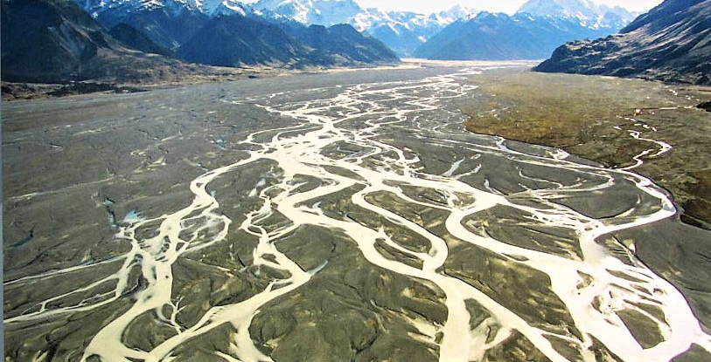
Braided River

Slide 13
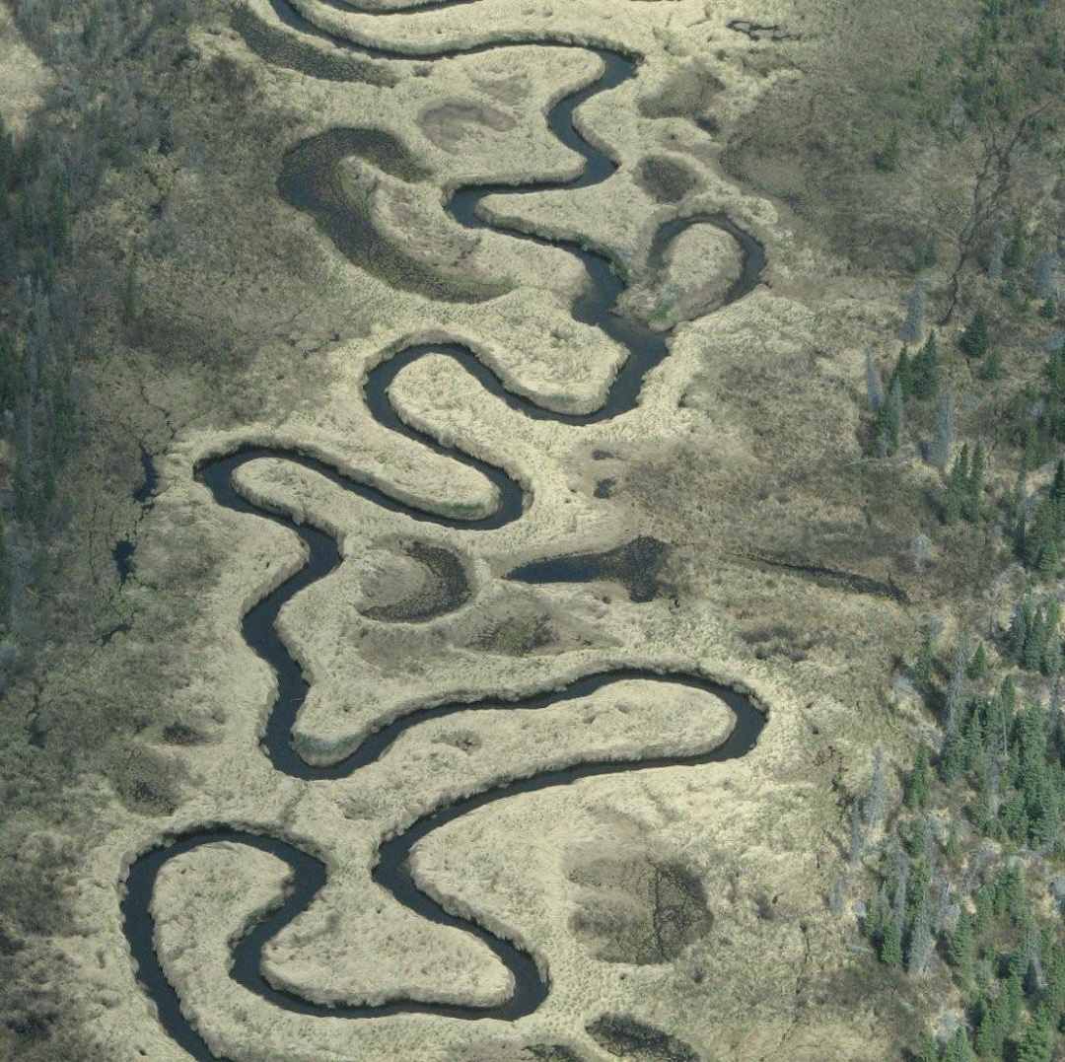
Oxbow Lake

