Slide 1

Inferential Statistics
When Is an Observed Difference Reliable?
Representative samples are better than biased samples.
Less-variable observations are more reliable than those that are more variable
More cases are better than fewer

Slide 2
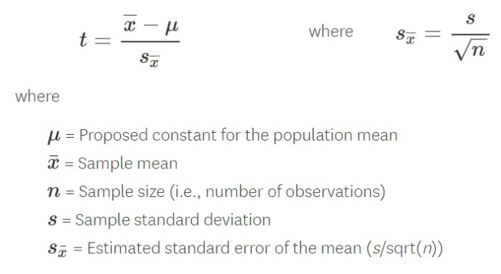
T-Test
If we have results (means) from two groups (experimental and control), is there a real difference between them or did it just happen by chance?
To answer the question, we must run a t-test.

Slide 3
T-test gives a P-value
From the T-test we can get a P-value that measures confidence in the observed difference.
It tells us whether the difference is real and not just by chance.
A P-value of less than 0.05 (<5%) is a common criteria for significance.
We call this statistically significant… there is less than a 5% probability the results are from chance.

