Slide 1
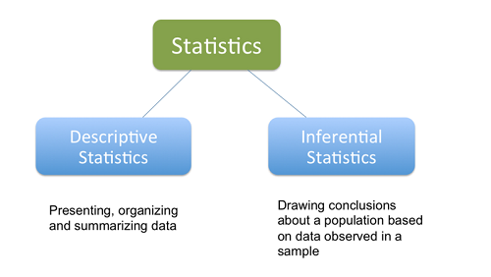
Descriptive Statistics
Notes:
1
OBJECTIVE 15| Explain the importance of statistical principles, and give an example of their use in daily life.

Slide 2
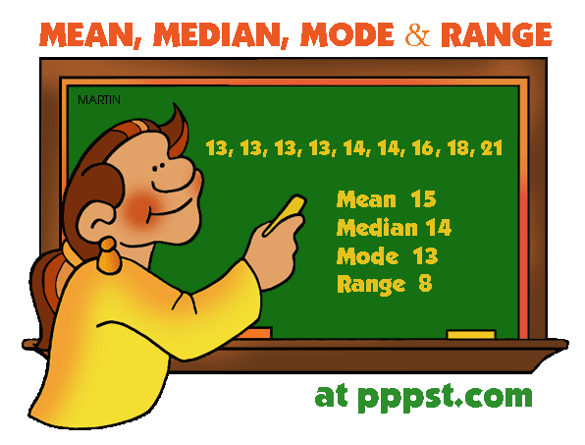
Measures of Central Tendency
Mode:
The most frequently occurring score.
Mean:
The average score. Add the scores
and divide by their number.
Median:
The middle score.
Notes:
2
OBJECTIVE 17| Describe three measures of central tendency and tell which is most affected by extreme scores.

Slide 3
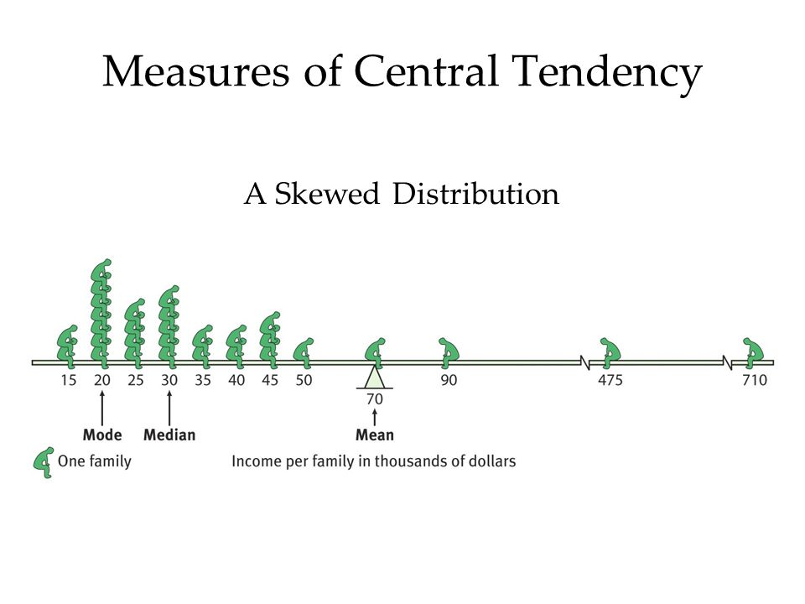
The mean doesn’t work in a skewed distribution
Notes:
3

Slide 4
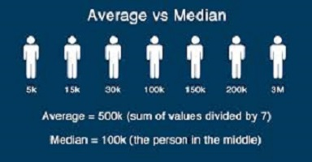

Slide 5
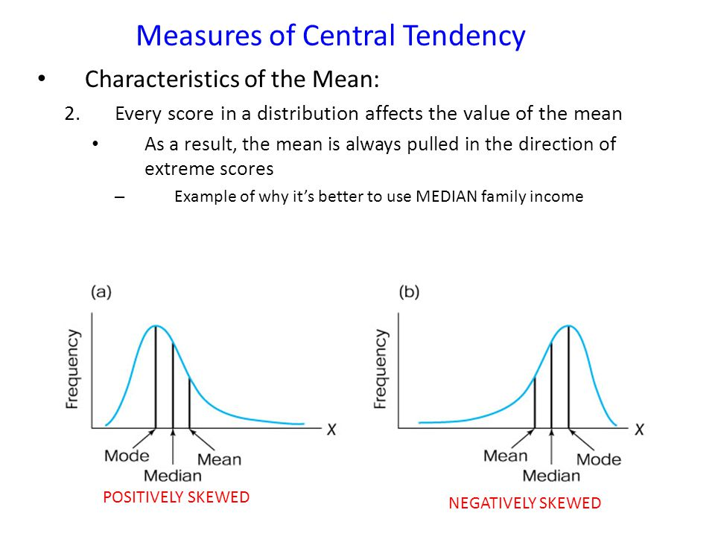

Slide 6
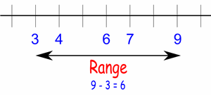
Measures of Variation
Statistical dispersion (how distributed the data points are).
Two keys to measuring statistical dispersion
  Range - The range simply gives the lowest and highest values of a data set.
  Standard Deviation
Notes:
6

Slide 7
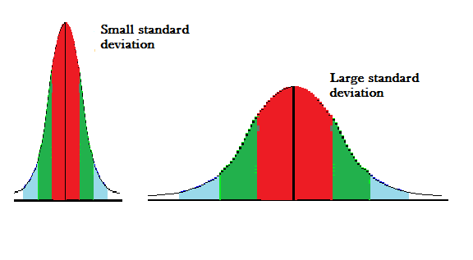
Standard Deviation
Standard deviation gives a measure of dispersion from the mean

Slide 8
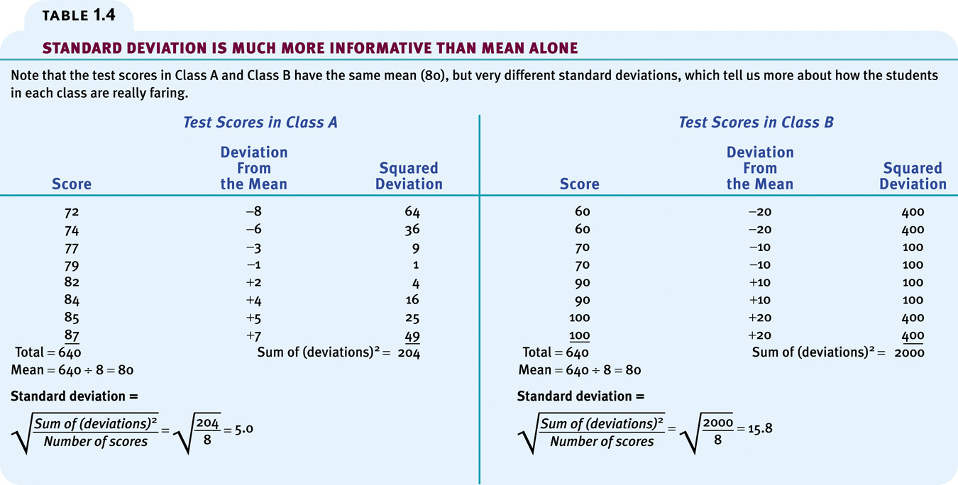
Standard Deviation
Notes:
8

Slide 9
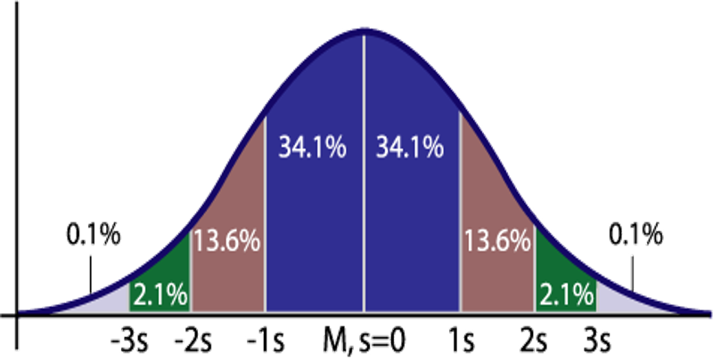
Normal Distribution

Slide 10
Normal Distributions
We know that many human attributes follow a normal distribution.
  e.g height, weight, task skill, reaction time, anxiousness, personality characteristics, attitudes etc.

Slide 11
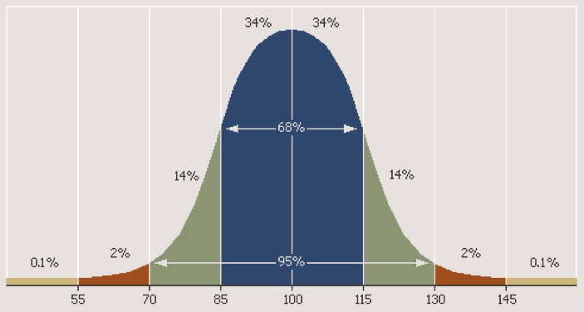
IQ Follows a Normal Distribution

Slide 12
