Slide 1
Star Formation
Star = large balls of gas that produce energy and shine…. unless old.
Nuclear Fusion = combines light elements to create heavy ones…. requires extreme high heat and pressure.

Slide 2
Star Evolution
How star evolves depends on its mass!

Slide 3
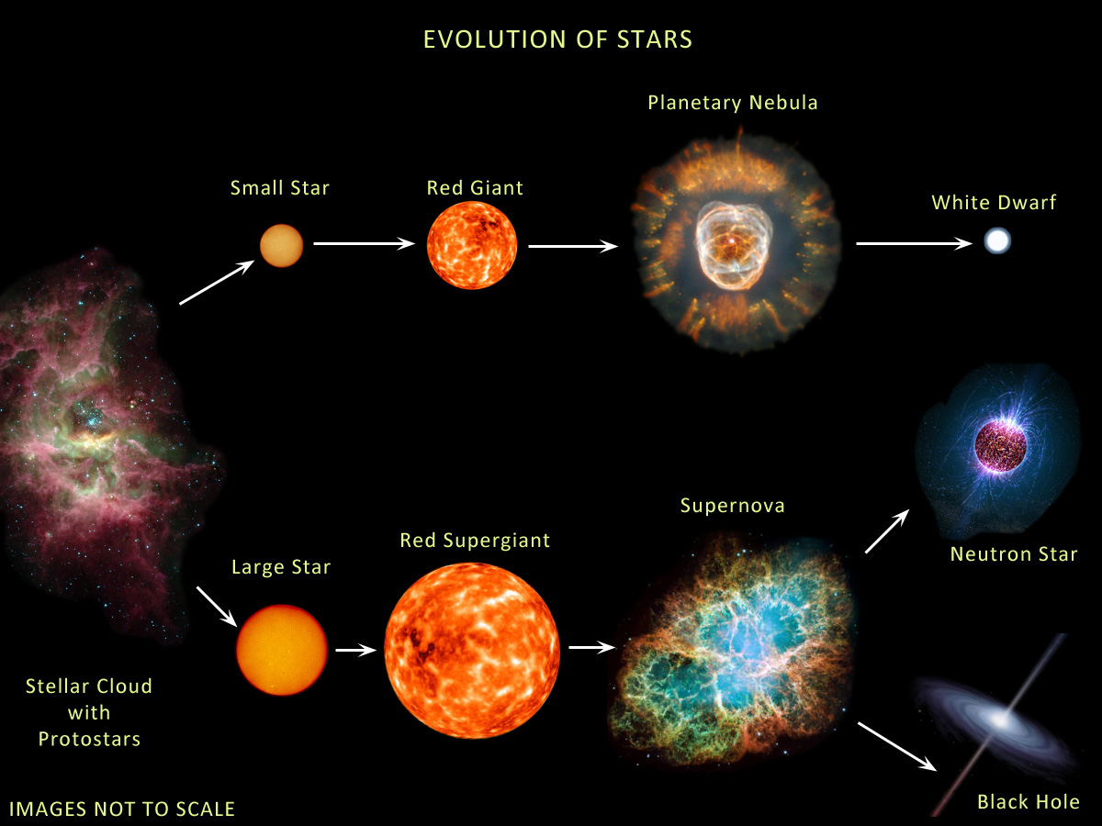
Depends on Mass

Slide 4
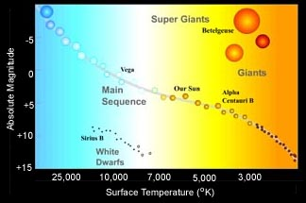

Slide 5
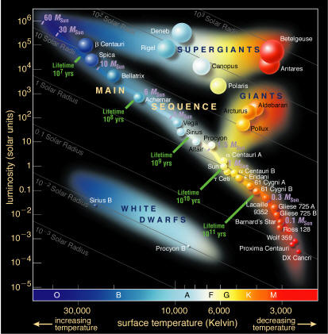

Slide 6
Star Types
Main Sequence Stars = early to middle age
90% of all stars.
luminosity increases with temperature.
Red is cool and blue is hot.

Slide 7
Star Types
Giant Stars = late stage
Late stage for 97% of main sequence stars.
Last only several million years.
Giant stars under ~8x mass of Sun become white dwarfs… if bigger they explode (supernova)
The sun will become a Giant before it dies.

Slide 8
Star Types
Super Giants = late stage
Same as Giants, but rarer and larger
Up to a billion times larger than the sun.
Usually explode in supernova.
Supernova = exploding star. Lasts a few weeks or months. Very bright in sky.

Slide 9
Star Types
White Dwarfs = final stage for small to medium size star
size of Earth with mass of Sun
no nuclear fusion
5. Black Dwarfs = When white dwarf completely cools down. None exist – age of universe not long enough for white dwarf to cool down.

Slide 10
Nebula
Nebula = cloud of gas and dust.
Planetary Nebula =
Nothing to do with planets.
Shell of gas given off by late stage small star.

