Slide 1
Space Travel
Many limits to traveling in space.
Distances are incomprehensible.
4 light years to nearest star… our fastest spaceship (not even built yet) would take over 1,000 years.

Slide 2
Fuel
Propellant is fuel stored in rocket that is ejected from engine backwards to create thrust.
Chemical and liquid propellants most common.
Need new form of fuel or energy to travel to stars.

Slide 3
Wormholes
Forget propulsion… how about moving through spacetime.
Special and General Relativity allow it.
Bend spacetime over on itself, then travel through hole…. easy!

Slide 4
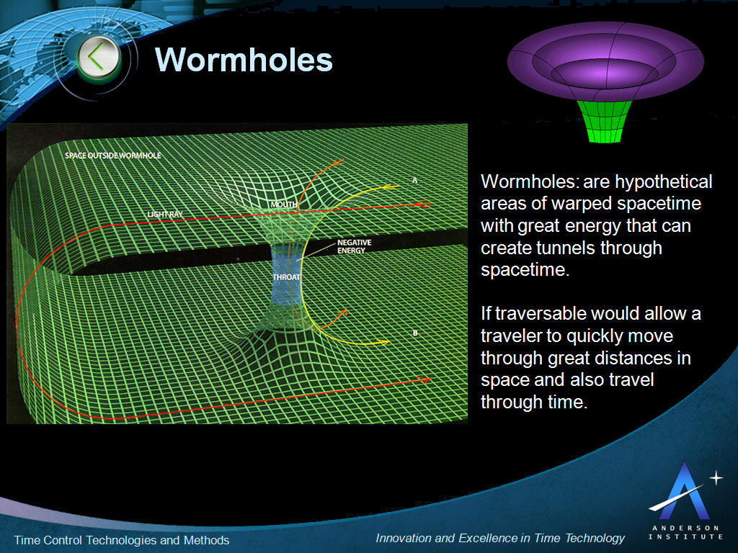

Slide 5
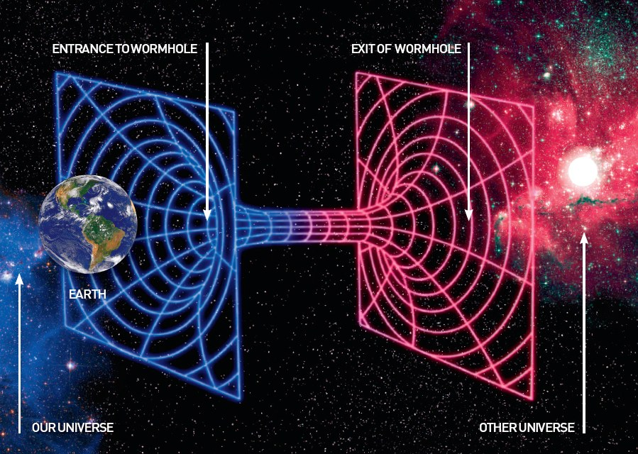

Slide 6
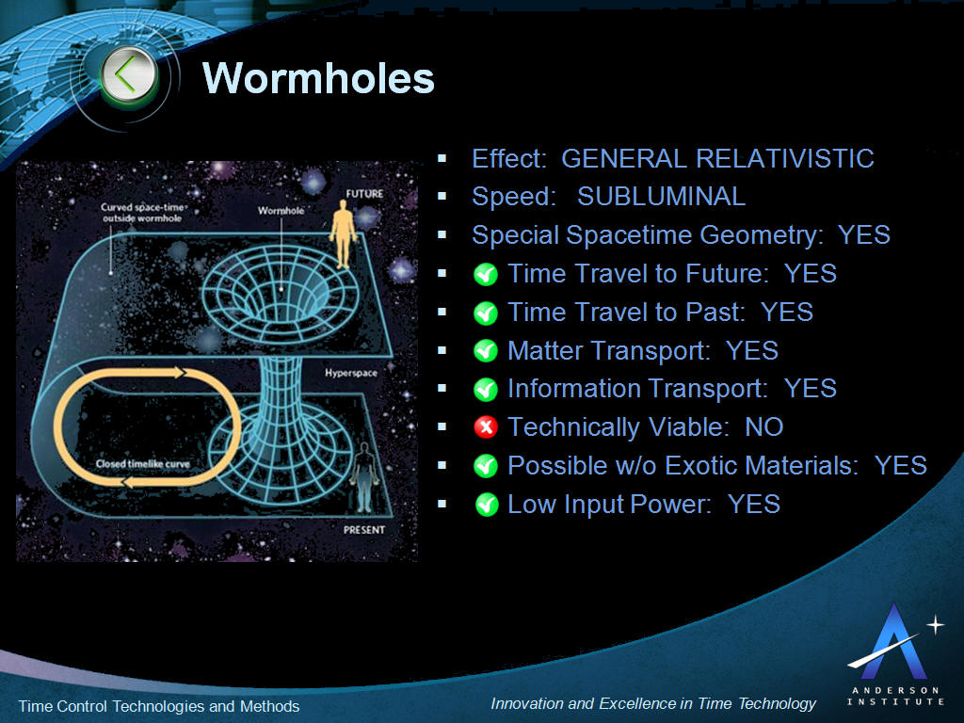

Slide 7
NASA Worksheet Questions
What are terms for “faster-than-light” travel?
What are 5 perspectives for achieving this?
What is the difference between breaking the sound barrier and breaking the light barrier?
What are two rules of special relativity?
What information is governed by electromagnetism?
How much energy do you need to move the speed of light?

Slide 8
Questions
How long will it take Voyager to reach our nearest star (proxima centauri)?
What is thrust?
What is specific impulse?
Will chemical fuel work? Why or why not?
How about nuclear fuel? Why or why not?
What would be the best propellant?
What forces do we need to modify for better propulsion?

Slide 9
Questions
How is a wormhole (shortcut) made?
How do we build a wormhole?
Describe Alcubierre’s Warp Drive?
What is Alcubierre’s Theory based on? Why?
What is negative mass propulsion? Does negative mass exist?
What is a space drive?
Describe 4 different space drives?

