Slide 1
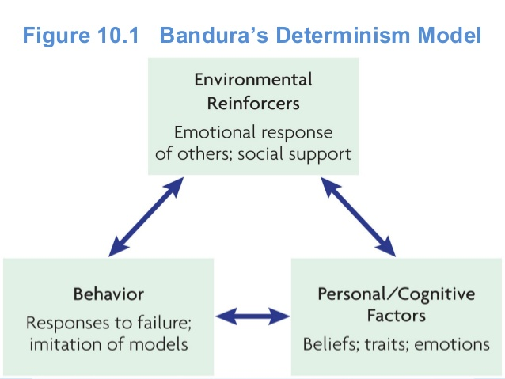
Bandura’s Social Cognitive Theory

Slide 2
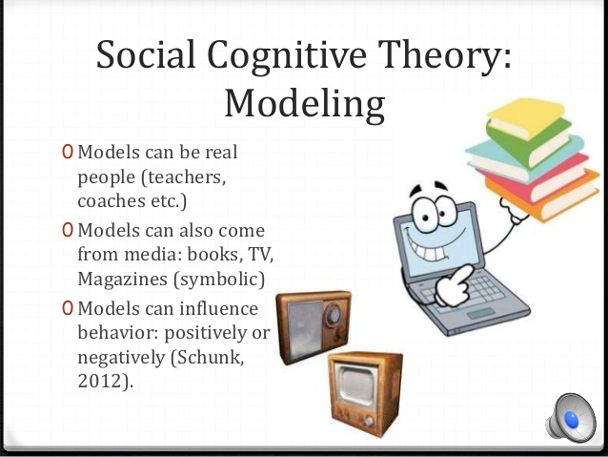

Slide 3

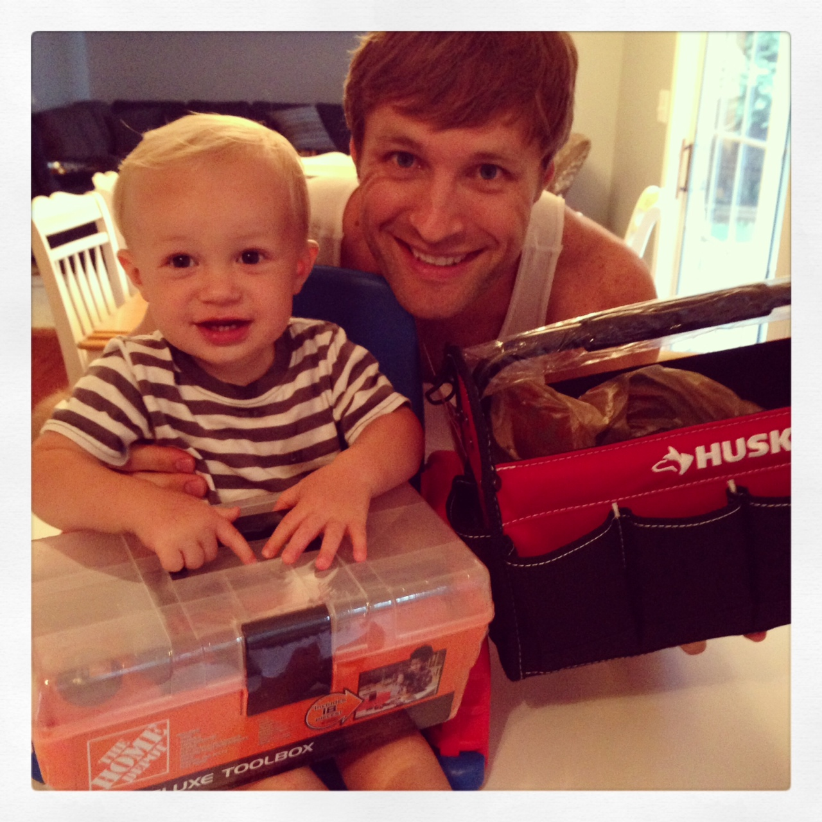
Social Cognitive Theory: Example
Gender Roles
By watching parents and society,
we learn our gender roles.

Slide 4
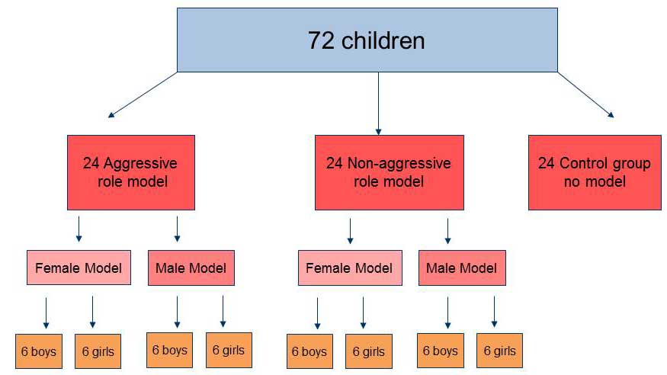
Bobo Doll Experimental Design

Slide 5

Results
Children exposed to the aggressive model were more likely to act in physically aggressive ways than those who were not exposed to the aggressive model. (Boys averaged 38.2 with 12.7 for girls)
Children are more influenced by same-sex models.
Boys showed more aggression when exposed to aggressive male models than boys exposed to aggressive female models.

Slide 6
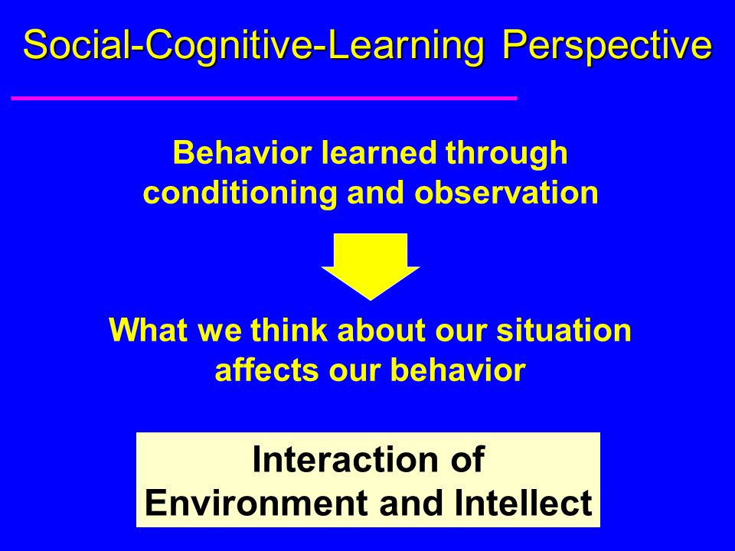

Slide 7
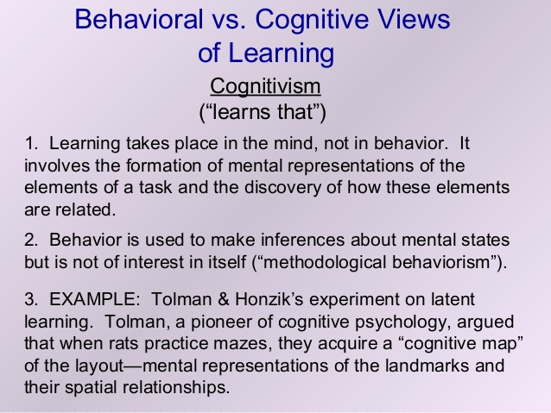

Slide 8
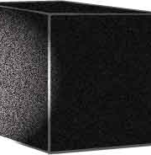
Cognitive Learning
Learning that depends on mental activity that is not directly observable
Involves such processes as attention, expectation, thinking, and memory

Slide 9
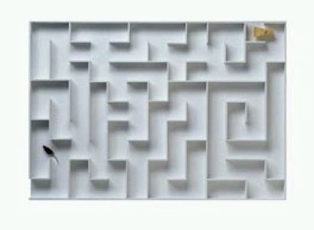
Latent Learning and Cognitive Maps
Latent learning is learning that takes place before the subject realizes it and is not immediately reflected in behavior.
A cognitive map is latent learning stored as a mental image.

Slide 10
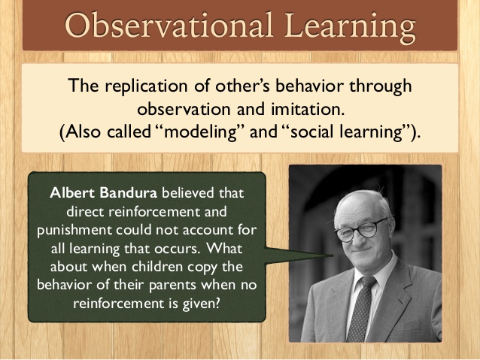

Slide 11

Social Cognitive Theory /Observational Learning
Tenet 1: Rewards or punishments influence the likelihood that a person will perform a particular behavior again.
Tenet 2: Humans can learn by observing others. Learning by observing others is called vicarious learning.
Tenet 3: Individuals are most likely to model behavior observed by others they identify with…someone similar to themselves.

Slide 12
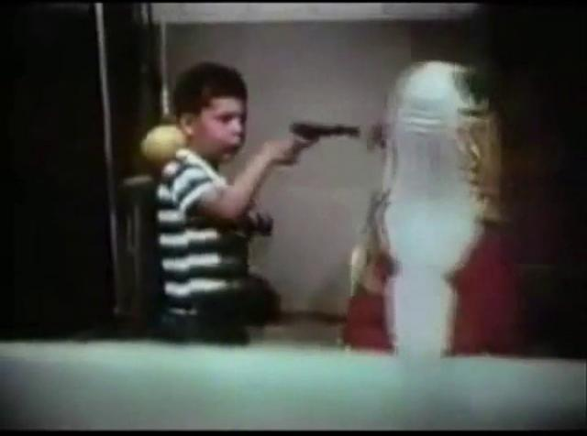
Bobo Doll Experiment

Slide 13
Results
Children exposed to the aggressive model were more likely to act in physically aggressive ways than those who were not exposed to the aggressive model. (Boys averaged 38.2 with 12.7 for girls)
Children exposed to the aggressive model were more likely to engage in novel hostile acts.
Children are more influenced by same-sex models.

Slide 14
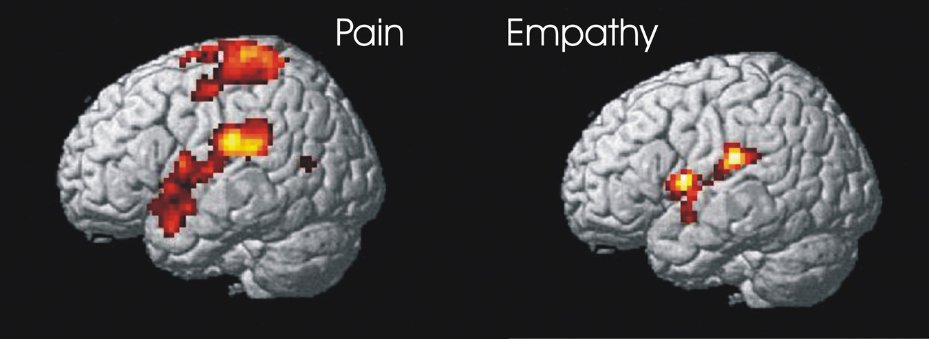
Mirror Neurons
Neuroscientists discovered mirror neurons in the brains of animals and humans that are active during observational learning.

