Slide 1
Erik Erikson
Stages of Psychosocial Development
8 successive psychosocial conflicts over the lifespan.
Psychosocial - psychological needs of the individual (i.e., psycho) conflicting with the needs of society (i.e., social).
As we move through each stage, we either respond:
- adaptively and acquire strengths needed for next developmental stage, or
- maladaptively and are less likely to adapt to later conflicts

Slide 2
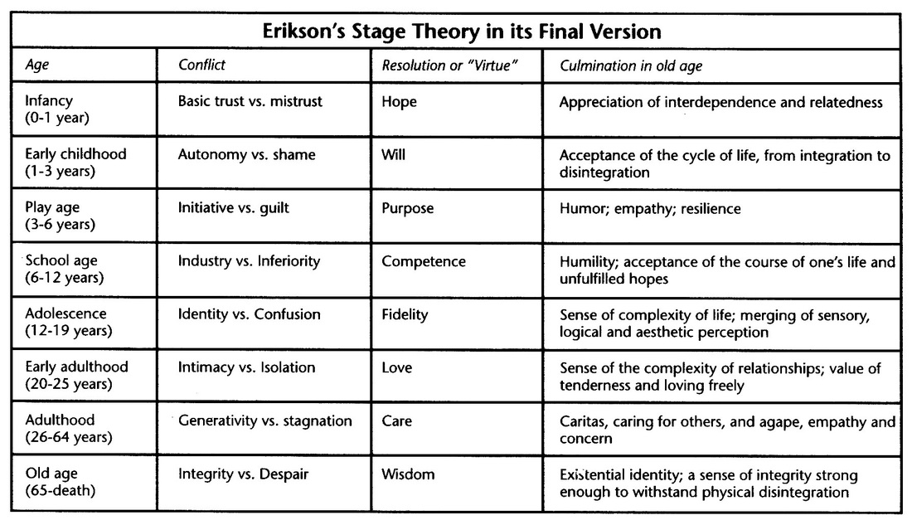

Slide 3
Summary of Stages
Stages 1-4
  Largely determined by others (parents, teachers)
Stages 5-8
  Individual has more control over environment
  Individual responsibility for crisis resolution in each stage

Slide 4
1. Basic Trust vs. Mistrust
Birth to 18 months -- Totally dependent on others
If caregiver consistently meets needs: child develops trust
If caregiver does not meet needs: mistrust
Basic strength: Hope

Slide 5
2. Autonomy vs. Shame and Doubt
Ages 1-3
Child able to exercise some degree of choice
If independence is thwarted, child develops feelings of self-doubt, shame in dealing with others
Basic Strength: Will

Slide 6
3. Initiative vs. Guilt
Ages 3-5
Child expresses desire to take initiative in activities
If parents punish child for initiative, child develops feelings of guilt
Basic strength: Purpose

Slide 7
4. Industriousness vs. Inferiority
Ages 6-11
Child develops cognitive abilities to complete tasks (school work, play)
If parents/teachers do not support child’s efforts, child develops feelings of inferiority and inadequacy
Basci strength: Competence

Slide 8
5. Identity vs. Role Confusion
Ages 12-18
Form ego identity: self-image
Strong sense of identity: face adulthood with certainty and confidence
Identity crisis: confusion of ego identity
Basic strength: Fidelity

Slide 9
6. Intimacy vs. Isolation
Ages 18-35 (approximately)
Undertake productive work and establish intimate relationships
Inability to establish intimacy leads to social isolation
Basic strength: Love

Slide 10
7. Generativity vs. Stagnation
Ages 35-55 (approximately)
Generativity: Active involvement in teaching/guiding the next generation
Stagnation involves not seeking outlets for generativity
Basic strength: Care

Slide 11
8. Ego Integrity vs. Despair
Ages 55+
Evaluation of entire life
Integrity: Look back with satisfaction
Despair: Review with anger, frustration
Basic strength: Wisdom

