Slide 1
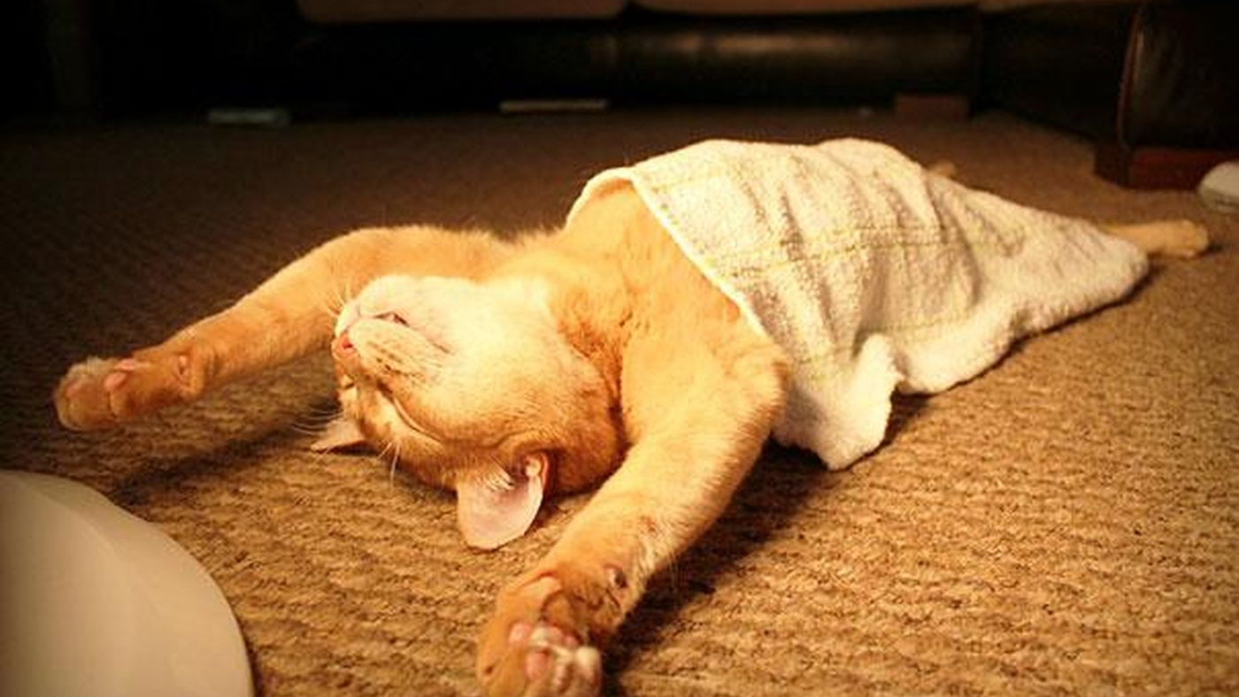

Slide 2
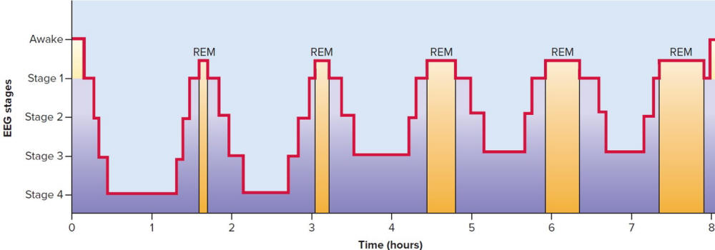
Sleep Stages
About every 90 minutes, we pass through a cycle of four distinct sleep stages.

Slide 3
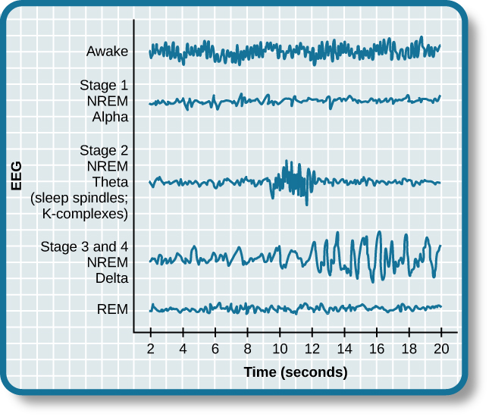
Brain Waves
Stage 1 (Alpha) – relaxed state...5-10 minutes (meditation)
Hypnogogic sleep – can have feeling of falling, floating
Stage 2 (Theta) – early, light sleep…10-25 mins. (sleep spindles)
Stage 3-4 (Delta) – deep sleep (dreaming may occur…not vivid)
REM – vivid dreaming

Slide 4
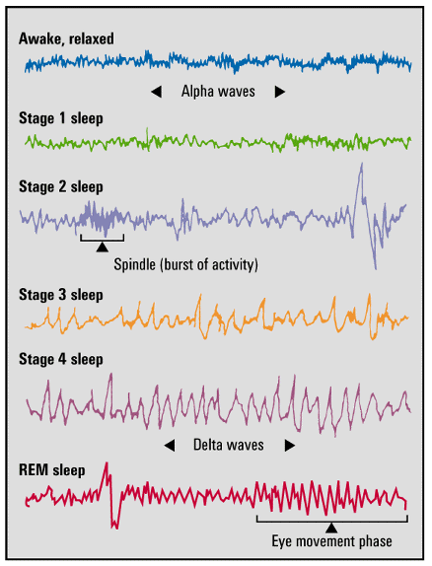
REM Sleep
After reaching stage 4, the sleep cycle starts moving backward towards stage 1.
Although still asleep, the brain engages in fast and regular beta waves much like awake-aroused state.
A person during this sleep exhibits Rapid Eye Movements (REM) and reports vivid dreams. Body is paralyzed during this phase…cannot move.

Slide 5
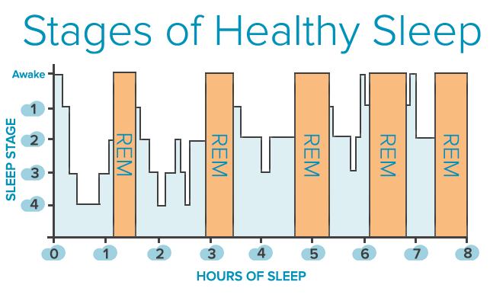
REM Sleep
With each 90-minute cycle, stage 4 decreases and REM sleep increases.

Slide 6


Why Do We Sleep?
Protection: Sleeping in the darkness when predators loomed about kept our ancestors out of harm’s way.
Recuperation: Sleep helps restore and repair brain tissue.
Helps Memory: Sleep encodes and builds daily memories.
Growth: During sleep, the pituitary gland releases growth hormone. Older people release less of this hormone and sleep less.
Notes:
OBJECTIVE 7| Identify four theories of why we sleep.

Slide 7
Circadian Rhythms
Physical, mental and behavioral changes that follow a roughly 24-hour cycle, responding primarily to light and darkness in an organism's environment.
Found in most living things.

Slide 8
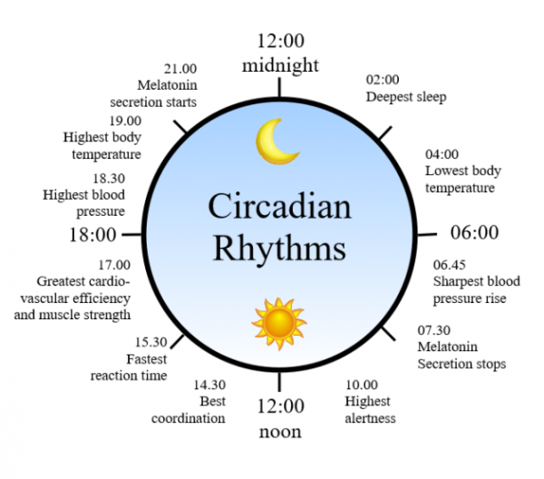
Circadian Rhythms

Slide 9
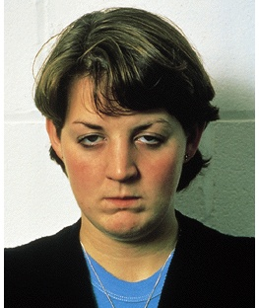
Sleep Deprivation
Fatigue and subsequent death.
Impaired concentration.
Emotional irritability.
Depressed immune system.
Notes:
OBJECTIVE 6| Discuss several risks associated with sleep deprivation.

Slide 10
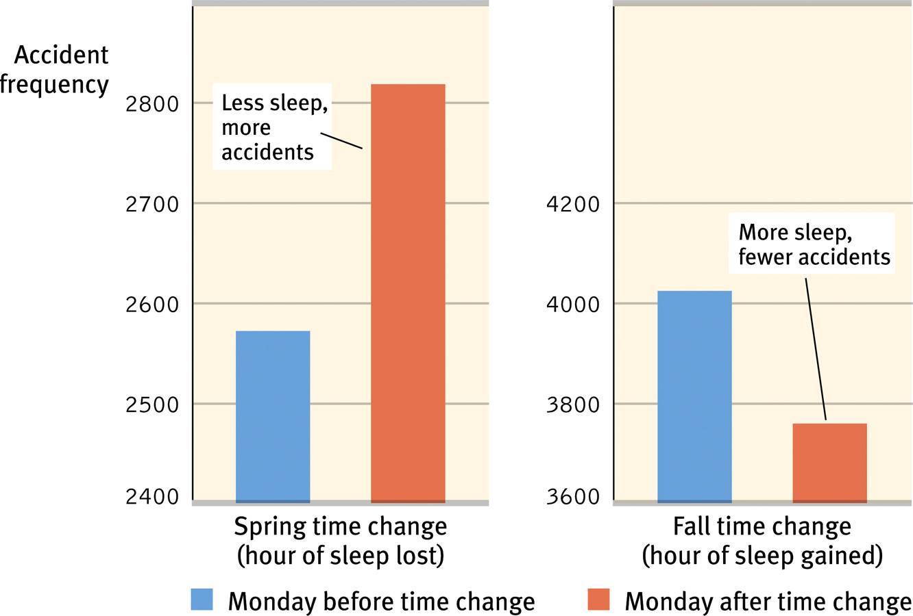
Accidents
Accidents increase with loss of sleep

Slide 11
Sleep Disorders
Insomnia
  Difficulty falling asleep or remaining asleep
Sleeptalking and Sleepwalking
  Usually occurs during Stage 4 sleep
  More common in children
Night terrors
  Episodes of fright that occur during stages 3 or 4 sleep
  Person may sit up or scream, but likely will not recall the episode in the morning

Slide 12
Sleep Disorders
Apnea
  Person stops breathing momentarily during sleep
REM Behavior Disorder
  Body fails to paralyze during REM sleep
Sleep Paralysis
  Body fails to undo the paralysis briefly upon walking.

Slide 13
Sleep Disorders
Narcolepsy
  Suddenly falling asleep without warning during waking hours
  Likely caused by a central nervous system defect

