Slide 1
Sensation and Perception
How we construct our representations of the external world.
Sensation = physical energy (stimulus) from the environment is converted into neural signals.
Perception = giving meaning by selecting, organizing, and interpreting our sensations
Notes:
OBJECTIVE 1| Contrast sensation and perception, and explain the difference between bottom-up and top-down processing.

Slide 2
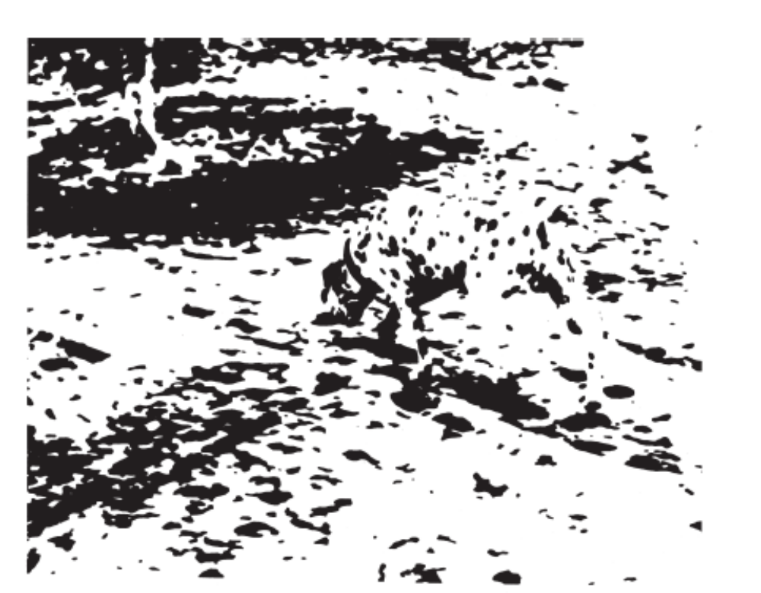
What You See vs.
What You Perceive?

Slide 3


Slide 4

What You See vs.
What You Perceive?

Slide 5
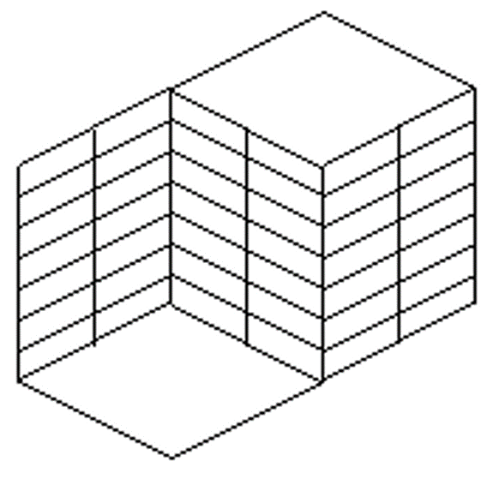
Optical Illusion

Slide 6

Bottom Up vs. Top Down Processing
Perception
Sensation

Slide 7
Bottom-up Processing
Stimulus begins with the senses and works up to the brain.
Letter “A” is really a black blotch broken down into features by the brain that we perceive as an “A.”

Slide 8
Top-Down Processing
Using higher-level mental processes to construct perceptions, based on our experience and expectations.
THE CHT

Slide 9
Example of Top-Down Processing
Aoccdrnig to rscheearch at Cmabrigde Uinervtisy, it deosn't mttaer in waht oredr the ltteers in a wrod are, the olny iprmoetnt tihng is taht the frist and lsat ltteer be at the rghit pclae. The rset can be a total mses and you can sitll raed it wouthit a porbelm. Tihs is bcuseae the huamn mnid deos not raed ervey lteter by istlef, but the wrod as a wlohe.

Slide 10
Bottom-up vs. Top-down
Bottom-up processing refers to sensory perception. It is using the senses, whether they are taste, touch, sight, smell or hearing, to understand information and process it in the brain.
Top-down processing involves cognition (thinking). The knowledge you have allows the brain to perceive something based on what it knows and what it sees. For instance, if you receive a text that reads: “C U L8r,” you can still read and interpret it as “see you later” based on what you already know.

Slide 11

The Basic Process
Receptor cells
Specialized cells that respond to a particular type of energy
Transduction
External energy is converted to neural signals.
Doctrine of Specific Nerve Energies
One-to-one relationship between stimulation of a specific nerve and the resulting sensory experience.
For example, applying pressure with your finger to your eye results in a visual experience
Notes:
transparent protective coating over the front of the eye

Slide 12
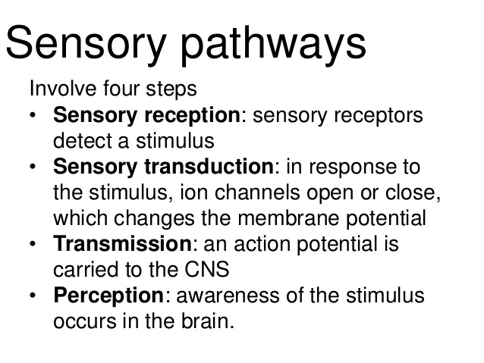

Slide 13
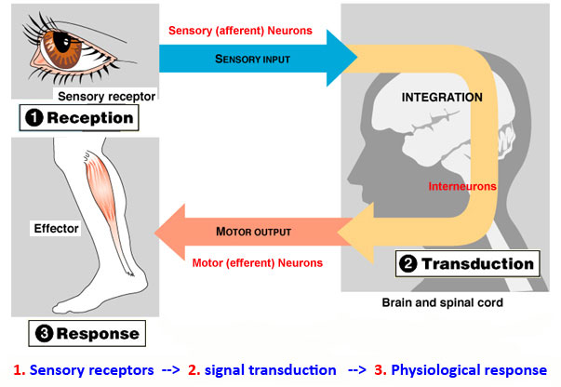
Sensory Transduction
when a physical stimulus is converted into an action potential, which is transmitted along axons towards the central nervous system for integration.

Slide 14


Absolute Threshold
Smallest detectable LEVEL of a stimulus.

Slide 15
Detection must be 50% of time.
Absolute
Threshold
Intensity
No
No
No
Yes
Yes
Observer’s Response
Detected
Tell when you (the observer) detect the light.

Slide 16
Absolute Thresholds
Taste: 1 gram (.0356 ounce) of table salt in 500 liters (529 quarts) of water
Smell: 1 drop of perfume diffused throughout a three-room apartment
Touch: the wing of a bee falling on your cheek from a height of 1cm (.39 inch)
Hearing: the tick of a watch from 6 meters (20 feet) in very quiet conditions
Vision: a candle flame seen from 50km (30 miles) on a clear, dark night

Slide 17
Difference Threshold
Difference Threshold: Minimum difference between two stimuli required for detection 50% of the time, also called just noticeable difference (JND).
Difference
Threshold
No
No
Yes
Observer’s Response

Slide 18
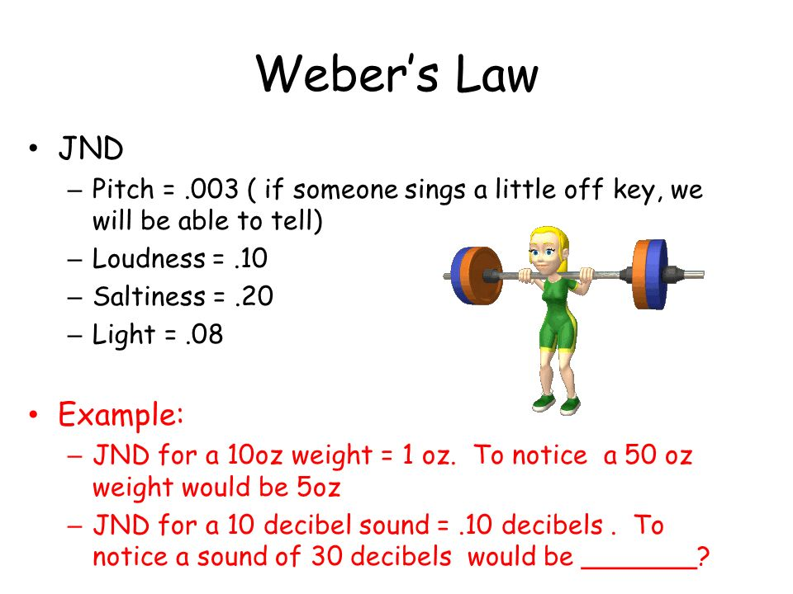
Weber’s Law
Two stimuli must differ by a minimum percentage
(rather than an amount)

Slide 19

Signal Detection Theory (SDT)
How and when we detect the presence of a faint stimulus (signal) amid background noise (other stimulation). SDT assumes that there is no single absolute threshold and detection depends on:
Person’s experience
Expectations
Motivation
Level of fatigue

Slide 20
Sensory Adaptation
  An adjustment of the senses to the level of stimulation they are receiving
  Ever forgotten you are wearing a watch?
  Ever gotten used to a smell?

