Slide 1
Size and Scale
Sizes and distances in astronomy are extremely large… in fact beyond comprehension
Scientists (and the world) use the metric system
Units
Convert km to miles = multiply by .6
Convert meters to feet = 3 ft / meter.

Slide 2
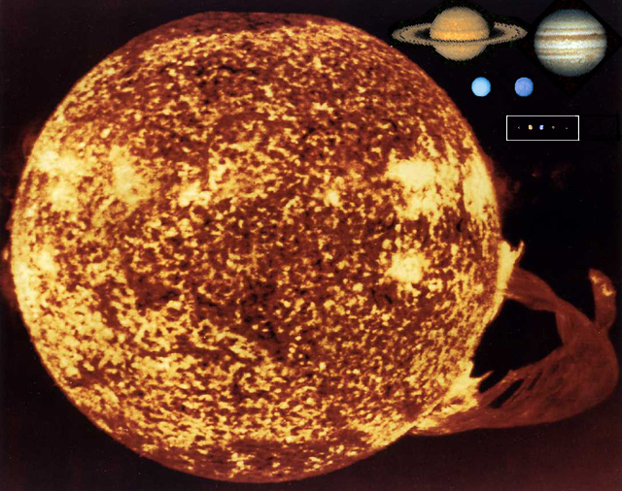

Slide 3
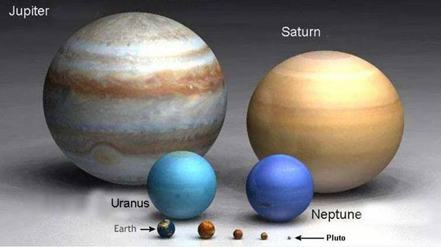
Scale Model of Solar System

Slide 4
Solar System Distances
Kilometer is too small. 150,000,000 km to Sun.
Astronomical Unit (AU) = average distance from Earth to Sun (93 million miles).
Mercury is 1/3 of an AU. Neptune is ~40 AU.

Slide 5
Universe Distances
Light-year (ly) = distance light travels in a year.
Light travels 300,000,000 m/s (186,000 mi/s)
Ly = 9.5 trillion kilometers (6 trillion miles)
Parsec = 3.3 Ly

Slide 6
Let’s Take a Walk
Sun = soccer ball
Mercury = pinhead (+10)
Venus = peppercorn (+9)
Earth = peppercorn (+7)
Mars = pinhead (+14)
Jupiter = quarter (+95)
Saturn = nickel (+112)
Uranus = dime (+249)
Neptune = dime (+281)
Pluto = grain of sand (+242)

Slide 7
Size and Distance
The Sun is 600x larger than all the planets put together.
Using scale from walk:
Moon = 2” from Earth
Light-year = 1,000 miles
Heliosphere = 2,000 miles

Slide 8
Some Distances
-- Proxima Centauri (nearest star) = 4.3 light-years away.
-- The Crab supernova is about 4,000 light-years away.
-- The Milky Way Galaxy is about 150,000 light-years across.
-- The Andromeda Galaxy is 2.3 million light-years away.

