Slide 1
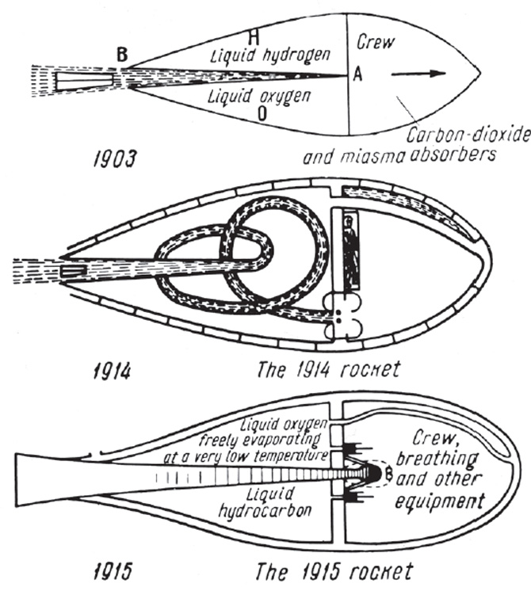

Slide 2
History
After Tsiolkovsky came an American, Robert Goddard (1920’s).
First to experiment with liquid fuel… more difficult.
Developed a gyroscope system (balance) and a payload compartment for instruments.

Slide 3
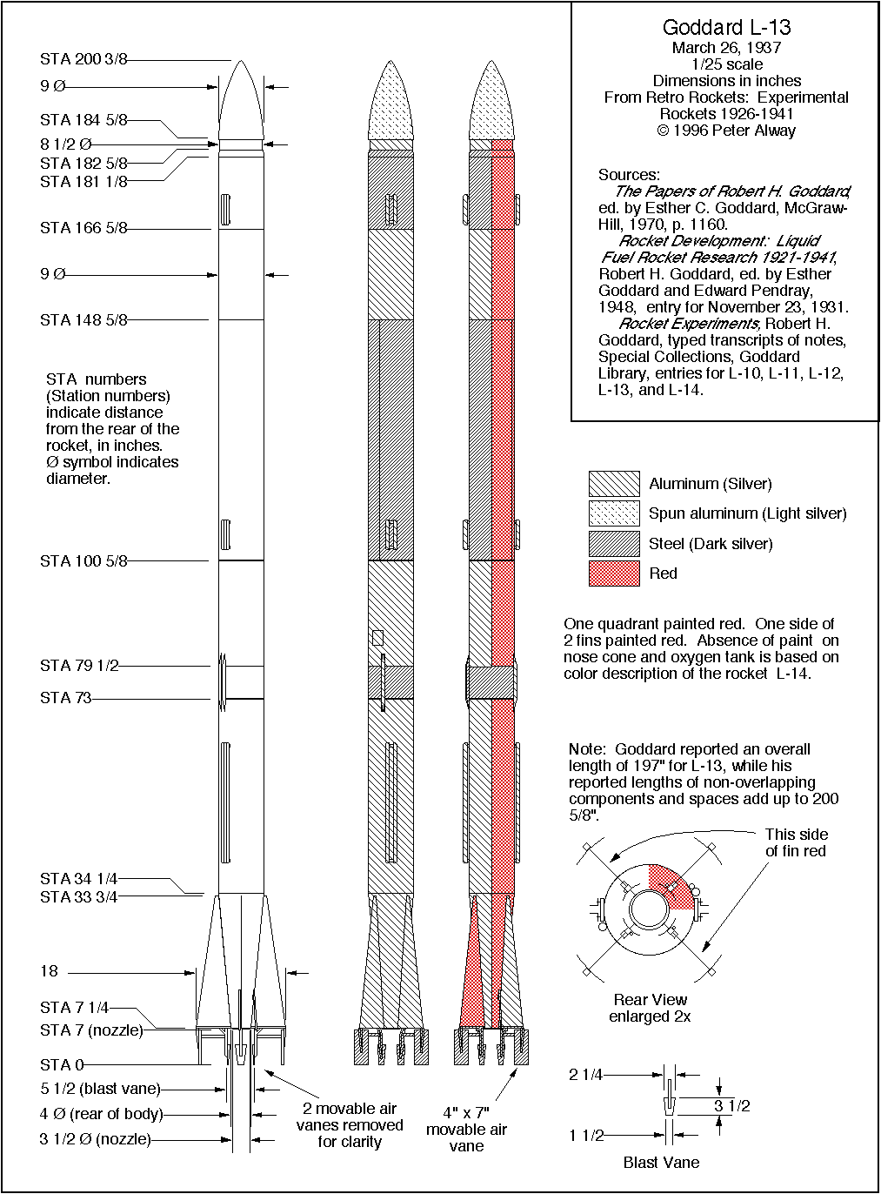

Slide 4
German V-2
Werner Von Braun and Hermann Oberth developed V-2.
It could lift off in Germany and hit London during end of war.
After war German scientists went to America or Russia.

Slide 5
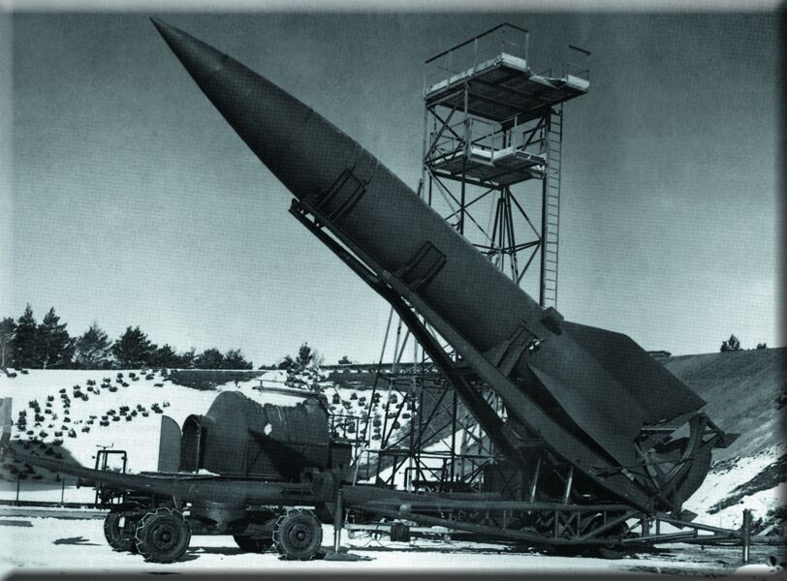

Slide 6
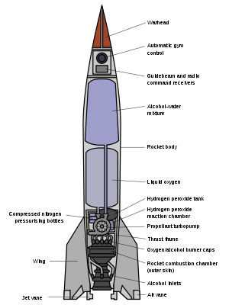

Slide 7
Chemical Fuel
A chemical reaction creates hot gas at high pressure.
This pressure is expelled out the back of the rocket.
Types: 1. Solid
2. Liquid

Slide 8
Post-War
Both Russia and U.S. developed ICBM’s (intercontinental ballistic missiles).
These missiles would eventually launch astronauts into space.
In 1957 Russia launches Sputnik, an artificial satellite.

Slide 9
After Sputnik
NASA formed in 1958… a civilian agency with a goal of peaceful exploration of space.
In 1969, U.S. astronauts land on the moon using Saturn V rocket.
All objects put into space require rocket engines to reach escape velocity.

Slide 10
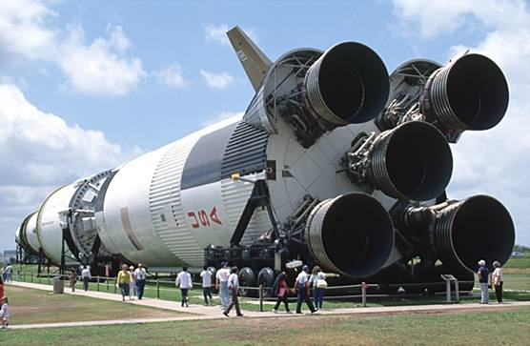

Slide 11
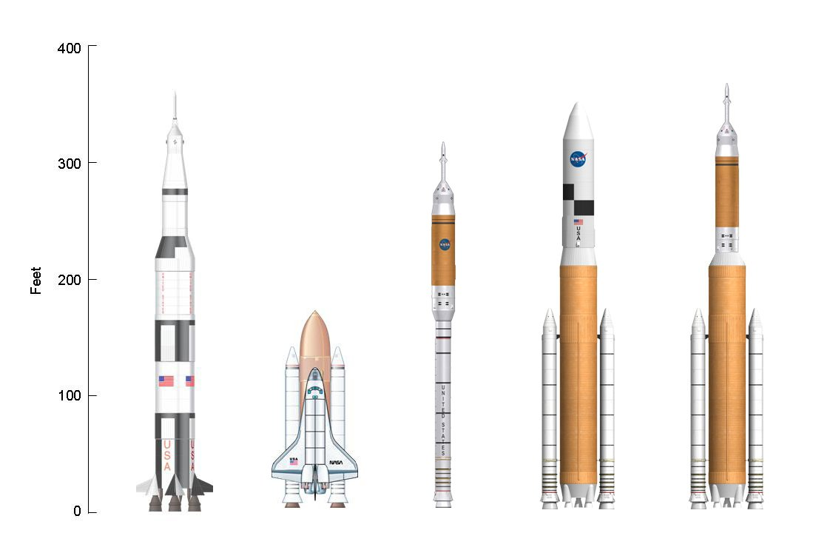

Slide 12
Satellites
Object put into space by humans
Sputnik was first in 1957. We had tried but failed previously.
Purposes: for communications, navigation, weather, and research, to name a few
Geostationary (geosynchronous orbit) = satellite stays in same spot over Earth

Slide 13
How Many?
There are over 13,000 satellites in orbit.
Of these, ~3,500 are functioning and 10,000 are debris.
So, 75% of satellites in orbit are junk!

Slide 14
Model Rockets
Use black powder propellant.
There is a delay element that lets the rocket coast upwards.
Then, an ejection charge triggers the parachute.

Slide 15
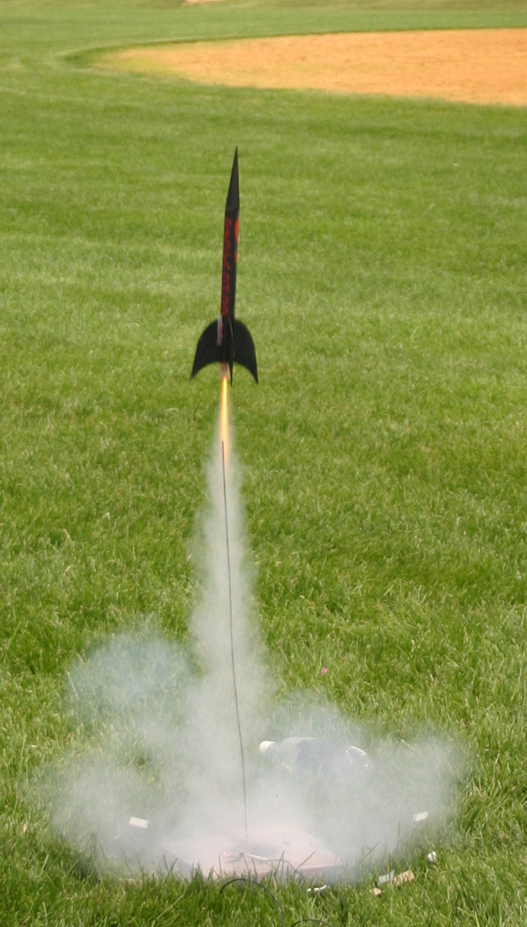
Model Rocket

Slide 16
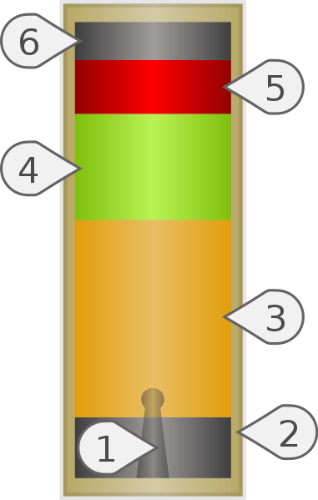
Model Rocket Engine
Nozzle
Case
Propellant
Delay Charge
Ejection Charge
End Cap

Slide 17
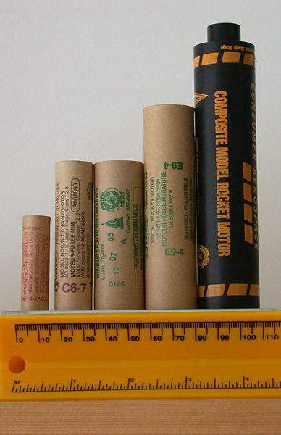
Model Rocket Motors

