Slide 1
Experimental Research
Purpose – to establish cause and effect relationships between variables.
Strength – You find out if one variable (IV) causes a change in another variable (DV)
Weakness – Confounding variables, experimenter bias, etc.

Slide 2
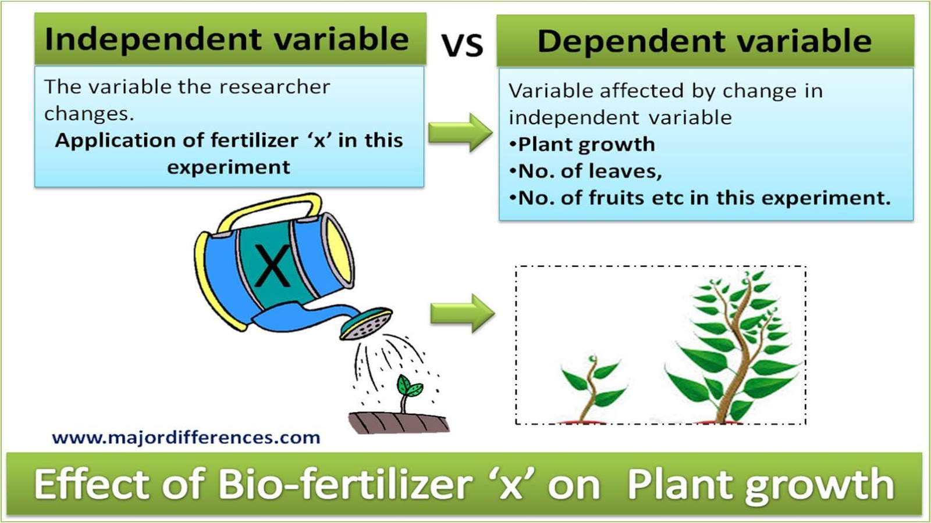
Independent/Dependent Variable
Independent Variable –
Cause (what you are studying)
variable changed by the experimenter
Dependent Variable –
Effect (result of experiment)
variable measured by the experimenter
It DEPENDS on the independent variable

Slide 3
IV and DV in real study
"There will be a statistically significant difference in graduation rates of at-risk high-school seniors who participate in an intensive study program as opposed to at-risk high-school seniors who do not participate in the intensive study program." (LaFountain & Bartos, 2002, p. 57)
IV: Participation in intensive study program.
DV: Graduation rates.

Slide 4
Determining Independent and Dependent
A good way to determine the IV from the DV is to use an “If . . . then” statement.
What follows the IF is the Independent Variable
What follows the THEN is the Dependent Variable

Slide 5
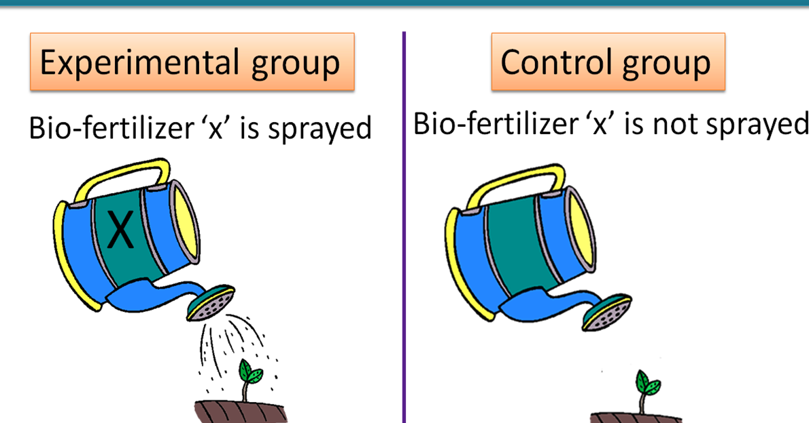
Control and Experimental Groups
The experimental group will get the treatment and the control group will not.

Slide 6

Placebo Effect
When a person takes a medication that he or she thinks will help, and it actually does.
This is NOT treatment. The effect does not last.

Slide 7
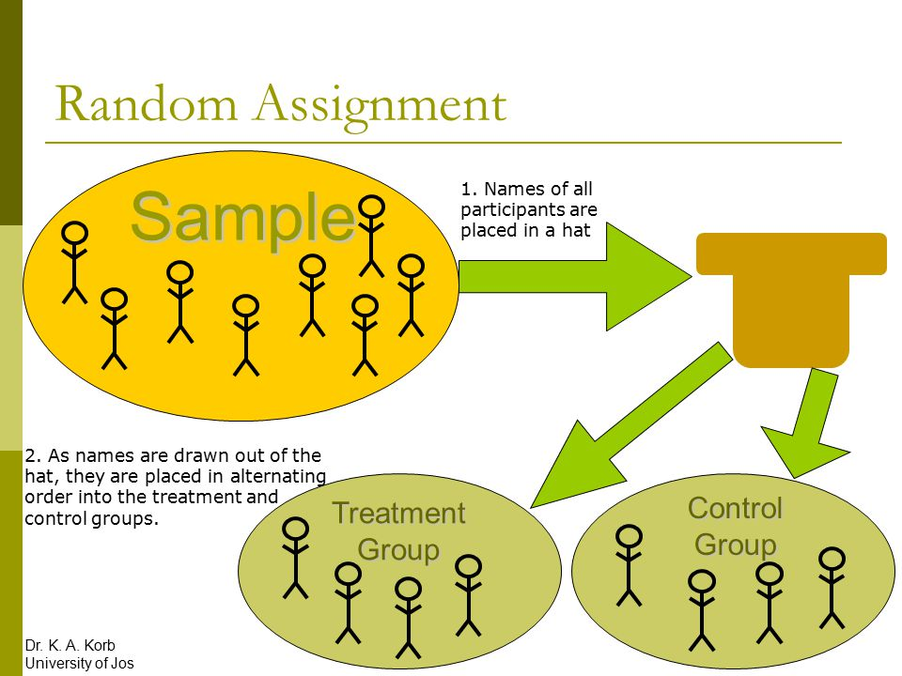
Random Assignment
You randomly assign participants to either your control or experimental groups.
Ex: using an alphabetical list of participants, assign every other name to the experimental group.
Random sampling refers to selecting individuals from the population.
Random assignment refers to how you place those participants into groups (such as experimental vs. control).

Slide 8
Single Blind and Double Blind
Single Blind:
Only the participant is unaware of which group they are in… either the control or experimental group.
Double Blind (Gold Standard):
Both the participant and the researcher are unaware of the group they are in.

Slide 9
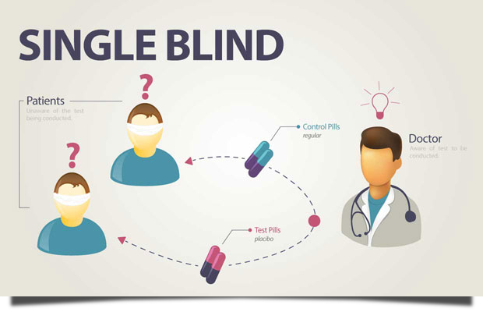
Single Blind

Slide 10
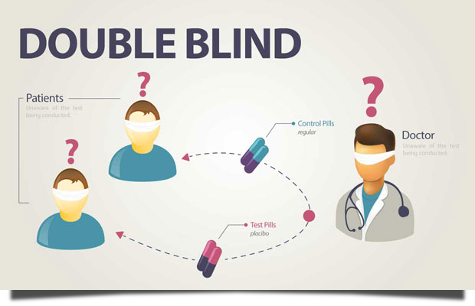
Double Blind

Slide 11
Confounding Variables
Variables that a researcher fails to control for or eliminate.
The only thing that should change is the Independent Variable. If the IV is the only thing that changes, then it must be the thing that caused the change.
If there were confounding variables it might have been them.

Slide 12
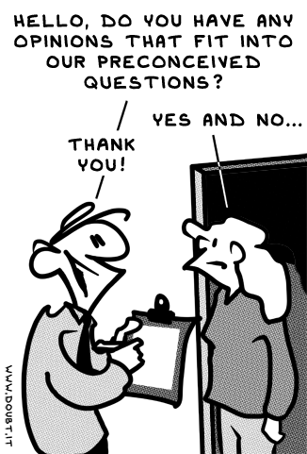
Experimenter Bias
Errors in a research study due to the predisposed notions or beliefs of the experimenter.

