Slide 1
Correlational Research
Research technique used to analyze findings.
Tries to find a naturally occurring relationship between two or more variables
Used to make PREDICTIONS, such as the relation between SAT scores and success at college
Can NOT be used to determine cause and effect
Asks: Do the two variables relate?

Slide 2
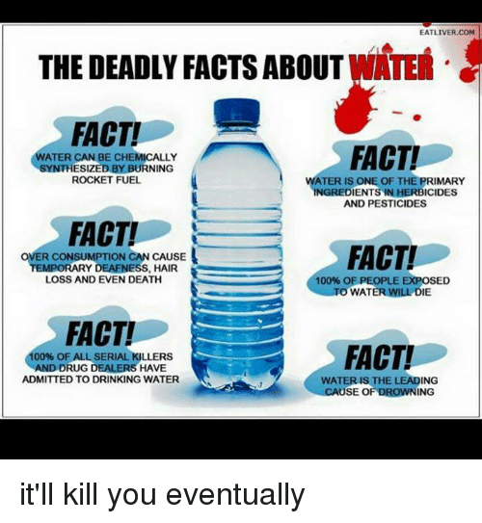

Slide 3
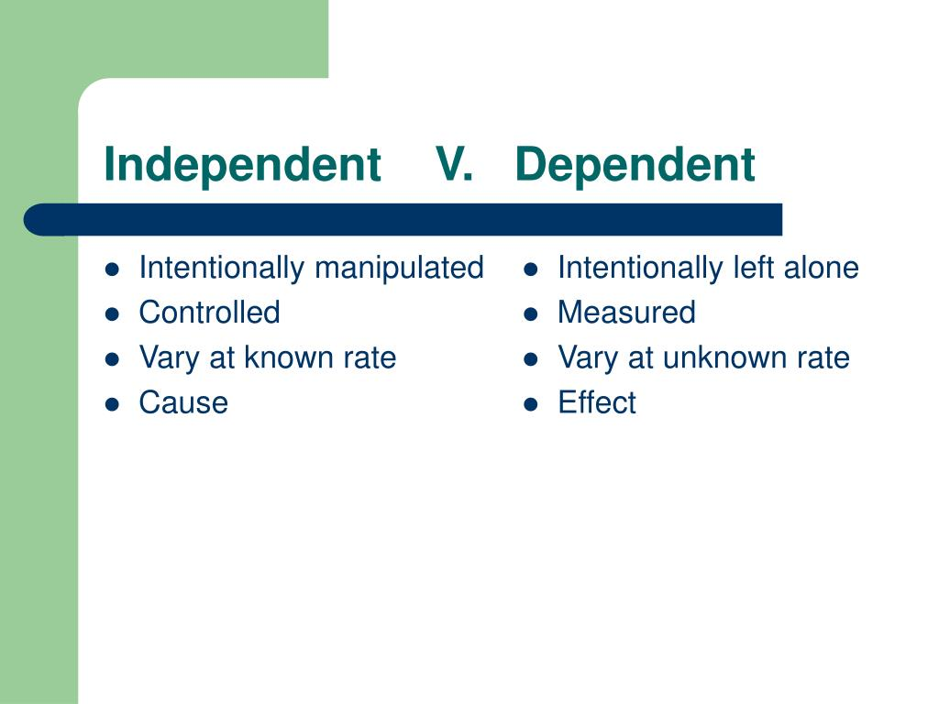
Independent vs. Dependent Variables

Slide 4
Start with 2 Dependent Variables
DV = Height
DV = Weight
DV = Golf Score
DV = years the person has played golf
DV = Salary
DV = Happiness
DV = IQ scores
DV = Size of your big toe

Slide 5

Is there a relationship?
Are the numbers which represent height somehow related to (vary with) the numbers which represent weight?
Does a person’s golf score vary with years of practice?
Does IQ vary with big toe length?
Does happiness vary with salary?

Slide 6
Operational Definition
An exact description of the characteristic you are measuring.

Slide 7
Operational Definitions in Blue
DV = Height (in inches without shoes)
DV = Weight (in lbs without clothes)
DV = Golf Score (on golf course x)
DV = Number of years the person has played golf
DV = IQ scores (from the QIRT Intelligence Test)
DV = Size of your big toe (in mm from top of joint to top of toe)
DV = Salary (annual salary including bonuses and benefits)
DV = Happiness (???)

Slide 8
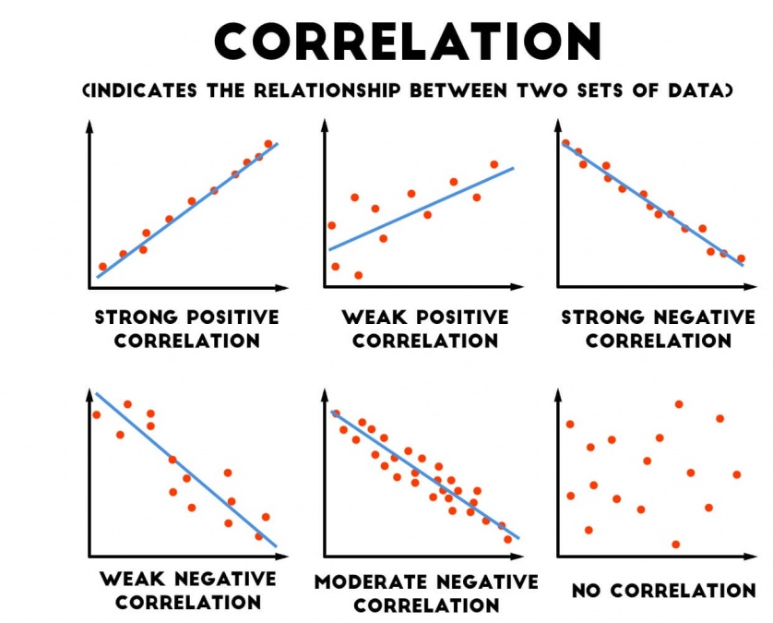
Scatterplots
Scatterplot is a graph representing the values of two variables.
The slope of points depicts the relationship…positive or negative
The amount of scatter shows the strength of relationship.

Slide 9
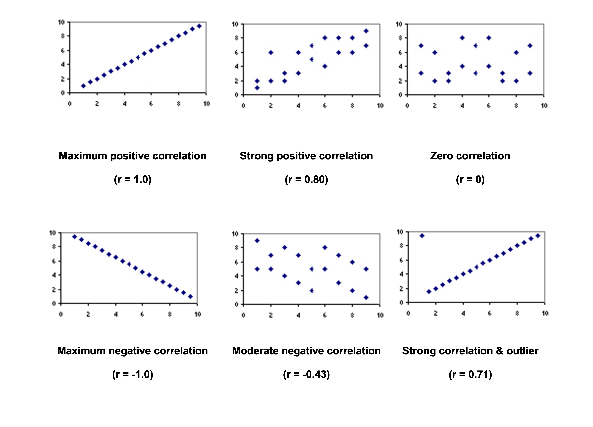
Correlation Coefficient
When one trait or behavior varies with the other, we say they correlate.
Correlation Coefficient is a statistical measure of relationship between two variables…(-1 to +1)

Slide 10
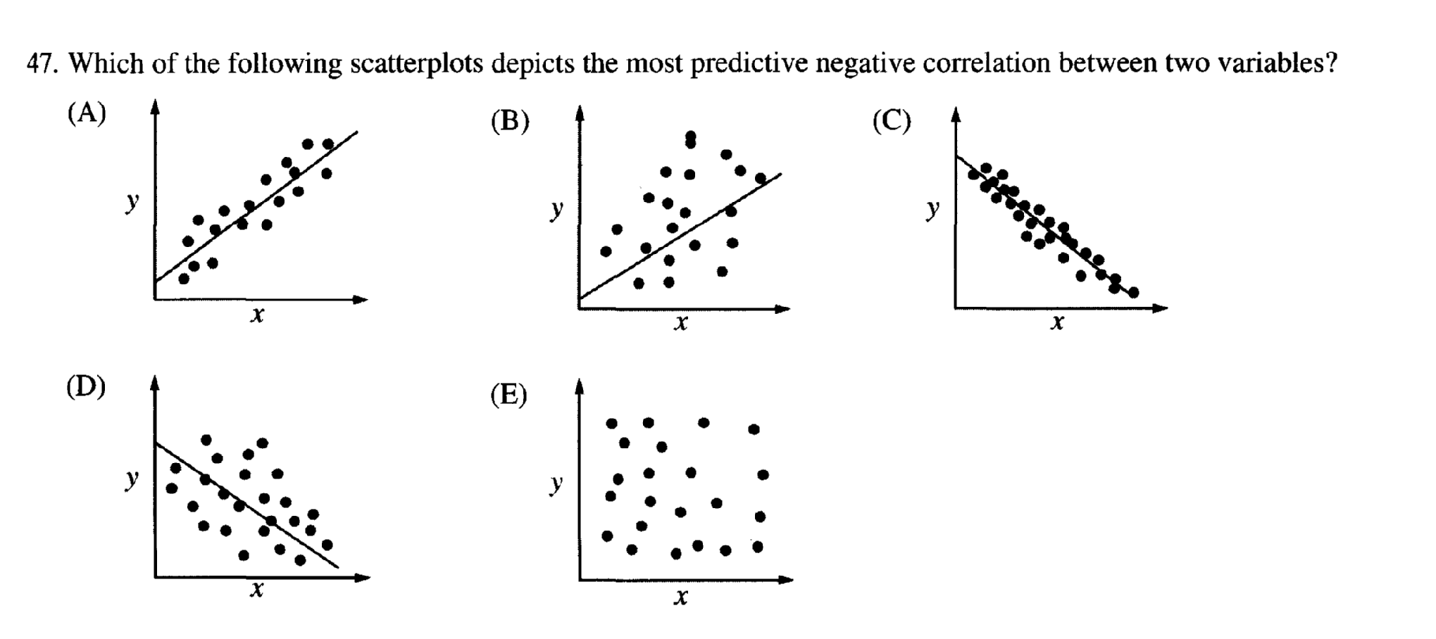

Slide 11
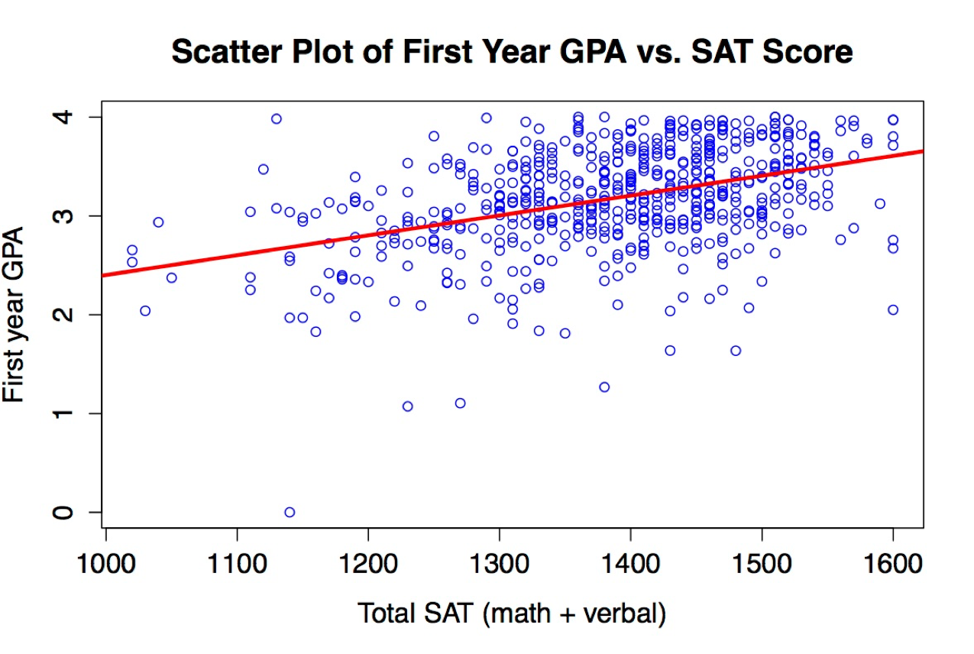
U. Virginia School of Engineering (n=588)
Notes:
r=.42

Slide 12
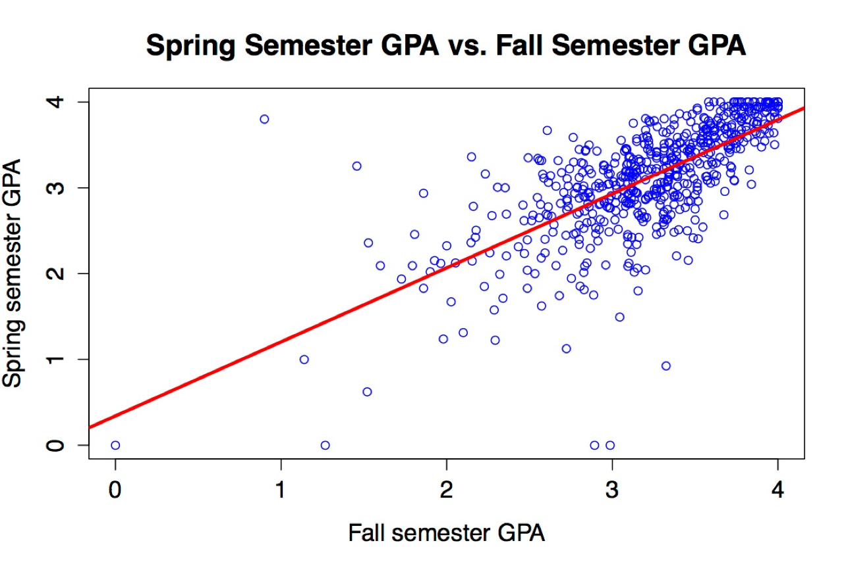
U. of Virginia School of Engineering (n=588)
Notes:
r=.70

Slide 13
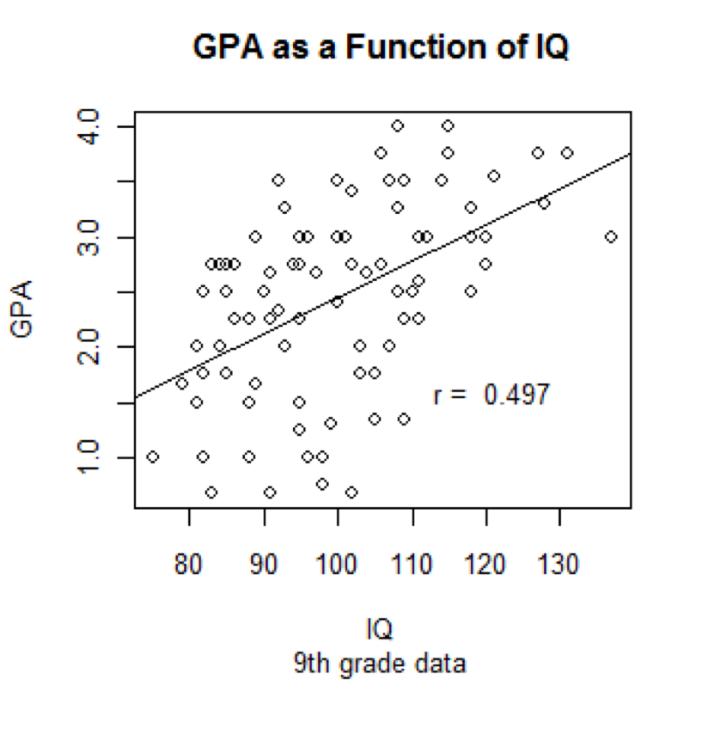
If not just IQ, then what?

Slide 14
Study of Low Self Esteem and Depression
You do the research because you assume the two are related
Compare two variables
  Variable 1 = Score on a self-esteem test
  Variable 2 = Length in months of a bout of depression

Slide 15

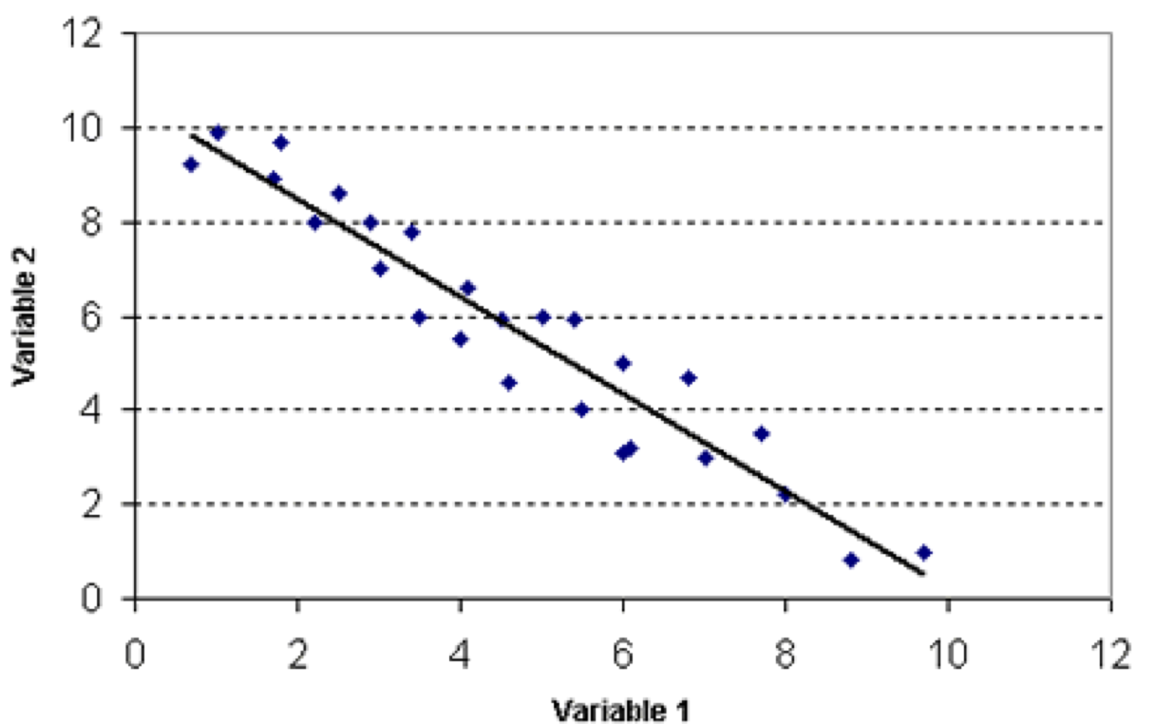
Score on Self-Esteem Test
Length of Depression in Months

Slide 16
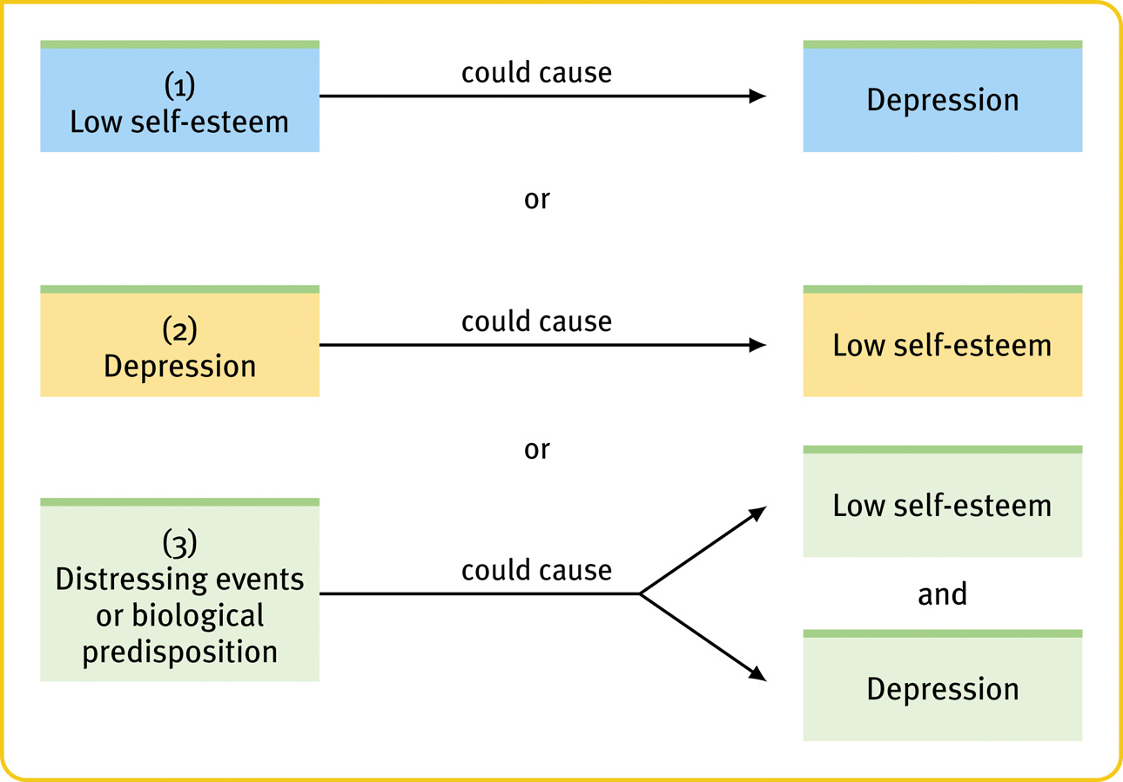
Correlation is NOT Causation
or
Notes:
16
OBJECTIVE 9| Explain why correlational research fails to provide evidence of cause-effect relationships.

Slide 17
Illusory Correlations
Redelmeier and Tversky (1996) assessed 18 arthritis patients over 15 months, while also taking comprehensive meteorological data. Virtually all of the patients were certain that their condition was correlated with the weather.
In fact the actual correlation was close to zero.
Notes:
17

Slide 18
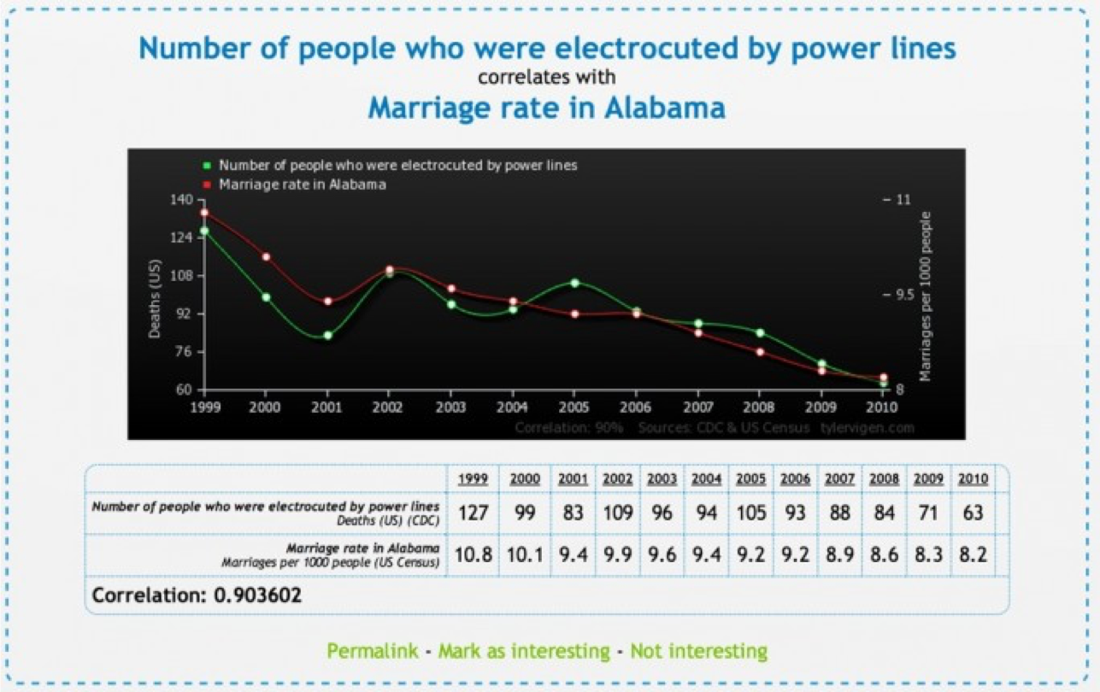
Correlation is not Causation

Slide 19
Correlation is not Causation: It only Predicts!!
Children with big feet reason better than children with small feet.
  (Children who are older have bigger feet than younger children; thus they can reason better)
Study done in Korea: The most predictive factor in the use of birth control use was the number of appliances in the home.
  (Those who have electrical appliances probably have higher socioeconomic level, and thus are probably better educated.)
Notes:
19

Slide 20
Correlation is not Causation: It only Predicts!!
People who often ate Frosted Flakes as children had half the cancer rate of those who never ate the cereal. Conversely, those who often ate oatmeal as children were four times more likely to develop cancer than those who did not.
  Cancer tends to be a disease of later life. Those who ate Frosted Flakes are younger. In fact, the cereal was not around until the 1950s (when older respondents were children, and so they are much more likely to have eaten oatmeal.)
Notes:
20

Slide 21
Correlation is not Causation: It only Predicts!!
Ice cream sales and the number of shark attacks on swimmers are correlated.
Skirt lengths and stock prices are highly correlated (as stock prices go up, skirt lengths get shorter).
The number of cavities in elementary school children and vocabulary size are strongly correlated.
Notes:
21

Slide 22
Diet soda and weight gain???
The study of more than 600 normal-weight people found that eight years later they were 65 percent more likely to be overweight if they drank one diet soda a day than if they drank none. And if they drank two or more diet sodas a day, they were even more likely to become overweight or obese.
Notes:
22

