Slide 1
Why Science?
“Science is what we do to keep from lying to ourselves.” Richard Feynman
“The good thing about science is that it’s true whether or not you believe in it.” Neil deGrasse Tyson
“It is far better to grasp the universe as it really is than to persist in delusion, however satisfying and reassuring.” Carl Sagan
“To believe with certainty, we must begin by doubting.” Polish proverb
Notes:
Because intuition is faulty.

Slide 2
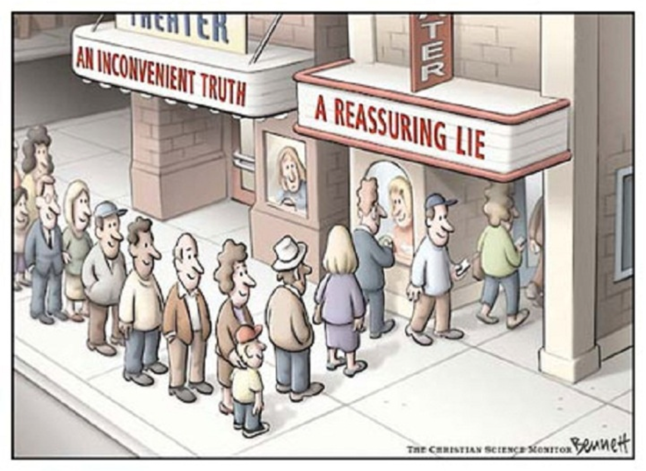
Confirmation Bias
We see and hear what fits our expectations and ignore the rest.

Slide 3
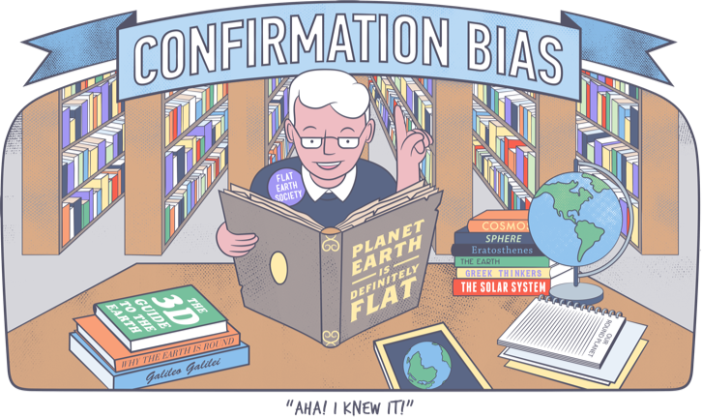

Slide 4
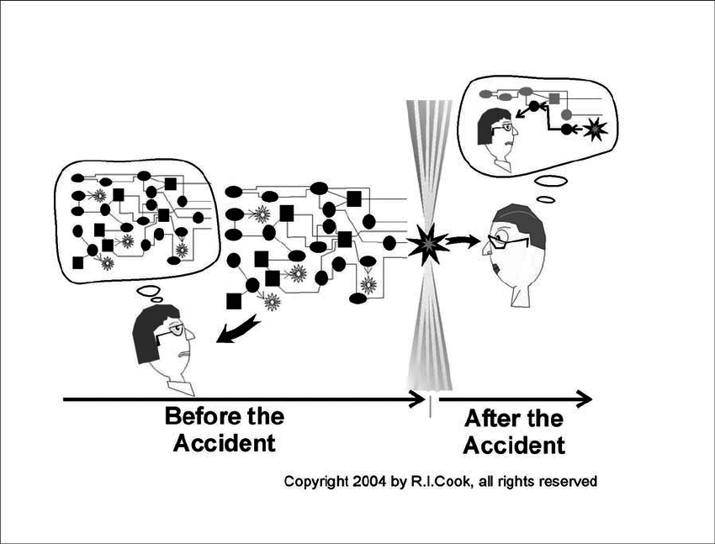
Biases
Hindsight Bias (the I-knew-it-all-along phenomenon).
It’s easy to predict the past.
If you get a result you think you already know, you may miss something about the data

Slide 5
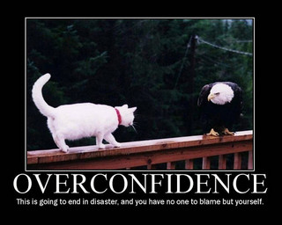
Biases
Overconfidence – we think we know more than we do.
Ask yourself:
“Do you have a hard time thinking you may be overconfident?”
Notes:
Could overconfidence be at work in that self-assessment?

Slide 6
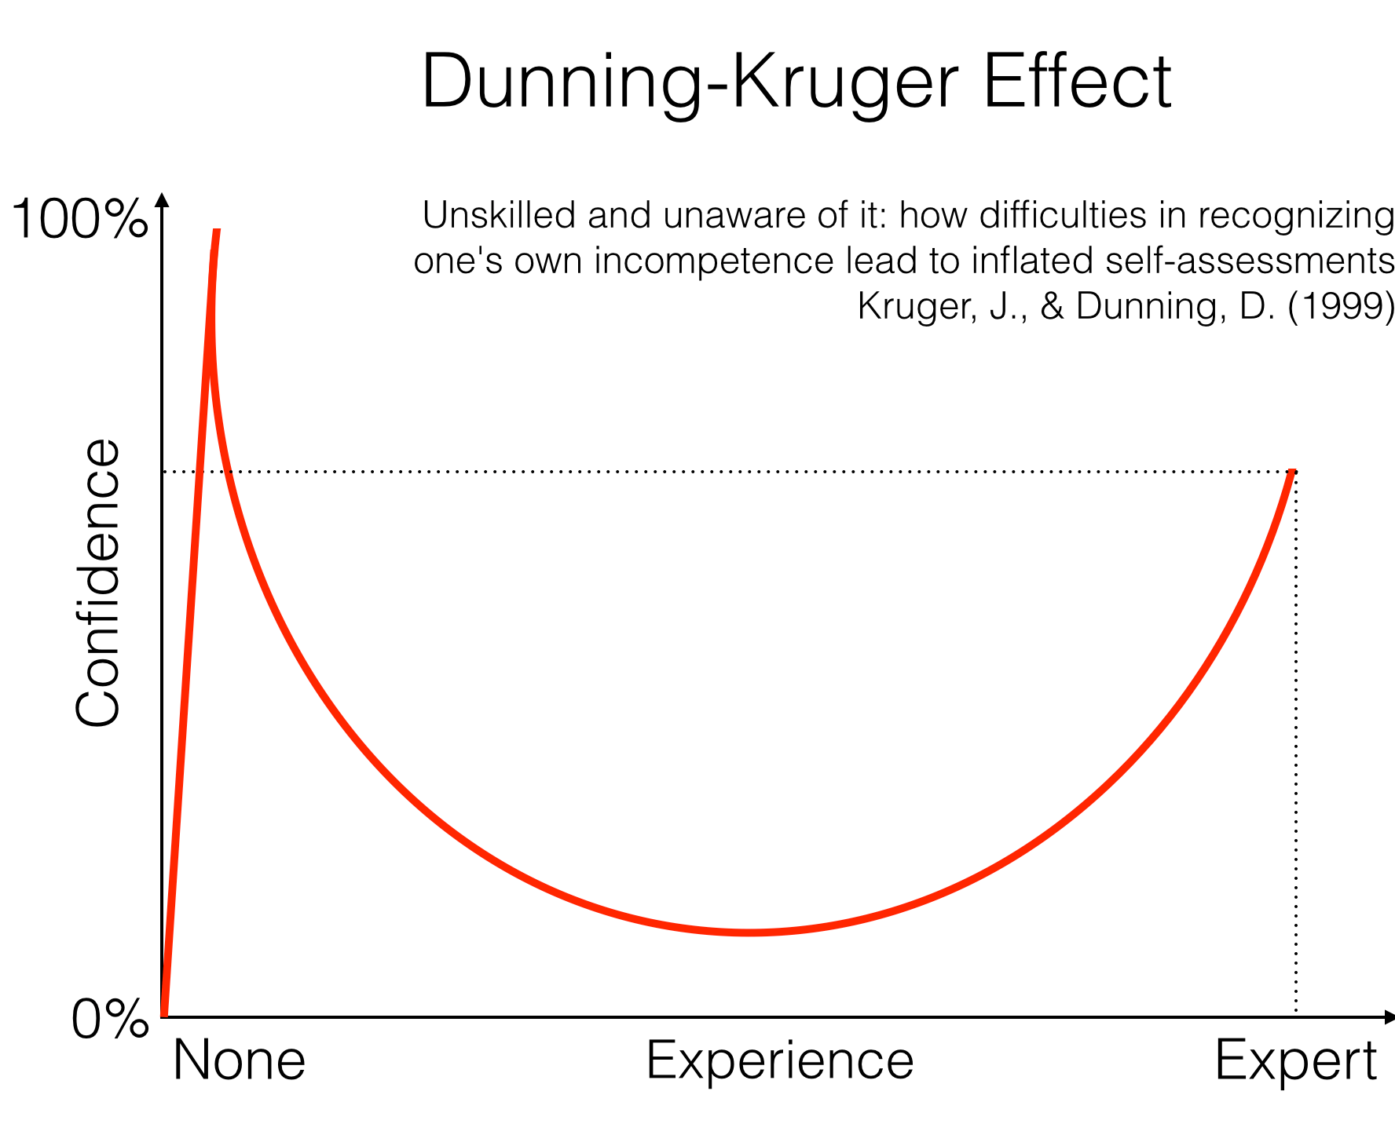
Biases
Dunning-Kruger Effect –
Low and medium skilled people overestimate their skills
High skilled people underestimate their skills
"If you're incompetent, you can't know you're incompetent... The skills you need to do something well are the same skills you need for knowing what doing something well is.”
Paraphrasing David Dunning

Slide 7
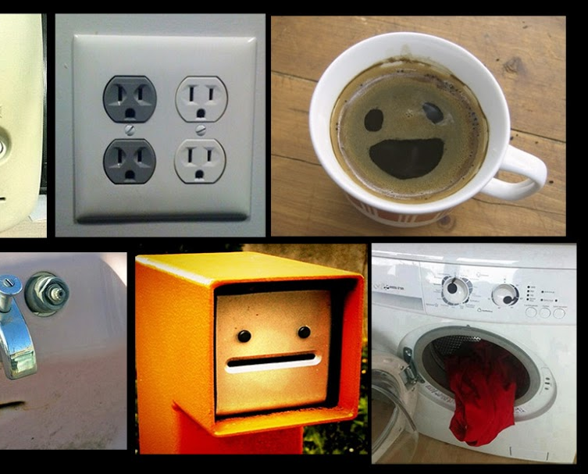
Patterns
Humans love patterns. We find them everywhere, even when none exists.
We perceive order in random events.
Pareidolia - to see or hear a pattern that doesn’t exist.

