Slide 1


Solution Strategies
Trial and error
  Works best with limited number of choices
Insight
  Sudden realization of a problem’s solution
Algorithms
  Step-by-step methods that guarantees a solution
  Math-type problems are best solved using an algorithm
Heuristics (Intuition)
  Rules of thumb that may help simplify a problem, but do not guarantee a solution.
  Quicker than algorithms

Slide 2
Algorithms
Algorithms, which are very time consuming, exhaust all possibilities before arriving at a solution. Computers use algorithms.
S P L O Y O C H Y G
Using an algorithmic approach, we would face 907,208 possibilities.

Slide 3
Heuristics
Heuristics make it easier for us to use simple principles to arrive at solutions to problems.
S P L O Y O C H Y G
S P L O Y O C H G Y
P S L O Y O C H G Y
P S Y C H O L O G Y
Heuristic at work: Y’s usually go at the end of a word.

Slide 4

Heuristics
Short-cuts learned from experience, to make decisions when facing complex problems or incomplete information.
Assumptions
Two Types
  Availability heuristic
  Representativeness Heuristic.

Slide 5

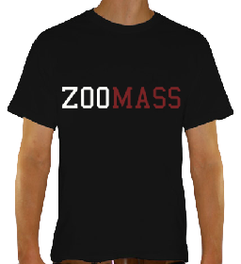
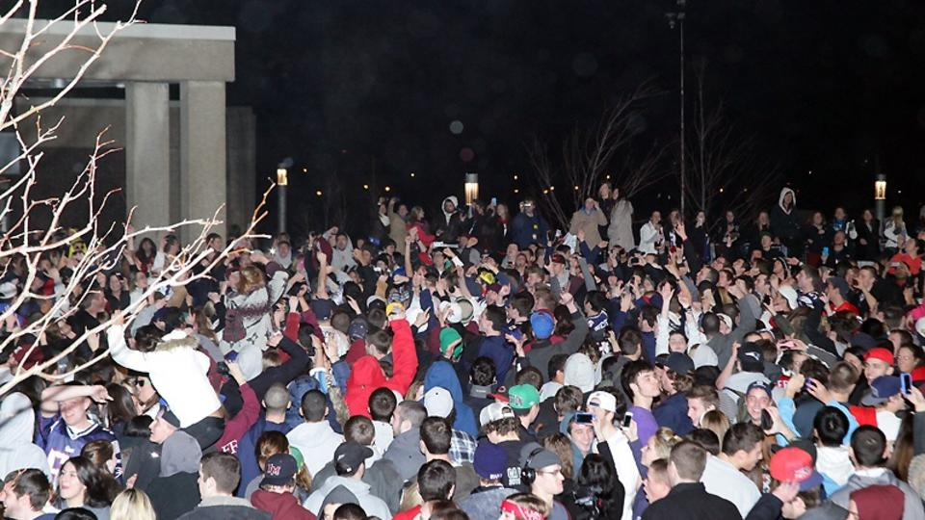
Representativeness Heuristic
Based upon how much something represents, or matches up, with characteristics from your typical case.
Good
School
It matches my
‘party school’
concept so I decide
it is bad school.
Bad School

Slide 6
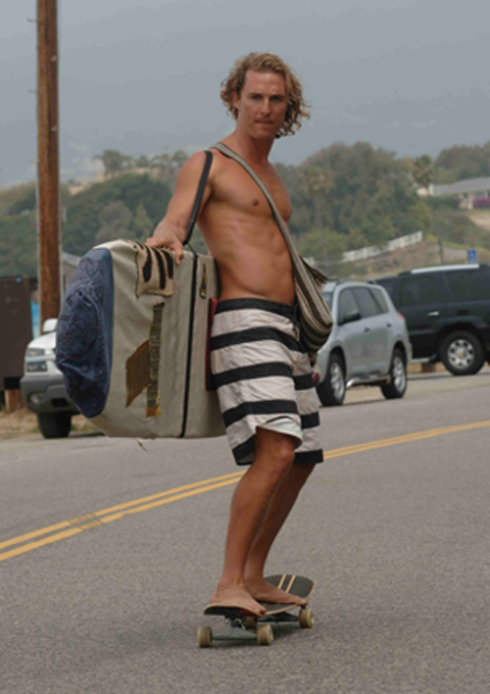
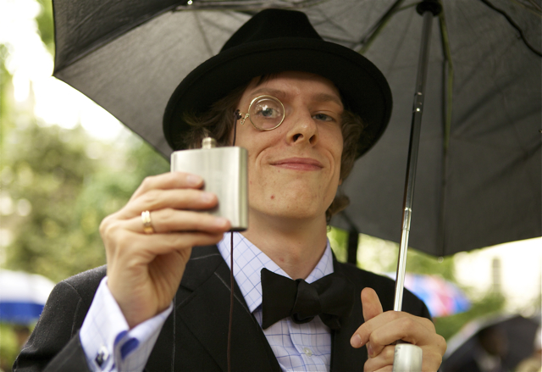

Representativeness Heuristic
Decide where they are from.

Slide 7
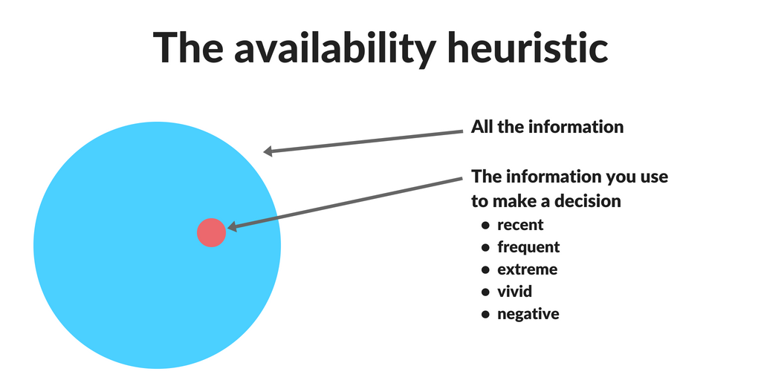
Availability Heuristic
We make decisions on how available information is.
The faster people can remember an instance of some event the more they expect it to occur.

Slide 8
Which causes more deaths per 100,000?
All accidents or strokes
Blood poisoning or suicide
Homicide or diabetes
Motor vehicle accidents or colorectal cancer
leukemia or Drowning

Slide 9
Which causes more deaths per 100,000?
All accidents (35.7) vs. strokes (57.4)
Suicide (10.4) vs. blood poisoning (11.3)
Homicide (7.1) vs. diabetes (25.1)
Motor vehicle accidents (15.7) vs. colorectal cancer (18.9)
Drowning (1.1) vs. leukemia (7.8)

Slide 10
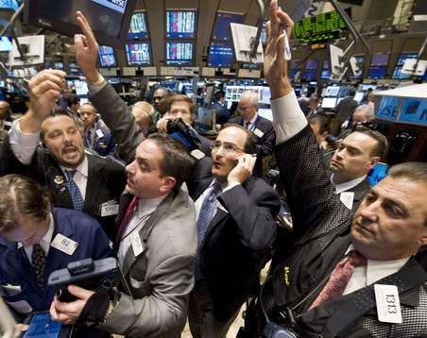
Overconfidence
Overestimate the accuracy of our beliefs and judgments.
At a stock market, both the seller and the buyer may be confident about their decisions on a stock.
Notes:
OBJECTIVE 6| Describe the drawbacks and advantages of overconfidence in decision making.

Slide 11
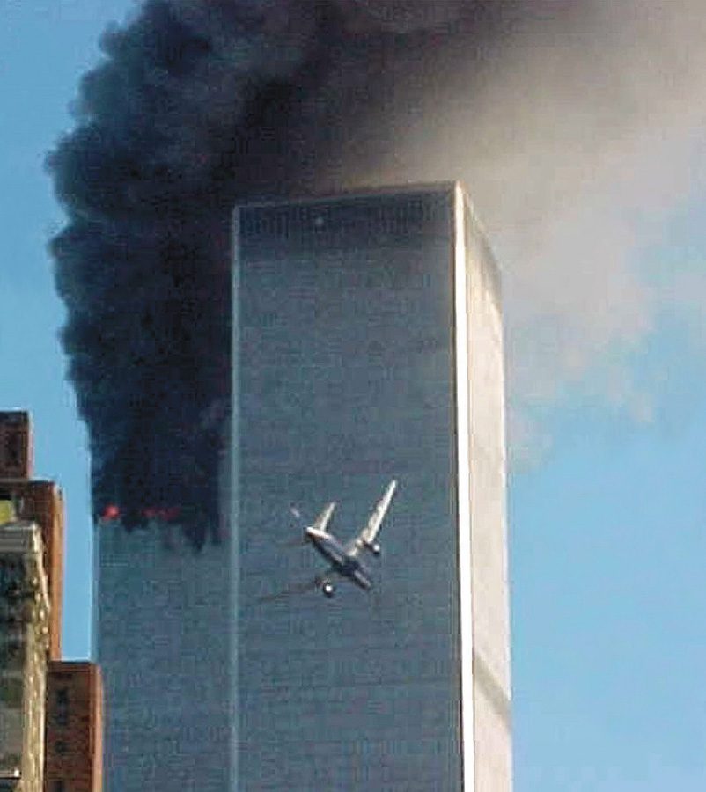
Exaggerated Fear
The opposite of overconfidence.
Such fears may be unfounded.
The 9/11 attacks led to a 20% decline in air travel due to fear.
800 more people would die if they drove just half those miles

Slide 12
Which city has the higher crime index?
Detroit or Myrtle Beach, SC
Chicago or Baltimore
Manhattan or Gary, Indiana
Boston or Flint, MI
Montreal or Hot Springs, Ark
San Francisco or Durham, NC

Slide 13
Answers
Detroit (crime index = 531) vs. Myrtle Beach (597)
Chicago (335) vs. Baltimore (479)
Manhattan (152) vs. Gary (544)
Boston (223) vs. Flint (329)
Montreal (181) vs. Hot Springs (201)
San Francisco (176) vs. Durham (216)

Slide 14

Obstacles to Solving Problems
Confirmation Bias
  We seek and favor information that verifies our ideas
Mental sets
  Tendency to only see solutions that have worked in the past.
Functional fixedness
  Tendency to see only a limited number of uses for an object

Slide 15

Confirmation Bias
We actively look for
information that
confirms our ideas

Slide 16
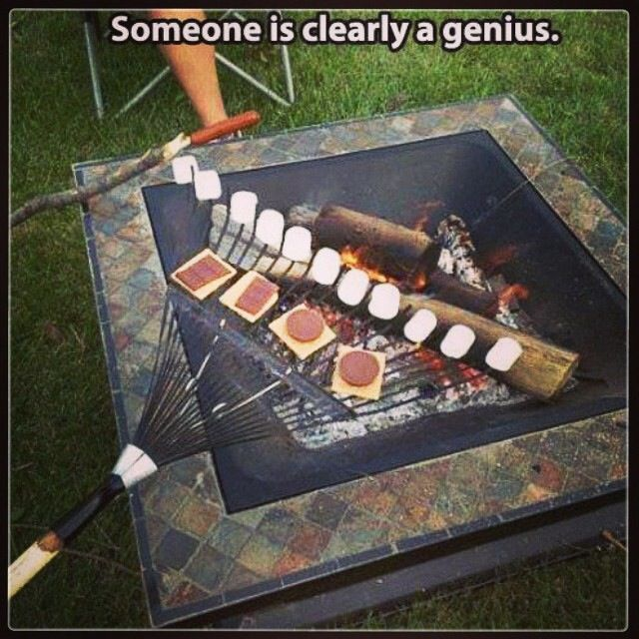
Functional Fixedness
“I can only use it for this one thing!”

Slide 17
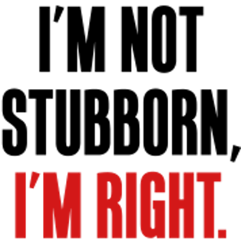
Belief Perseverance
Tendency to cling to our beliefs in the face of contrary evidence.
Notes:
OBJECTIVE 9| Describe the remedy for belief perseverance phenomenon.

