Slide 1

Developmental Psychology
Study of humans from
womb to tomb.

Slide 2
Developmental Psychology
Issue | Details
Nature/Nurture | How do genetic inheritance (nature) and experience (nurture) influence our behavior?
Stability/Change | Do our early personality traits persist through life, or do we become different persons as we age.
Continuity/Stages | Is development a gradual, continuous process or a sequence of separate stages?
Notes:
OBJECTIVE 1| State the three areas of change that developmental psychologists study, and identify the three major issues in developmental psychology.

Slide 3
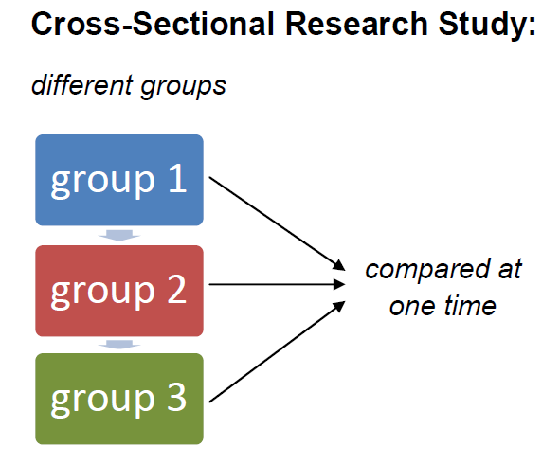
Cross-Sectional Study
Study people of different ages at the same point in time
Advantages
  Inexpensive
  Can be completed quickly
Disadvantages
  Different age groups are not necessarily much alike

Slide 4
Longitudinal Study
Study the same group of people over time
Advantages
  Detailed information about subjects
  Developmental changes studied in detail
Disadvantages
  Expensive and time consuming
  Potential for high attrition
  Differences over time may be due to assessment tools and not age

Slide 5


Slide 6

Biographical or Retrospective Study
Participant’s past is reconstructed through interviews and other research about their life
Advantages
  Great detail about life of individual
  In-depth study of one person
Disadvantages
  Recall of individual may not be accurate
  Can be expensive and time consuming

Slide 7
Prenatal/Newborn Development
How, over time, did we come to be who we are?
From zygote (fertilized egg) to birth, development progresses in a somewhat orderly sequence.
Placenta - During the embryo and fetal stages, the baby is attached to the placenta and receives food and oxygen from the mother.

Slide 8
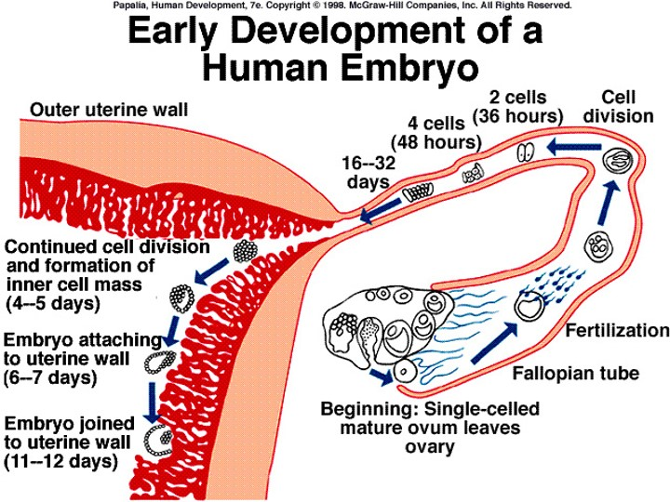

Slide 9
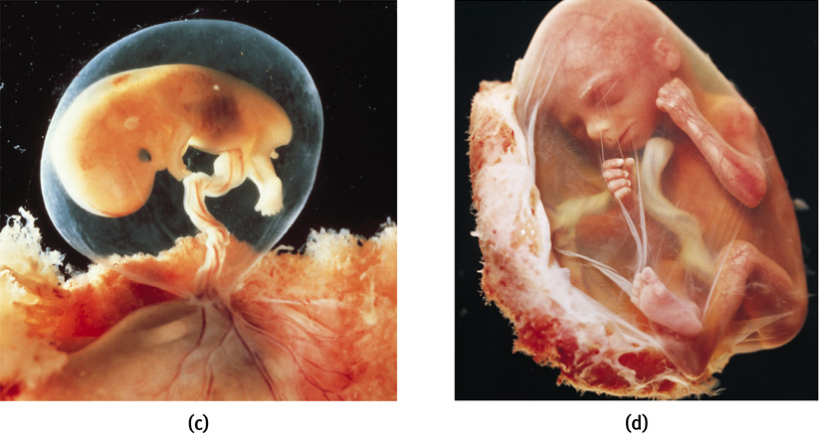
Prenatal Development
At 9 weeks, an embryo turns into a fetus.

Slide 10

Teratogens
Any environmental agent that can reach the embryo or fetus and cause harm.

Slide 11
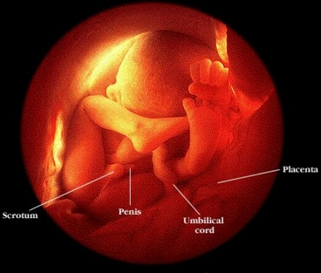
32 Weeks
The fetus sleeps 90-95% of the day with REM sleep dominating the sleep cycle, an indication of dreaming.
The baby is viable at this point, with a 75% or higher chance of survival.
If the baby is born, the concerns are with adequate lung development. Final lung development does not occur until about 37 weeks.

Slide 12
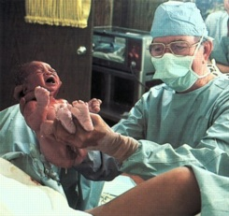
Birth: 38-42 Weeks
40 weeks is normal gestation
Babies average size is 7 lbs., 20 inches.
At birth the baby can see, hear, move and recognizes the voices of her parents or others who have been near the mother.

Slide 13
Reflexes
Rooting
  Baby turns its head toward something that brushes its cheek and gropes around with mouth
Sucking
  Newborn’s tendency to suck on objects placed in the mouth
Swallowing
  Enables newborn babies to swallow liquids without choking
Grasping
  Close fist around anything placed in their hand
Stepping
  Stepping motions made by an infant when held upright

Slide 14

Temperament
Temperament = characteristic patterns of emotional reactions and self-regulation
3 basic types of babies
  Easy
    Good-natured, easy to care for
  Difficult
    Moody and intense
  Slow-to-warm-up
    Inactive and slow to respond to new things

Slide 15
Temperament
Kagan has added a fourth type:
  Shy child
    Timid and inhibited, fearful of anything new or strange
Temperament may predict later disposition

Slide 16

Perceptual Abilities
Vision
  Clear for 8-10 inches
  Good vision by 6 months
Depth perception
  Visual cliff research
Other senses
  Ears are functional prior to birth
  Infants particularly tune in to human voices
  Taste and smell are fully functional

