Slide 1
Pluto
Pluto resides in Kuiper Belt.
In 2005, Eris (same size as Pluto) found in Kuiper Belt.
In 2006 Pluto and Eris classified as “Dwarf Planets”.
Pluto does not clear out its orbit

Slide 2
Pluto
Retrograde rotation, like Venus and Uranus
Has 5 moons.. Charon, Hydra, Nix, P4 and P5
Pluto and Charon orbit each other -- double dwarf planet system

Slide 3
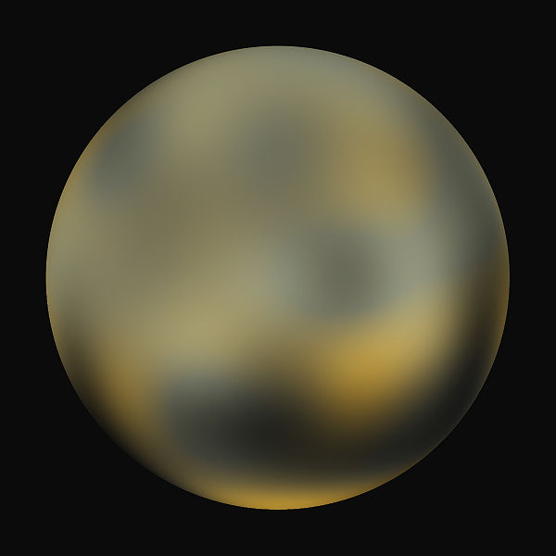

Slide 4
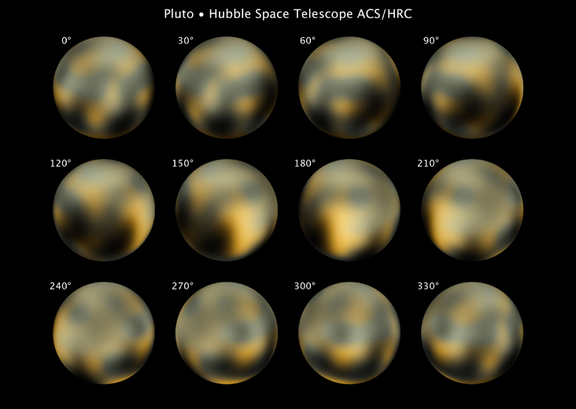

Slide 5
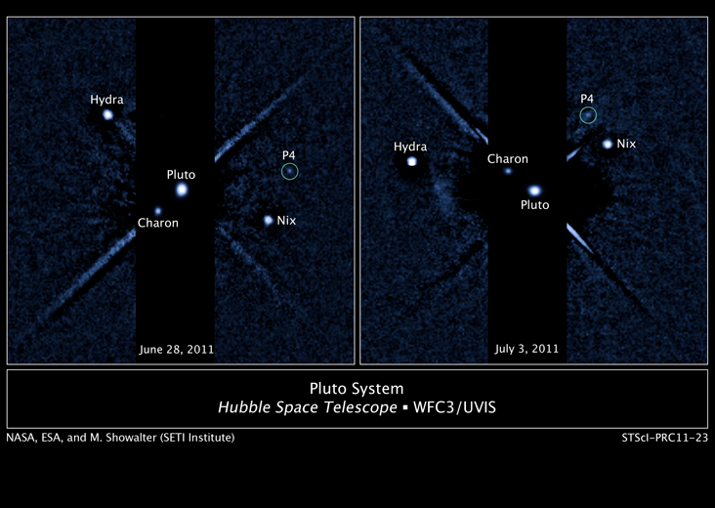

Slide 6
Dwarf Planets
Only 5 so far… Pluto, Eris, Ceres, Makemake, and Haumea. Most have moons
If found in Kuiper Belt, than also called “Plutoid”
Only Ceres is in the asteroid belt

Slide 7
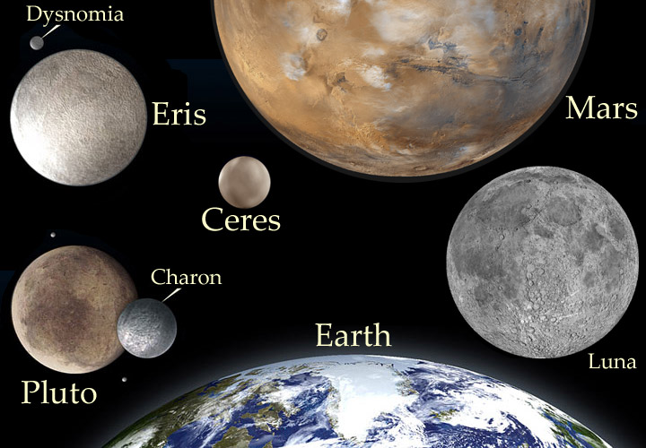

Slide 8
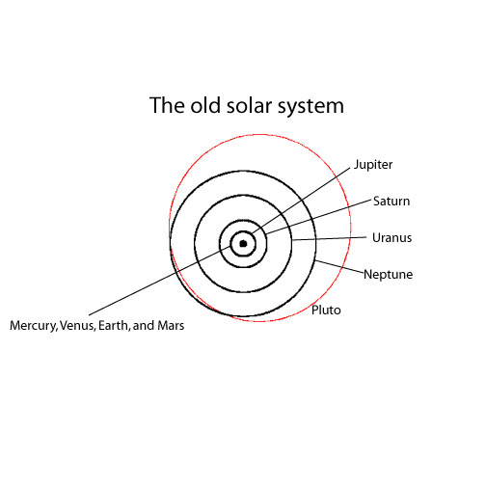

Slide 9
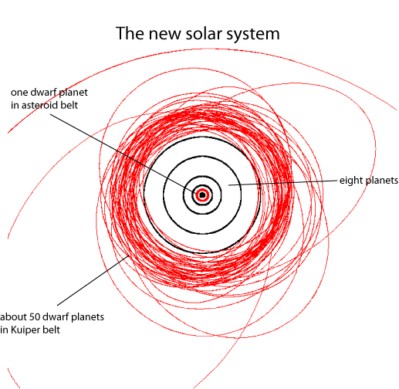

Slide 10
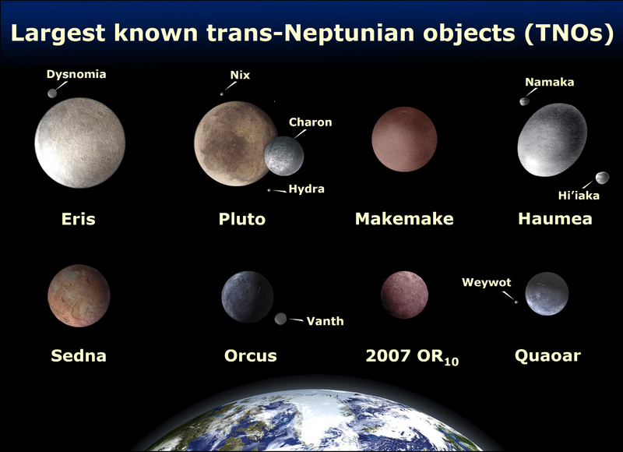

Slide 11
Kuiper Belt
Region located 30 to 55 AU (past Neptune).
1,300 objects discovered so far.
May have over a trillion comets and 200 dwarf planets.

Slide 12
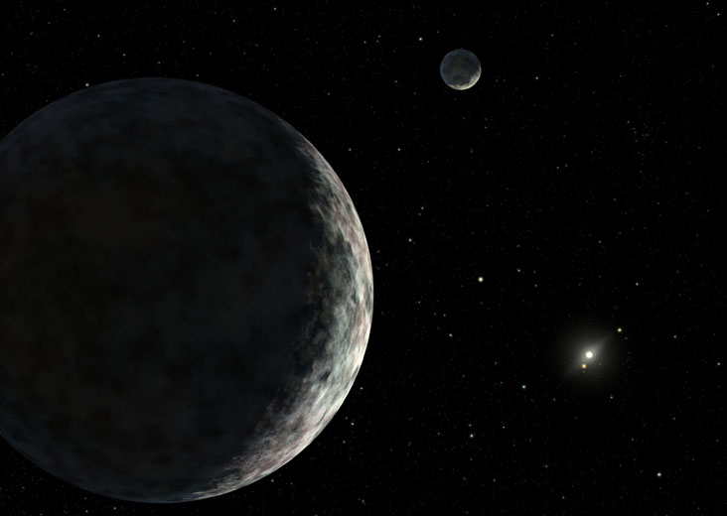
Eris and Dysnomia

Slide 13
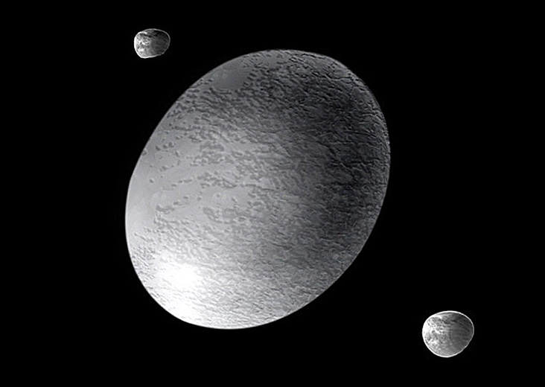
Haumea
(turns end over end every 4 hours)

Slide 14
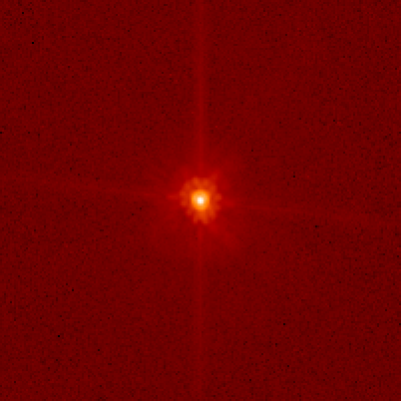
Makemake

