Slide 1
Do Now
What are the 3 pieces of evidence for the theory of Continental Drift?
Who developed the theory?

Slide 2
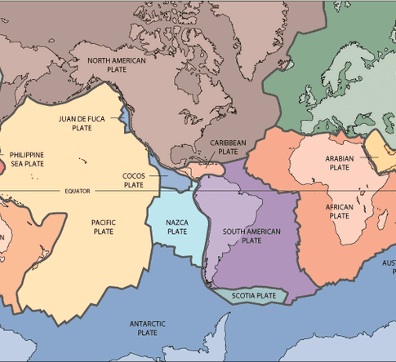
Plate Tectonics
Crust is broken into pieces (plates).
New crust is always being made
(ridges and volcanoes)
Old crust is always being destroyed
(by subduction)

Slide 3
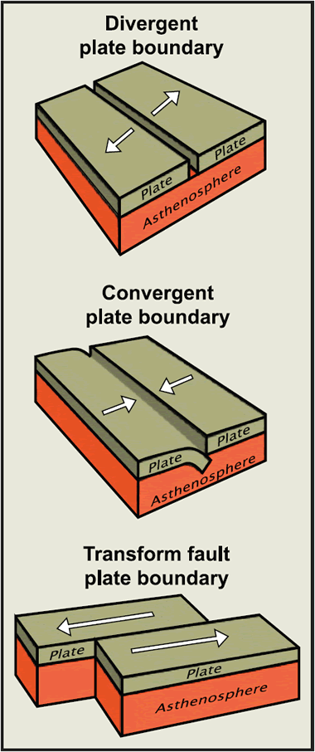
Plate Boundaries
Where plates meet, three things can happen:
Diverge – move apart
Converge – come together
Transform – move past each other

Slide 4
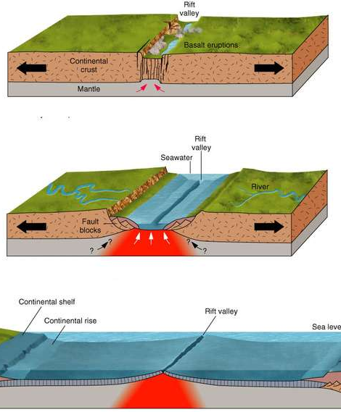
Divergent Plates
youngest rock where magma rises.

Slide 5
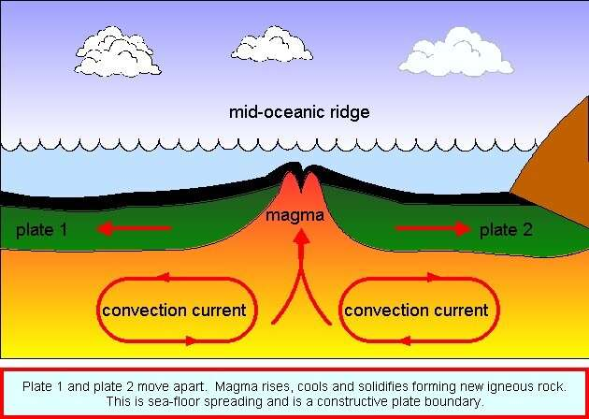

Slide 6
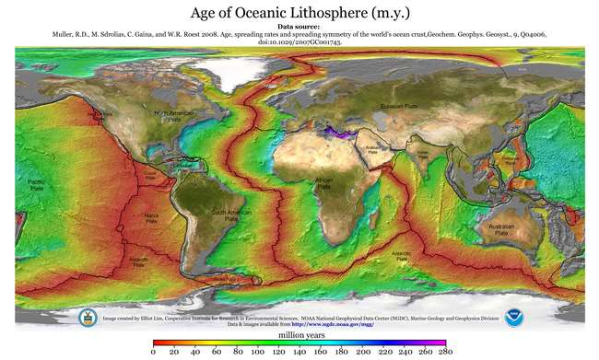

Slide 7
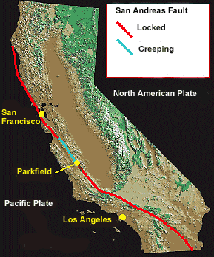
Transform Plates
When plates move past each other.
Ex. San Andreas Fault

Slide 8
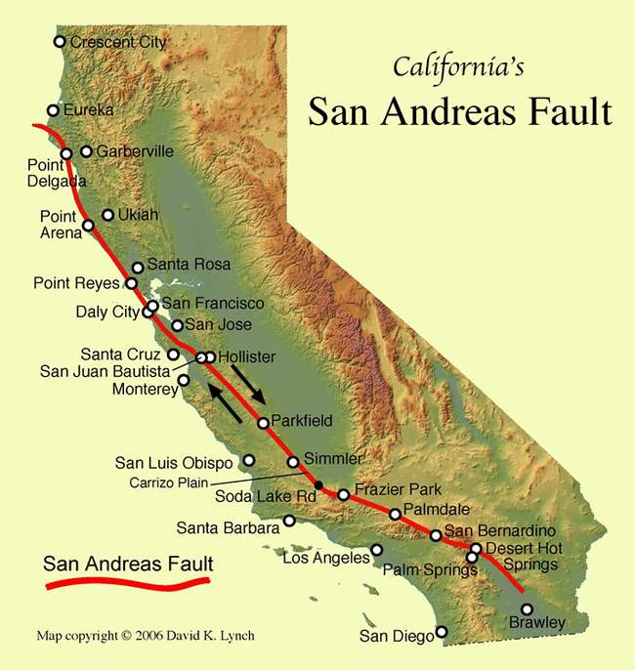
San Andreas Fault

Slide 9
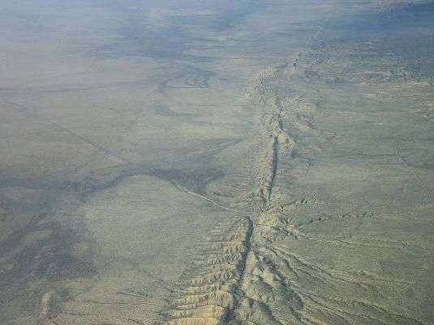
San Andreas Fault

Slide 10
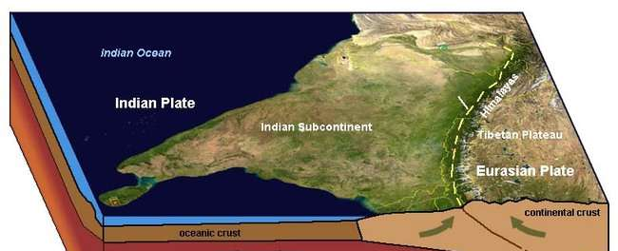
Converging Plates
When plates move toward each other
If plates have same density, they crumple and fold, making mountains.

Slide 11
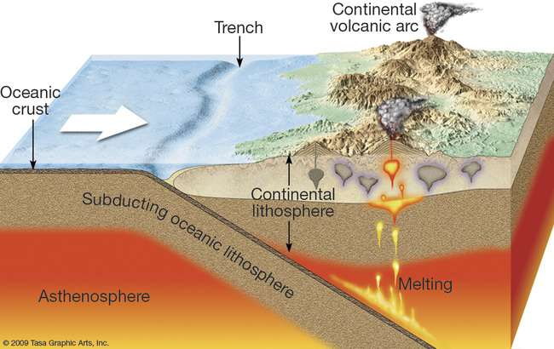
Subduction
When oceanic crust (denser) sinks under continental crust into mantle

Slide 12
Subduction

Slide 13
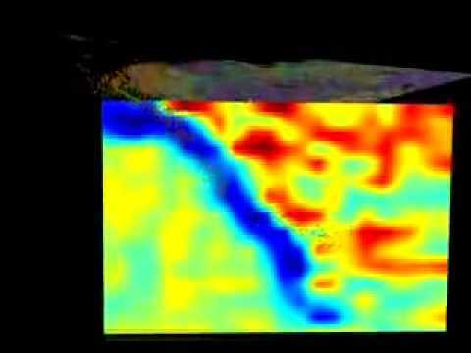
Thermal Slab

Slide 14

Subduction
All subduction zones have:
Volcanoes
Ocean Trenches
Earthquakes
Tsunamis

Slide 15
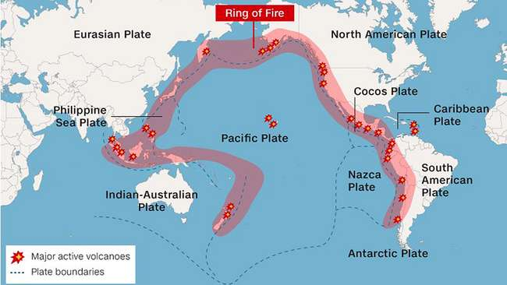

Slide 16
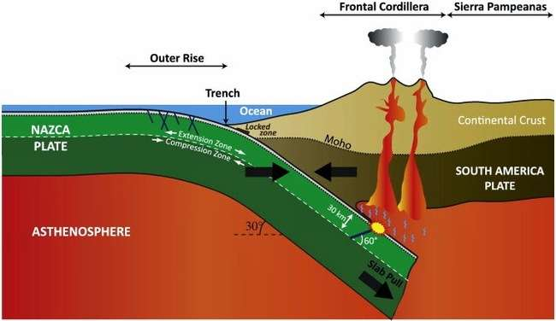
Andes Mountains

Slide 17
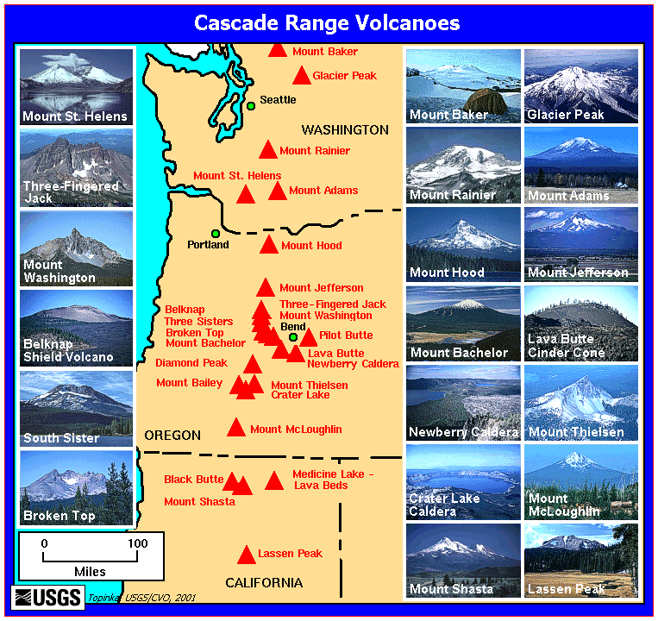

Slide 18
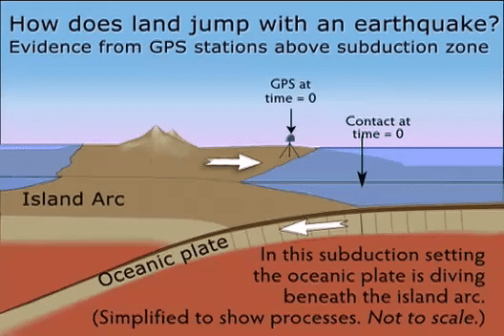

Slide 19
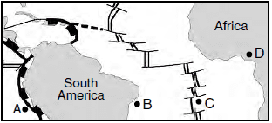
Do Now
In at least one full sentence, identify the location (A,B,C or D)
where the newest bedrock would be located and explain the science behind it.

Slide 20
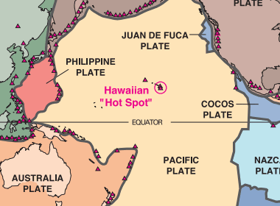
Hot Spots
Some volcanoes form far from plate edges.
Hawaiian volcanoes are 4,000 km from a plate boundary.
How do they form?
Mantle Plume!

Slide 21
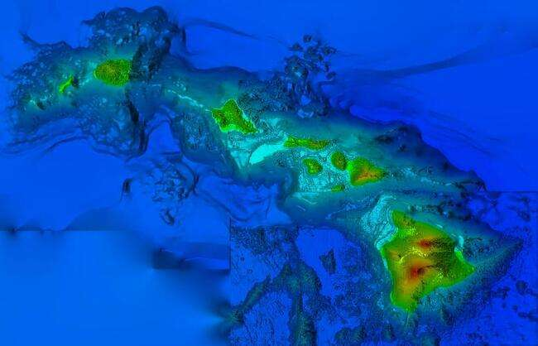

Slide 22
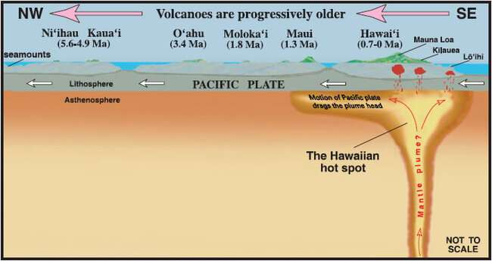

Slide 23
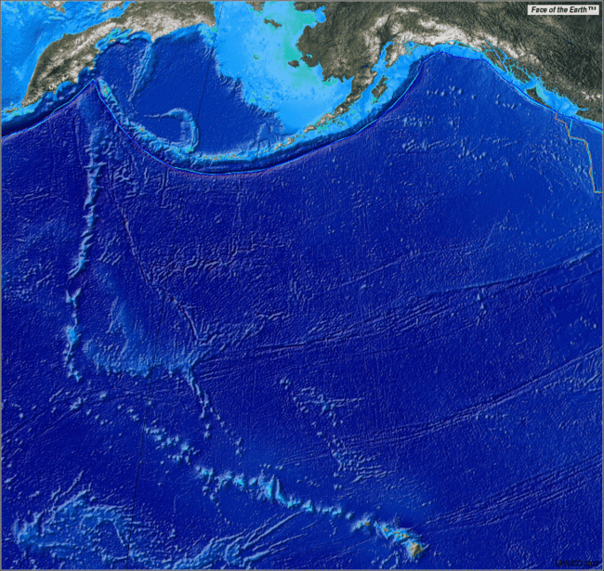

Slide 24
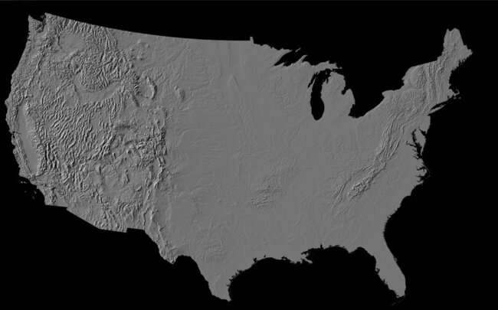

Slide 25
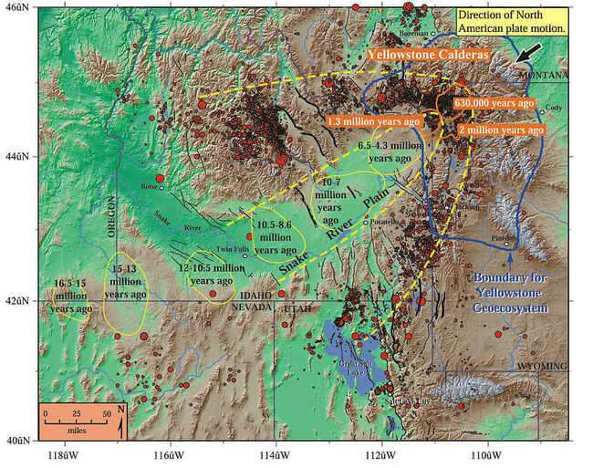

Slide 26
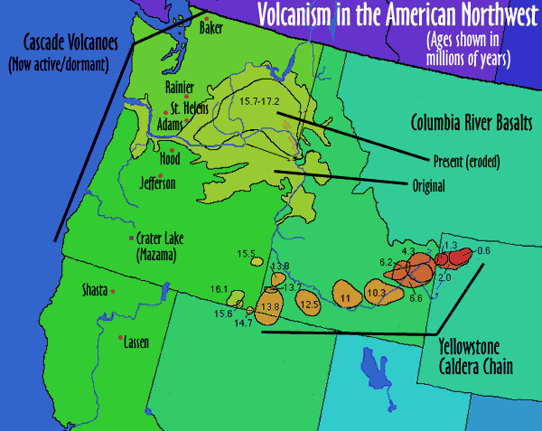

Slide 27
