Slide 1
Astronomy
Astronomy = study of celestial objects and phenomena outside Earth’s atmosphere
Includes galaxies, stars, planets, moons, cosmic radiation, etc.
Celestial object = Every object outside of Earth’s atmosphere

Slide 2
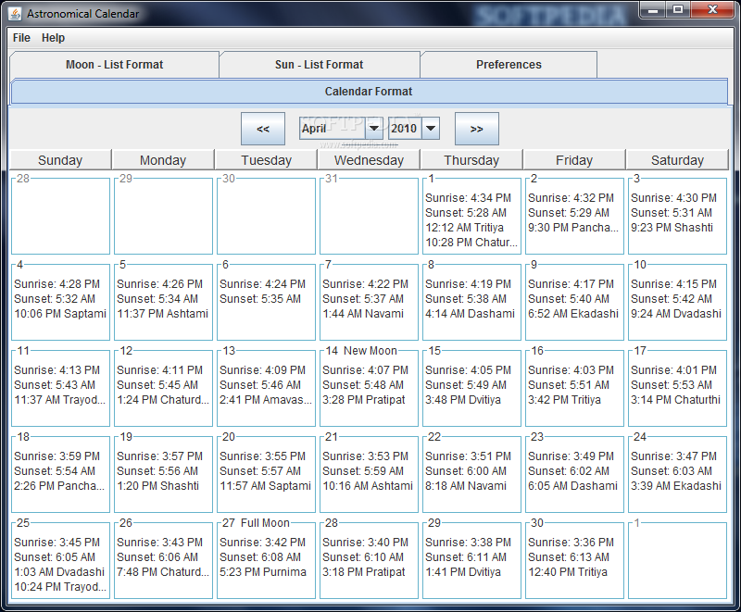
Calendars
Our calendar marks
astronomical events.
Year - one Earth revolution
around Sun.
Month - one Moon revolution around Earth
Day - one Earth rotation

Slide 3
Space
Universe = includes everything in existence.
~13.8 billion years old.
Galaxies = collections of billions of stars.
Our galaxy is the Milky Way.
Solar System = Stars and whatever revolves around them;
Includes planets, dwarf planets, comets, and asteroids.

Slide 4
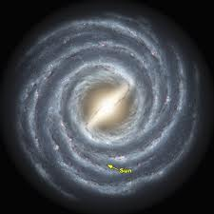
Milky Way

Slide 5
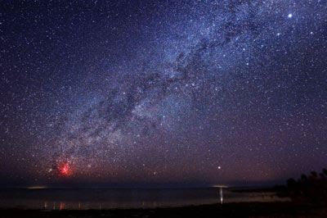
Milky Way

Slide 6
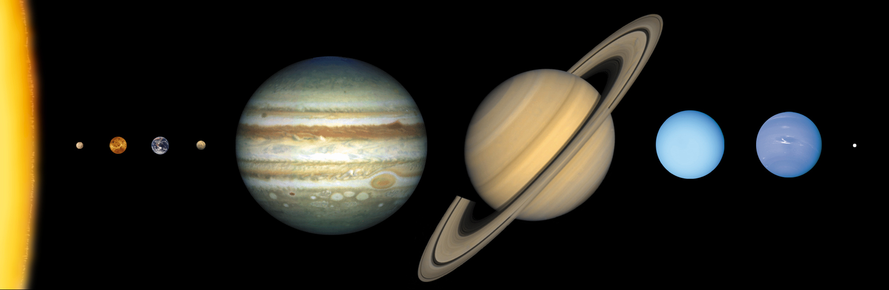
Solar System

Slide 7
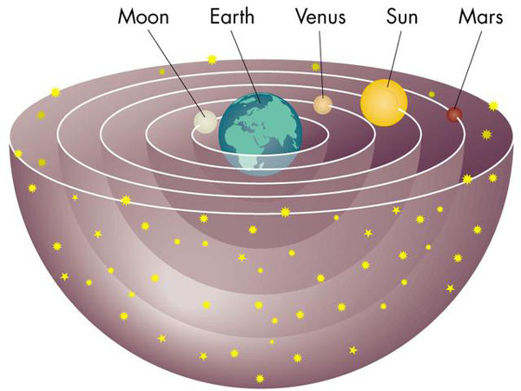
Geocentric Model
Aristotle (350 BC) - Geocentric model.
Why?
It explains the sun’s motion during the day.
Geocentric Model:
Earth at the center of universe.

Slide 8
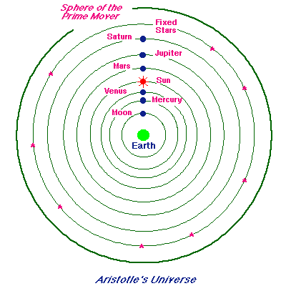
Aristotle’s Universe

Slide 9
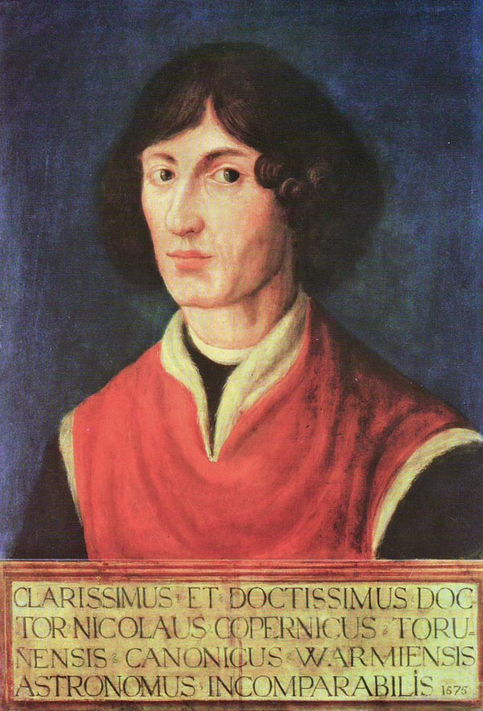
Copernicus

Slide 10
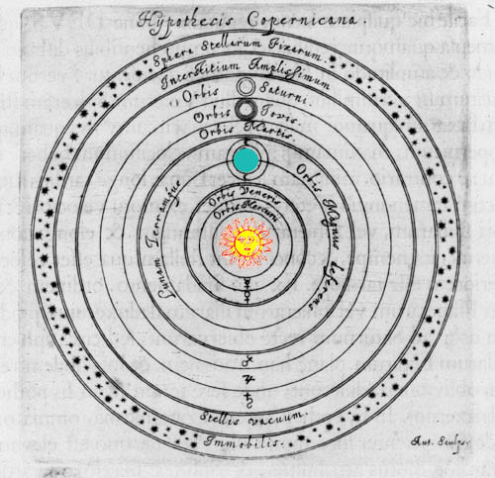
Heliocentric Model
Nicolaus Copernicus (1473 – 1543)
Heliocentric Model: Sun is at the center of universe.
Not accepted until Galileo 100 years later

Slide 11
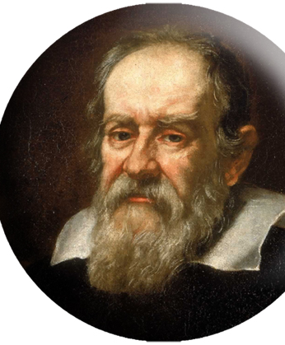
Galileo
Galileo Galilei (1564 – 1642)
-- finally disproved the geocentric theory.
-- the first to turn the telescope to the sky (he did not invent the telescope).
-- first scientist…tested ideas with experiments.

Slide 12
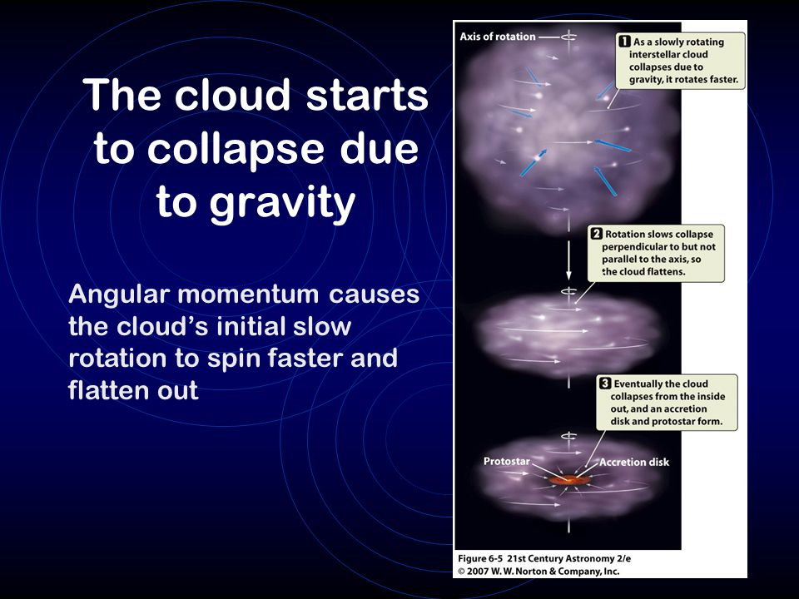
Solar Nebula Theory
How To Make A Star and Planets:
nebula = a large cloud of dust and gas.
2. GRAVITY makes the nebula spin and flatten….like making pizza

Slide 13
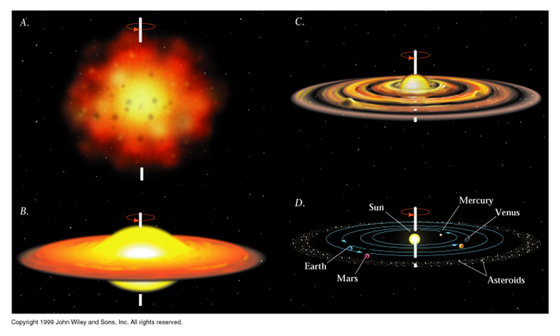
Solar Nebula Theory
3. The center reaches 15 million degrees and ignites!
4. Nuclear Fusion
lighter elements combine into heavier elements.
5. Voila… a star and planets are formed.

Slide 15
Planet Formation
Dust and rocks begin to clump together… like a snowball = accretion.
Planetesimals = objects size of small moons with gravitational fields.

Slide 16
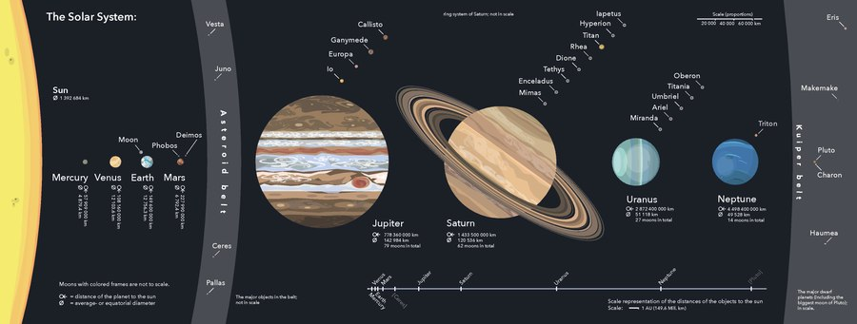
Planets
Definition (2006):
1. In orbit around the Sun (no moons)
2. Enough mass to be a sphere
3. Cleared the “neighborhood” around its orbit

Slide 17
Planet Groups
Characteristics | Terrestrial-M,V,E,M | Jovian-J,S,U,N
Distance from Sun
Made mostly of…
Relative Size/Diameter
Density
# of moons
Length of revolution around the Sun
Closer
Farther
Minerals and rocks
Gas
Relatively Small
Very large
Very Dense
Less Dense
Few if any
Many moons
Relatively Short
Very long
Notes:
We will ask the students to provide a one or two word response that would characterize the different aspects of the planets in the solar system.
We will lead with “Compared to the Jovian planets, terrestrial planets are closer or farther from the Sun”.

Slide 18
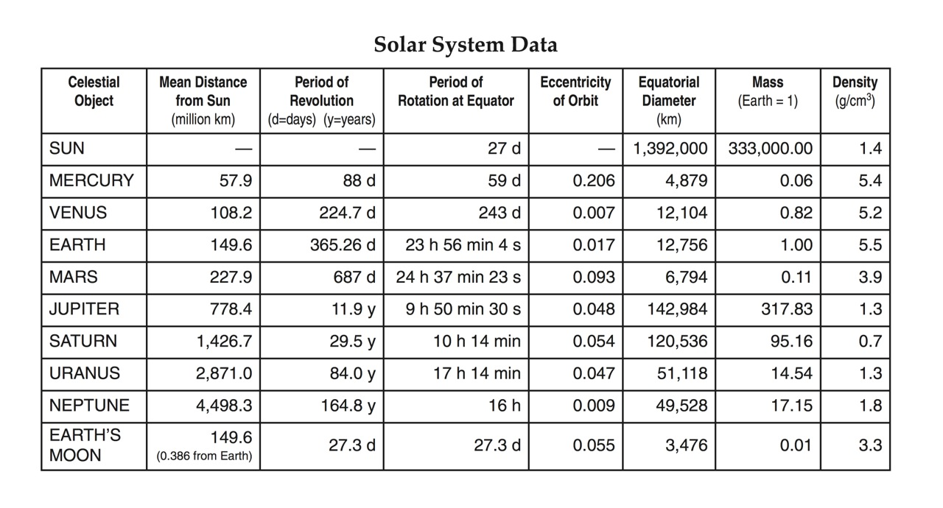

Slide 19
Ice Line
-- Sun’s high temperatures burn off lighter elements (gas) from planets close to the sun.
-- Cooler temperatures further away allow gas and ice to collect.
As a Result:
Inner planets are solid (Terrestrial)
Outer planets are gas (Jovian)

Slide 20
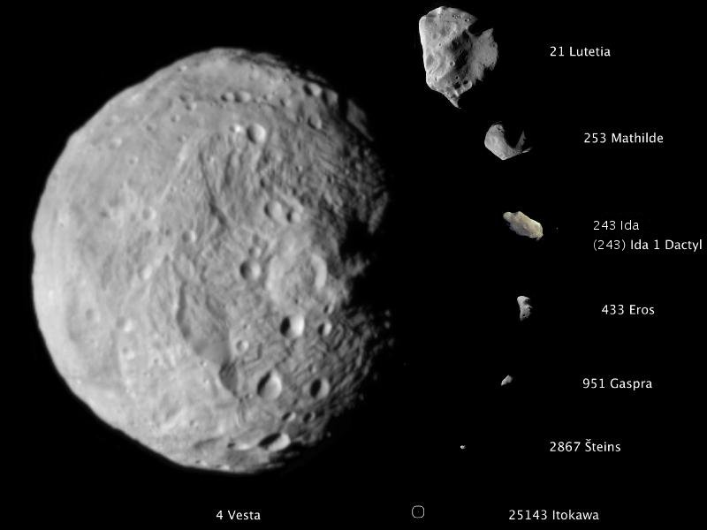
Asteroids
Rocky and Metallic objects that orbit the sun.
Most located between Mars and Jupiter.
Potential end to civilization or species.

Slide 21
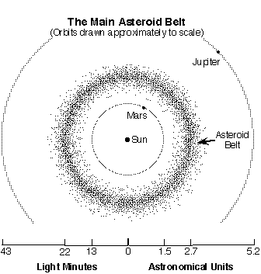

Slide 22
Meteors
Meteoroids = asteroids on collision course with Earth.
Meteor = when meteoroid hits Earth’s atmosphere… usually burn up (shooting star).
Meteorite = if meteor hits Earth. Over 100 meteorites fall annually…most very small.

Slide 23
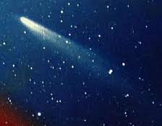
Comets
Ball of dust and ice that revolves around the sun.
“Dirty snowball”.
Potential end to civilization or species.

Slide 24
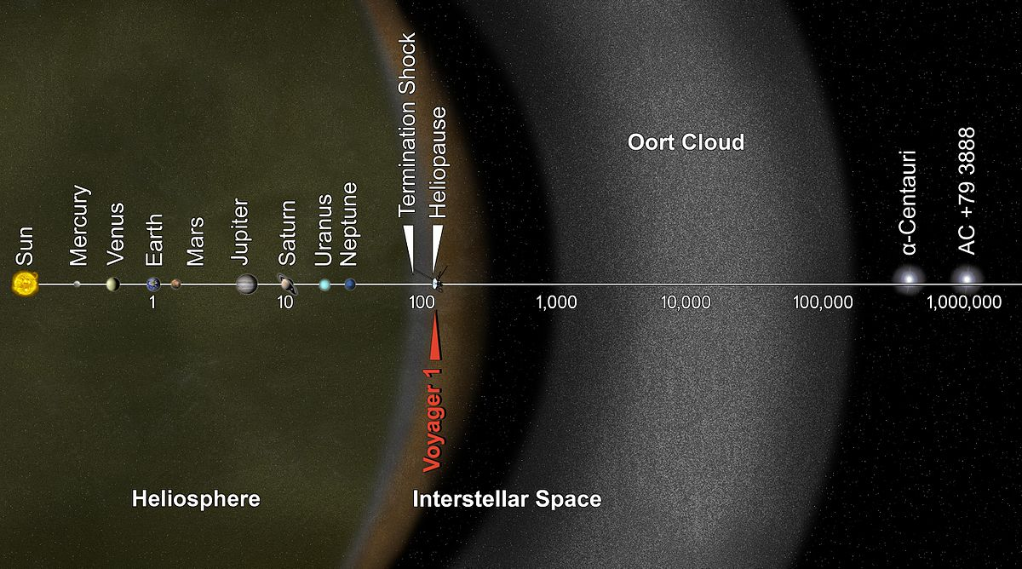
Oort Cloud (many comets live here)

Slide 25
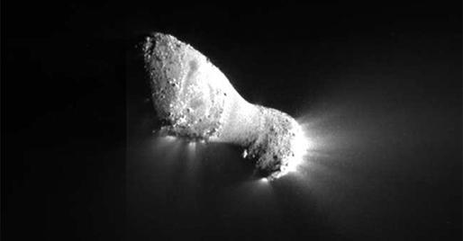
Rosetta

Slide 26
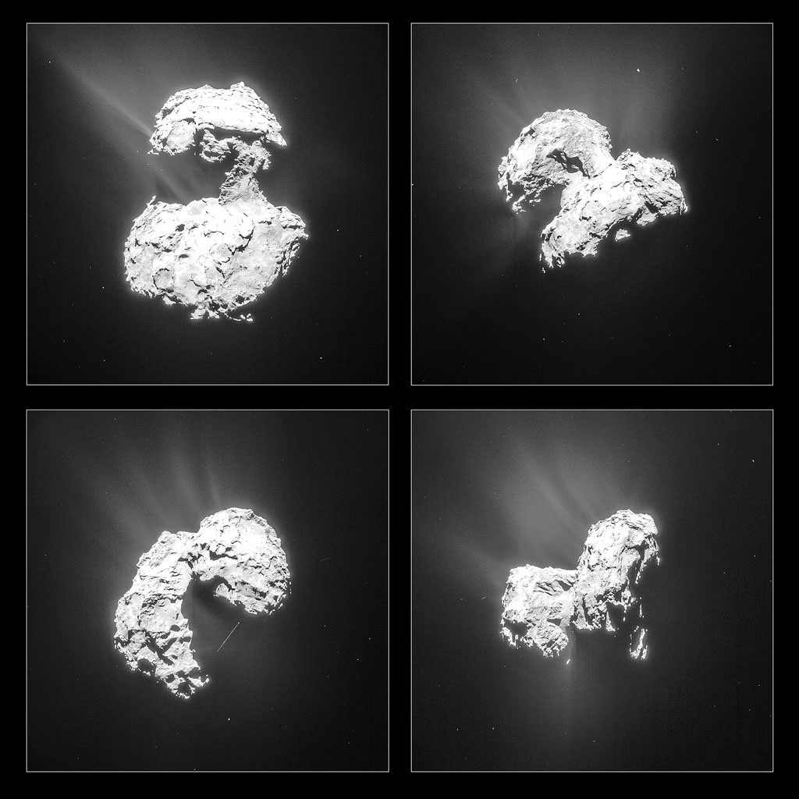
Comet 67P

Slide 27
Exoplanet
Exoplanet = planet outside the solar system.
Over 4,300 confirmed so far.
Habitable Zone: Orbit around a star where liquid water can exist on a planet’s surface.

