Slide 1
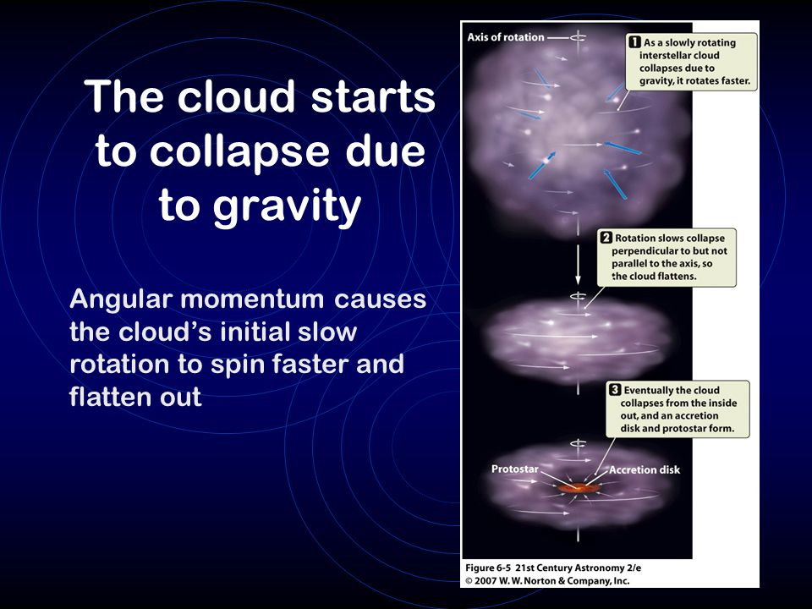
Solar Nebula Theory
How To Make A Star and Planets:
nebula = a large cloud of dust and gas.
2. GRAVITY makes the nebula spin and flatten….like making pizza

Slide 2
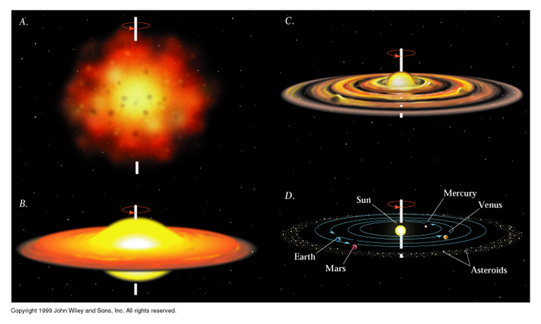
Solar Nebula Theory
3. The center reaches 15 million degrees and ignites!
4. Nuclear Fusion
lighter elements combine into heavier elements.
5. Voila… a star and planets are formed.

Slide 4
Planet Formation
Planetary Disk - dust and rocks orbiting the new Sun.
Dust and rocks begin to clump together… like a snowball = accretion.
Planetesimals = objects size of small moons with gravitational fields.

Slide 6
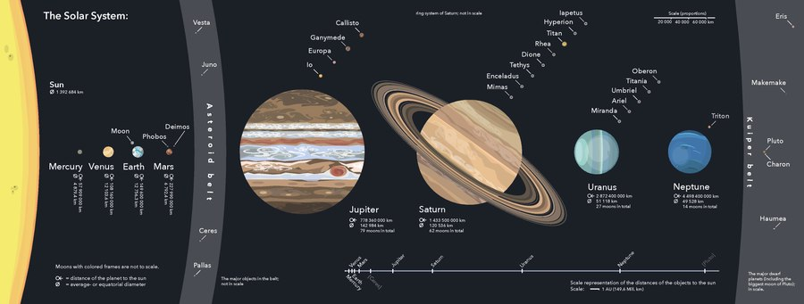
Planets
Definition (2006):
1. In orbit around the Sun (no moons)
2. Enough mass to be a sphere
3. Cleared the “neighborhood” around its orbit

Slide 7
Ice Line
-- Sun’s high temperatures burn off lighter elements (gas) from planets close to the sun.
-- Cooler temperatures further away allow gas and ice to collect.
As a Result:
Inner planets are solid (Terrestrial)
Outer planets are gas (Jovian)

Slide 8
Planet Groups
Characteristics | Terrestrial-M,V,E,M | Jovian-J,S,U,N
Distance from Sun
Made mostly of…
Relative Size/Diameter
Density
# of moons
Length of revolution around the Sun
Closer
Farther
Minerals and rocks
Gas
Relatively Small
Very large
Very Dense
Less Dense
Few if any
Many moons
Relatively Short
Very long
Notes:
We will ask the students to provide a one or two word response that would characterize the different aspects of the planets in the solar system.
We will lead with “Compared to the Jovian planets, terrestrial planets are closer or farther from the Sun”.

Slide 9
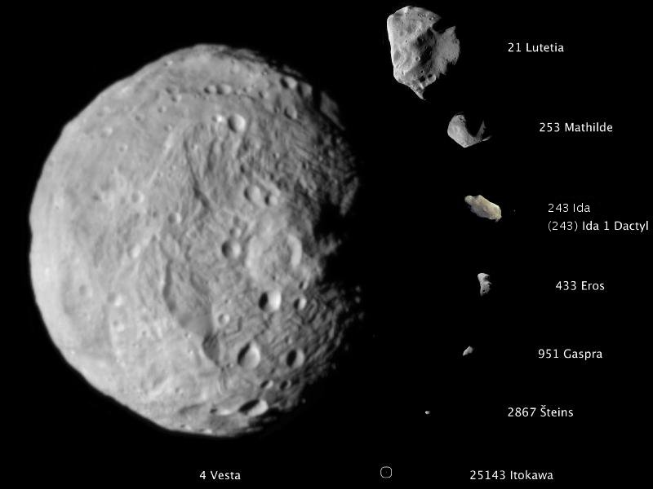
Asteroids
Rocky and Metallic objects that orbit the sun.
Most located between Mars and Jupiter.
Potential end to civilization or species.

Slide 10
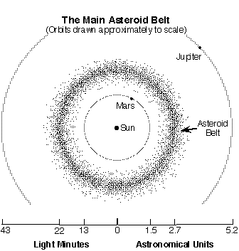

Slide 11
Meteoroids
Meteoroids = asteroids on collision course with Earth.
Meteor = when meteoroid hits Earth’s atmosphere… usually burn up (shooting star).
Meteorite = if meteor hits Earth. Over 100 meteorites fall annually…most very small.

Slide 12
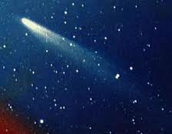
Comets
Ball of dust and ice that revolves around the sun.
“Dirty snowball”.
Potential end to civilization or species.

Slide 13
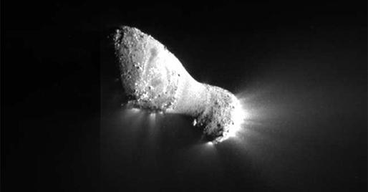
Rosetta

Slide 14
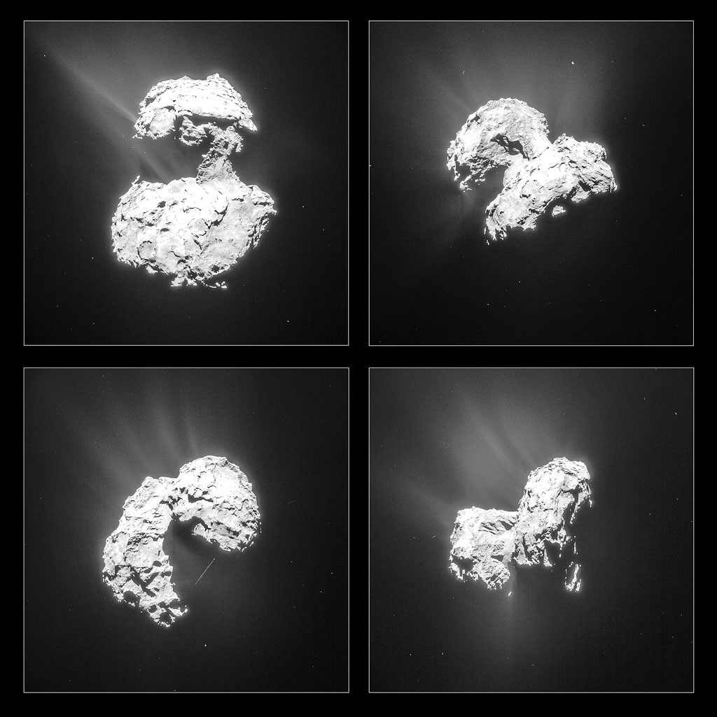
Comet 67P

Slide 15
Exoplanet
Exoplanet = planet outside the solar system.
Over 2,400 found so far.
First rocky planet found.

