Slide 1
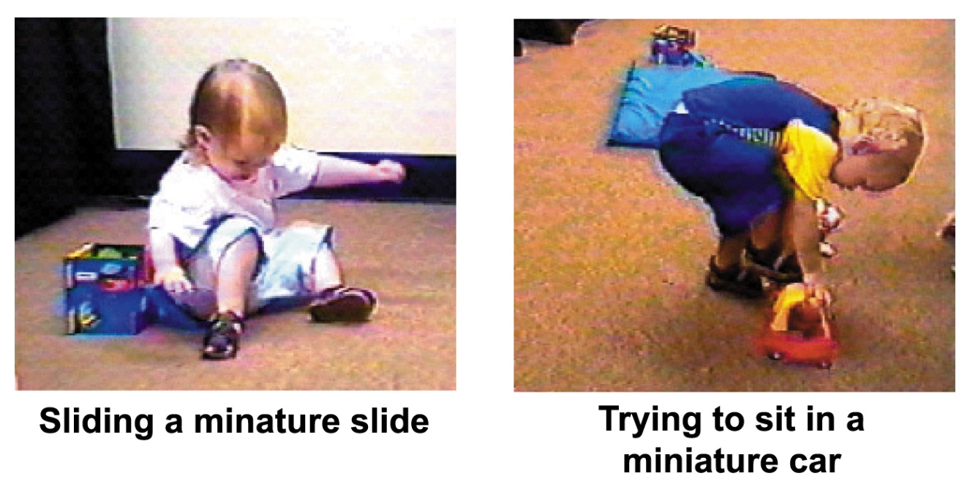

Cognitive Development
Piaget = biological development (maturation) drives cognitive development.
As we age, we enter new cognitive stages.
Notes:
OBJECTIVE 8| State Piaget’s understanding of how the mind develops, and discuss the importance of assimilation and accommodation in this process.

Slide 2
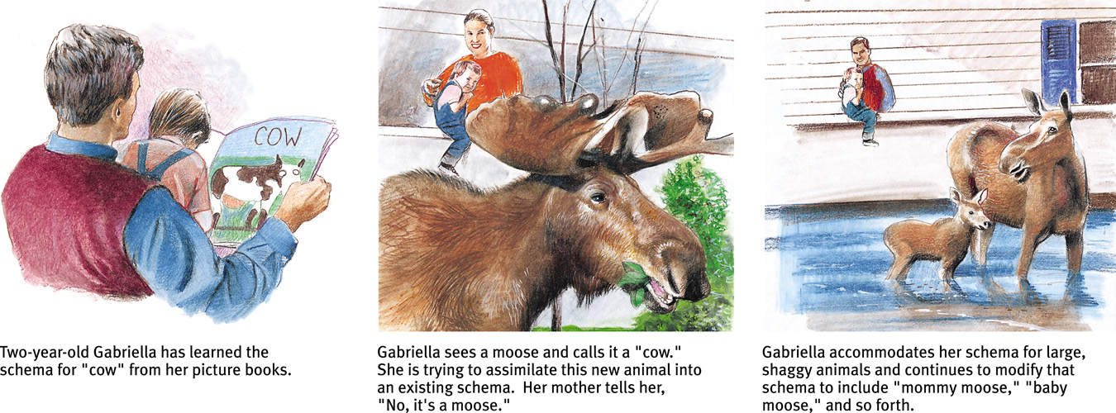
Schemas
Schemas are mental molds that we use to organize our world and are formed from experiences.
Star Wars according to a 3 year old

Slide 3
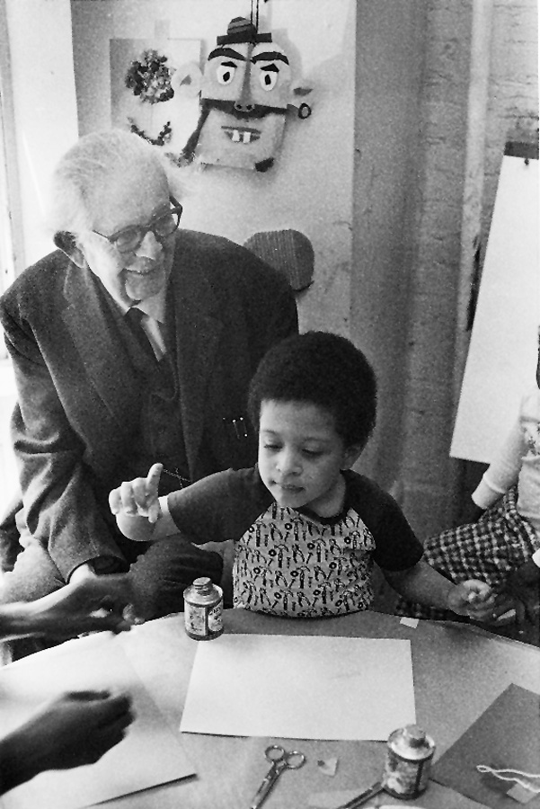
Assimilation and Accommodation
Assimilation - incorporating new experiences into our schema.
In Assimilation, the schema is not changed, only modified.
Accommodation - adjusting and modifying schema.
In Accommodation, the schema is altered; a new schema may be developed.
Bill Anderson/ Photo Researchers, Inc.
Jean Piaget with a subject

Slide 4
Questions
A child believes that all birds can fly but realizes a penguin is a bird.
Accommodation
Assimilation
Here the child is changing one’s ways of thinking in order to incorporate new information?
Notes:
Since her schema is that all birds fly…

Slide 5
Questions
A mother gives her child an orange for the first time. The child rolls it across the table and says, “ball.” Which of the following Piagetian processes would account for this behavior?
Accommodation
Assimilation
Notes:
The ball and orange are similar… both roll and are round. Schema altered.

Slide 6
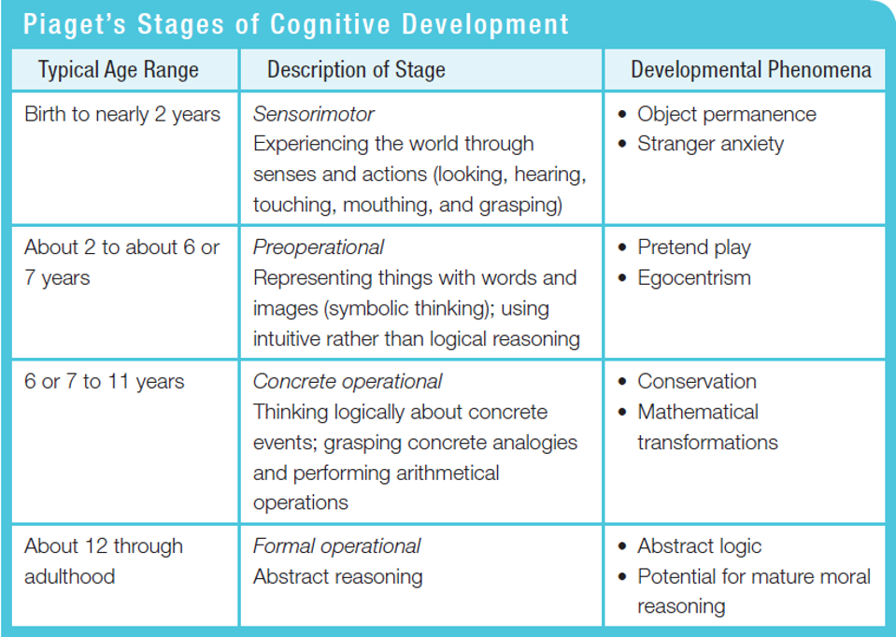

Slide 7
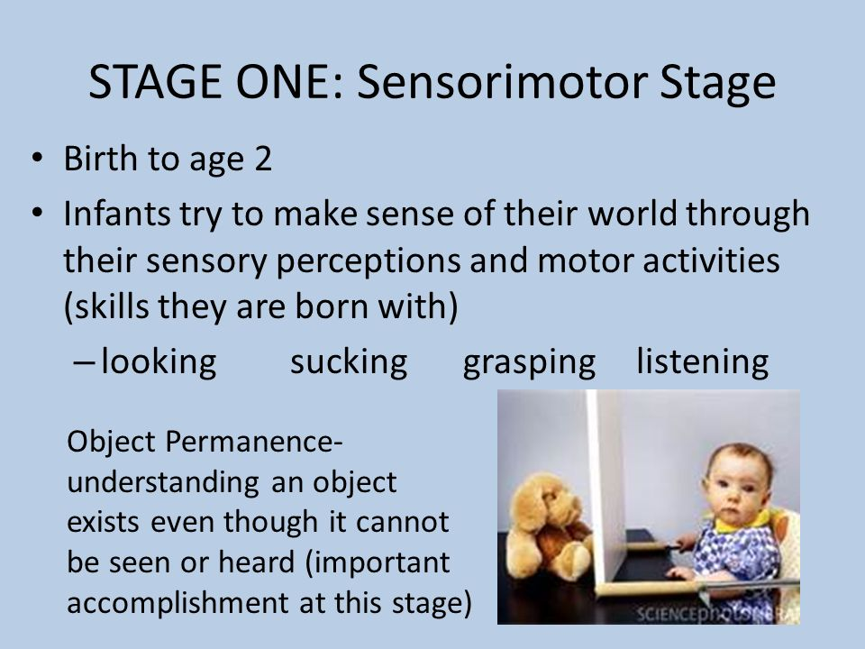

Slide 8
Other things during Sensorimotor Stage.
Stranger Anxiety
Separation Anxiety (depends on attachment to the parent)
Sense of Self

Slide 9
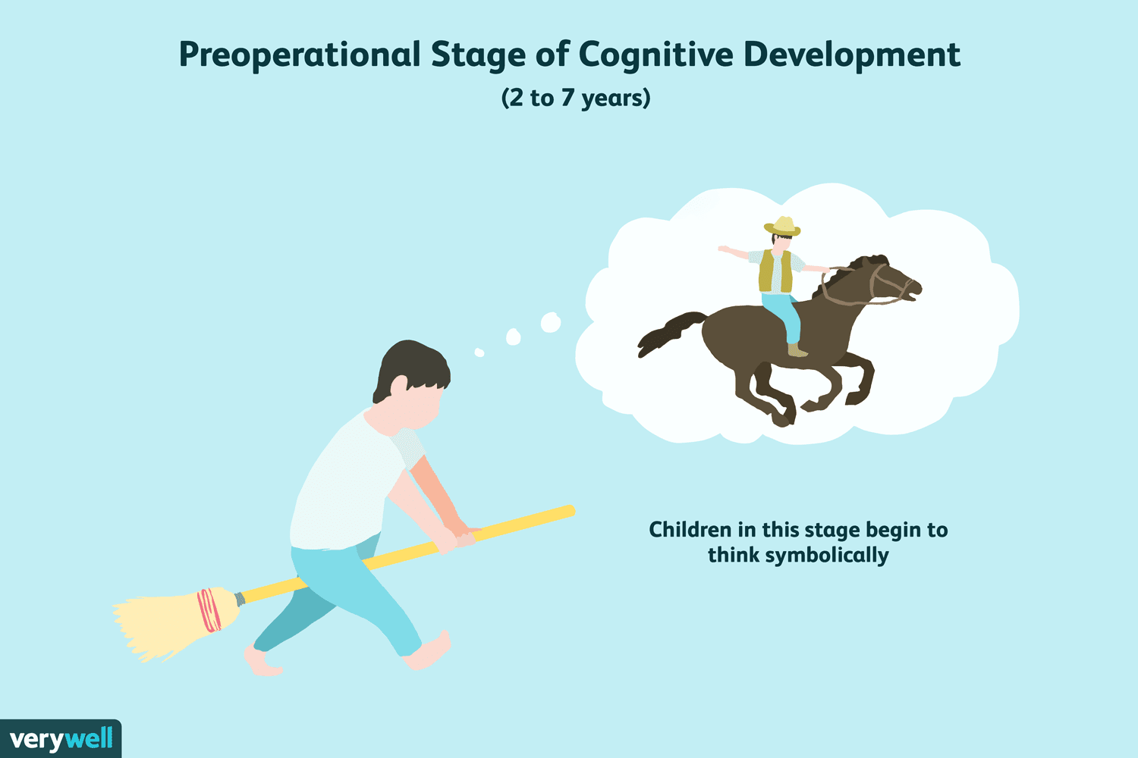

Slide 10
Mental Representations
DeLoache (1987) showed that children as young as 3 years of age are able to use mental operations.
When shown a model of a dog’s hiding place behind the couch, a 2½-year-old could not locate the stuffed dog in an actual room, but the 3-year-old did.
Language development and pretend play

Slide 11
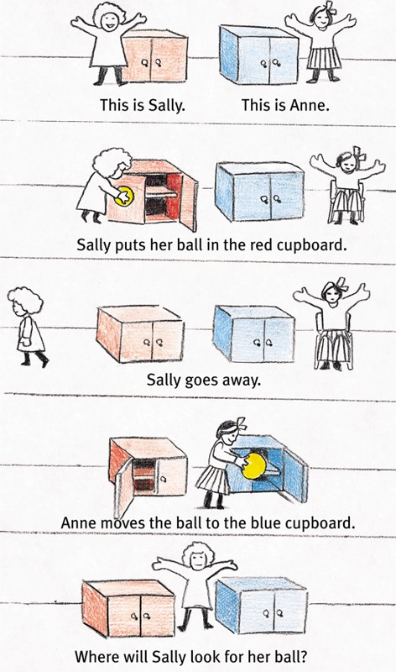
Theory of Mind
Preschoolers develop the ability to understand another’s mental state.

Slide 12
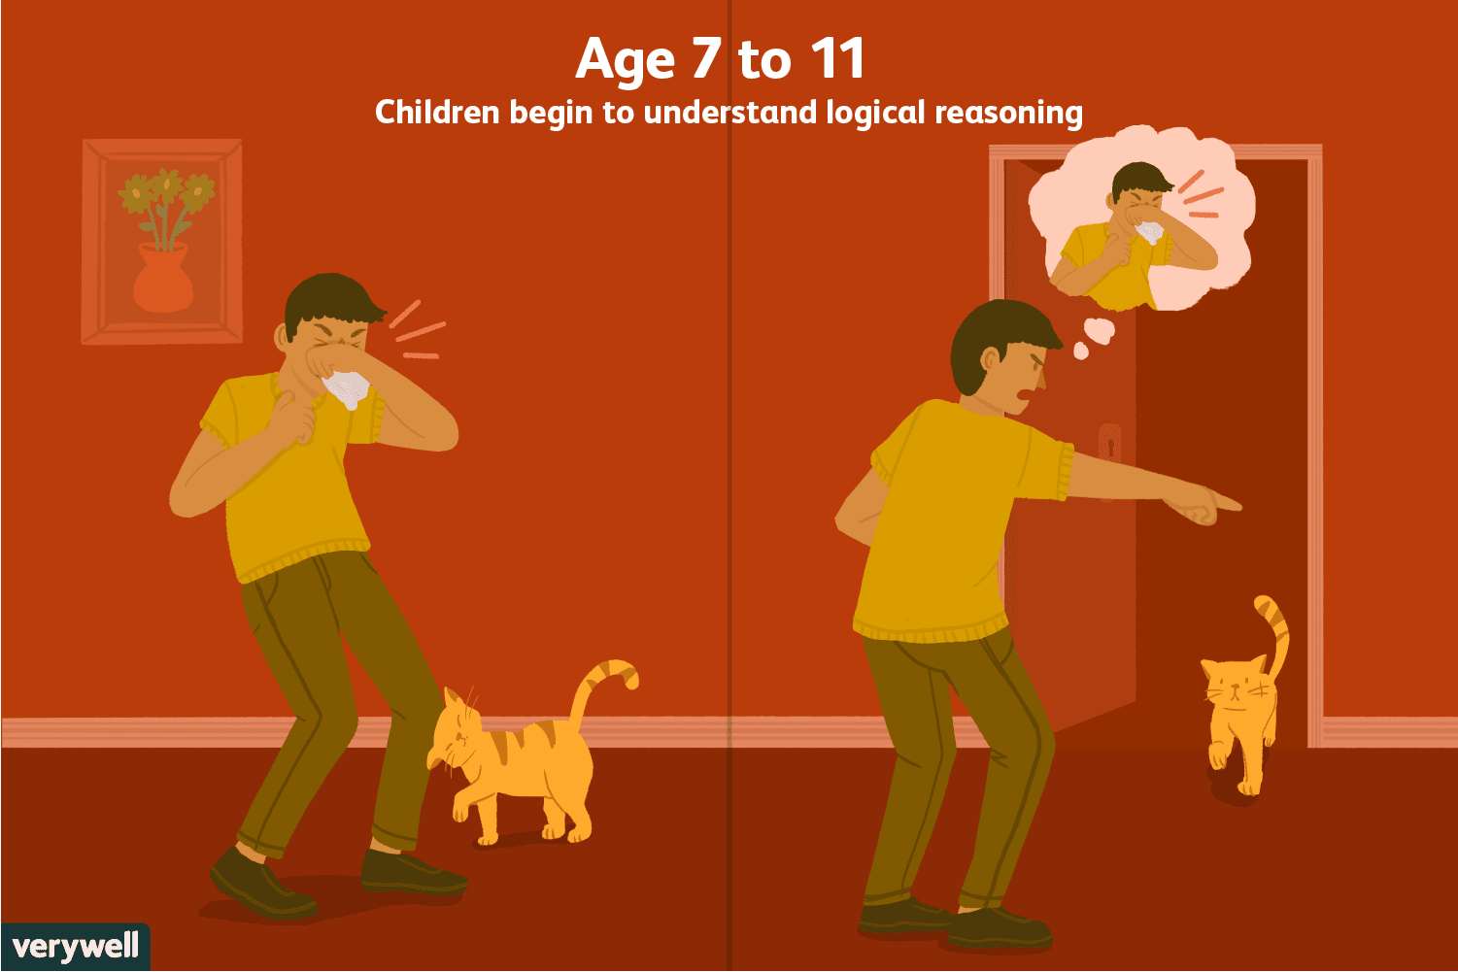

Slide 13
Concrete Operational Stage (7-11 yrs)
6 to 7 year-olds grasp conservation problems and mentally pour liquids back and forth into glasses of different shapes conserving their quantities.
Children in this stage are also able to transform mathematical functions. So, if 4 + 8 = 12, then a transformation, 12 – 4 = 8, is also easily doable.

Slide 14
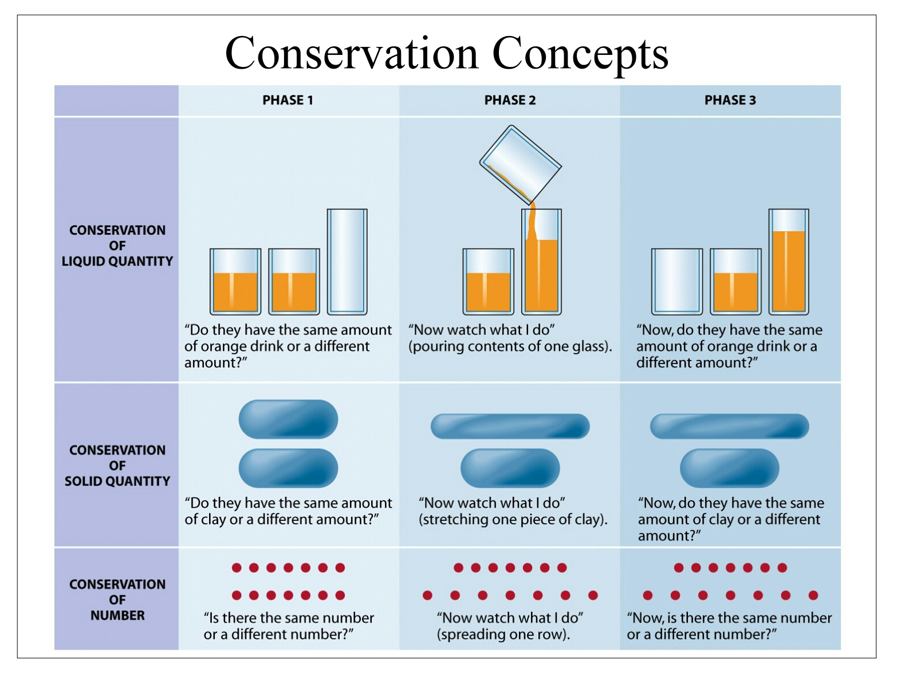

Slide 15
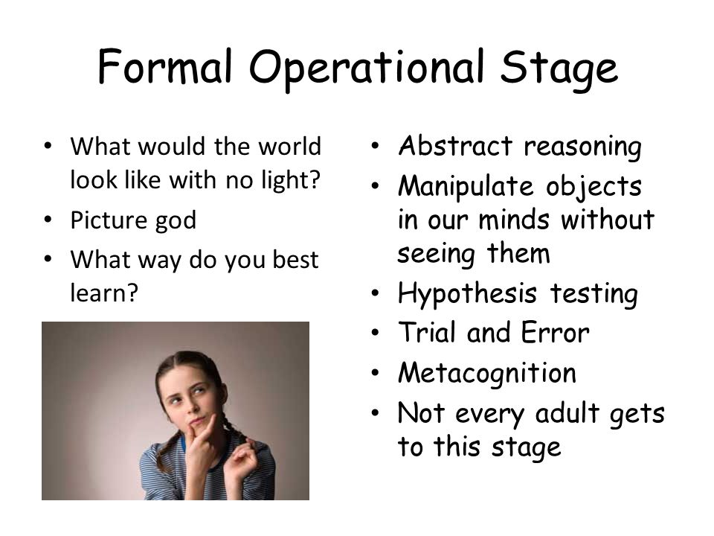

Slide 16

Reflecting on Piaget’s Theory
Piaget’s stage theory has been influential globally. However, today’s researchers believe the following:
Development is a continuous process.
Children express mental abilities at an earlier age.
Formal logic is a smaller part of cognition.
Notes:
OBJECTIVE 10| Discuss psychologists’ current views on Piaget’s theory of cognitive development.

Slide 17
Questions
A schema can be described as
1. an outer layer of the eye
2. mental construct
3. a fissure between lobes of the brain
4. an optical illusion
5. a fixed response to a particular stimulus

Slide 18
Questions
Which Piagetian stage of cognitive development is characterized by mastery of conservation tasks?
(A) Sensorimotor
(B) Preoperational
(C) Concrete operations
(D) Formal operations
(E) Tertiary circular reactions

Slide 19
Questions
According to Jean Piaget, what is the earliest stage at which a child is capable of using simple logic to think about objects and events?
(A) Sensorimotor
(B) Pre-operational
(C) Symbolic
(D) Concrete operational
(E) Formal operational

Slide 20
Questions
According to Jean Piaget, what is the earliest stage at which a child is capable of using abstract thought to think about objects and events?
(A) Sensorimotor
(B) Pre-operational
(C) Symbolic
(D) Concrete operational
(E) Formal operational

Slide 21
Questions
According to Jean Piaget, what is the earliest stage at which a child develops a theory of mind?
(A) Sensorimotor
(B) Pre-operational
(C) Symbolic
(D) Concrete operational
(E) Formal operational

