Slide 1
The Trait Perspective:
Not Why but What
Examples of Traits
Honest Dependable Moody Impulsive
An individual’s unique makeup of durable dispositions and consistent ways of behaving (traits) constitutes his or her personality.
Notes:
OBJECTIVE 14| Describe the trait and perspective’s contribution to personality research.

Slide 2
Trait Theory of Personality
Trait Theory – describes the characteristics that make up human personality in an effort to predict future behavior.
Trait – a consistent, enduring way of thinking, feeling, and behaving.
Allport – first developed a list of 200 traits and believed they were part of the nervous system.
Cattell – reduced the number to about 16 using statistics.

Slide 3

Factor Analysis
Cattell found that large groups of traits could be reduced down to 16 core personality traits based on statistical correlations.
Irritable
Impatient
Excitement
Boisterous
Superficial
traits
Basic
trait
Impulsive

Slide 4
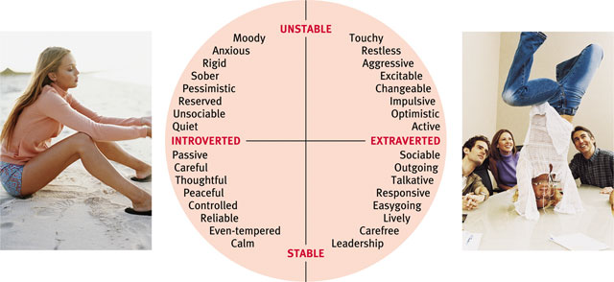
Personality Dimensions
Hans and Sybil Eysenck suggested that personality could be reduced down to three polar dimensions, extraversion-introversion emotional stability-instability, and pychoticism

Slide 5
The Big Five Factors
Today’s trait researchers believe that Eysencks’ personality dimensions are too narrow and Cattell’s 16 too large. So, a middle range (five factors) of traits does a better job of assessment.
Openness/Culture Conscientiousness
Extroversion/Introversion Agreeableness
Neuroticism/ Emotional Stability
Notes:
OBJECTIVE 17| Identify the Big Five personality factors, and discuss some of the strengths of this approach to studying personality.

Slide 6
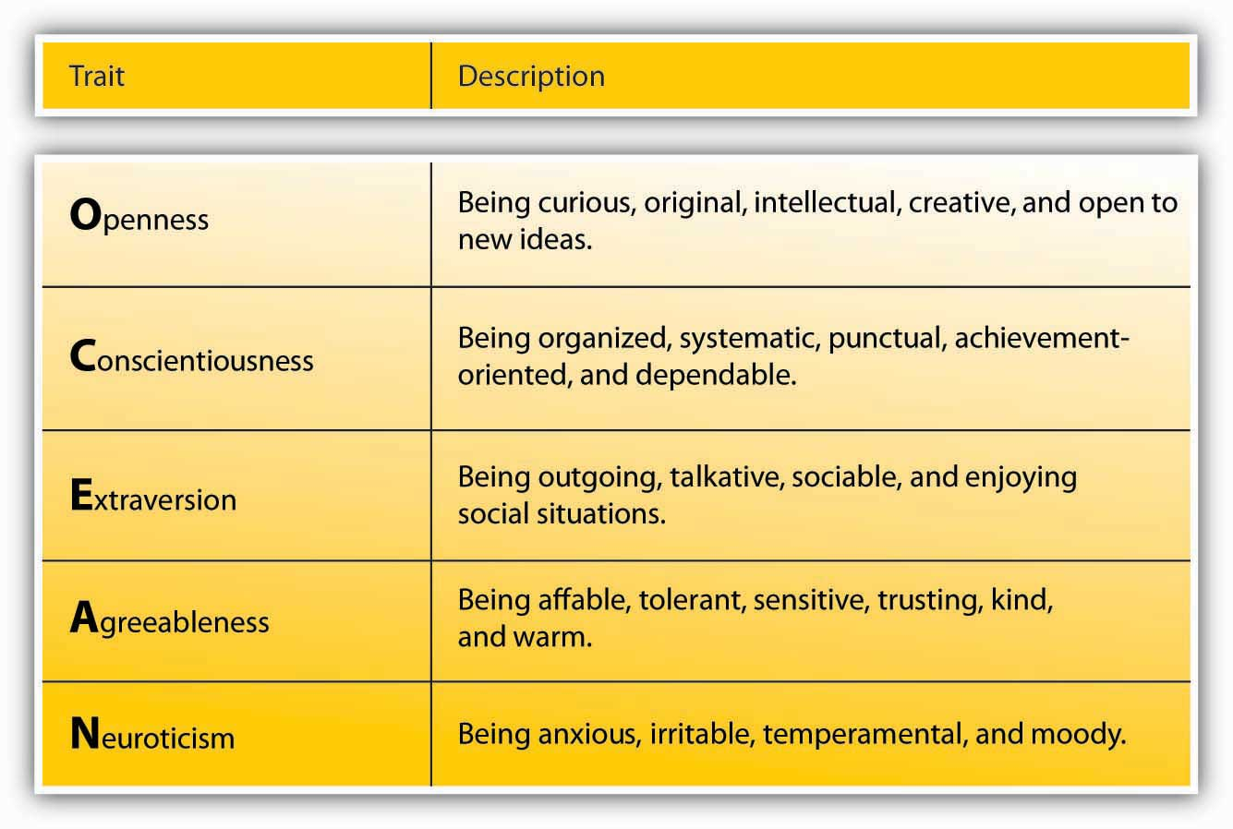

Slide 7
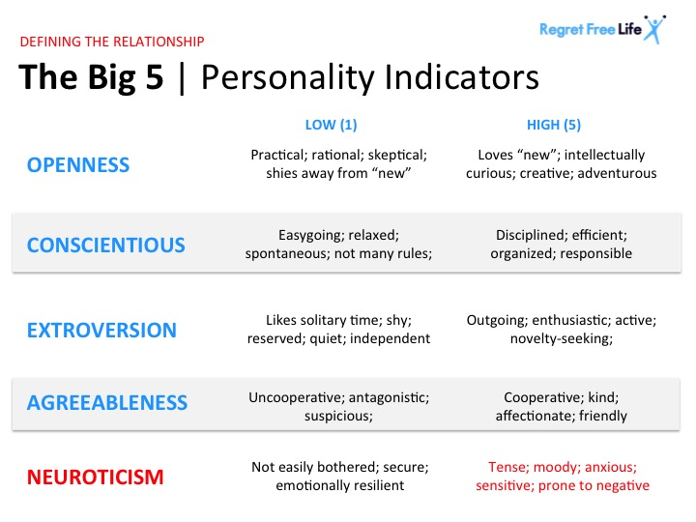

Slide 8
Questions about the Big Five
1. How stable are these traits?
Quite stable in adulthood. However, they change over development.
2. How heritable are they?
Fifty percent or so for each trait.
3. How about other cultures?
These traits are common across cultures.
4. Can they predict other personal attributes?
Yes. Ex. Conscientious people may be more productive (good at school). Ex. Can predict political leanings.

Slide 9

Evaluating the Trait Perspective
The Person-Situation Controversy
Walter Mischel (1968, 1984, 2004) points out that traits may be enduring, but the resulting behavior in various situations is different. Therefore, traits are not good predictors of behavior.
Notes:
OBJECTIVE 18| Summarize the person-situation controversy, and explain its importance as a commentary on the trait perspective.

