Slide 1
Thematic Apperception Test (TAT)
Developed by Henry Murray, the TAT is a projective test in which people express their inner feelings and interests through the stories they make up about ambiguous scenes.

Slide 2
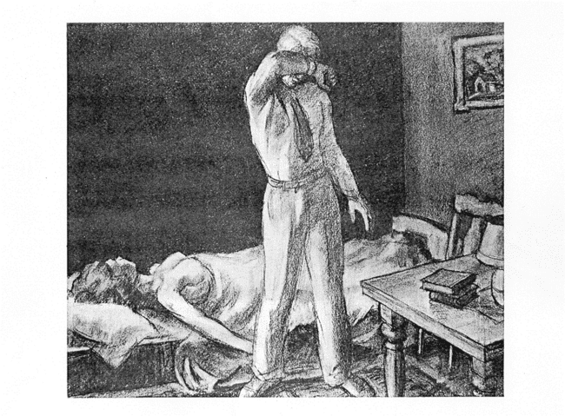
What’s going on in this scene?

Slide 3
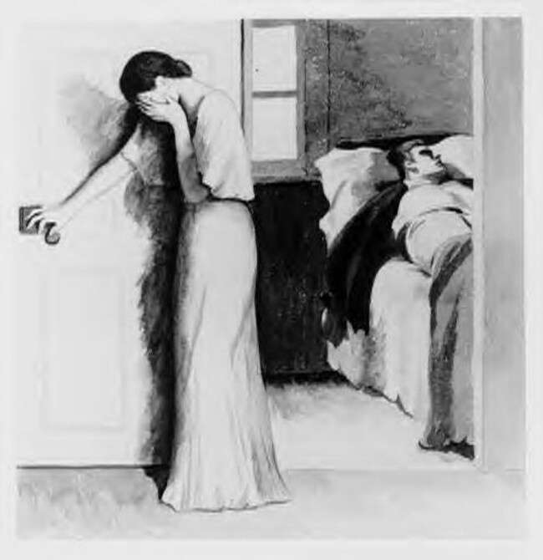
What’s going on in this scene?

Slide 4
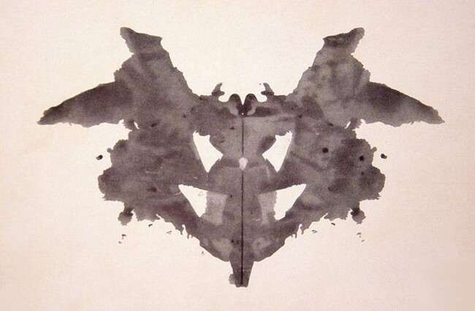
Rorschach Inkblot Test
The most widely used projective test uses a set of 10 inkblots and was designed by Hermann Rorschach.
It seeks to identify people’s inner feelings by analyzing their interpretations of the blots.

Slide 5
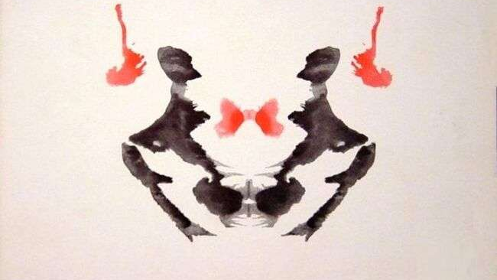

Slide 6
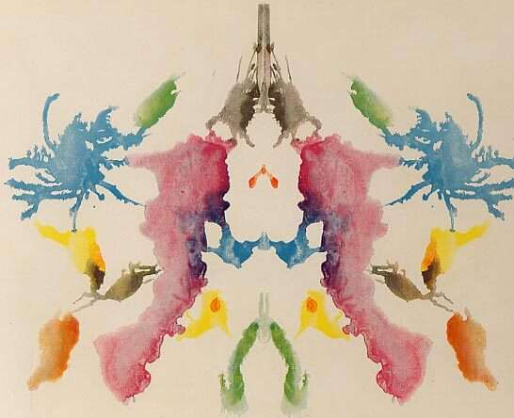

Slide 7
Projective Tests: Criticisms
Critics argue that projective tests lack both reliability (consistency of results) and validity (predicting what it is supposed to).
When evaluating the same patient, even trained raters come up with different interpretations (reliability).
Projective tests may misdiagnose a normal individual as pathological (validity).

Slide 8
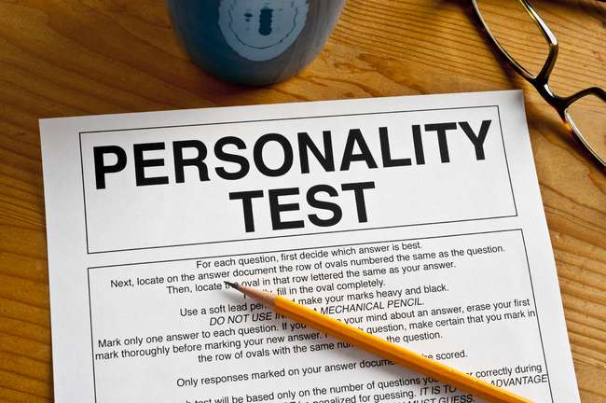
Assessing Traits
Personality inventories are questionnaires (often with true-false or agree-disagree items) designed to gauge a wide range of feelings and behaviors.
Notes:
OBJECTIVE 16| Explain how psychologists use personality inventories to assess traits, and discuss the most widely used of these inventories.

Slide 9
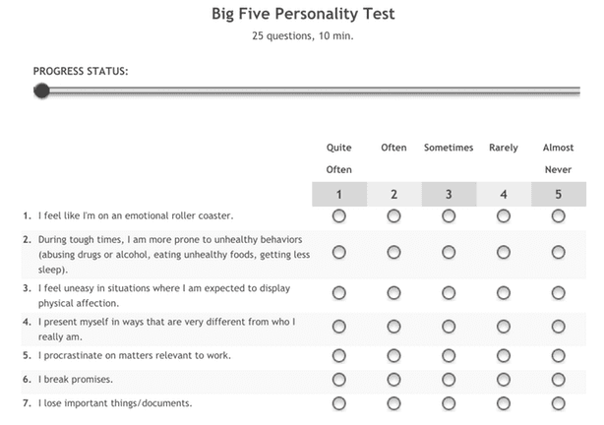

Slide 10
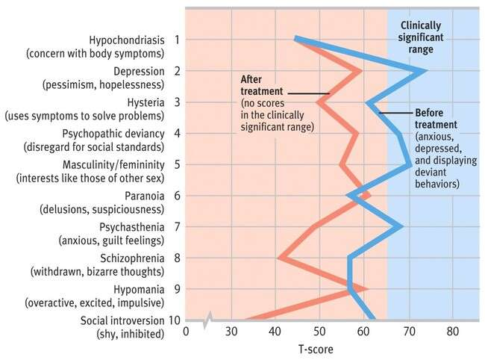
MMPI
The Minnesota Multiphasic Personality Inventory (MMPI) is the most widely researched and clinically used of all personality tests.
It was originally developed to identify emotional disorders.

Slide 11
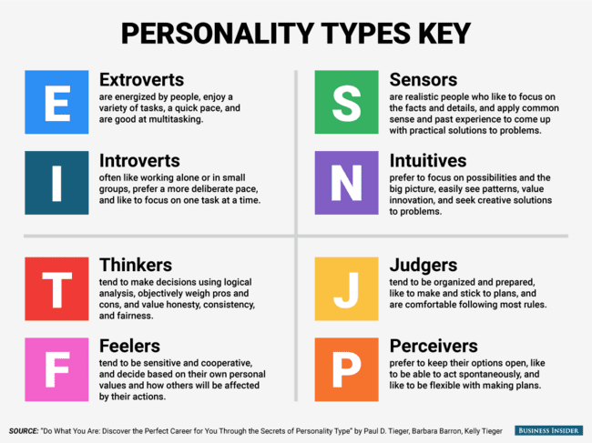
Personality Tests
Personality types, assessed by measures such as the Myers-Briggs Type Indicator, consist of a number of traits.
More research is needed on this popular test’s validity.

