Slide 1
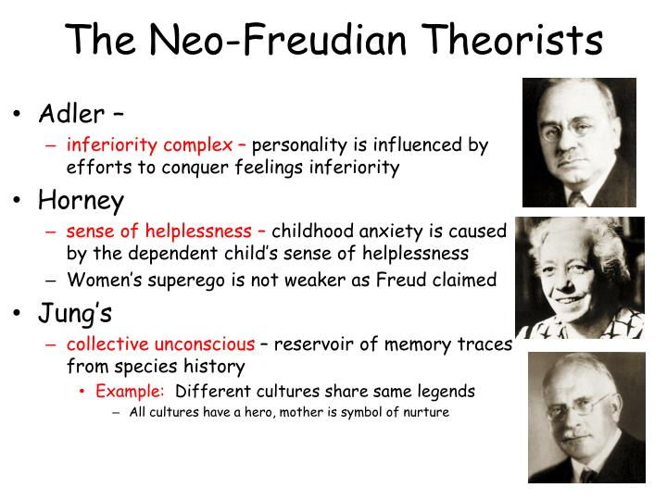

Slide 2
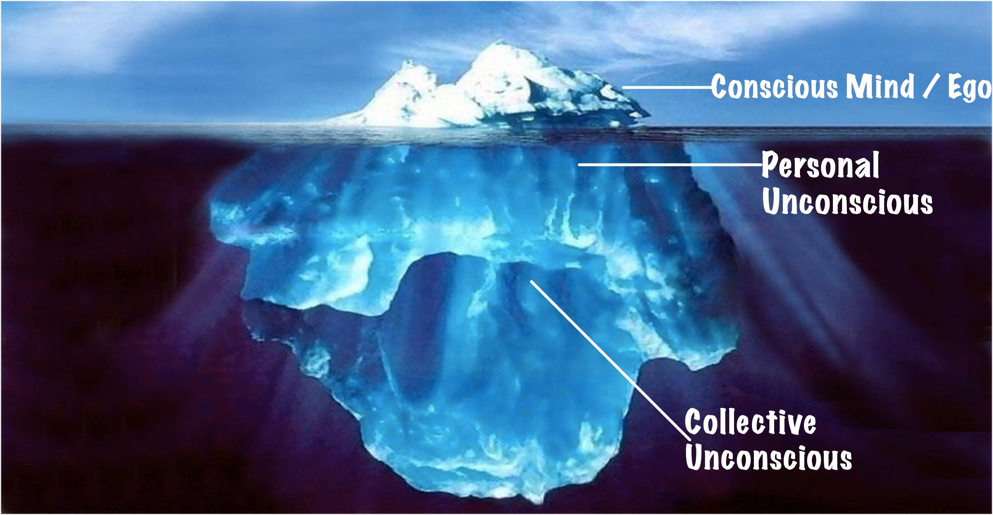
Carl Jung
Personal unconscious
containing repressed thoughts and feelings
Collective unconscious (archetypes)
inherited (genetic) and common to all members of a species
Ex: Mother, Father, Hero, etc.

Slide 3
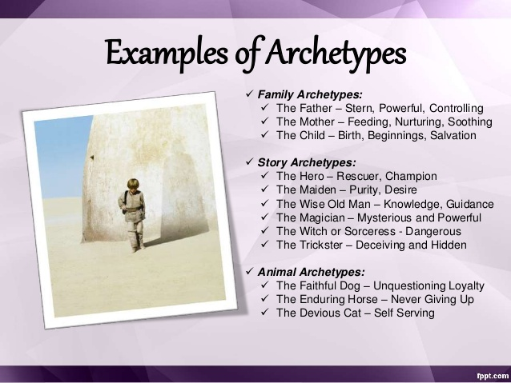

Slide 4
Personality Types
Extroverts:
Focus on external world and social life
Introverts:
Focus on internal thoughts and feelings
Jung felt that everyone had both qualities, but one is usually dominant

Slide 5

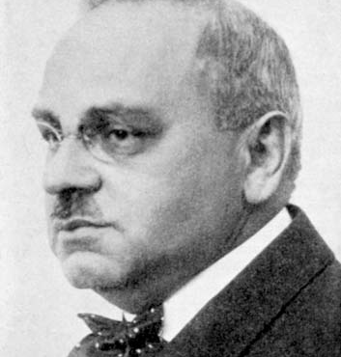
Alfred Adler
No conflict between id and superego
People are innately good, and strive for personal/social perfection

Slide 6

Alfred Adler
Compensation
  Our efforts to overcome real or perceived weaknesses (inferiority) while we strive for that perfection.
Inferiority complex
  Fixation on feelings of personal inferiority that can lead to emotional and social paralysis
– father of Humanistic Psychology

Slide 7
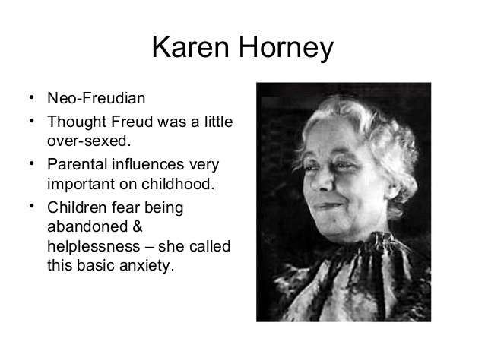

Slide 8
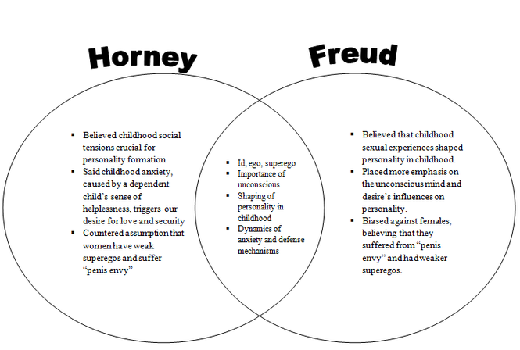

Slide 9
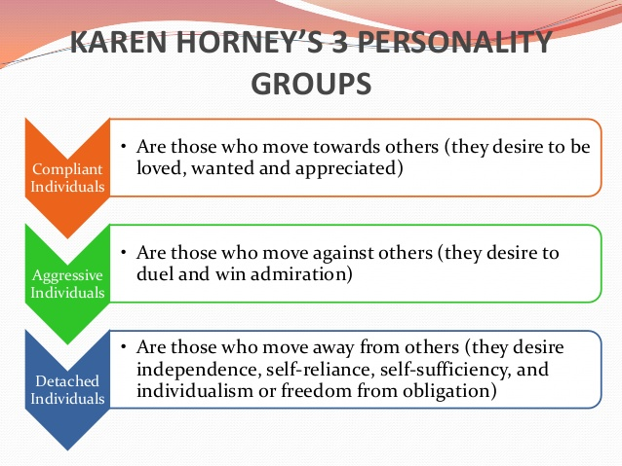

Slide 10
Erik Erikson
Eight stages of personality development
  Trust vs. mistrust
  Autonomy vs. shame and doubt
  Initiative vs. guilt
  Industry vs. inferiority
  Identity vs. role confusion
  Intimacy vs. isolation
  Generativity vs. stagnation
  Ego integrity vs. despair

Slide 11
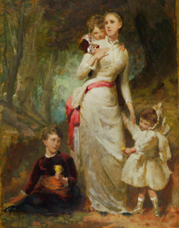
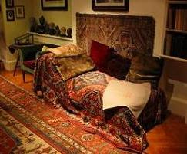
Evaluating Psychodynamic Theories
Culture-bound ideas
  Freud made no connection between women’s subordinate status in society and their sense of inferiority. Also, hysteria diagnoses may have been hiding abuse.
Psychodymanic theories are largely untestable in any scientific way
Most of its concepts arise out of clinical practice, which are the after-the-fact explanation.

Slide 12
Evaluating the Psychoanalytic Perspective
Personality develops throughout life and is not fixed in childhood.
Freud underemphasized peer influence on the individual, which may be as powerful as parental influence.
Gender identity may develop before 5-6 years of age.
Modern Research
Notes:
OBJECTIVE 9| Summarize psychology’s current assessment of Freud’s theory of psychoanalysis.

Slide 13
Evaluating the Psychoanalytic Perspective
There may be other reasons for dreams besides wish fulfillment.
Verbal slips can be explained on the basis of cognitive processing of verbal choices. (capture effect)
If suppressed sexuality leads to psychological disorders, why do we still have psychological disorders even though sexual inhibition has decreased.
Modern Research

Slide 14
Freud and the Unconscious Mind
Modern research shows non-conscious information processing.
Schemas that automatically control perceptions and interpretations
Parallel processing during vision and thinking
Implicit memories
Emotions that activate instantly without consciousness

