Slide 1
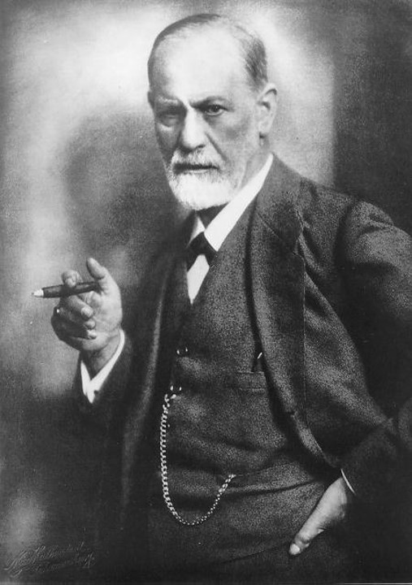
Sigmund Freud
Devised “psychoanalysis”, or talk therapy, as a way to reach the unconscious thoughts that drive behavior.

Slide 2
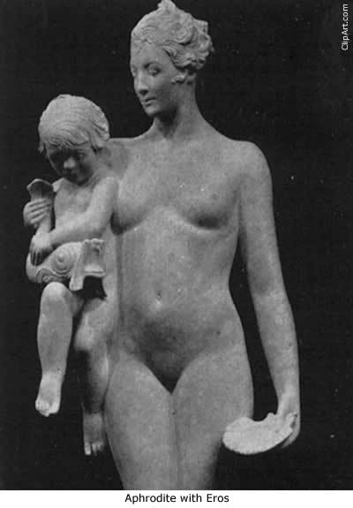
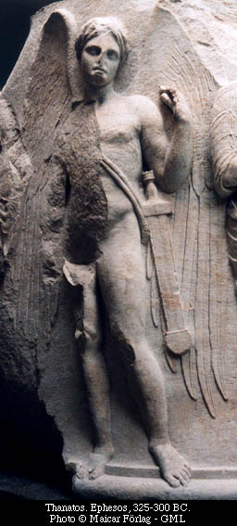
Freudian Drives
Eros (Life Instinct)
  - Covers all the self-preserving and erotic instincts
  - Libido is the most important of all – seen as sexual energy
Thanatos (Death Instinct)
  - Covers all the instincts toward aggression, self-destruction, and cruelty

Slide 3
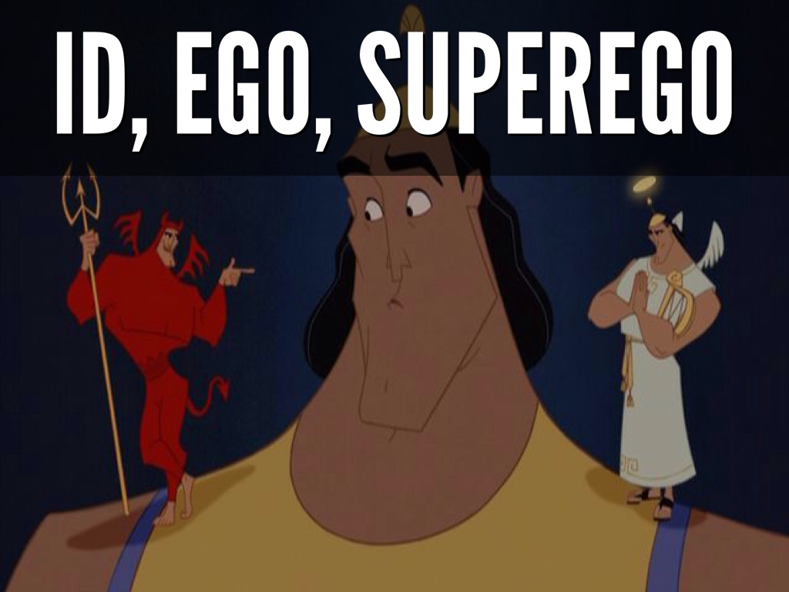
Structure of the Mind
Tripartite Theoretical Model
  Id
  Super-ego
  Ego

Slide 4
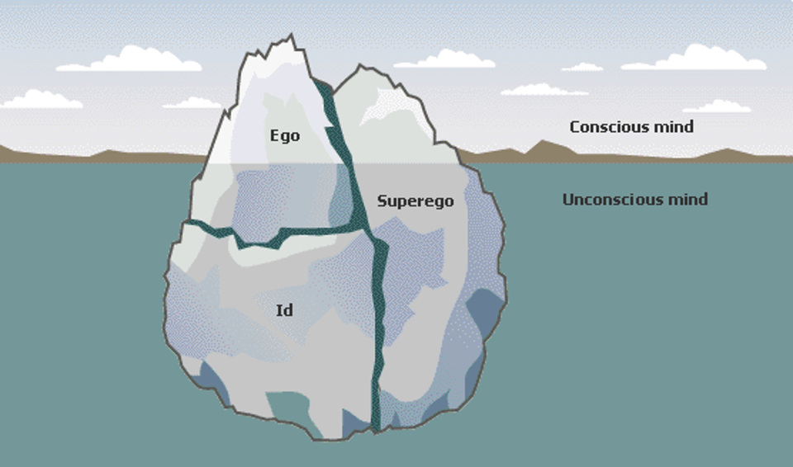

Slide 5
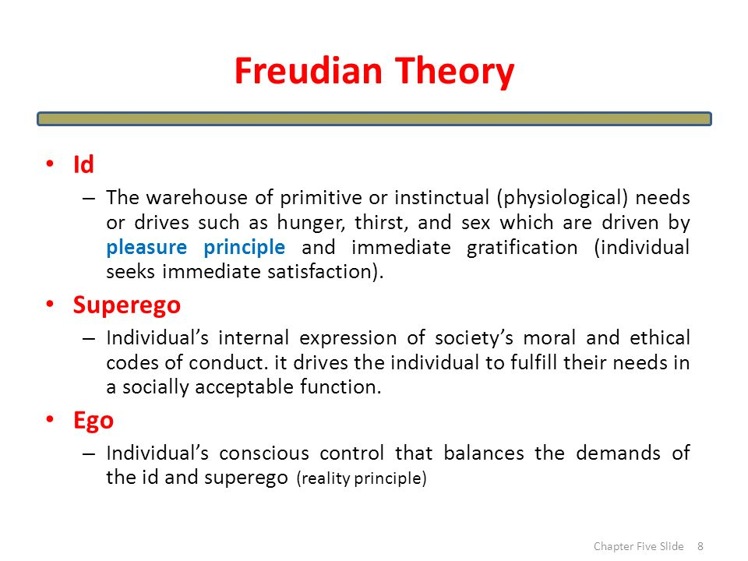

Slide 6
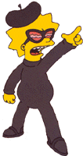

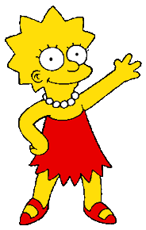

Superego
Moral center - “should”, “should not”
Society’s moral code… Guilt if we fail to follow
Ego Ideal – perfect standards of what one would like to be

Slide 7
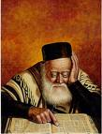
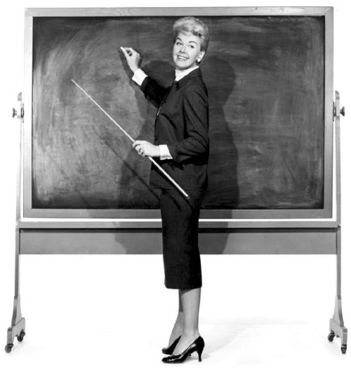

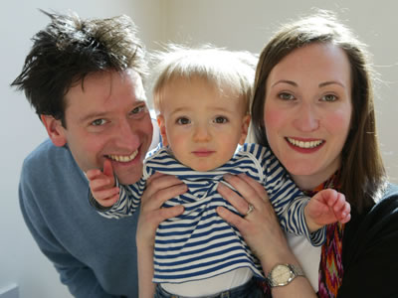
Learned, not present at birth

Slide 8

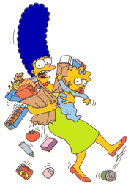
Ego
Deals with reality - “reality principle”
Negotiates demands of the id with the reality of living in society and with the demands of the super ego.
Rational

Slide 9
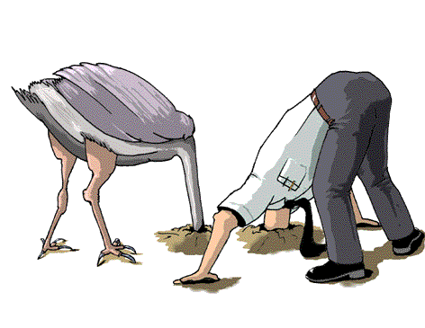
When the Id and Super-ego can’t reconcile
The psychic energy has to go somewhere!
To protect itself the organism employs defense mechanisms.

Slide 10
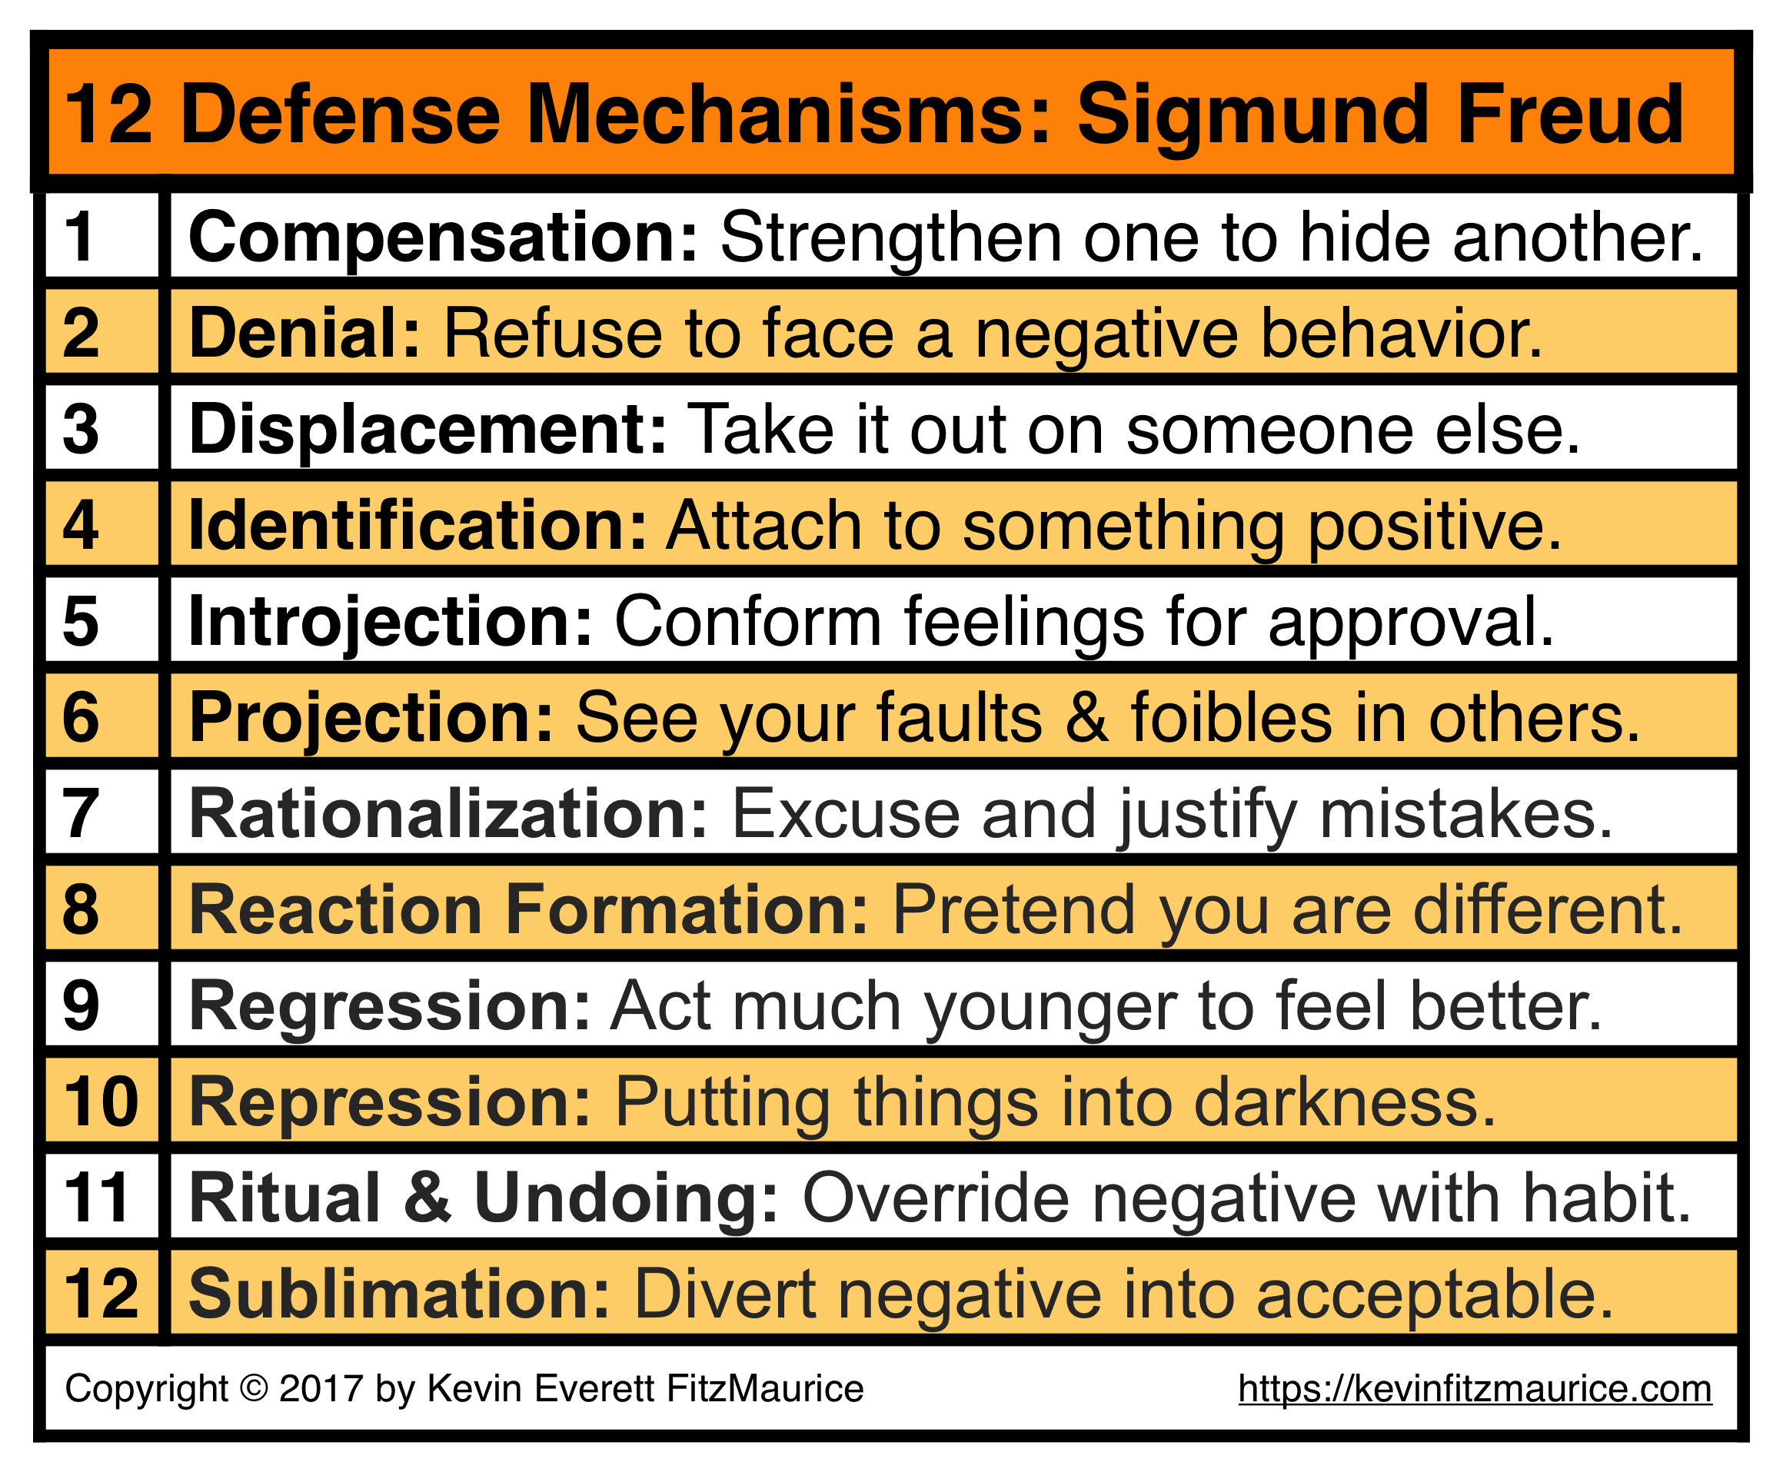

Slide 11
Thin line between the conscious and unconscious
Sometimes our unconscious thoughts slip into the conscious.
How?
  “Freudian slips” (really?)
  Dreams (really?)

Slide 12
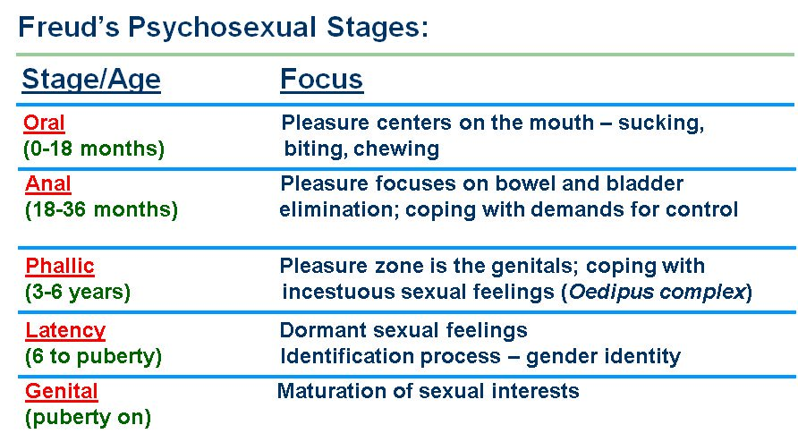

Slide 13
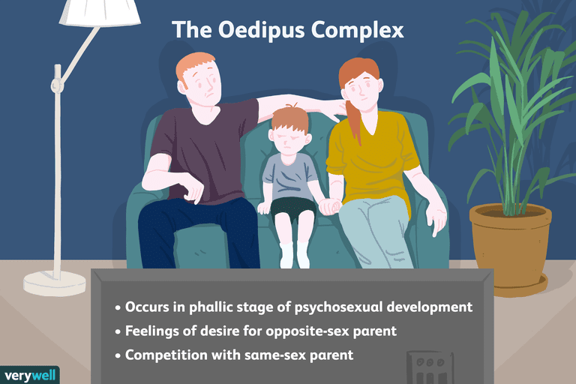

Slide 14
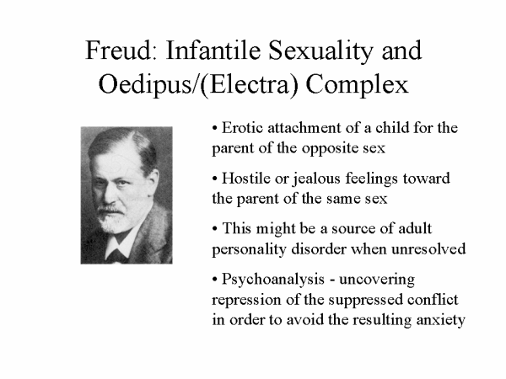

Slide 15
