Slide 1
Behaviorism
Only behavior matters, no cognitive or social aspect.
Personality is developed solely from the environment.
The environment causes changes in the personality, based on reward and incentives that each person comes into contact with.
People are passive recipients of environmental influences.

Slide 2
Cognitive-Social Learning Theories in Personality
Albert Bandura
We each have a set of personal standards that grow out of our own life history and thus shape our behavior.
Behavior is seen as the interaction of cognition, learning, and the current environment.
Personal choices effect the environment and behavior, which then effect personal choices.

Slide 3
Cognitive-Social Learning Theories in Personality
Learning (observation)
Self-efficacy (cognition)
Reciprocal Determinism (interaction of mental state, behavior, environment)

Slide 4
Self-Efficacy
Self-efficacy is a person’s particular set of beliefs that determine how well one can execute a plan of action in prospective situations (Bandura, 1977).
To put it in more simple terms, self-efficacy is a person’s belief in their ability to succeed in a particular situation.
Self-efficacy is when you meet your own personal performance standards.

Slide 5
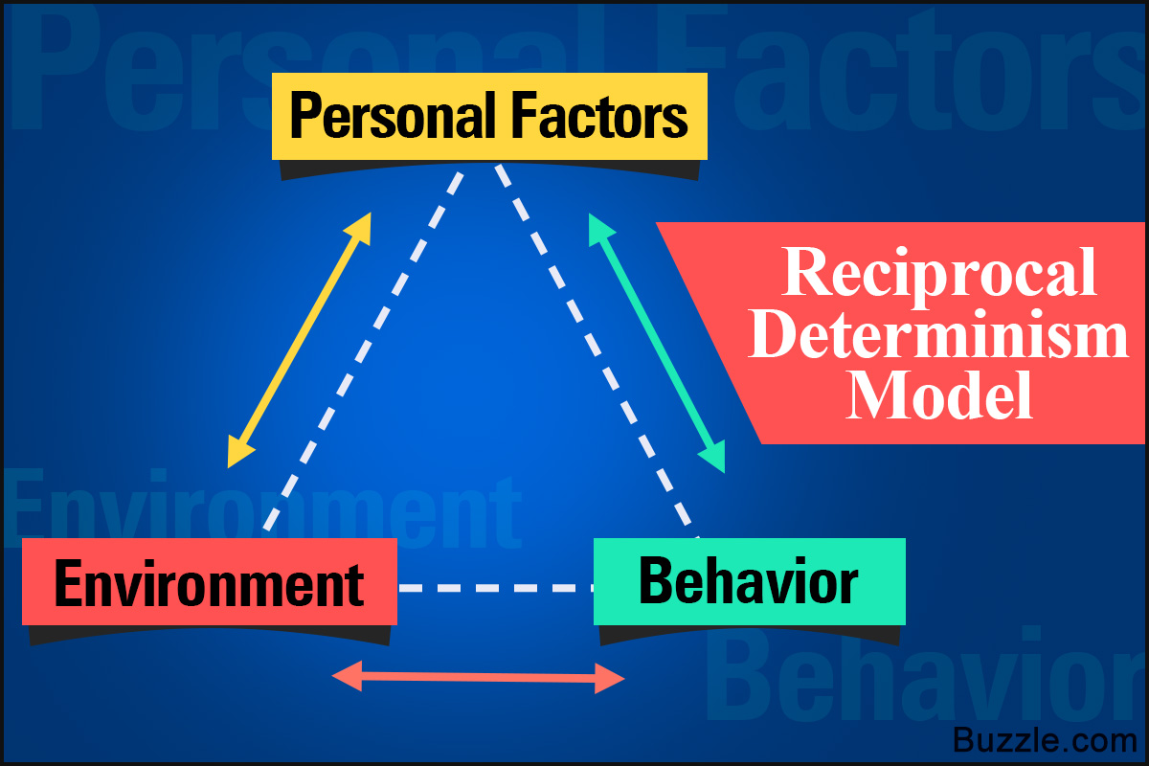
Reciprocal Determinism
According to Bandura, the environment influences how a person thinks and feels (personality), which influences their behavior, which impacts the environment, and so on.
Ex. a child doesn't like school, they act out, the teachers and classmates react to the bad behavior, creating a hostile environment, reinforcing the student's dislike of school.

Slide 6
Locus of Control
a common expectancy (Julian Rotter) by which people view a situation
  Internal locus of control – you believe you can control your own fate. Through hard work, skill, and training, you can find reinforcements and avoid punishments.
  External locus of control – you do not control your own fate. You are convinced that chance, luck, and the behavior of others determines your destiny and that you are helpless to change the course of your life. – learned helplessness

