Slide 1
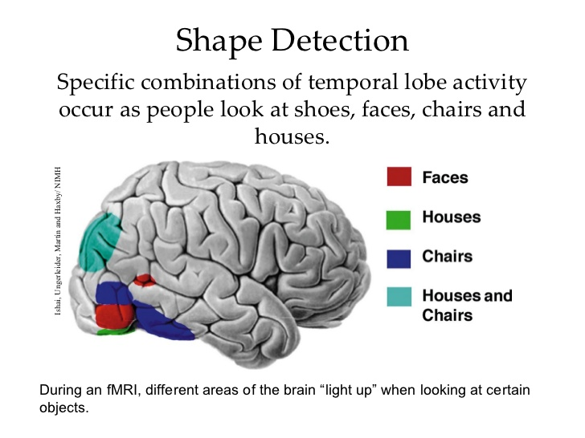
Feature Detectors
nerve cells in the brain that respond to specific features, such as shape, angle, or movement.

Slide 2
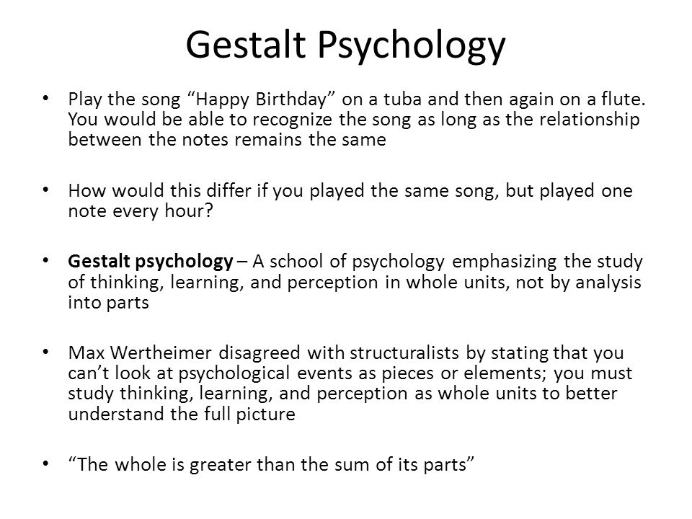

Slide 3
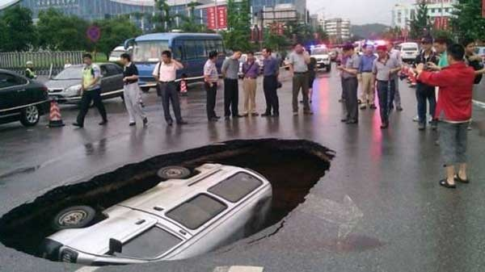
Sidewalk Chalk Art

Slide 4
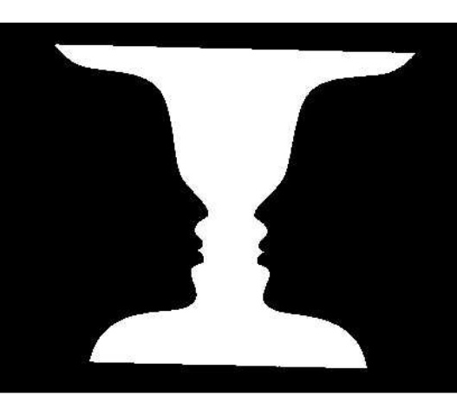
Figure-Ground
We organize the visual field into objects (figures) that stand out from their surroundings (ground).

Slide 5

Examples of Figure-Ground
What you make the figure and what you back the background determines your perception
Notes:
OBJECTIVE 4| Explain the figure-ground relationship and identify principles of perceptual grouping in form perception.

Slide 6

Examples of Figure-Ground

Slide 7

Figure-Ground

Slide 8

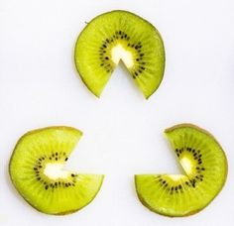
Closure

Slide 9
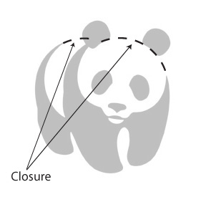


Closure

Slide 10
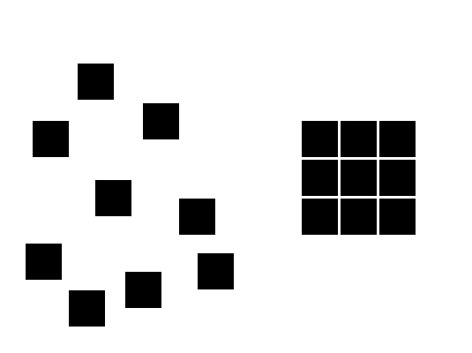
Proximity

Slide 11

Proximity

Slide 12
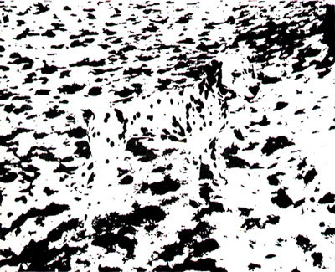
Proximity and Closure

Slide 13
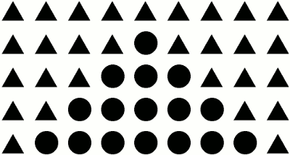
Similarity

Slide 14
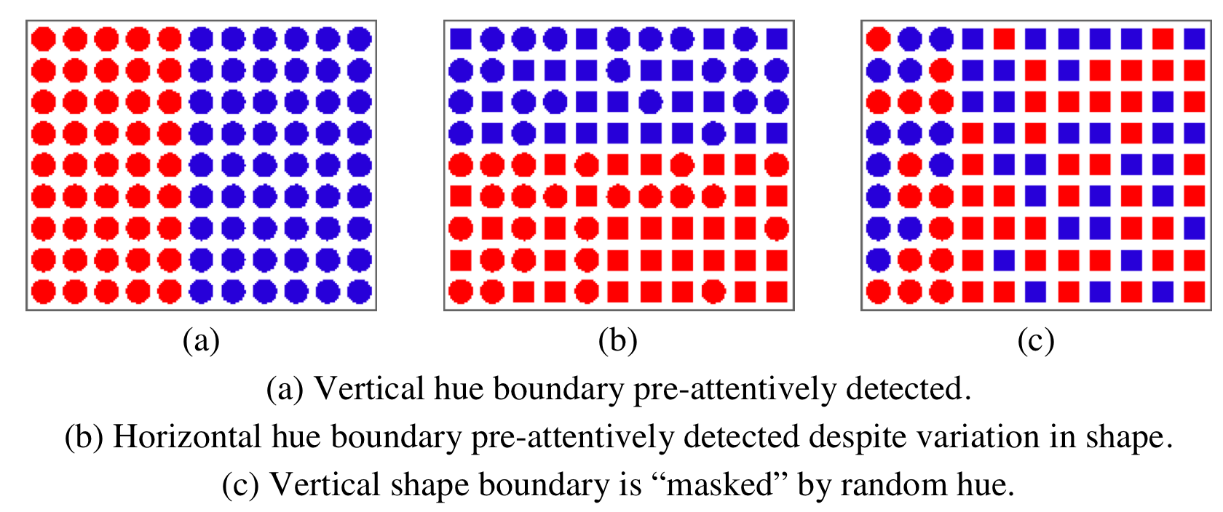
Similarity

Slide 15

Continuity

Slide 16
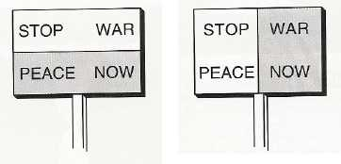
Connectedness
The Principle of Common Region states that objects that are within the same region are perceptually grouped together.

Slide 17
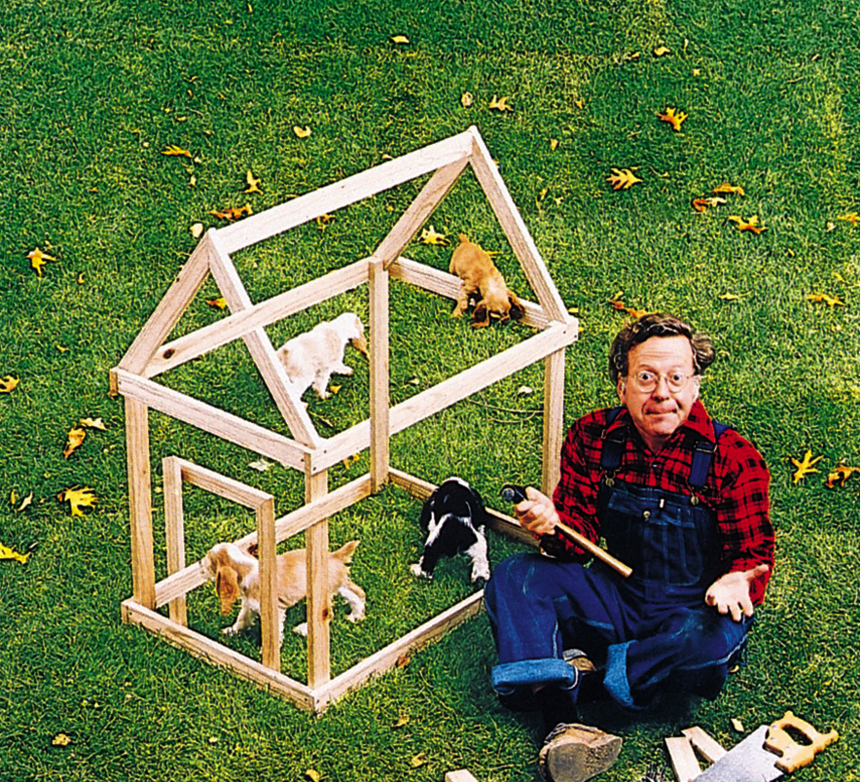
These are predictable, so they can be exploited.

Slide 18
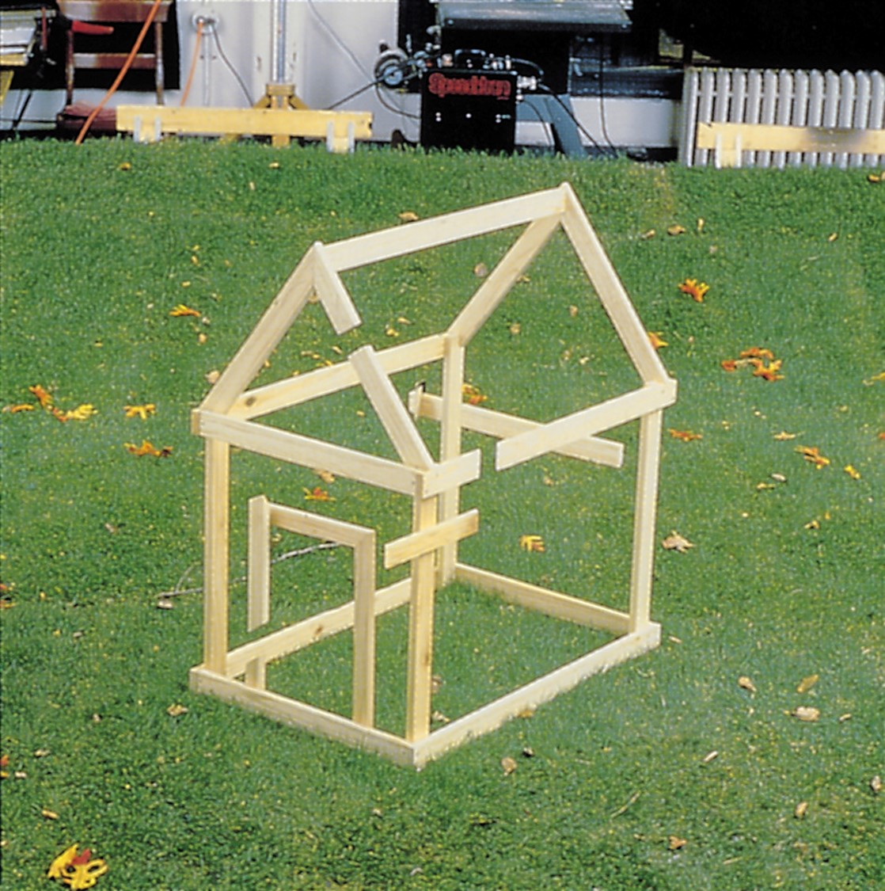

Slide 19
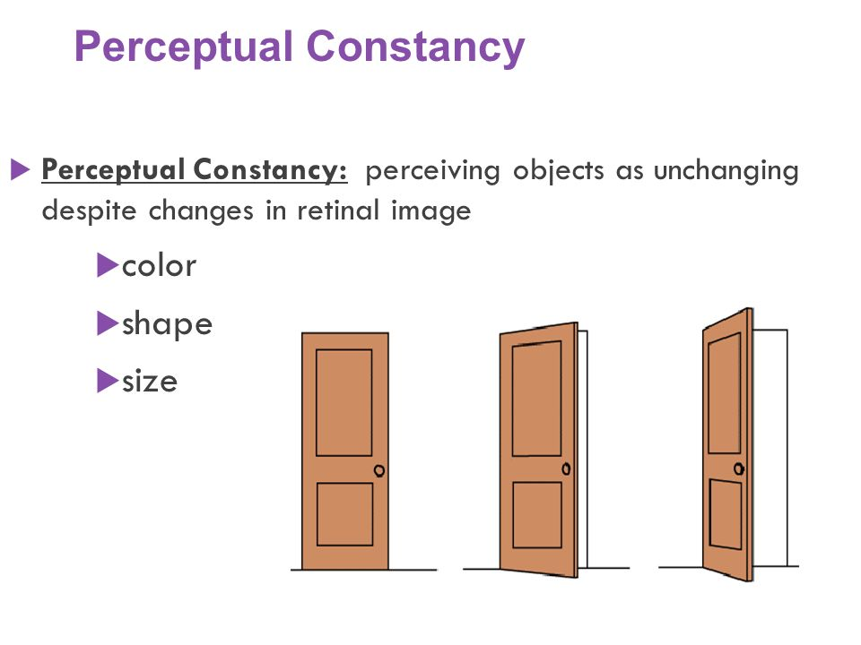

Slide 20
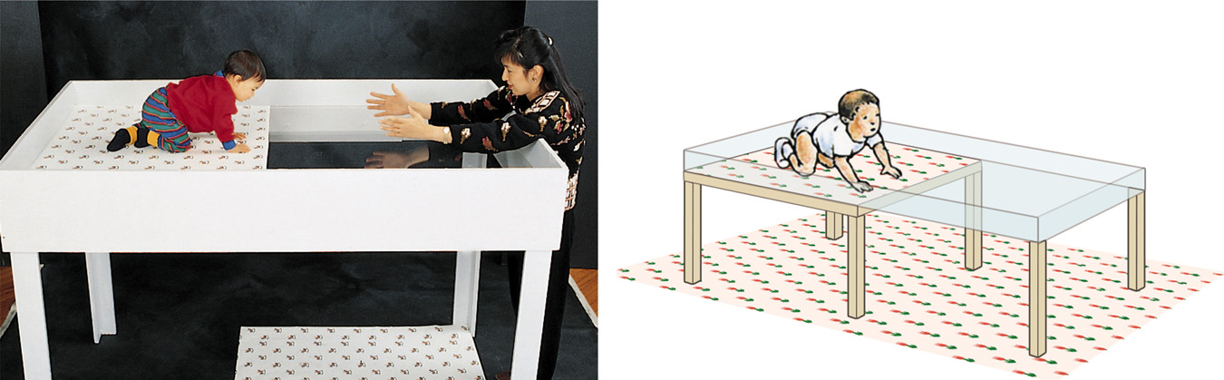
Depth Perception
Gibson and Walk (1960) suggested that infants (crawling age) have depth perception. Even newborn animals show depth perception.
Visual Cliff
Notes:
OBJECTIVE 5| Explain the importance of depth perception, and discuss the contribution of visual cliff research to our understanding of this ability.

Slide 21
Binocular Cues
Two eyes give us depth perception!
Retinal Disparity - Images from two eyes differ. Used as a cue for distance
Convergence – eyes move inward and outward depending on distance to object.

Slide 22
Retinal Disparity
While focusing far away try touching your fingers about 5 inches directly in front of your eyes. You will see a “finger sausage”
Try holding up two fingers one in front of the other. Focus on the front one (you should now see two images of the back one). Now move the back one away from, then back towards you, while still focusing on the front one.

Slide 23
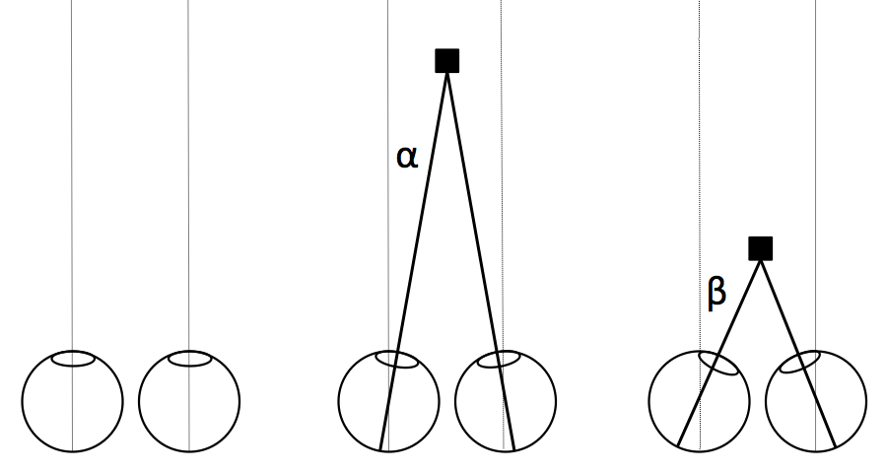
Convergence
When eyes move inward (towards the nose) to see near objects and outward (away from the nose) to see faraway objects.
Notes:
OBJECTIVE 6| Describe two binocular cues for perceiving depth, and explain how they help the brain to compute distance.

Slide 24

Monocular Cues
Relative Size: If two objects are similar in size, we perceive the one that casts a smaller retinal image to be farther away.
Notes:
OBJECTIVE 7| Explain how monocular cues differ from binocular cues, and describe several monocular cues for perceiving depth.

Slide 25
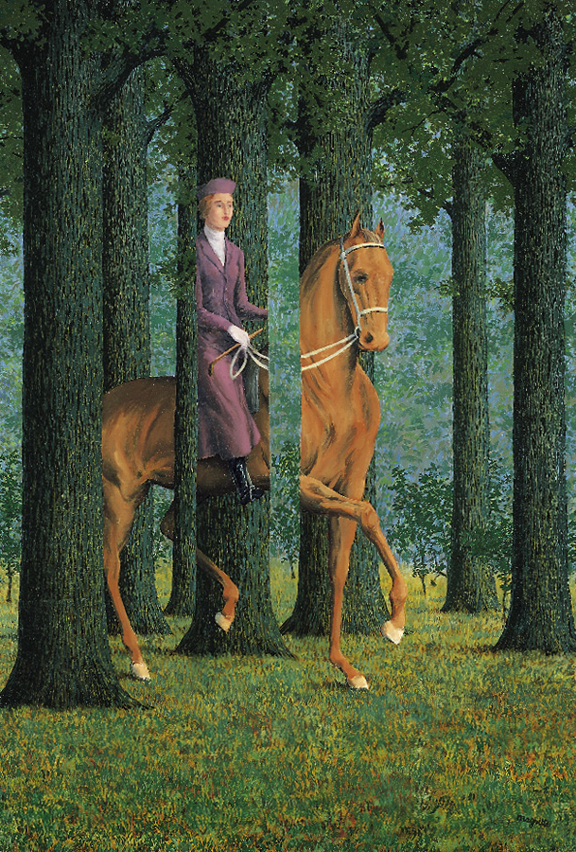
Monocular Cues
Interposition - Objects that occlude (block) other objects tend to be perceived as closer.

Slide 26

Monocular Cues
Texture Gradient: Courser textures appear closer

Slide 27
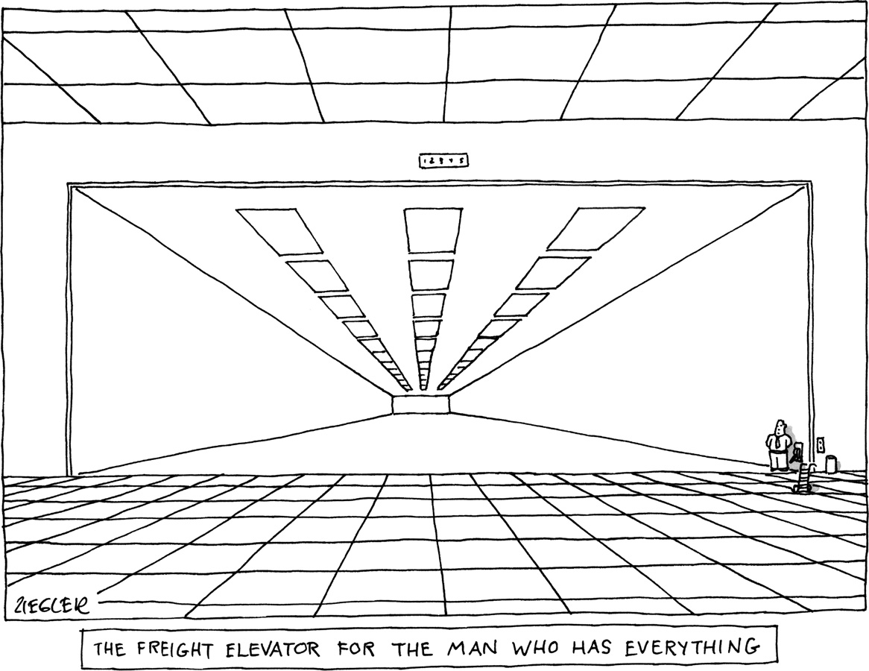
Monocular Cues
Linear Perspective:
Parallel lines, such as railroad tracks, appear to converge in the distance. The more the lines converge, the greater their perceived distance.

Slide 28
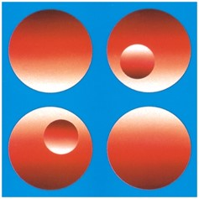
Monocular Cues
Light and Shadow: when shaded on the bottom it appears to stick out.

Slide 29
Questions
One of the ways we perceive images is by organizing stimuli into an object seen against its surroundings. What is this perceptual tendency called?
a. opponent-process theory
b. binocular cue
c. retinal disparity
d. figure-ground
e. sensory adaptation

Slide 30
Questions
The perceptual tendency to group together stimuli that are near each other is called
a. interposition.
b. perceptual set.
c. proximity.
d. closure.
e. disparity.

Slide 31
Questions
Feature detectors
a. are retinal cells that allow you to see in dim light and are located in the periphery of the eye.
b. combine to form the optic nerve, which sends visual information to the brain.
c. are primarily located in the fovea.
d. are nerve cells in the brain's visual cortex that fire in response to specific edges, lines, and angles.
e. cause the lens to change its curvature in response to incoming light waves.

