Slide 1

What do you see?

Slide 2
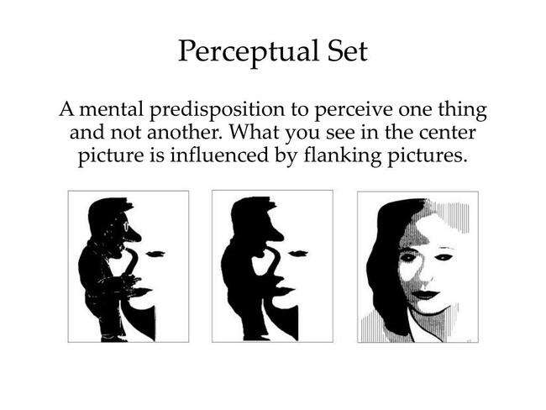

Slide 3
Conclusion
Top Down processing – you go beyond the sensory information to try to make meaning out of ambiguity in your world
What you expect (your experiences and your perceptual set) drives this process.
Perceptual Set = a bias or readiness to perceive certain aspects of available sensory data and to ignore others.

Slide 4
The First Step in Perception is Attention
We sense 11,000,000 bits of information per second.
We consciously only process about 40 bits (Wilson 2002).
The process by which we attend to these bits is called selective attention
(Click here)

Slide 5
Inattentional Blindness
Daniel Simons and Christopher Chabris (1999)
Participants told to count how many times the black jersey team passes the ball
Over 50% of the participants completely missed the gorilla

Slide 6
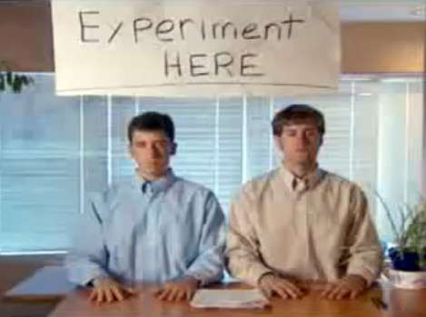
Change Blindness
We are blind to changes in our environment.

Slide 7
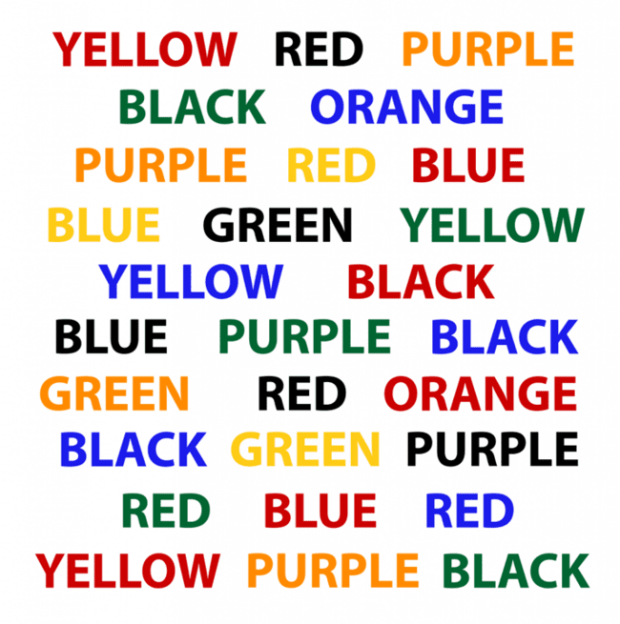
Stroop Effect
Study shows that when we have 2 processes that conflict, our processing slows down.
Here, reading and color identification conflict, causing us to slow down.
https://faculty.washington.edu/chudler/java/ready.html

Slide 8
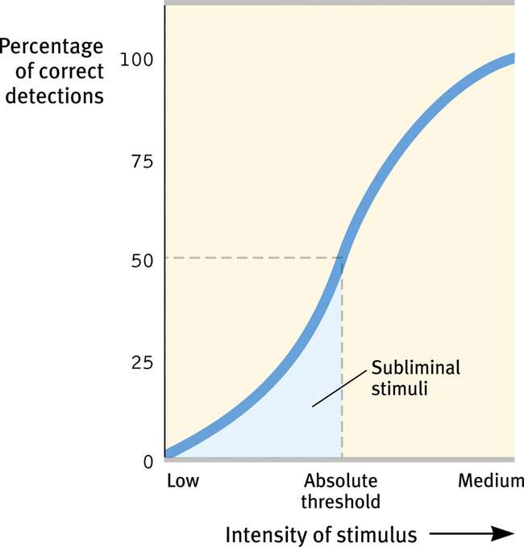
Subliminal Threshold
When stimulus is below absolute threshold for conscious awareness.
What do we perceive then?

Slide 9
Subliminal Perception
Subliminal = just below awareness
Because the message is quick or hidden, stimuli do not reach awareness.
Quick Survey
Do you think you are influenced by subliminal messages in advertising?
Do you think you are influenced by everyday advertisements that you perceive consciously (e.g. laundry detergent, beverages)?

Slide 10

Vicary’s Study
New Jersey, 1957 (Famous Study)
  Over 6 weeks, 45,699 people see subliminal ads:
  “Eat Popcorn” – sales up 57.5%
  “Drink Coke” – sales up 18.1%
    “Minds have been broken and entered”

Slide 11
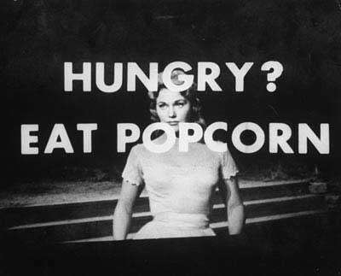
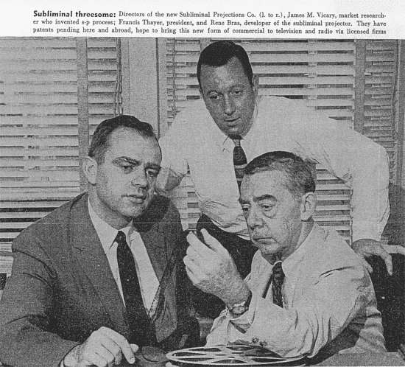

Slide 12
Except…
In a 1962 interview, Vicary admitted that he had made the whole thing up!

Slide 13
It Doesn’t Work
Research shows no significant effect of subliminal information
We don’t blindly obey!
Placebo Effect with subliminal self-help tapes

Slide 14

…You Decide
Could 1/30th of a second really influence impressions of Al Gore?

Slide 15


Slide 16
Alleged types of subliminal presentation
Flashing it on the screen so quickly you can not perceive it but you still see it. Below the sensory perception threshold.
Playing it backwards
Embedding it into another image.
Playing it at a low-volume masked over by other music or sounds.

Slide 17
Why? Perceptual Set!
Listeners “hear” diabolical messages in rock music because they are prepared to “discover” certain messages, and therefore they do. Vokey and Read 1985

Slide 18
Backmasking
A recording studio technique where backward messages are deliberately superimposed on the soundtrack
The fear . . . “Human brains are capable of receiving, scanning, deciphering, storing and later reacting to subliminal or subconscious messages”
http://jeffmilner.com/backmasking.htm

Slide 19
Another One Bites the Dust
Forward
Reverse
“It’s fun to smoke marijuana"

Slide 20
Stairway to Heaven
Forward
Reverse
"Glory glory to my sweet Satan, there was a little child born, it makes me sad, whose power is Satan"

Slide 21
The most famous backmasking ever?
Forward
Reverse
Message - "Paul is a dead man, miss him, miss him, MISS HIM" The Beatles have vehemently denied this. Still fans of every generation have listened to this message and heard the same words.

Slide 22
Pokemon Rap
Forward
Reverse
"I love satan, love satan. I love satan, love satan."
http://www.backmaskonline.com/pop.html

Slide 23
Maybe Subliminal Embeds?
In the 1970s, Wilson Bryan Key wrote “Subliminal Seduction and Media Sexploitation” in which he claimed subliminal sexual symbols or objects are often used to entice consumers to buy and use various products and services. One of Key’s most famous claims is that the word sex was often embedded in products and advertisements.
This is controversial.

Slide 24


Not the last of it…
Sexual imagery in ads?
This has never been admitted to by the advertisers and would likely not be effective anyway.
The idea is these images put us in good mood and pay more attention to ad.

Slide 25
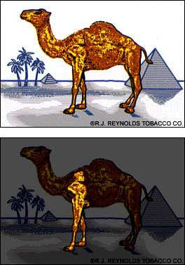

Slide 26


Slide 27


Slide 28

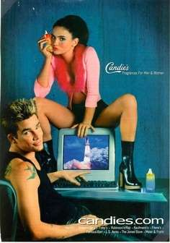
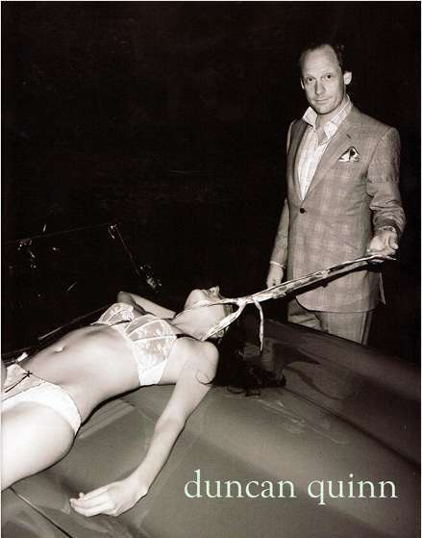
This is not to say that sex isn’t used in ads.
It is used harmfully and ubiquitously.

Slide 29


Cinthia Dicker – 1986
25 years old swimsuit model with breast implants
In February 2006, American Eagle launched the aerie Intimates sub-brand, targeting the 15–21 year old female demographic segment.

Slide 30
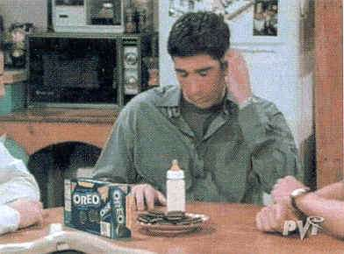
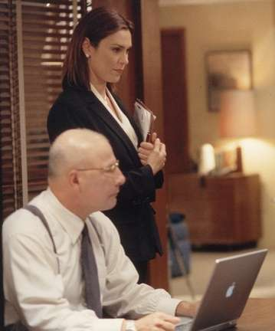
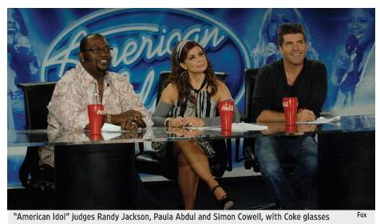
Product Placement = Not subliminal

