Slide 1
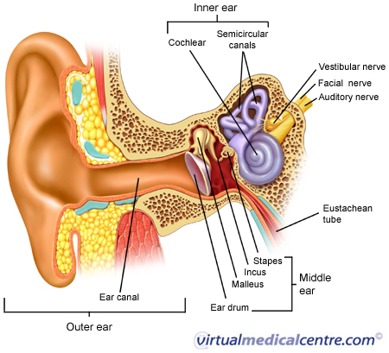
The Ear

Slide 2
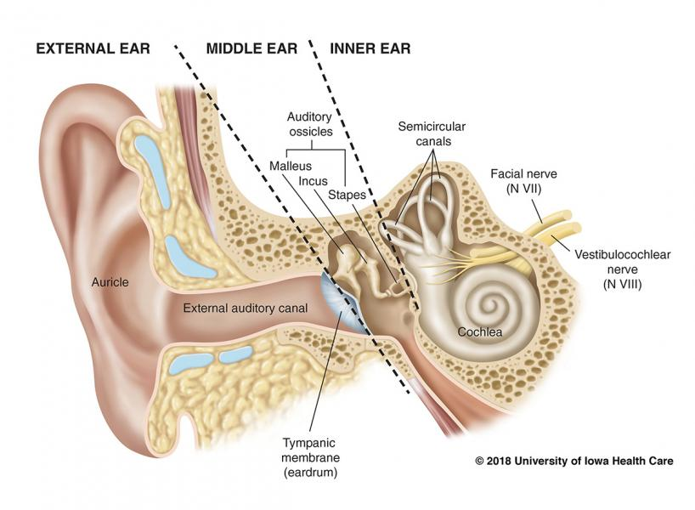

Slide 3
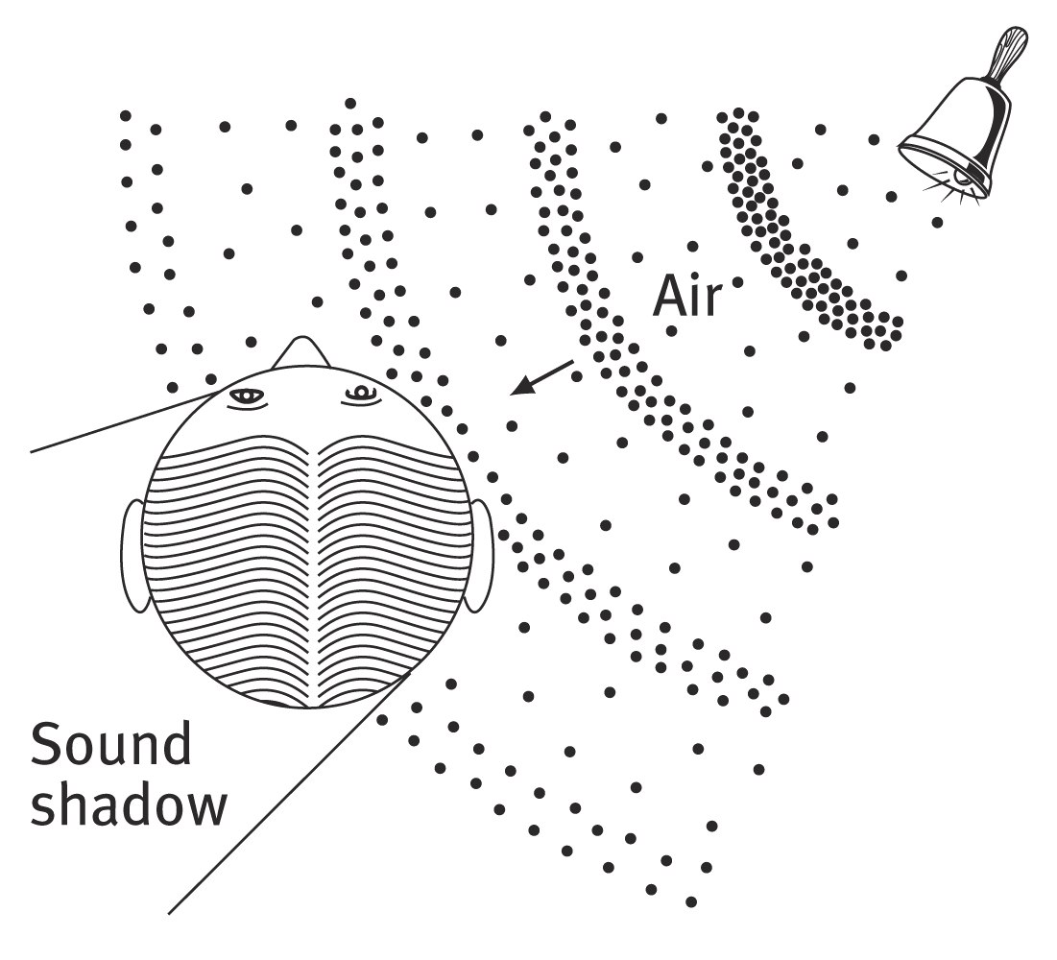
Sound Localization
Because we have two ears, sounds that reach one ear faster than the other ear cause us to localize the sound.
Notes:
OBJECTIVE 14 Describe how we pinpoint sounds.

Slide 4
Theories of Hearing
Place theory
  Pitch (how high or low something is) determined by where vibration located on the basilar membrane
  Doesn’t explain low-pitch since no specific positions found on membrane.
Frequency theory
  Pitch determined by frequency hair cells produce. If the frequency of the sound is 100 waves per second (hertz: Hz) then the neuron fires at 100 Hz.
  Doesn’t explain high-pitch. Although we can hear frequencies above 5,000 Hz, neurons can’t fire faster than 5,000 Hz.
Both theories together explain hearing.

Slide 5
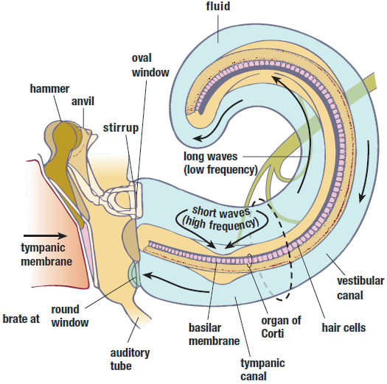

Slide 6
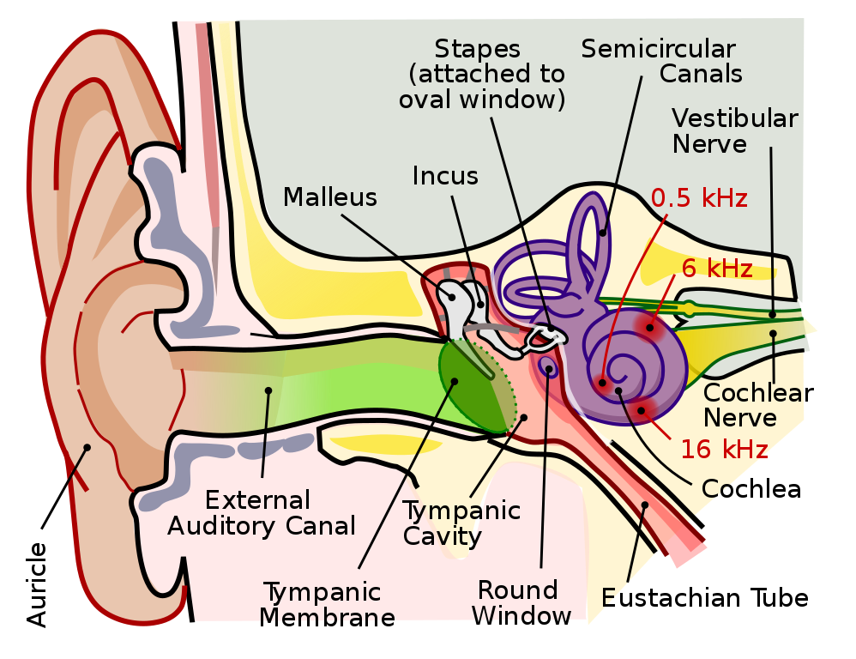

Slide 7
Hearing Loss
Conduction Hearing Loss: damage to the mechanical system that conducts sound waves to the cochlea.
  Surgery
Sensorineural Hearing Loss: loss caused by damage to the cochlea’s receptor cells or to the auditory nerve, also called nerve deafness.
  Hearing aid to amplify sound
  Cochlear Implant
Notes:
OBJECTIVE 15 Contrast two types of hearing loss and describe some of their causes.

Slide 8
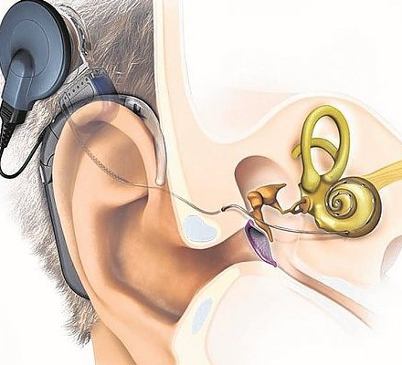
Cochlear Implant
electronic device that enables the brain to hear sounds.
Notes:
OBJECTIVE 16 Describe how cochlear implants function and explain why Deaf culture advocates object to these devices. Where these implants are pertinent for hearing parents with deaf children, deaf culture advocate not using them especially on children deafened before learning to speak.

Slide 9
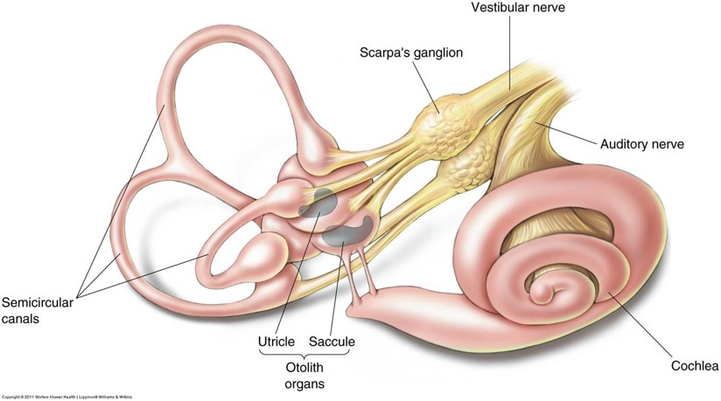
Vestibular Senses
Vestibular senses = equilibrium and body position
Fluid moves in two vestibular sacs (in the semicircular canals)
Motion sickness may be caused by discrepancies between visual and vestibular sensation

Slide 10
Why Do We Feel Dizzy?
The inner parts of the vestibular nerve are open spaces filled with fluid and covered with tiny hairs. Each hair is connected to a nerve cell that carries signals to the brain. When the head moves, the fluid sloshes around and bends the hairs. As each hair bends, it makes its nerve cell send a signal, telling the brain about that movement.
When we spin around, the fluid starts spinning, too. That gives us the sensation of spinning. When we stop, the fluid keeps moving (and bending tiny hairs and signaling the brain). That may make us feel that we are spinning backward. We call that "feeling dizzy."

Slide 11
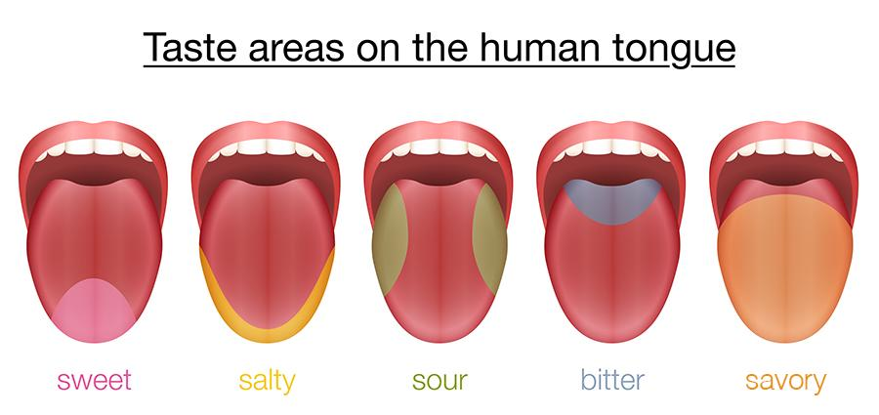
Taste
Five basic tastes
  Sweet
  Salty
  Sour
  Bitter
  Umami – savory

Slide 12
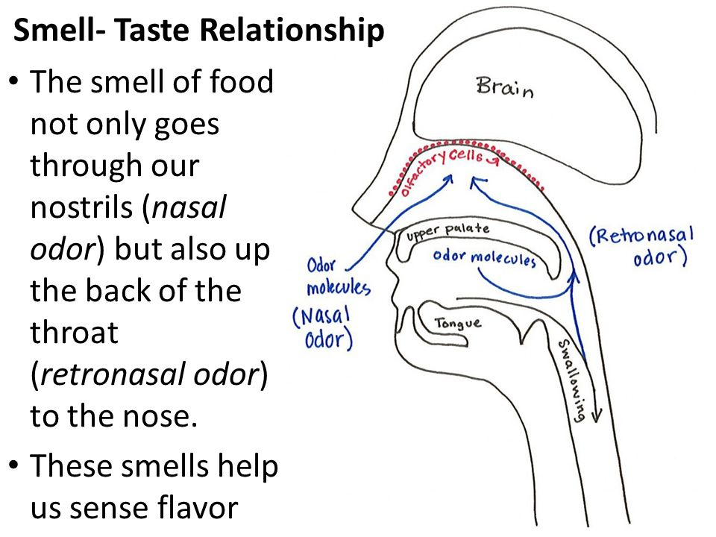

Slide 13
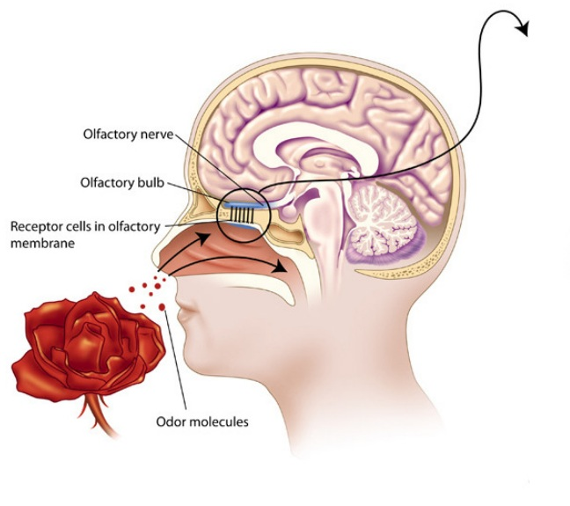
Smell
Like taste, smell is a chemical sense.
5 million receptors to sense smell.
10,000x more powerful than taste.
Notes:
OBJECTIVE 20 Describe the sense of smell and explain why specific odors so easily trigger memories.

Slide 14
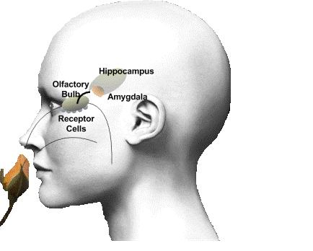
Smell and Memories
Smell is hard wired into the limbic system – amygdala and the hippocampus.
This is why smell makes strong memories.

Slide 15
Smell
Anosmia = No ability to smell
Pheromones
  - Used by animals as a form of communication
  - Provides information about sexual receptivity

Slide 16
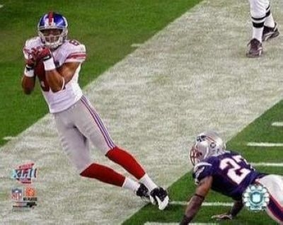
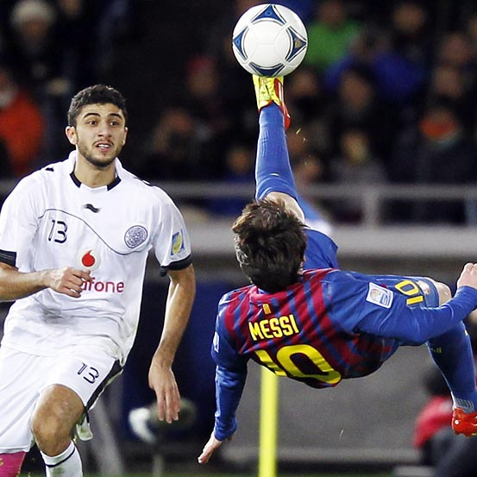
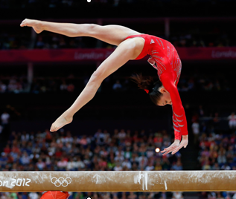
Proprioception/Kinesthetic Sense
Proprioception = the sense of the relative position of parts of the body and strength of effort.

Slide 17
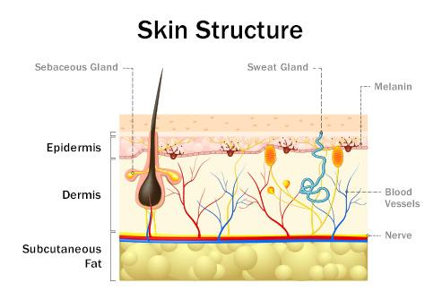
Touch
Skin is the largest sense organ
Receptors for pressure, temperature, and pain
Touch important in bonding with others

Slide 18
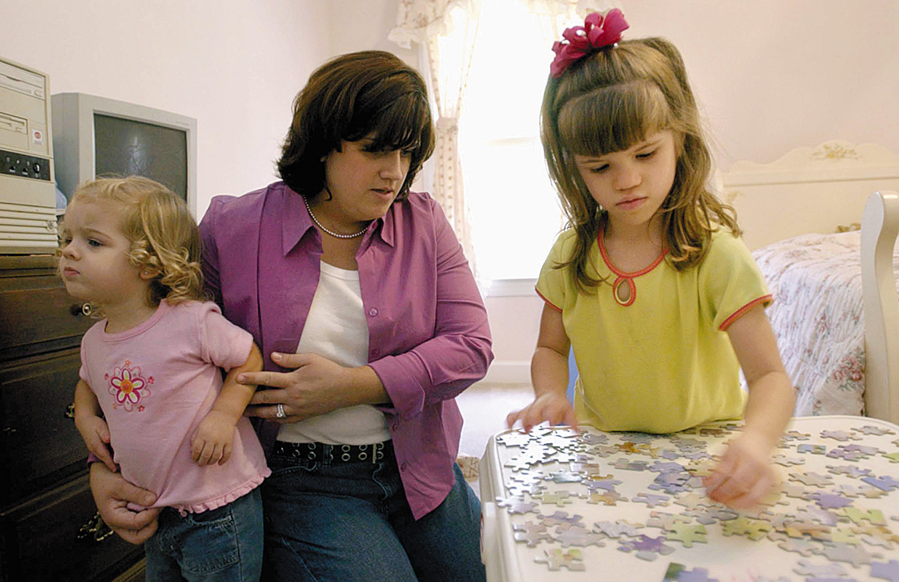
Pain
Pain tells us something is wrong.
Usually, pain results from damage to the skin and other tissues.
Ashley Blocker (right) feels neither pain
nor extreme hot or cold.
Notes:
OBJECTIVE 18 State the purpose of pain and describe the biopsychosocial perspective on pain.

Slide 19
Gate Control Theory
Spinal cord contains small nerve fibers that conduct most pain signals
Larger fibers conduct most other sensory signals
When tissue is injured small nerve fibers activate and open the neural gate
Large fiber activity shuts that gate
So, if you stimulate gate closing activity by massage or electrical signal you can disrupt the pain message.
The brain can also close the gate!

Slide 20
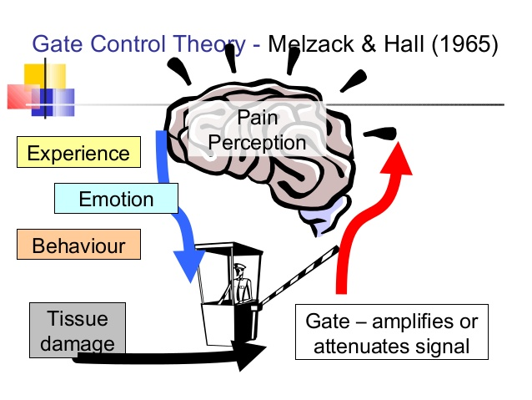
Gate-Control Theory
Melzak and Wall (1965)
- spinal cord contains neurological “gates” that either block pain or allow it to be sensed.
Notes:
One way to treat chronic pain is to stimulate it through massage by electrical stimulation or acupuncture. Rubbing causes competitive stimulation to pain thus reduces its effect.

Slide 21
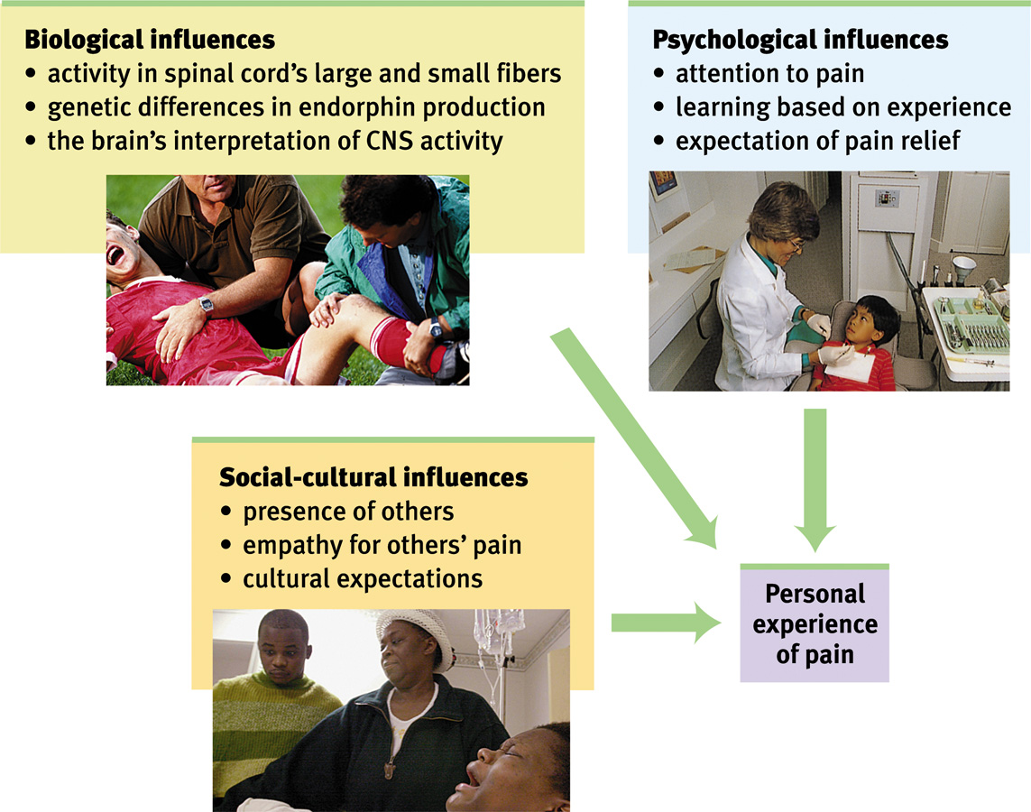
Biopsychosocial Influences for Pain

Slide 22
ESP (Extra Sensory Perception)
  Give me a break. Save your money and ignore these charlatans.
  There is zero evidence (and we have looked) that people can move objects (telekinesis), or read minds (telepathy), or predict the future (clairvoyance).
  There is also no plausible mechanism for any of this to work.

Slide 23
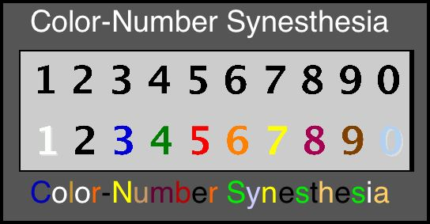
Synesthesia
Extraordinary sensory condition in which stimulation of one modality leads to perceptual experience in another. Literally, the term means “to perceive together.”
typographic synesthesia

Slide 24
