Slide 1
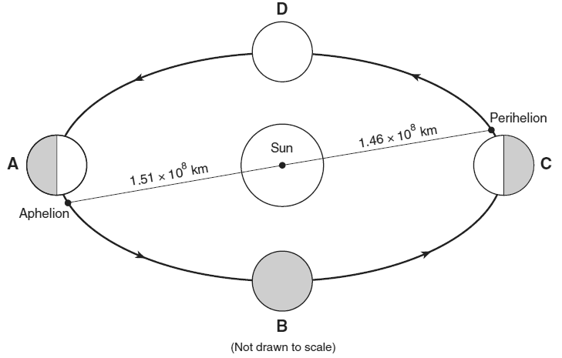
Aim: What are Kepler’s laws of planetary motion?
Explain why the Earth speeds up in its orbit as Earth travels from location B to location C.

Slide 2
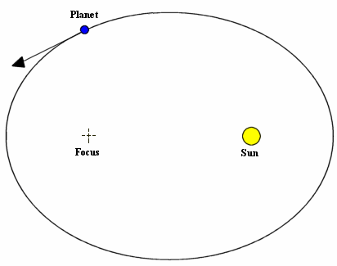
Kepler’s 1st Law
All planets have
elliptical (oval) orbits.
Orbit
path a body takes as it revolves around another object.
Orbital Velocity (speed)
faster when close to Sun.

Slide 3
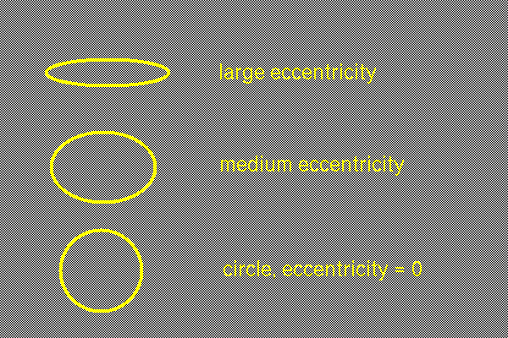
Eccentricity
Eccentricity - measures
how elliptical
(number from 0 – 1)
0.781 (high)
0.241 (low)
Two focuses (foci) with the Sun at one of the focuses.

Slide 4
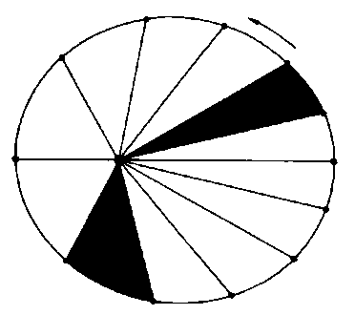
Kepler’s Laws
2. Law of Equal Areas
-- each triangle is the same area.
-- shows that a planet moves faster when close to the sun.

Slide 5
Each triangle has the same area and the time it takes the planet to go from one position to the next is equal (one month).

Slide 6
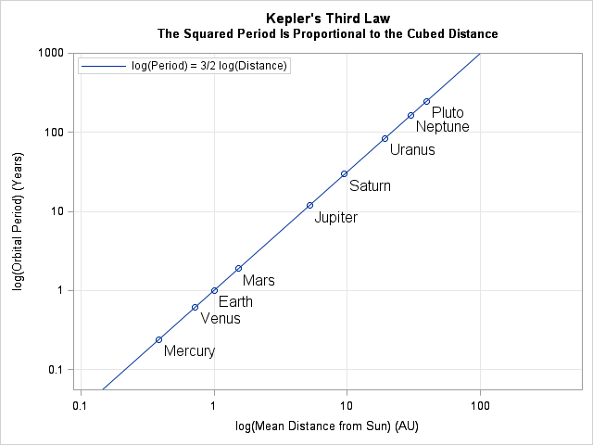
Kepler’s 3rd Law
A planet’s period of revolution is related to its distance from Sun.
The farther away it is, the longer it takes.

