Slide 1
Schedules of Reinforcement
Continuous Reinforcement: Reinforces the desired response each time it occurs.
Intermittent Reinforcement: Reinforces a response only part of the time. Though this results in slower acquisition in the beginning, it shows greater resistance to extinction later on.
Notes:
OBJECTIVE 14| Discuss the strengths and weaknesses of continuous and partial reinforcement schedules, and identify four schedules of partial reinforcements.

Slide 2
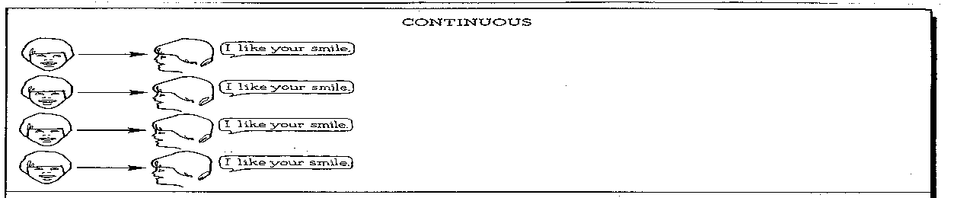
Example of Continuous Reinforcement
Each instance of a smile is reinforced.

Slide 3
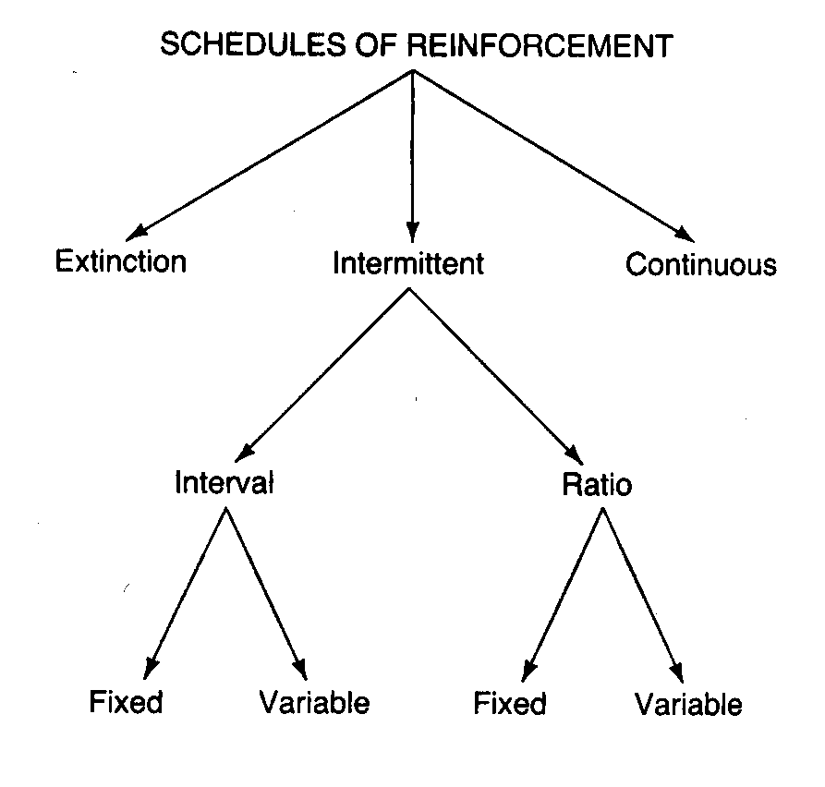

Slide 4
Ratio vs. Interval
Ratio – based on when behavior occurs.
Ex. – Reinforce behavior after a set number or x many times that an action or behavior is demonstrated.
Interval – based on time.
Ex. – Reinforce behavior after a x period of time that the behavior is demonstrated.

Slide 5
Fixed-Interval Schedule
Fixed-Interval schedule – A fixed amount of time must elapse before reinforcement will occur.
No response during the interval is reinforced.
The first response following the interval is reinforced.
Ex. I get one pellet of food every 5 minutes when I press the lever

Slide 6
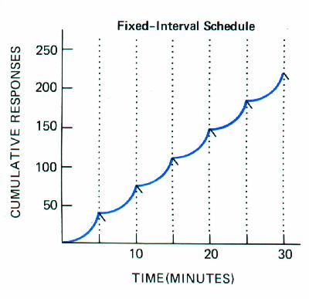
Fixed Interval Reinforcement

Slide 7
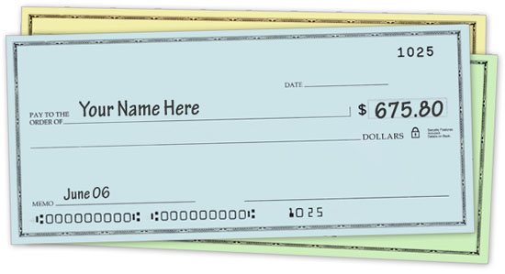
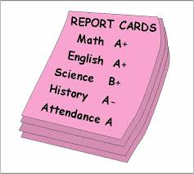
Examples

Slide 8
Variable-Interval Schedule
Variable-Interval Schedule – A variable amount of time must elapse before reinforcement is available.
Ex. – I get a pellet of food on average every 5 minutes when I press the bar.
Ex. – Pop Quiz

Slide 9
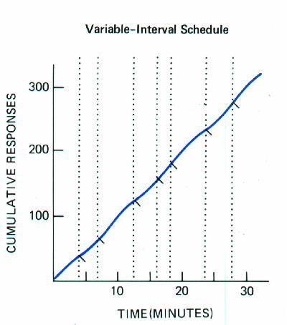
Variable Interval Reinforcement

Slide 10
Examples
Texting / Social Media
You might check your phone at 9:00 a.m. and have 5 new messages, at 11:00 a.m. and have none, and then at 3:00 p.m. and have 7. As long as you periodically continue to receive messages, your checking behavior will continue; however, this behavior can be influenced by the number of messages received. If you don't receive any messages for 5 days, you may check less often.

Slide 11
Fixed-Ratio Schedule
Fixed-Ratio Schedule – Reinforcement is provided after a fixed number of behaviors.
These schedules usually produce rapid rates of responding with short post-reinforcement pauses.
In workplace, may lead to quantity over quality.
Ex. – For every 5 bar presses, I get one pellet of food

Slide 12
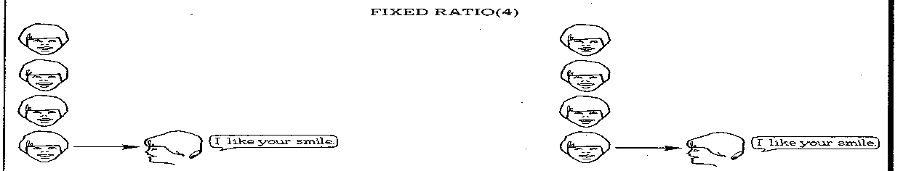
Example of Fixed Ratio Reinforcement
Every fourth instance of a smile is reinforced.

Slide 13
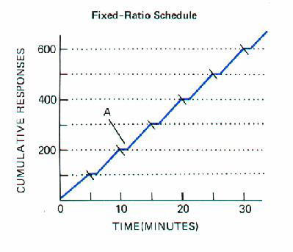
Fixed Ratio Reinforcement

Slide 14
Variable-Ratio Schedule
Variable-Ratio Schedule – Reinforcement after a variable number of behaviors.
Produces an overall high consistent rate of responding.
Ex. – slot machines

Slide 15
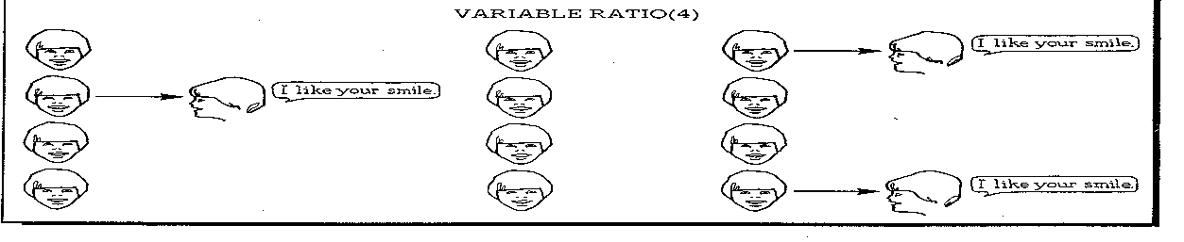
Example of Variable Ratio Reinforcement
Random instances of the behavior are reinforced.

Slide 16
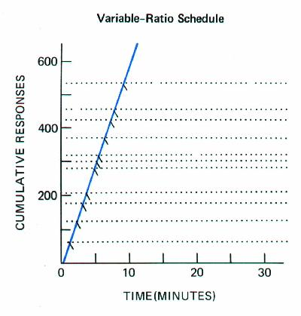
Variable Ratio Reinforcement

Slide 17
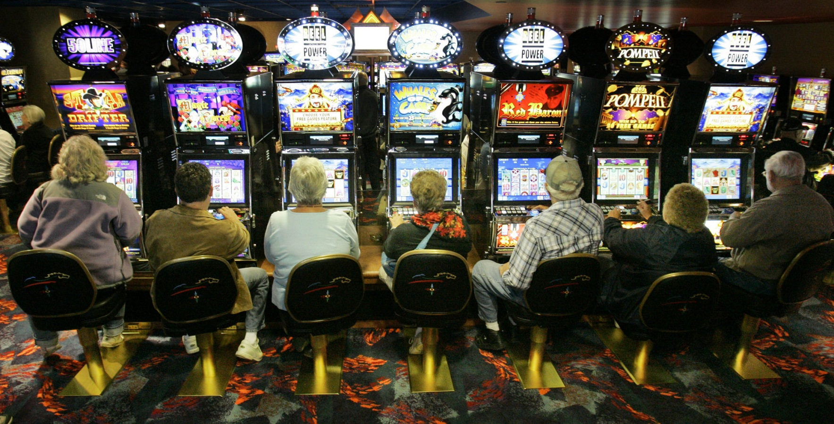
Examples

Slide 18
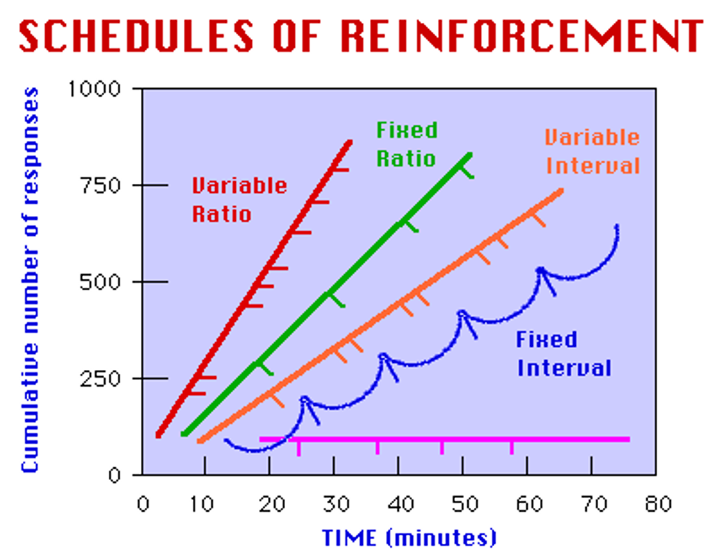

Slide 19
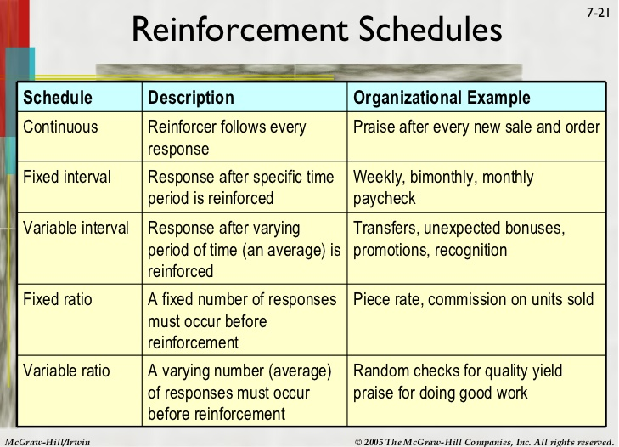

Slide 20
TYPE | MEANING | OUTCOME
Fixed Interval | Depends on a fixed time | Activity increases as deadline nears
Variable Interval | Time between reinforcement varies | Activity slows after reinforcement and then picks up
Fixed Ratio | Depends on a definite number of responses | Steady activity results
Variable Ratio | Number of responses varies | Greatest activity of all schedules.

Slide 21
FI, VI, FR, or VR?
When I bake cookies, I can only put one set in at a time, so after 10 minutes my first set of cookies is done. After another ten minutes, my second set of cookies is done. I get to eat a cookie after each set is done baking.
After every 10 math problems that I complete, I allow myself a 5 minute break.
I look over my notes every night because I never know how much time will go by before my next pop quiz.
When hunting season comes around, sometimes I’ll spend all day sitting in the woods waiting to get a shot at a big buck. It’s worth it though when I get a nice 10 point.
Today in Psychology class we were talking about Schedules of Reinforcement and everyone was eagerly raising their hands and participating. Miranda raised her hand a couple of times and was eventually called on.
FI
FR
VI
Vi
VR

Slide 22
FI, VI, FR, or VR?
Madison spanks her son if she has to ask him three times to clean up his room.
Emily has a spelling test every Friday. She usually does well and gets a star sticker.
Steve’s a big gambling man. He plays the slot machines all day hoping for a big win.
Snakes get hungry at certain times of the day. They might watch any number of prey go by before they decide to strike.
Mr. Bertani receives a salary paycheck every 2 weeks.
Christina works at a tanning salon. For every 2 bottles of lotion she sells, she gets 1 dollar in commission.
Mike is trying to study for his upcoming Psychology quiz. He reads five pages, then takes a break. He resumes reading and takes another break after he has completed 5 more pages.
FR
FI
VR
VI
FI
FR
FR

Slide 23
FI, VI, FR, or VR?
13. Megan is fundraising to try to raise money so she can go on the annual band trip. She goes door to door in her neighborhood trying to sell popcorn tins. She eventually sells some.
14. Kylie works in the big city. Her boss is busy, so he only checks her work periodically.
15. Mark is a lawyer who owns his own practice. His customers make payments at irregular times.
16. Jessica is a dental assistant and gets a raise every year at the same time and never in between.
17. Andrew works at a GM factory and is in charge of attaching 3 parts. After he gets his parts attached, he gets some free time before the next car moves down the line.
18. Brittany is a telemarketer trying to sell life insurance. After so many calls, someone will eventually buy.
13. VR
14. VI
15. VI
16. FI
17. FR
18. VR

Slide 24
Motivation
Intrinsic Motivation: The desire to perform a behavior for its own sake.
Extrinsic Motivation: The desire to perform a behavior due to promised rewards or threats of punishments.

